Slide 1
Back-EndTechnical Assessment
File Transfer Manager REST API
Urszula Leus

Slide 2
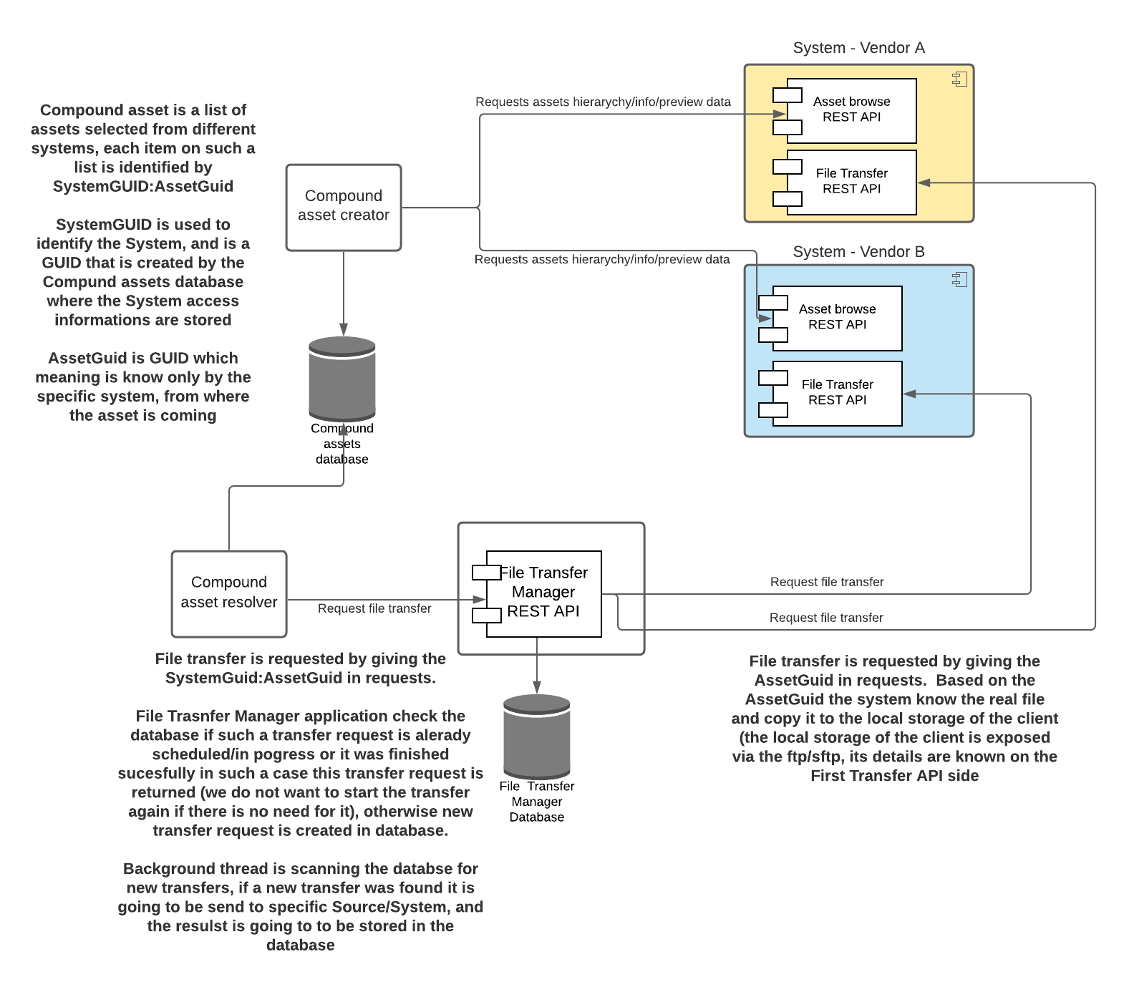
Usage of File Transfer Manager REST API

Slide 3
File Transfer Manager REST API – Create/Read
Create
Read
Create request is send with giving the SystemGUID and AssetGUID
Based on the SystemGUID and AssetGUID the database is checked if such a transfer request already exists and it is still in progress or was sucessfully finished – in such a case this transfer request GUID is returned, otherwise a new transfer request is created
Database is used to save the information that the file was already transfered, so the transfer will be started only in case if the previous one failed or was nerver done before
Get request is send with the GUID that was recived via the Create request
It reads the transfer request from database and returns the information about it (containing the transfer progress and result in case it was finished)

Slide 4
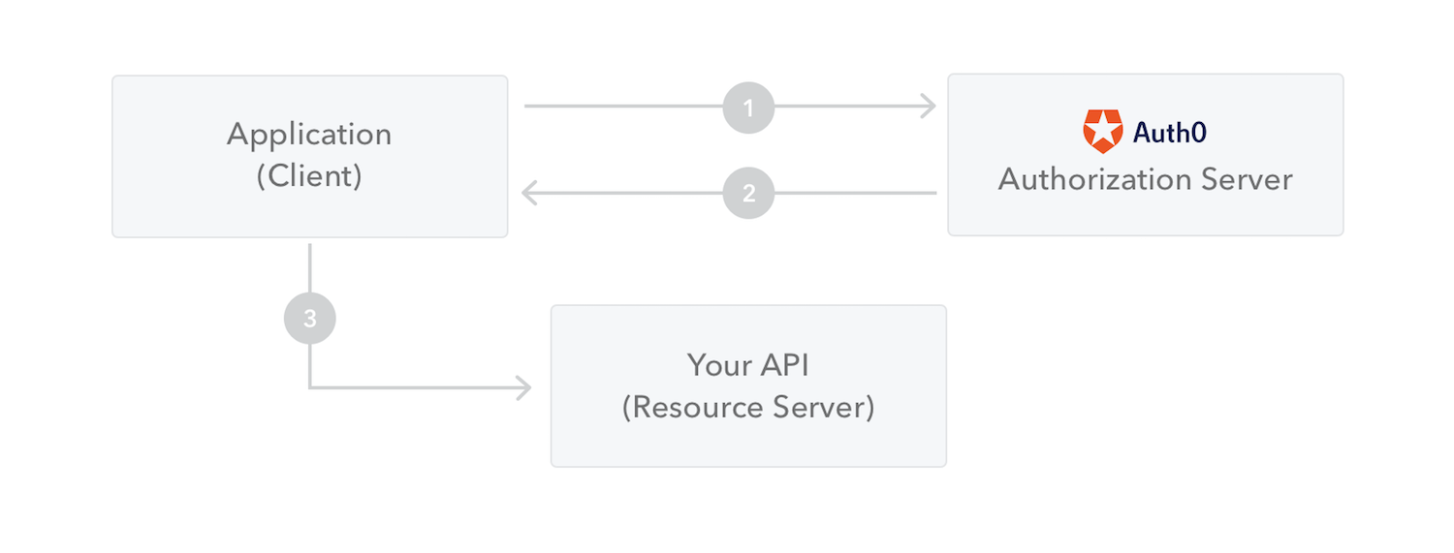
File Transfer Manager REST API – Auth0
Machine to Machine Communications was taken into account and for this the Authorization/authentication based on the Client Credentials Flow
File Transfer Manager REST API is checking for the token with help of the Microsoft.AspNetCore.Authentication.JwtBearer library
The client of the File Transfer Manager REST API requests the authorization server for the access token, which is later used to authorize the API calls
The client makes a request to the authorization server sending the client ID, the client secret, along with the audience and other claims.
The authorization server validates the request, and, if successful, sends a response with an access token.
The client can now use the access token to request the protected resource from the resource server.

Slide 5
File Transfer Manager REST API - Demo

Slide 6
File Transfer Manager – functional issues
Removing files from local storage –there are few paths to take into account:
File watcher to react on manual file removal
Some datbase repated procedures to remove files that were recentlly not accessed
Taking a history of users, who requested the files

Slide 7
File Transfer Manager – summary
„implement an enterprise-ready solution using best practices”
Things to do:
Clean the source code
Where are unit tests?
Authorization/Authentifications – scopes/roles

