Slide 1
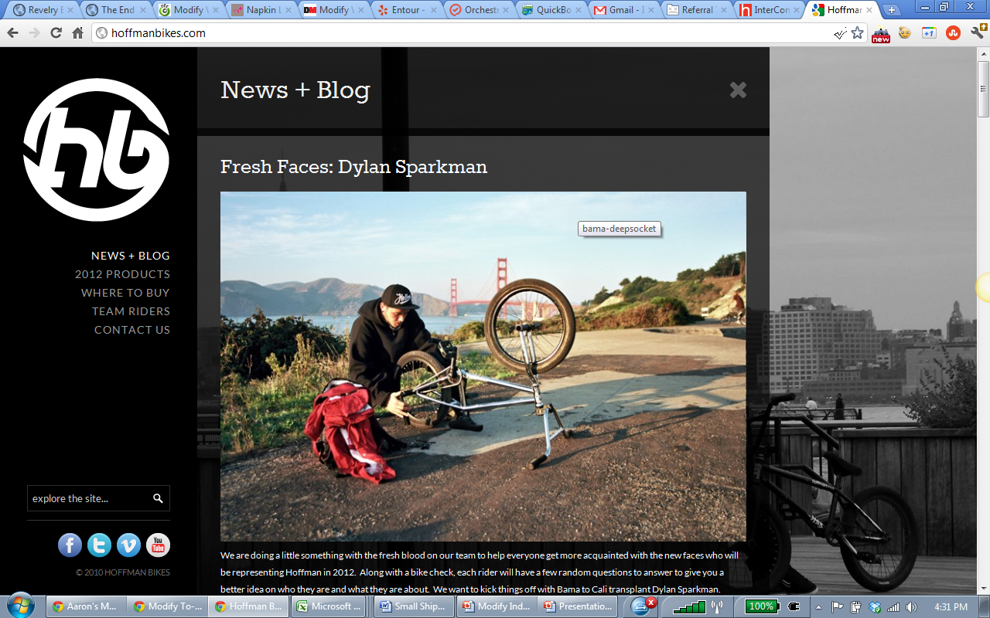
http://hoffmanbikes.com/

