Slide 1
Titanic: Machine Learning from Disaster
HONGYE XU

Slide 2
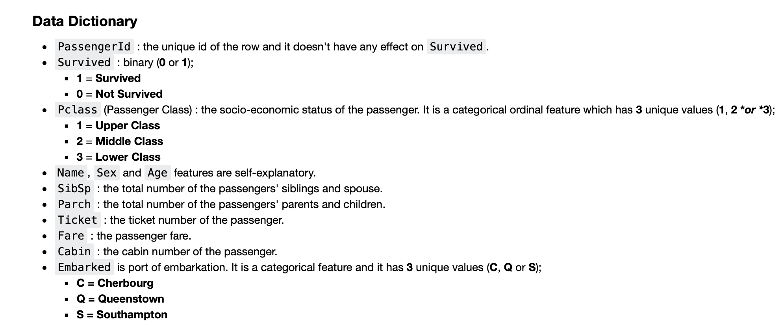

Slide 3
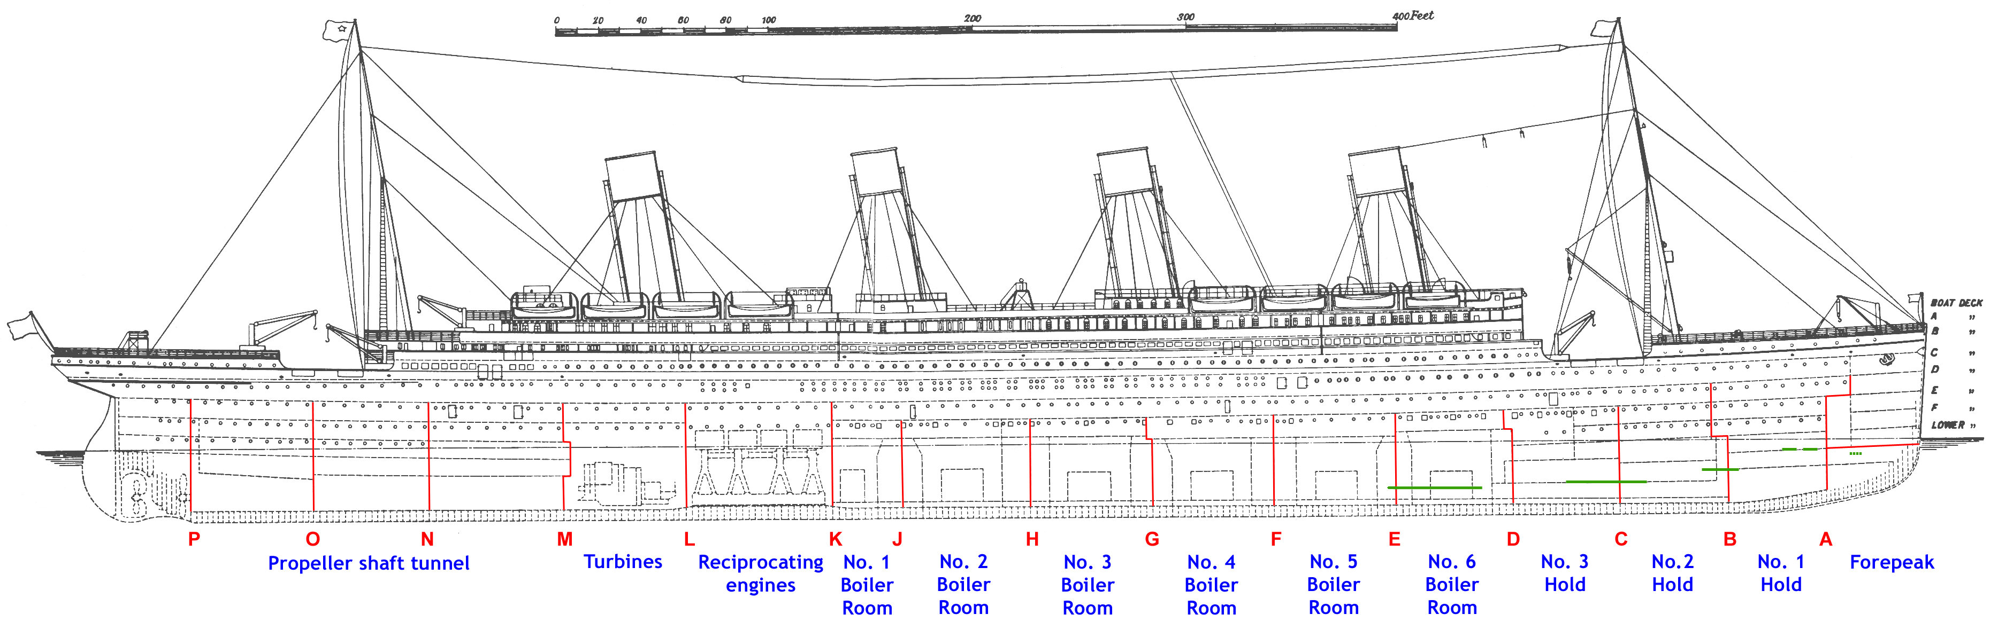
Missing value processing
The age null values are filled by a random forest regressor.
The 'Embarked' features are filled by searching for the passengers’ information in the encyclopedia of TITANICA .
There are many null values in 'Cabin' features. Usually, we may delete the whole columns for better prediction. But I still choose to keep this feature, because when the ship sinks, the passenger's cabin should affect the passenger's survival rate to a certain extent.
The fare can be filled up with median value or mean value.

Slide 4
Feature engineering
Title: I extracted the title of the passengers and distribute them into four different categories.
Family_name : I made the exception list of ‘maleadult’ and ‘female and children group’. Then I change the features of test of the family in the list into the average features according to the list.
Familysize: I learned that the families with 2 to 4 members have relatively higher survival rate, so I can label the family size with 3 different type.
Deck: I extracted the deck type from the cabin number.

Slide 5
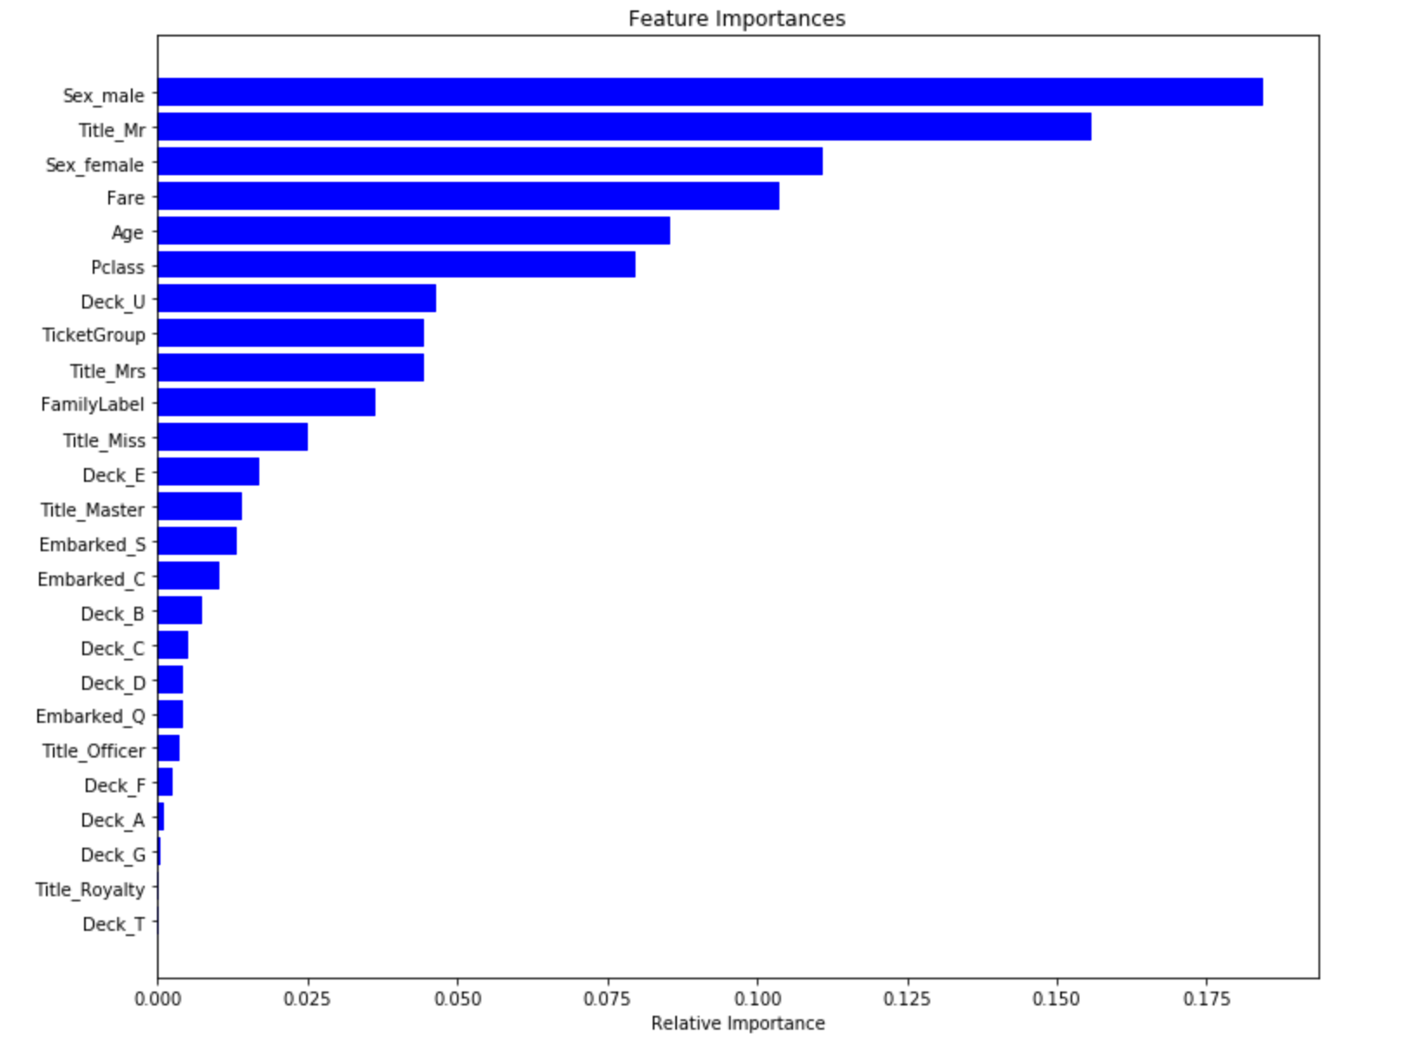
Random Forest : CV Test Score : CV Test Score : Mean - 0.8428677 | Std - 0.03657637

Slide 6
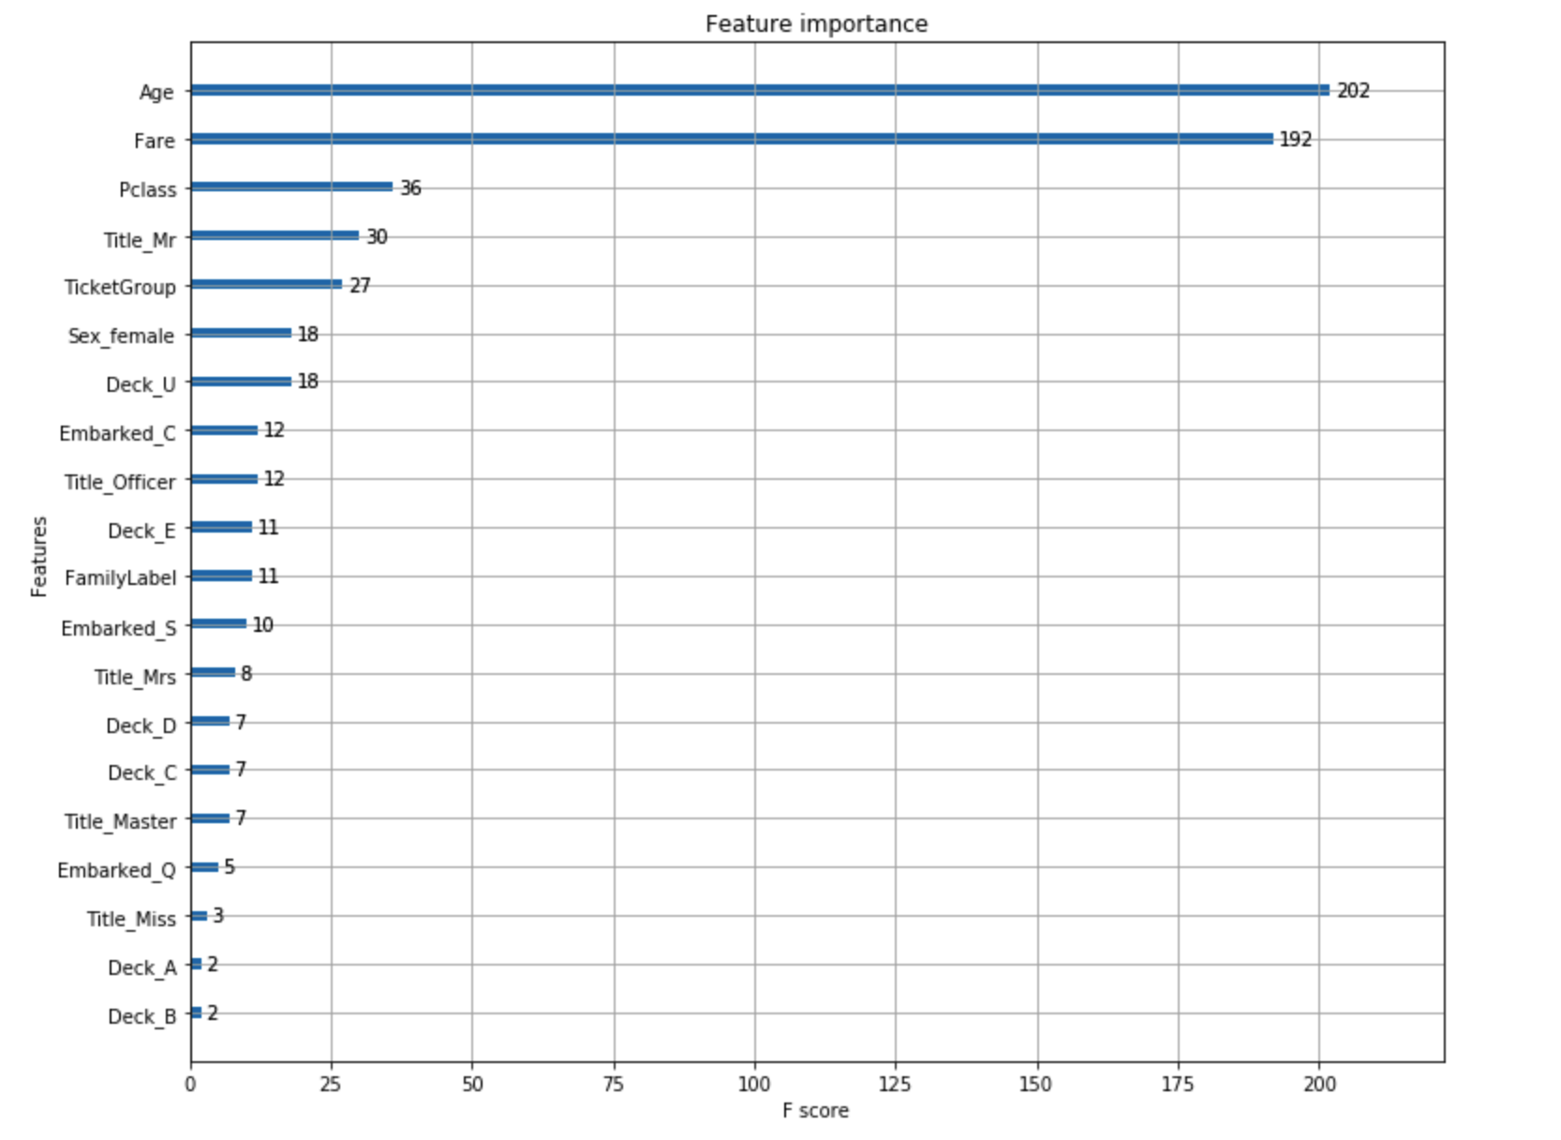
XGBoost : CV Test Score : Mean - 0.8294093 | Std - 0.03359253

