Slide 1

Python intermediate workshop
Szymon Borkowski Cloud Software Development Engineer

Slide 2
First, some information...
It’s a workshop -> workstation with IDE (either local or remote) is mandatory, e.g., VSC, Pycharm Community
link to repository with exercises: https://github.com/szymbor1993/PythonIntermediate
Intermediate level -> Python basic knowledge won’t be covered here
Python 3.11 required. You can download it here: https://www.python.org/downloads/release/python-3110/
I strongly encourage you to actively participate during workshop
ask questions
try to do exercises
feel free to present your solution
Notes:
First of all, I’d like to share some information about the workshop.
As it was stated in the invitation, it IS a workshop, so in order to experience it totally
you need to have any type of workstation with IDE like vsc or pycharm.
Another thing is that the level of this workshop is intermediate –
so I’m assuming you all know Python basics like dicts, lists, writing functions, classes, etc.
These are not going to be covered here.
What is more, in order to learn the most of this workshop is to participate actively,
by asking questions (I will hopefully know the answer or suggest sth), trying to do the exercises
and even by presenting your solution.

Slide 3

Second, about the author...
Over 8 years at Intel
Conducted presentations & workshops during several conferences
3rd time as a mentor in NTDD program
Technical area of interests:
SW testing & validation
Languages: python, C#
Cloud engineering
Hobbys:
music – making, singing, playing piano
board games
Notes:
Now, some informations about me to give you an insight about my person.
During my 8 year career at Intel I was involed in several different projects,
ranging from cloud engineering, through backend applications to testing and validation of sophisticated software.
I also conducted several presentations and other workshops during some international conferences,
like OpenStack Days Cracow 2018 and Perspektywy Women In Tech summit 2022.
I am also third time as a mentor in NTDD mentorship program, hosted by Intel.
Regarding my hobby, music is very important part of my life.
I graduated from Music School a couple of years ago, but still I’m participating for example in choirs and bands.
I also very like playing board games.

Slide 4
Third, agenda!
Intermediate topics
list comprehension
lambda expression
decorators
exceptions
type hints (with typing module)
arguments parsing (argparse module)
pdb (python debugger)
Python 3.10 features
Python 3.11 features
some smaller tasks to do
bigger task to do
Notes:
Now, going into the agenda, the content of this workshop will be divided into 2 days
In first day, we will focus on intermediate concepts.
The plan for every of theses concepts is to talk about it from theoretic point of view,
then provide some examples in the code (some are even live)
and lastly, for majority of topics, some small exercises.
During these exercises you are free to use examples from the presentation,
or look for other ones on the Internet.
However, if we don’t cover some topics from day 1, they will move naturally to day 2.
The second day will be focused on new language features, introduced in latest 3.10 and 3.11 releases.
Also, at the end of the entire workshop I plan to give you one bigger exercise,
which will cover some of topics from the workshop.

Slide 5
Intermediate topics
Assuming Python base knowledge
Notes:
So, that’s all from the introduction part,
now we can dive into our intermediate topics.

Slide 6
List comprehension (1)
Similar to LINQ in C#
Kind of syntax sugar, but very powerful
Example:
select
looping part
where (optional)
[ item.name for item in equipment if item.value >= 100 ]
Notes:
The first main concept, which in my opinion is very important and is used globally and usually in the code – list comprehension
If anybody used to write in C#, should be familiar with LINQ – very powerful engine for collection operations
In python there is another syntax. Look at the slide – this is an example of such list comprehension.
First you have „select” part -> this part indicates how the element of the resulting list will look like
In this case in resulting list we will have names (probably strings) of every item from the source list „equipment”
Then, we have looping part -> just like in loop syntax
Last, an optional part, where part, which is a condition.
If it is met, the element will be included in the resulting list.
But please be mindful of square brackets ->
with normal ones (round), this syntax will produce a generator object, which needs to be iterated over
in order to get the results
Square brackets implicitly evaluates this generator and returns a list.

Slide 7
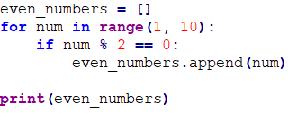
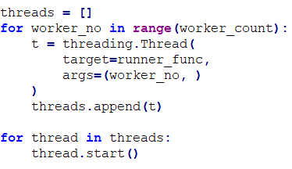
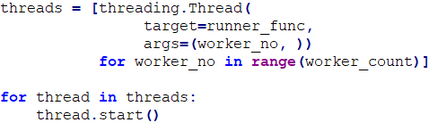
List comprehension (2)
Notes:
Now, how it translates into normal loop syntax?
Here are the examples – on the left you have code without list comprehension.
< DESCRIBE BOTH EXAMPLES >
One can think that this concept is just a syntax sugar -> more compact and readable code.
But list comprehension is not just that-> it can be used in more complex situations
and this feature, like LINQ in C#, can be really powerful.

Slide 8
List comprehension (3)
Excercises:
Squares
Triangle inequality
List of values from dictionaries
Long words from list
file list_comprehension.py
Notes:
Now, let’s do first exercises. In the given file on the repository, you have 4 exercises.
We can do the first together, in live coding session.
The other three is for you to do.
< DO THE FIRST EXERCISE WITH COMMENTARY >

Slide 9
Lambda expression (1)
anonymous function (definition)
Structure:
bound variable(s)/
argument(s)
body/
expression
keyword
>>> sum = lambda num_x, num_y: num_x + num_y
>>> sum(2, 3)
5
Notes:
Now, heading into the second concept, also found in other languages – lambda expressions
If you are not familiar with lambdas, you can think of them as a definition / delegate of an anonymous function.
On the slide you have syntax. First is always keyword ‚lambda’.
Then, you have a part where you define input arguments, like in normal function syntax.
If you don’t have any arguments – omit this part.
Last part is a body of lambda function – just like in normal function,
but this is inline syntax, without ‚return’ keyword
In order to execute such lambda, you need to call it, like a normal function.

Slide 10



Lambda expression (2)
Other examples
No parameters
Immediately Invoked Function Expression
Higher-order functions: map, filter, reduce, max, sorted, etc.
Notes:
On this slide you have other examples of lambda usage.
These are:
mentioned earlier parameterless case,
< DESCRIBE IT >
immediately invoked lambda
< DESCRIBE IT >
and usage in higher-order functions.
Here I will explain these two bottom code examples with map and filter.
First, map function, which transformes all elements of the input list.
It takes the transformation function as a first parameter.
This can be either delegate to a normal function, or lambda expression
The second parameter is just an input list.
< DESCRIBE IT >
The second example is filter function, which acts like list comprehension with where part.
Here the first parameter is a boolean function delegate aka predicate, or boolean lambda.
< DESCRIBE IT >
Please note that these operations can be easily done using list comprehension!

Slide 11
Lambda expression (3)
Excercises:
Sort by modulo 4
<list>.sort(key=<lambda>) # in place
sorted(<list>, key=<lambda>) # returns new list obj
Factorial
functools.reduce(<lambda>, <list>)
file lambda_expression.py
Links:
https://stackoverflow.com/questions/13638898/how-to-use-filter-map-and-reduce-in-python-3
Notes:
For lambda expression, I have two exercises for you.
Also, for more reference, here’s the link regarding higher-order functions.

Slide 12
Decorators (1)
A wrapper around given function
Can do something:
before function call
after function call
Notes:
The next important concept to learn are decorators.
Probably you have already seen them – for example if using testing frameworks like pytest or unittest.
These annotations above function with `@` at the beginning.
What are they? Well, you can think of them as wrappers around given function.
Why wrappers? Because you can perform additional actions before and after the call of the wrapped function.
The flow is that after „before actions”, the decorator needs to call the wrapped function.
It can either take result of it or not and then, the „after actions” part happens.
Of course, both parts are optional.

Slide 13
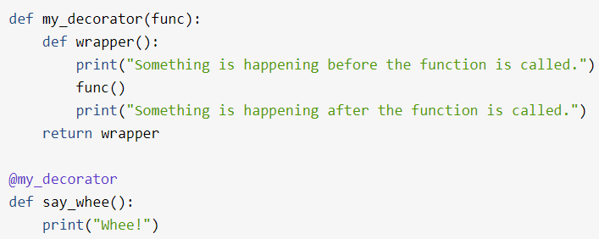

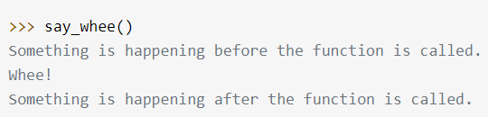
Decorators (2)
Structure:
Decorator function
Inner (wrapper) function
Decorated function
Source:
https://realpython.com/primer-on-python-decorators/
Notes:
Here you have more detailed structure of decorator and very simple code example.
In order to make this work, one needs to define an inner function (usually, developers call it ‚wrapper’),
which then its delegate is returned from main / outer decorator function.
Keep in mind, that this outer function takes the ‚func’ parameter, which is a delegate to the wrapped function.
< DESCRIBE IT >
Another good example to understand –
The decorator syntax can be treated as if decorator overwrites the definition of the wrapped function.
And certainly at the bottom you see the call of decorated function.
The result contains texts from both ‚before’ and ‚after’ parts

Slide 14
Decorators (3)
Excercises:
Logging decorator for squares
print return value to the console
need to return value of decorated function
Logging decorator for factorial
print return value to the console
need to pass the argument to decorated function
file decorators.py
Notes:
Here I also have 2 exercises for you.
But I know, that this concept can be harder to understand for those who has never any experience with it
Hence, I will live code the first one.
The second one is for you to do alone.
< READ THE HINTS BEFORE LIVE CODE >

Slide 15
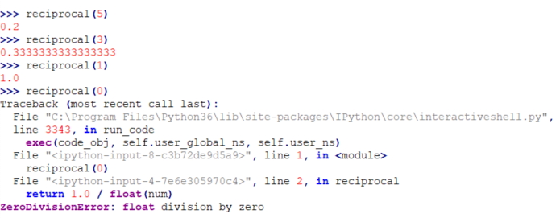

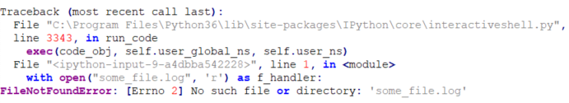

Exceptions (1)
Notes:
Now, let’s talk about something else – the exceptions in the code.
For those of you who have experience with other languages this can be a well-known thing.
So what are they and why we need some handling around them?
Let’s take a look at these two different examples.
The first one is about zero division. Such error is the cause of bug or badly written code
(for example, we did not check the value provided from the user)
The second one is less deterministic, as it can fail because of things outside of our python environment.
Here the problem is a with filesystem stuff, but the same thing goes from REST API calls, calls from other local processes
or even problems with third party modules.
In both cases, an exception is thrown, which interrupts the program execution.
If not handled, our program exits early in a broken state.

Slide 16
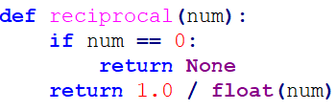
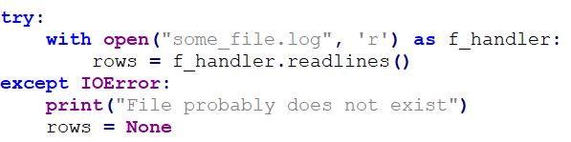
Exceptions (2)
Check manually arguments
for example, with if-clause
Sometimes it is not possible
Catch an exception and handle it!
Notes:
So how we can deal with such problems?
For the first example, the best way to prevent such errors is for example to validate user input.
In the code at the top of current slide you see a guarding condition,
which validates the input variable against zero value.
This is doable, because such behavior is deterministic – if user provides zero, the function will always fail.
However, in second example we do not have such situation
Here, anything can happen, from wrong permissions, bad internet connection, incorrect credentials, etc.
And that’s why the exception handling is very handy here.

Slide 17
Exceptions (3)
Structure:
try...except -> catches any matching exceptions from lower stack layers
finally -> this block will execute always, nevertheless exception raised
’return’ can be put in ’try’ block. However, if ’finally’ block is present, it will be executed
raise -> breaks the execution and returns control to upper stack layers
Notes:
So, the structure is as follows:
First, there is a ‚try’ keyword.
Inside of it, put the fragment of the code in which we know that the exception may be thrown.
Then, there should be ‚except’ clause with type of exception
and optionally the variable in which we can store caught exception object.
Additionally, you have also optional ‚finally’ clause.
This part of code will be executed always nevertheless the exception was thrown or not.
Keep in mind, that ‚return’ can be put inside try block, but if ‚finally’ block is also written,
it will be executed BEFORE the return statement.
< LIVE SESSION HERE: TestExecutor project, test_executor.py:216 >
On the other hand, to raise the exception explicitly from our code (for example, after condition which went wrong)
you need to put ‚raise’ keyword and then an exception object.
The narrower exception type, the better. You should avoid catching with base class usage called ‚Exception’

Slide 18
Exceptions (4)
Excercises:
Sum only positive numbers
Get longest remote entry (SSH)
file exceptions.py
Notes:
For exceptions, I have prepared two exercises.
Please keep in mind that you don’t have to use exceptions in them
If possible, you can try validate input, or perform some other checks.
I leave the decission to you.

Slide 19
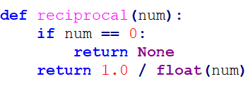
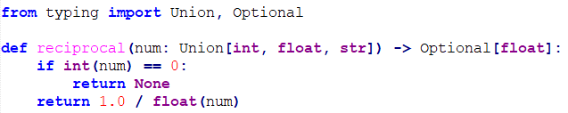
Type hints (1)
’num’ can be EITHER
int, float, str...
Python is not strongly-typed language
„Typing” module adds such posibility*
* only at warning level with IDE
returns EITHER None or float
and it’s OK
Notes:
Ok, now something which does not affect the code structure, nor performance,
but rather readability aspect of the code.
If you don’t know it already, I can explain what ‚strongly-typed’ means.
It can be explained in an example of C# language
when you declare variable, you either need to explicitly specify the type,
or use ‚var’ keyword, which in fact will determine the type during compilation time anyway.
Of course, there is an exception – dynamic keyword,
but the essence of this, is a fact that once defined variable cannot change type during runtime.
On the other hand, python is not strongly-typed,
so you can re-use the same variable and change its type as many times as you want.
However, typing module emerged to try to encourage developers to strict the type of the variables.
But please be mindful, that this does not affect the interpreter in any way
At most it will produce warnings in your IDE
Because the purpose of typing module is to enhance code readability.
What is more, some libraries take advantage of typing and work because of it (for example, pydantic)

Slide 20
Type hints (2)
Syntax:
variables/arguments:
[variable] : [type]
example: first_name : str
return value:
[function signature] -> [return type]:
example: def calculate_income(months: int) -> float:
Notes:
We have two types of syntax here,
one for variable/argument definition,
and the second for return values
< DESCRIBE BOTH OF THEM >

Slide 21
Type hints (3)
Example:
code from my MSc ;)
Links:
typing module: https://docs.python.org/3/library/typing.html
Notes:
In contrary to the previous topics, in this one we don’t have any exercises,
But I will show you some parts of my python code from Master Thesis
< LIVE SESSION project TestExecutor utils.py:37 >

Slide 22
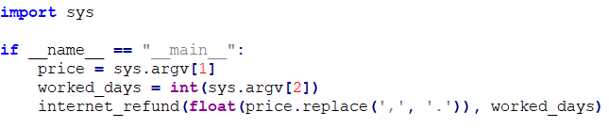
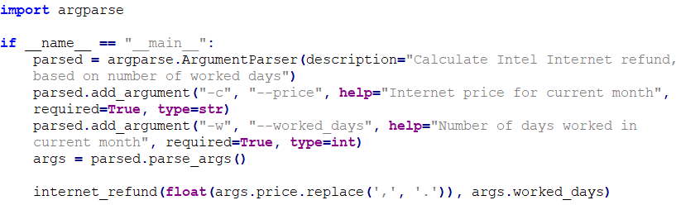
Argument parsing (1)
’Normal’ way: ’sys’ module
’Argparse’ module:
Notes:
Now, something very useful when creating standalone scripts or programs
Normally, when we want to call our python program with some arguments from command line,
we use sys module and sys.argv list.
Just like in the first code example on the slide, we expect that the user will provide exactly 2 arguments.
However, what if he does not do that? For example, he forgets about 2nd argument, provides other ones,
or the 2nd argument cannot be converted into integer?
We will get a normal exception/error, which can be hard to read at the first glance.
And here comes ‚argparse’ module, which can solve all of these problems.
If you look at the second code example, it may seem to be less readable and more lines of code to write.
However, everything there has a purpose
From type validation, to parameter signatures.

Slide 23
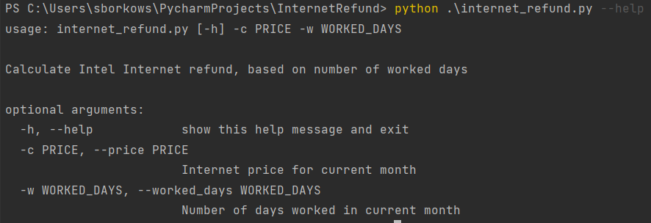
Argument parsing (2)
Argparse functionalities:
--help will print detailed info about arguments
type validation
required/optional arguments
Notes:
You can for example add help info to every parameter,
and if you call your program with ‚--help’
argparse will generate help string and print it to the console.
You can validate type of parameter
for advanced usage, you can even define your own validator!
You can specify whether this argument is required or not
If it is optional, you need to provide the default value.
Let us back to the previous slide and analyze the bottom code.
< DESCRIBE CODE >

Slide 24
Argument parsing (3)
Exercise:
utilize argparse module in the given code, follow the advices in the comments
file argument_parsing.py
Links:
https://docs.python.org/3/library/argparse.html https://realpython.com/command-line-interfaces-python-argparse/
Notes:
Certainly, there are more features in this library, you can study on your own,
here I provide helpful links, feel free to use them
And for the practice part, I prepared single exercise.
Your task will be to utilize argparse module in the given code.
< EXPLAIN THE TASK IN THE CODE >

Slide 25

Pdb (1)
Python command line debugger
It’s like GDB but for Python
set breakpoint line in the code or by command in runtime
Notes:
The last concept I want to share with you today is about debugging.
Of course, you have IDE and with it, a GUI debugger
Where you can set up breakpoints, see stack trace, manipulate variables, and so on
But sometimes it is difficult to run IDE on scripts working behind some firewall, VPN,
or with any other obstacles, making remote debugging hard or impossible.
Python has its own module, which can be run from command line
It is called PDB
As it’s written on the slide, PDB is python version of GDB. You have even similar commands.
To set everything up, you need to add line to the code which will set up a breakpoint.
Then, you can perform many actions, like step in, step out, continue, run python expression,
manipulate variables, go up / down in the stack, etc.

Slide 26
Pdb (2)
Example:
my tool for monthly Internet compensation ;)
Links:
tutorial/docs: https://realpython.com/python-debugging-pdb/ cheat sheet: https://nblock.org/2011/11/15/pdb-cheatsheet/
Notes:
I will show you how it is working on my tool made for internet compensation.
< LIVE SESSION project InternetRefund, add breakpoint at line 35 >
For more details regarding PDB and for cheatsheet, please see the links on the slide.

Slide 27
Python 3.10 features
With some small exercises
Notes:
Now we are going into the second part of this workshop.
The first one focused on intermediate concepts,
which are widely used in coding practice of mid or senior python developers.
The second will be about new language features, which came in the last two releases:
release 3.10 and 3.11.

Slide 28
Python 3.10 new features
New method of comparing python version in code
’typing’ improvements:
type union as |
TypeAlias
Structural Pattern Matching:
introducing python’s ’switch’
Other:
more precise exception messages
’strict’ parameter in ’zip’
context managers can be wrapped in (...)
Notes:
On this slide I provided brief listing of features from python 3.10
The first three bullets will be soon elaborated.
Now I will focus only on „other” ones as they are too small to give them more than 2 minutes.
So „more precise exception messages” means, that builtin exception messages gives more information
and are more precise in showing where in the code is a problem.
‚Strict’ parameter in ‚zip’ function is a flag.
If set, all the collections need to be the same size, otherwise, throw an exception.
The last one, context manager syntax can now be wrapped in parenthenses.
Earlier, one had only option to break the line using backslash.

Slide 29
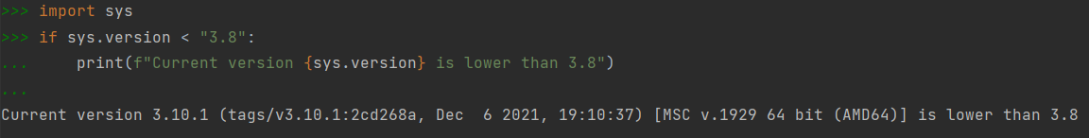
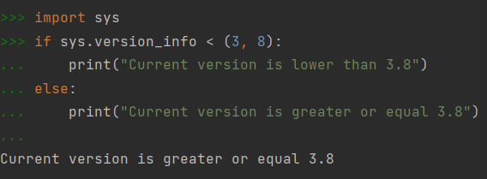
Comparing python version in code
’Old’ bad way:
’New’ proper way:
„3.10” < „3.8”
lexically
Notes:
The interesting thing is about checking python version in runtime.
In previous versions, one could compare versions like numbers, using operators <, >
It was not recommended and worked only because string comparision using this way is lexicographical,
like comparing words.
That is why this approach does not work now, as string 3.10 will be „smaller” than 3.9.
In order to correctly compare python version, one should rather use `sys.version_info` field
and compare to it a tuple containing major and minor release, like shown on the slide.

Slide 30
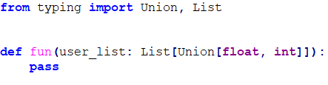
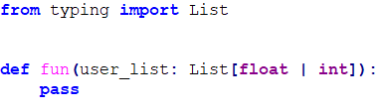
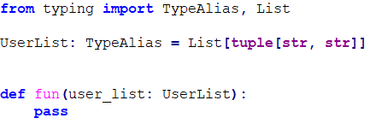
Typing improvements
Type union as |
TypeAlias
useful for more complex types!
Notes:
Now, some bigger changes.
First, some improvements in aforementioned typing module.
These improvements enhances easiness and readability.
Just look at the examples on the slide.
Instead of using Union, one can use | (vertical line) operator.
< DESCRIBE THE EXAMPLE >
And instead of using complex structured types many times,
one can define custom type aliases and use them instead in the code.
< DESCRIBE THE EXAMPLE >

Slide 31
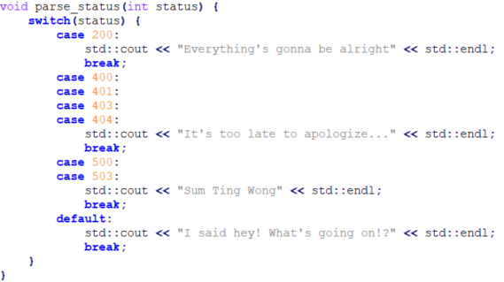
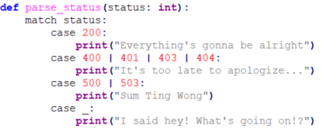
Structural pattern matching (1)
Python at last received ’switch’ concept!
C++
Python 3.10+
Notes:
Secondly, we have structural pattern matching, which introduces so long awaited switch concept.
On this slide you see a difference between switch concept in C++ and in python.
Of course, first difference is about keyword.
In C++ (and other languages) we have switch, in python however it is match
The second difference is about case fallthrough.
In C++ (also in other languages) you need to break the fallthrough.
If you don’t do it, it will fall through next case statesment.
Sometimes it is intended, sometimes not.
In some cases it can also lead to compiler errors.
In python, if you want to process some cases in the same way, just add them to case line, separating with | (like in typing module)
And lastly, the default clause is ‚case _’ in python.

Slide 32
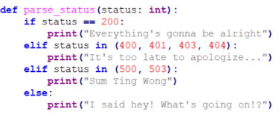
Structural pattern matching (2)
Python < 3.10
Python 3.10+
Notes:
But how we used to handle situations, when switch is now handy, in previous releases?
Well, you could for example create if-elif-else clauses.
It is arguable though which variant is cleaner and more readable.
I leave the decision up to you on that matter.

Slide 33
Structural pattern matching (3)
Other examples:
variables in ’case’ statements
custom classes in ’case’ statements
enums
file match_case_examples.py
Notes:
This was the basic usage of match statement in python 3.10.
But how about other ones?
In the given file I presented some other examples on how use it.
Let us go into the file and explain them one by one.

Slide 34
Structural pattern matching (4)
Excercises:
Fibonacci with ’match-case’ statement
fibonacci sequence definition: fib(0) = 0, fib(1) = 1, fib(n) = fib(n-1) + fib(n-2), n >= 2
Optional: Rewrite ’parse_status’ function from slide ’Structural pattern matching (2)’ (python version < 3.10) without ’if’ statements
Notes:
For this feature I prepared also an exercise for you.
What is more, if you managed to do it, there is an optional one
Go back 2 slides and try to rewrite older version of code
in a way that it won’t have any if statements.
Remember that it is prior 3.10 release and you cannot use match statement!

Slide 35
Python 3.11 features
Notes:
Now, let’s dive into new features from 3.11 version

Slide 36
Python 3.11 new features
Yet another ’typing’ improvements:
’Self’
Variadic generics
Exception improvements:
exception grouping and ’except*’
better exception readability
Other:
Enhanced language performance
Notes:
In my opinion, they are smaller and less game changing than the ones from 3.10 release,
but in some cases it may be very handy to use them.
Overall, the main big feature of this python version is to improve the entire language performance.
Of course, it will be visible only if you have programs operating on large data sets, or perform billions of operations.
The other two features I will describe in the following slides.

Slide 37
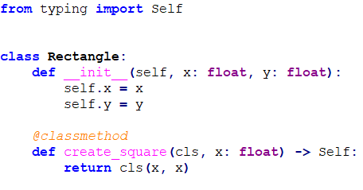
Yet another typing improvements (1)
’Self’ type:
useful in factory-ish functions
@classmethod – a decorator, function is bound to class rather than to object, first argument is a class obj
Notes:
And yes we are again going back into the typing module. Here I will be speaking about two new features
and start with the simpler one.
3.11 version introduces ‚self’ type. It is extremely useful in some cases.
First is shown on the slide – if we have a function, which acts similar to (or is) factory pattern,
we are returning a new object of the class -> and ‚self’ is used here to specify the return type of this function
Please take note of classmethod decorator – this function needs to be called from class type, not object
and first argument will be class, not object of this class.
Another case is for comparison functions or operator override, when one of arguments is an object of the same class.
There you also can specify its type as ‚self’.

Slide 38
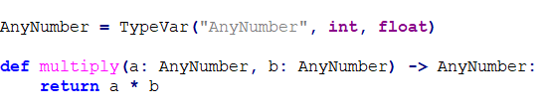

Yet another typing improvements (2)
Variadic generics
advanced topic
in earlier versions one could define template signatures for class/functions
in 3.11 type variable can be assigned to tuple of variables
Link:
https://www.sobyte.net/post/2022-10/python-3-11-new-typing-feature/
Notes:
The second feature in typing is an advanced topic and I will only cover some basic information.
If you are familiar with template function/classes and generic types, it is about it in python
and in version 3.11 it has been implemented not only for single variable template, but also for tuples of variables.
< KIND OF DESCRIBE BOTH EXAMPLES >
I am only providing you with some little information on this slide
If you are eager to learn more details, on the bottom of slide you have a link to explore.

Slide 39
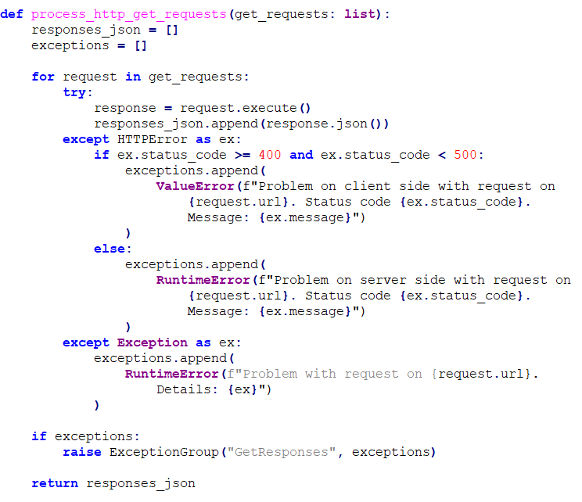
Exception grouping (1)
Now one can group exceptions to raise them together
Useful in cases, when program repeats some actions and instead of interrupting program, collects any exceptions caught
Notes:
The last feature I will talk about today is another improvement to exceptions, exception grouping.
The example on the slide is prepared by myself, let’s investigate it.
< DESCRIBE THE EXAMPLE >
To summarize this feature, in the example case we don’t want to interrupt the process of requesting things from REST API,
but rather collect exceptions and if there are any, raise them together as single one.

Slide 40
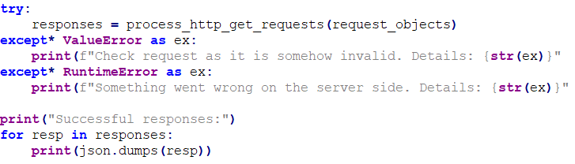
Exception grouping (2)
’except*’ catches specific exception type from ExceptionGroup
Notes:
On the other side of raising-catching exception mechanism, we have also a new keyword, except*
It can selectively catch an element of the raised ExceptionGroup.
So in our example, first except* clause will catch only every ValueError(s) from our group.
Analogically, the second one will catch only every RuntimeError(s).

Slide 41
Main exercise

Slide 42
Foreign dividend tax tool (1)
Problem:
If you have shares in a foreign company and you acquire dividends, you need to know the tax rates both in foreign country and PL
According to PL law, if foreign tax rate is lower than PL one, you need to pay the difference in PLN
Example:
One has earned 100 $ of dividends in the previous year
The tax rate in USA for dividends is 15%
he/she receives then 85 $
However, in PL tax rate for dividends is 19%
So he/she „owes” 4% of it to PL => need to pay 4 $ converted to PLN

Slide 43
Foreign dividend tax tool (2)
Algorithm:
for each dividend payment:
get exchange rates (foreign currency to PLN) from the previous working day
calculate foreign tax and polish tax => in result, the difference
if it is negative, return 0
convert it to PLN
Sum up calculated PLN values
Round it to 2nd decimal place
Note, that you cannot convert the whole sum to PLN, because exchange rates may vary in different days

Slide 44
Foreign dividend tax tool (3)
File dividend_tax_tool.py:
Skeleton and some parts already done, like calls to NBP (National Polish Bank) REST API
Task:
Implement the algorithm from previous slide
Program should return either:
JSON file with information about tax difference in PLN to pay (format on the next slide)
the same information as some text representation printed to the console

Slide 45
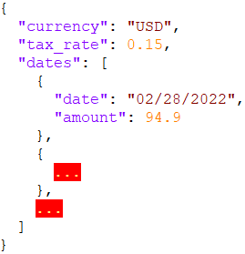
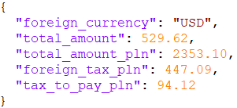
Foreign dividend tax tool (4)
Input JSON file schema:
Output JSON file schema:

