Slide 1
Assignments Schedule: Breakout game Stage A/1
Row numbers can vary a bit from the values below.
Demonstrate operation using a few annotated screen captures
Use 32-bit data memory rows 0 – 15 as game arena
Paddle in word 2, with centre point at bit 16
Wall in word 15
Score in word 2, number of lives in word 1 (=3 at start)
Ball in row 3 start, bit 16
Vertical ball movement only
Increment score when wall element is removed by ball
No of lives will always be 3, i.e, can’t end the game with lives = 0
Use functions where useful
Design documentation highlighting program structure, register assignment

Slide 2
Assignment: Breakout game submission stage B/2
RISC-V breakout game arena / IDE
High quality game design documentation. Include complete header page.
Structured assembly program, with clear and efficient commenting
Implement and demonstrate (video) and upload to BB
List and detail of any issues (resolved or unresolved)
Zip program and upload to BB
Assessment considers functionality and clarity of design documentation and code
Bonus options:
Highlight game over / message
Game start control using IOIn(2) input toggle low-high-low
Increase speed after score = 5 and 10
Add two wall rows with (space between) in rows 12 and 15
Other self-proposed function (highlight and document)

Slide 3
EE451 RISC-V Assignments Schedule
Title Submission date
swapX3DigitX4WithX5DigitX6 Tuesday 26th Oct
Breakout game Stage A Tuesday 8th Nov
Breakout game Stage B Tuesday 21st Nov

Slide 4
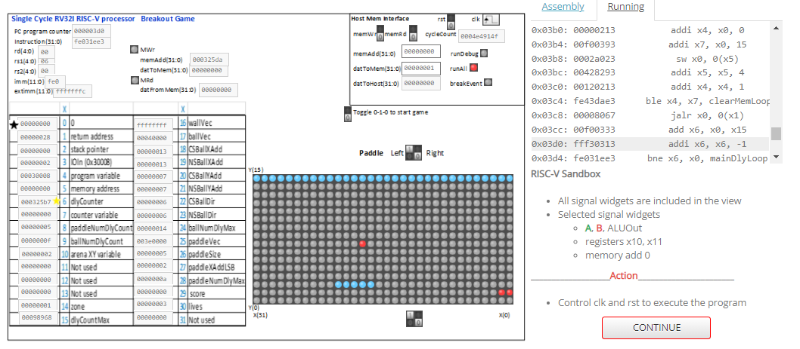
Assignment: Breakout game submission

Slide 5
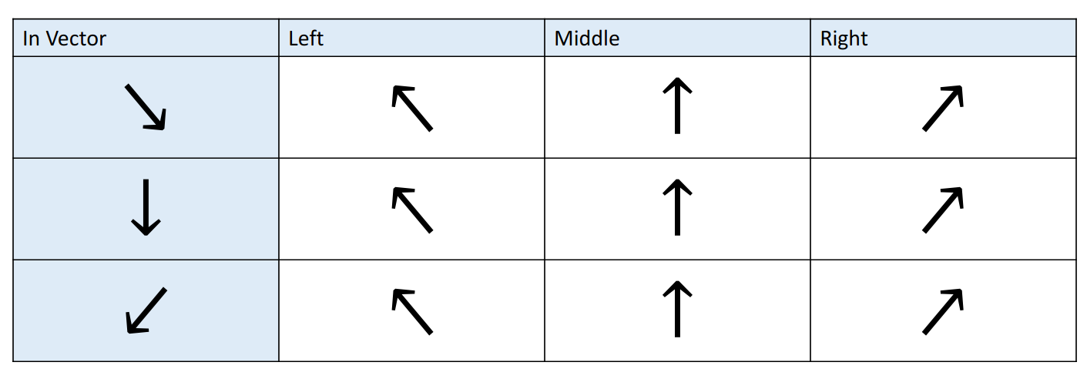
Ball rebound strategy
Left (In Vector) highlights the incoming direction of the ball when it hits the paddle
Columns left, middle and right highlight the required rebound direction on ball collision with paddle.

Slide 6
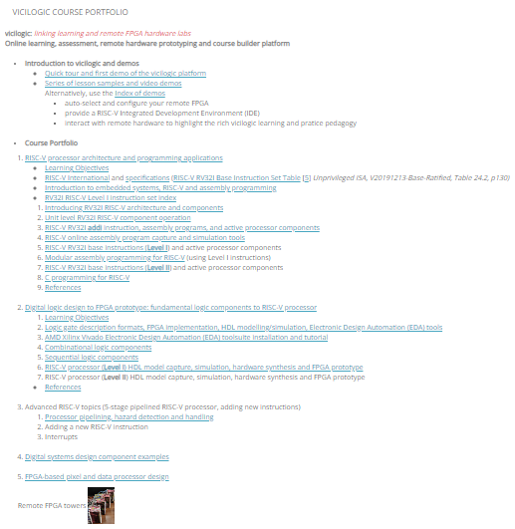
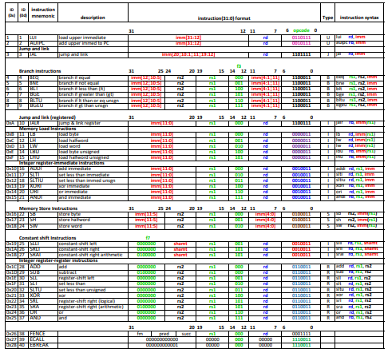
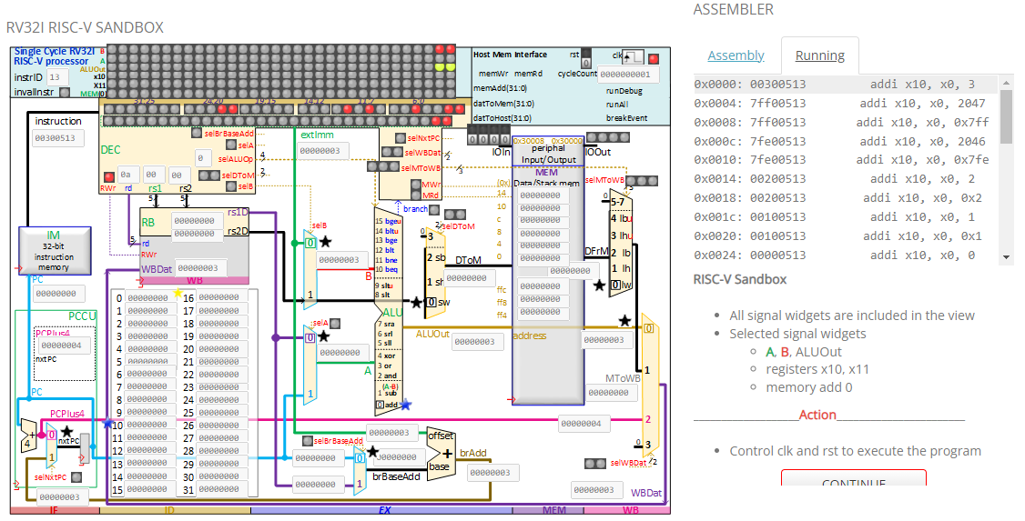
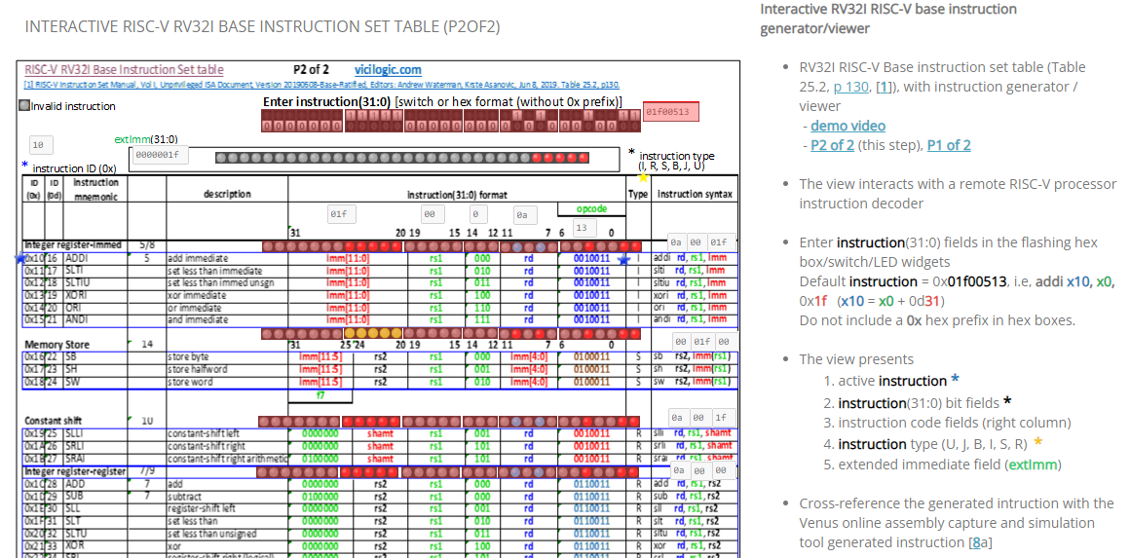
RV32I RISC-V Instruction Examples
Course contents and links (on vicilogic)
RISC-V breakout game arena / IDE
RV32I RISC-V base instruction set
vicilogic RV32I RISC-V IDE Assembly programming IDE and sandbox (integrated development environment)
Download RV32I instruction example programs, copy/paste, assemble,execute and test
Venus online RISC-V assembly program simulator https://venus.kvakil.me/
RISC-V RV32I Instruction generator
3

Slide 7
Points discussed at class 1st Nov
Use of functions
If using nested function calls
use push/pop approach to/from stack, to perform return address house-keeping
Do not branch from one function to another
Only use branches in a contiguous code section.
If calling a function using jal, recommended to use rd = x1
Don’t use rd = x0 in function call
The above adheres to a formal process and supports function re-use

Slide 8
Points discussed at class 1st Nov
Template RISC-V .s program
Structure, register allocation, some function code
is available on BB for reference (use
GameApplication_V1.1_template.s RISC-V template provided on BB
Include assembly program structure which you may wish to consider (all, part of, or none)
Includes register allocation. Include your allocation in your solution.
Uses NS* and CS* variables, though as discussed in class, you can do without using NS* variables in your solution

Slide 9
vicilogic breakout game
RISC-V: Consider the following variables and possible register assignment

Slide 10
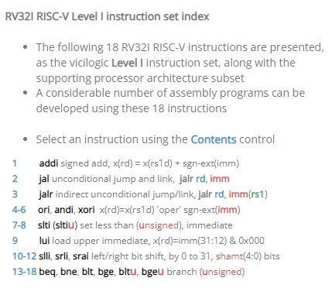
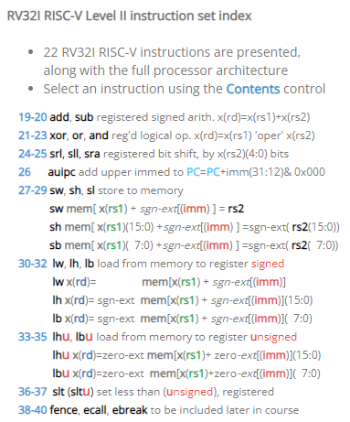
RV32I RISC-V Instruction Index / Course Modules
RV32I RISC-V Level I Instruction Set Index
RV32I RISC-V Level II Instruction Set Index

Slide 11
Assignment: Breakout game Stage A
Use main memory words 0 – 15 as game arena
Paddle row 2, with centre point at bit 16, 5-bit wide
Wall row 15
Ball start position row 3, bit 16
Score row 1
Number of remaining lives row 0, initialise with 3
Stage A: implement vertical ball movement only and not moving paddle
The number of lives will always be 3, since cannot end the game
Increment score when ball collides with active wall element
Lose life when ball passes paddle (on downward movement)
Game over when number of lives = 0

Slide 12
Assignment: Breakout game Stage A
Use functions
Try to avoid nested function
If using nested function, refer to vicilogic lesson
Preparation and documentation
Game strategy / functions
Register allocation and function
Game memory addressing

Slide 13
Assignment: Breakout game Stage B
Paddle left / right movement
Controlled by RISC-V processor input port signal IOIn(1:0) (L:R)
Memory address 0x00030008
Use RISC-V lw rd, imm(rs1) instruction

Slide 14
Assignment: Breakout game Stage B
Support angled movement, with 0, 45, 90 degree movement directions
If ball touches paddle on down movement
Vertical direction
touching left paddle bit rebound in up, NW direction
touching right paddle bit rebound in up, NE direction
SW direction
touching right paddle bit rebound in up, N direction
SE direction
touching left paddle bit rebound in up, N direction
Other down E-W directions
rebound in up, W-E direction direction

Slide 15
Assignment: Breakout game Stage B
wall collision handling

Slide 16
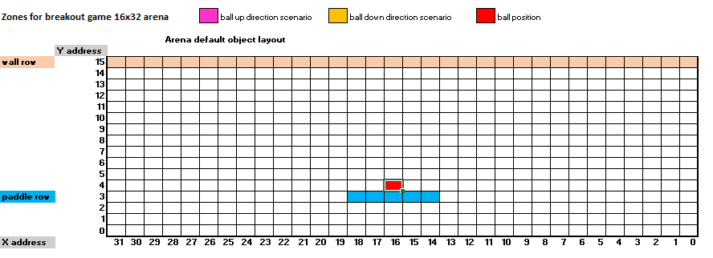
Breakout game zones
Zone regions

