Slide 1
CNN - Convolutional Neural Networks
Statistical View on Machine Learning
Marta Kałużna
Szymon Czop

Slide 2
Plan of our presentation
Why using CNN is better than normal Neural Networks?
CNN overview. Convolution, ReLU and pooling - what do they mean?
Building and training the model - Jupyter coding.

Slide 3
Before we begin - some facts about CNN

Slide 4
Before we begin - some facts about CNN
One of the variants of neural networks.

Slide 5
Before we begin - some facts about CNN
One of the variants of neural networks.
Used heavily in the field of Computer Vision.

Slide 6
Before we begin - some facts about CNN
One of the variants of neural networks.
Used heavily in the field of Computer Vision.
Derives its name from the type of hidden layers.

Slide 7
Why using Convolutional Neural Networks is better than normal Neural Networks?

Slide 8
1. Why using CNN is better than normal NN?
Reason 1: Images are Big

Slide 9
1. Why using CNN is better than normal NN?
Reason 1: Images are Big
The nice thing about images: pixels are most useful in the context of their neighbors.

Slide 10
1. Why using CNN is better than normal NN?
Reason 1: Images are Big
The nice thing about images: pixels are most useful in the context of their neighbors.
Reason 2: Positions can change

Slide 11
1. Why using CNN is better than normal NN?
Reason 1: Images are Big
The nice thing about images: pixels are most useful in the context of their neighbors.
Reason 2: Positions can change
We want to be able to detect a thing regardless of where it appears in the image.

Slide 12
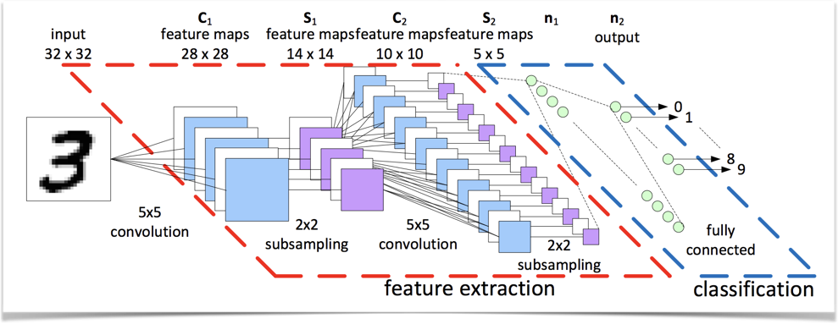
2. CNN Overview
Convolutional Neural Networks architecture

Slide 13
Differences between CNN and NN

Slide 14
Differences between CNN and NN
The layers are organized in 3 dimensions: width, height, depth.

Slide 15
Differences between CNN and NN
The layers are organized in 3 dimensions: width, height, depth.
The neurons in one layer do not connect to all the neurons in the next layer (only to a small region of it).

Slide 16
Differences between CNN and NN
The layers are organized in 3 dimensions: width, height, depth.
The neurons in one layer do not connect to all the neurons in the next layer (only to a small region of it).
The final output will be reduced to a single vector of probability scores (organized along the depth dimension).

Slide 17
Convolution, padding, pooling

Slide 18
Convolution
Overlaying the filter on top of the image at some location.
Performing element-wise multiplication between the values in the filter and their corresponding values in the image.
Summing up all the element-wise products. This sum is the output value for the destination pixel in the output image.
Repeating for all locations.

Slide 19
Convolution of images with multiple channels

Slide 20
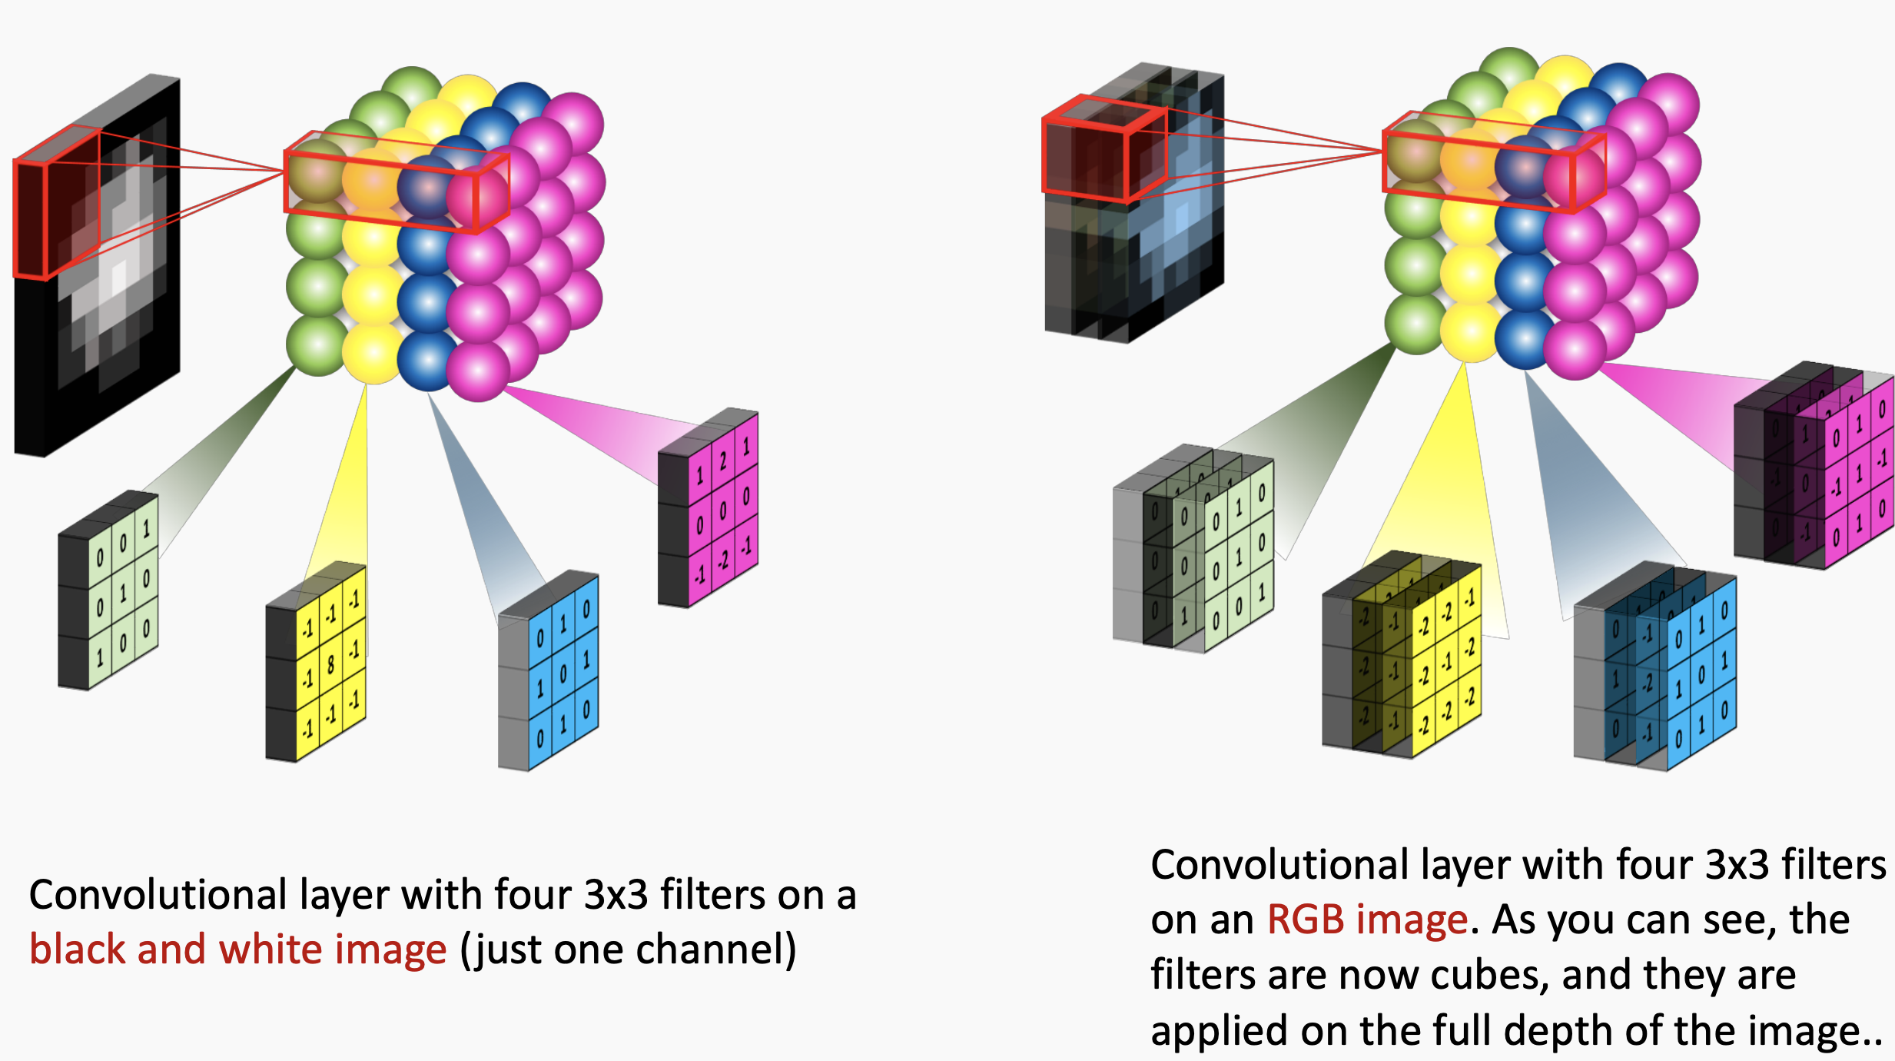
How do we connect our filters together?

Slide 21

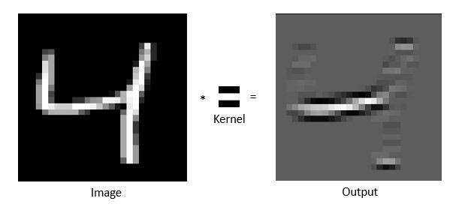

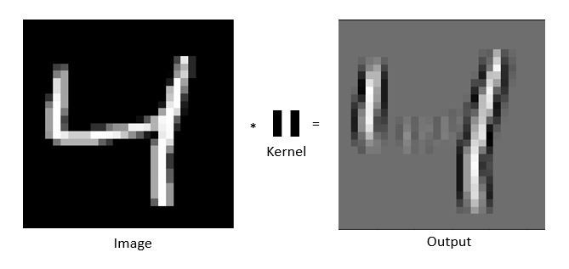
Horizontal vs vertical filter

Slide 22
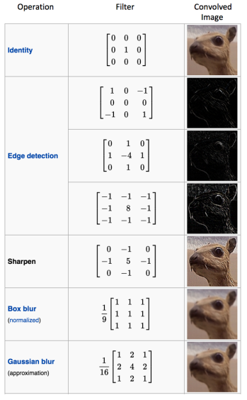
Various convolution image after applying different types of filters

Slide 23
Padding
Same Padding - the output image has the same dimensions as the input image (to achieve it, we pad the input image with zeros).

Slide 24
Padding
Valid Padding - the output image is reduced in the dimensionality as compared to the input

Slide 25

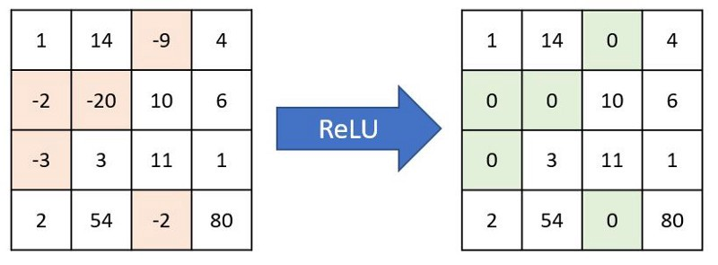
Non Linearity (ReLU)
ReLU = Rectified Linear Unit
The output is f(x) = max(0,x).
Converts all of the negative values to 0 and keeps the positive values the same.

Slide 26
Pooling
Reduces the number of parameters when the images are too large.
Why? To decrease the computational power required to process the data through dimensionality reduction.
Shortens the training time and controls over-fitting.

Slide 27

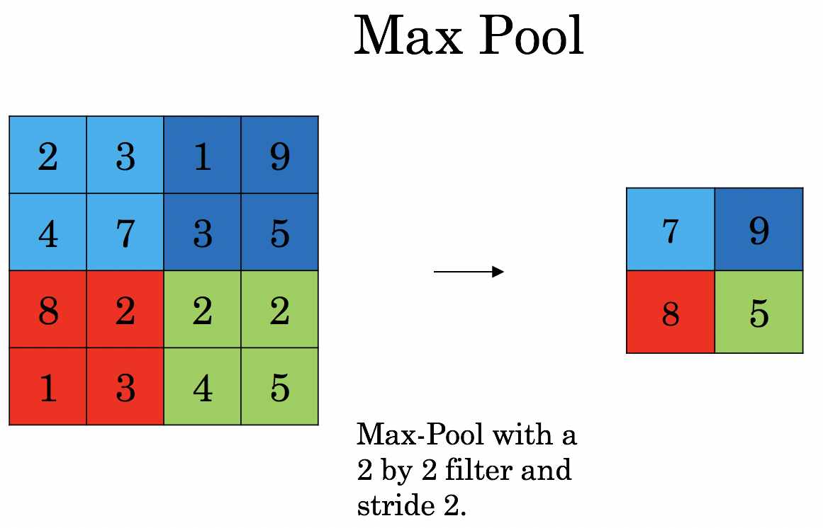

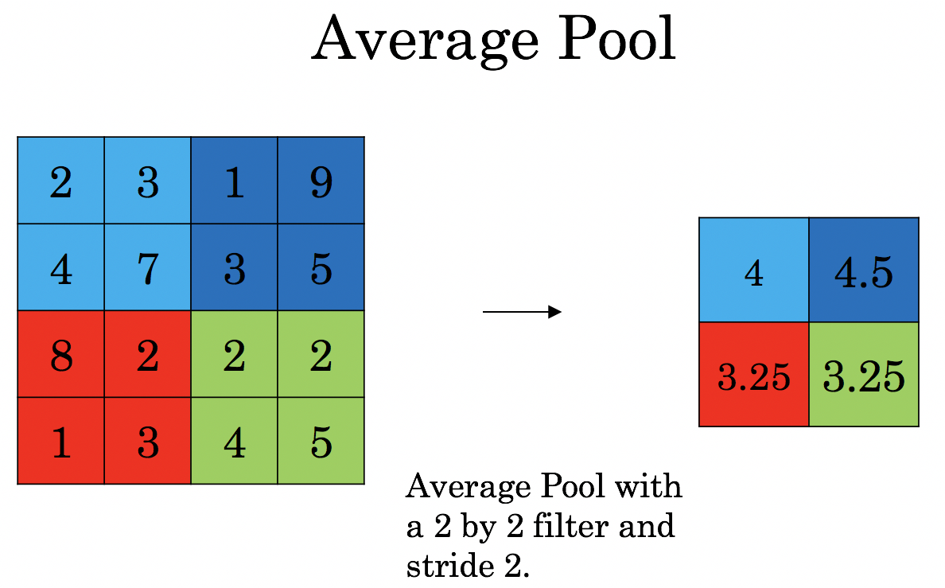
Pooling
Max Pooling - returns the maximum value from the portion of the image covered by the Kernel.
Average Pooling - returns the average of all the values from the portion of the image covered by the Kernel.

Slide 28
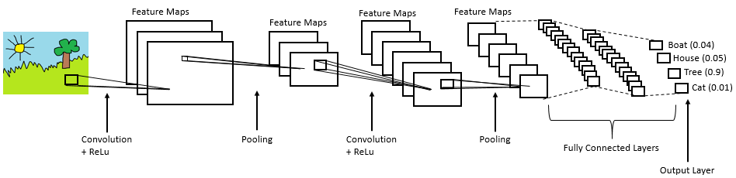
Complete CNN architecture

Slide 29
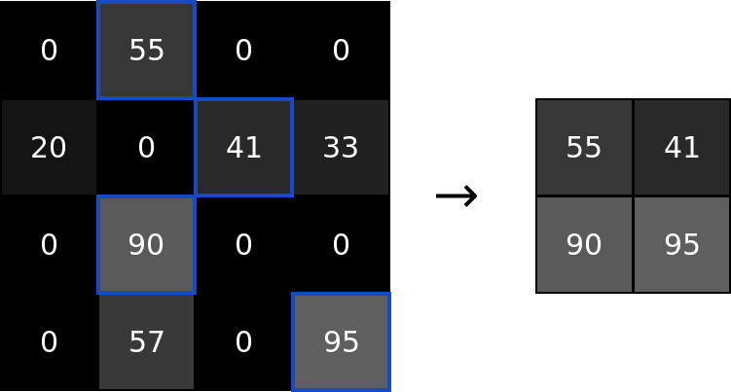
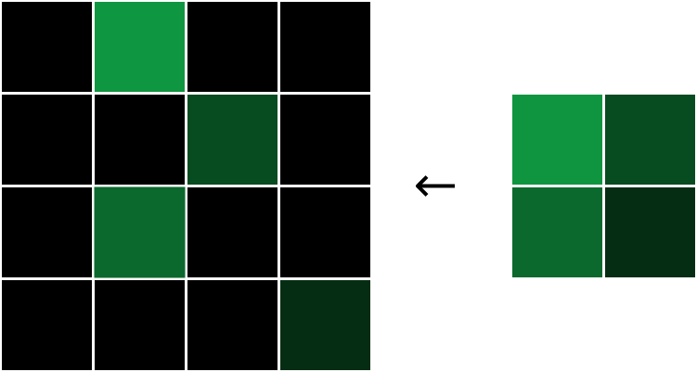
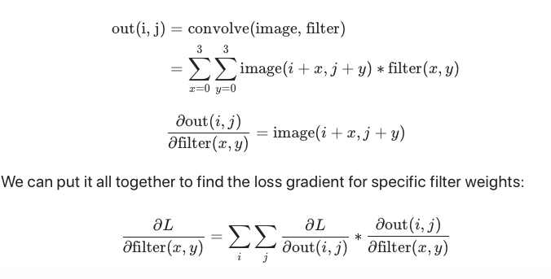
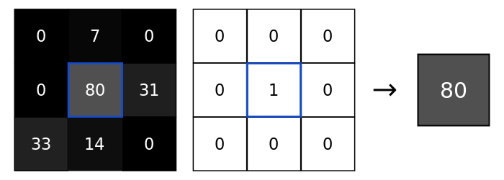
Backpropagation
Max Pooling
Conv layer

Slide 30
Building and training the model

Slide 31
Thank you for your attention!

