Slide 1

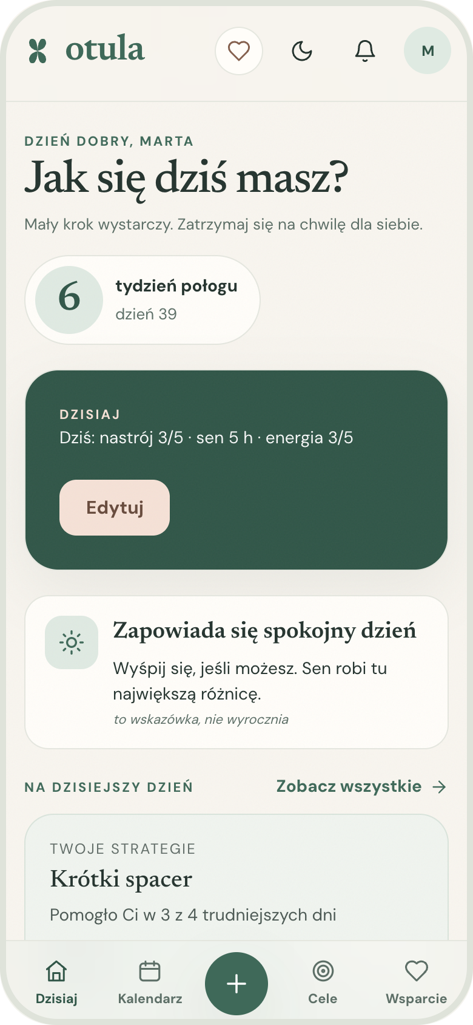
otula
Care for the mother,
not just the baby.
A wellbeing companion for the fourth trimester — and every cycle after it. Daily check-ins, support on hard days, and a safety net that notices when it is more than a bad week.
ImpactHer · HackYeah 2026
Notes:
Open with the line: care follows the baby — Otula follows the mother. 15 seconds.

Slide 2



After birth, the mother drops off the radar
THE PROBLEM
Care follows the baby
13%
Visits, checklists and apps are built around the newborn. The mother’s sleep, pain and mood are nobody’s job.
Alone after week six
of women who have just given birth experience a mental disorder — primarily depression.
After the 6-week check-up the system goes quiet — right when exhaustion peaks and “baby blues” can turn into depression.
Apps count days, not feelings
Cycle trackers predict periods. None of them help on a hard day, or notice when “a bad week” is something more.
Source: World Health Organization, maternal mental health.
Notes:
WHO: about 13% of women who have just given birth experience a mental disorder, primarily depression. Then the three gaps.

Slide 3
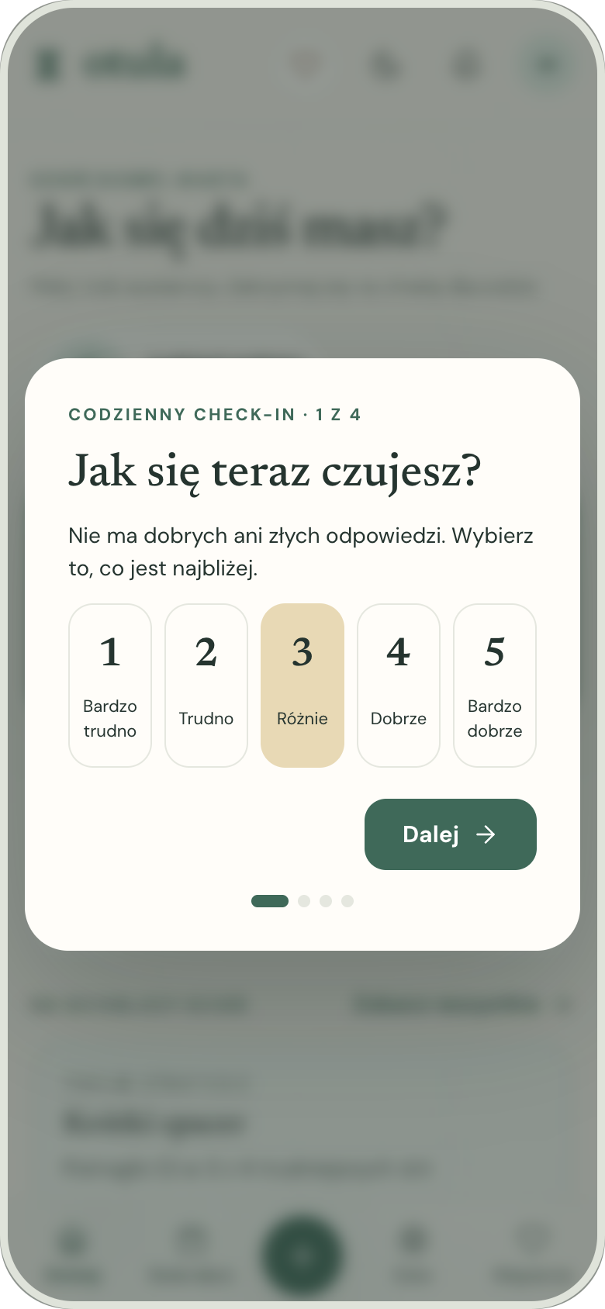
Meet Marta, day 39 after a C-section
WHO WE BUILD FOR
“Is this still baby blues, or should I tell someone?”
39
4.4 h
2.5 / 5
days postpartum
average sleep
average mood
Breastfeeding, recovering from surgery, partner back at work. She will not open a medical app at 3 a.m. — but she will tap a number between 1 and 5.
Also for Kasia, 29: no baby, but mood swings across her cycle she wants to understand and get ahead of.
The 30-second daily check-in
Notes:
Personas are composites. The numbers are from Marta’s demo data, which follows a realistic six-week story.

Slide 4
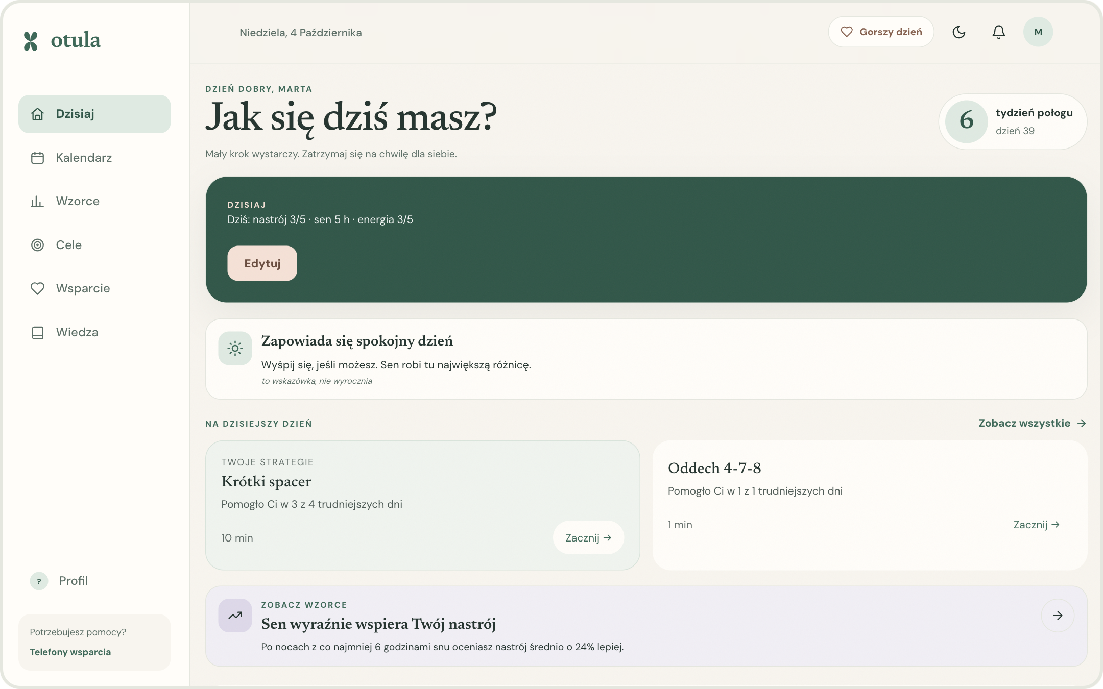





One minute a day, and someone who notices
THE SOLUTION
Daily check-in
Mood, sleep, energy, pain — 30 seconds, one hand.
Tough-day mode
Breathing first, then what helped you before.
Goals & reminders
Tiny steps she sets herself, with push reminders.
Knowledge
16 calm, sourced articles for her week.
Safety net
EPDS screening, red flags, crisis help.
Responsive PWA: phone, tablet and desktop · Polish and English
Notes:
Walk through the Today screen: stage pill, check-in, forecast, best-matching strategy, goals.

Slide 5
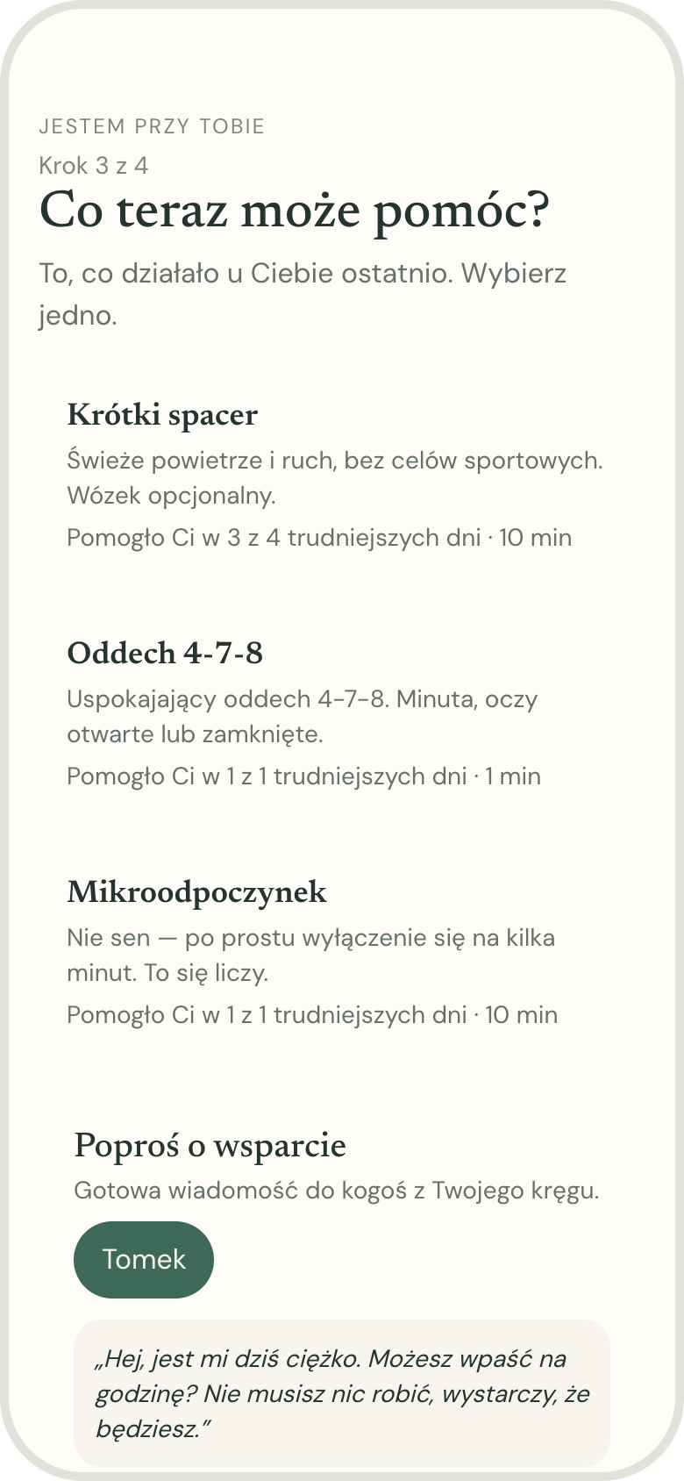
Support that learns what actually helps her
WHAT IS NEW · 1 / 3
1
She tells us
Onboarding asks what helps on hard days — a walk, a call, a nap — and what drains her.
3 of 4
2
Hard day
One tap on the heart: a minute of breathing, then her top strategies, ranked.
harder days a short walk helped Marta — so it is suggested first.
3
“Did it help?”
Yes · a bit · no. Each answer updates a Bayesian score per strategy.
4
It adapts
Next time the list is reordered — with the evidence shown back to her.
Tough day, step 3: ranked strategies + ask Tomek for help
Notes:
Ranking = (survey prior × 2 + helped score) / (2 + uses). Simple, explainable, no black box. “Ask for support” prepares an SMS/WhatsApp message to her trusted person.

Slide 6
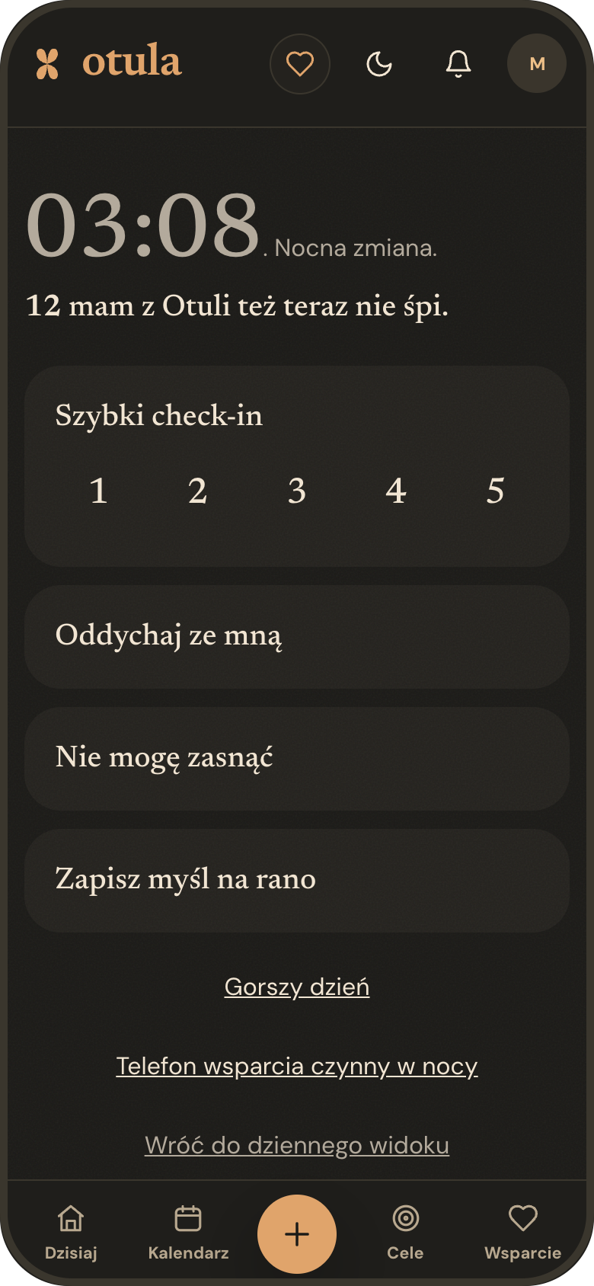
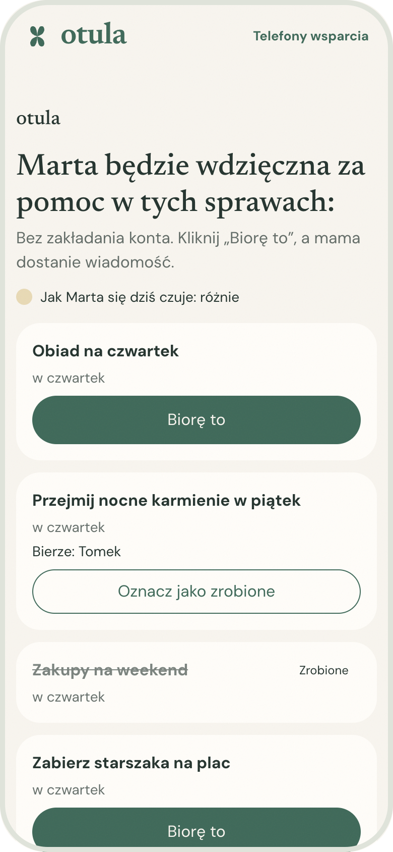
3 a.m. is not lonely anymore
WHAT IS NEW · 2 / 3
Night Shift
Support circle
From 22:00 to 6:00 the app turns warm and dim: big one-hand buttons, a 1-tap check-in, breathing, “can’t sleep”, and a note for the morning.
She lists concrete asks — dinner on Thursday, the 2 a.m. feed. Family opens a link, no account, and taps “I’ll take it”. She gets a push.
“12 mums from Otula are awake right now.”
Turns “let me know if you need anything” into real help.
Anonymous count, hidden below 5 people.
Notes:
Be honest: in the demo the awake count comes from seeded demo accounts. The public page never shows notes, symptoms or screening results.

Slide 7
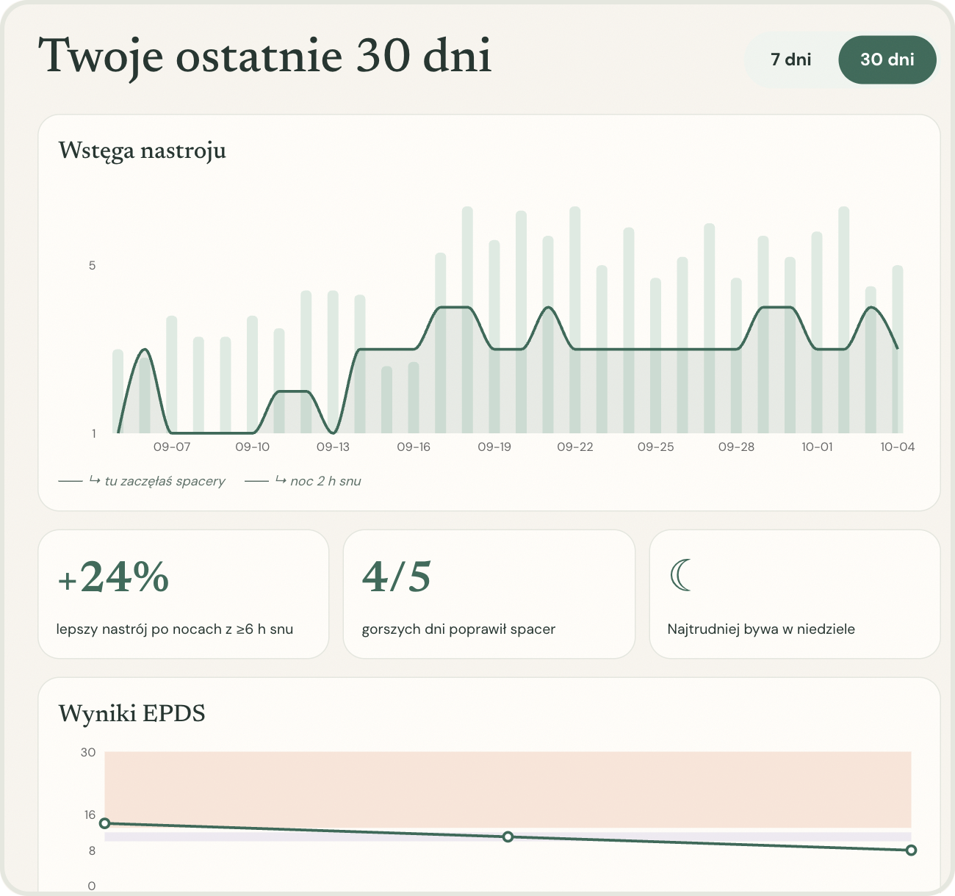
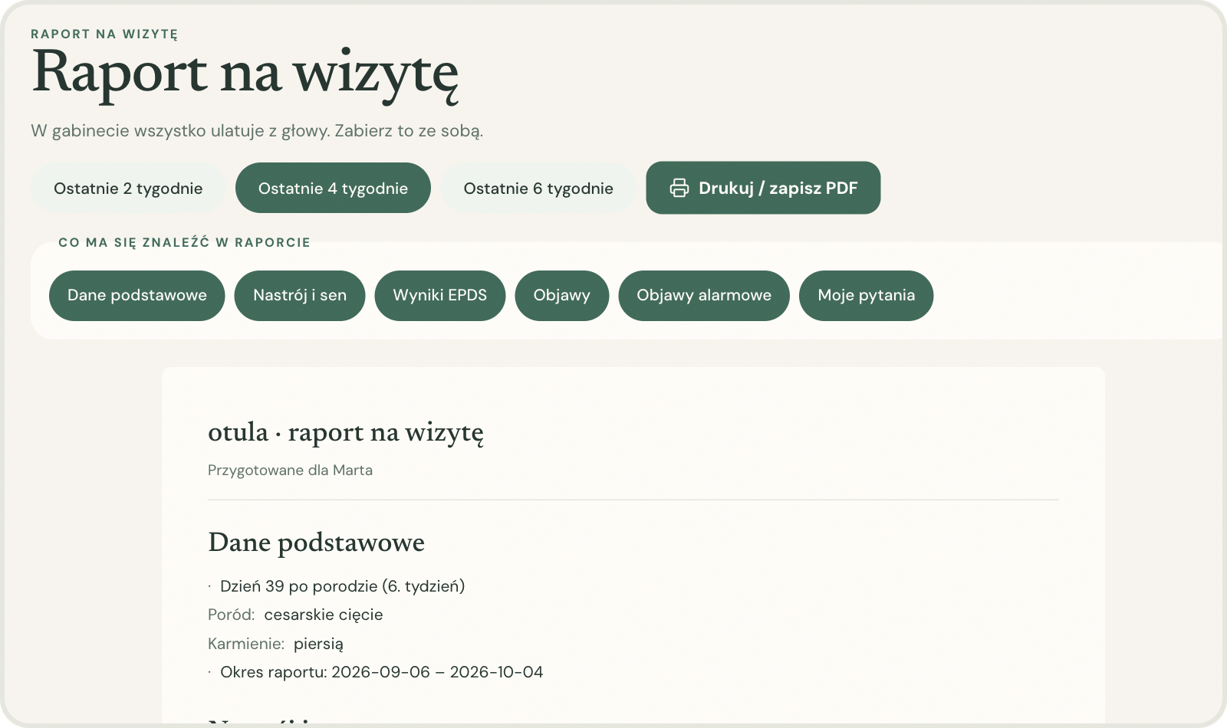
From daily taps to a report for the midwife
WHAT IS NEW · 3 / 3
+24%
better mood after nights with ≥ 6 h of sleep — patterns are written as sentences, with notes on the chart.
1 tap
builds a printable visit report: mood & sleep, EPDS trend, symptoms, red flags and her own questions.
3 a.m.
“Save as a question for my visit” — thoughts captured when they happen, not forgotten in the office.
Notes:
“In the doctor’s office everything slips my mind” — the report solves that. Print or save as PDF straight from the browser.

Slide 8






Kind by default, serious when it matters
SAFETY BY DESIGN
EPDS screening
Risk engine
Red flags after birth
The validated Edinburgh scale every 14 days postpartum, with a trend over time.
8 transparent rules over check-ins and EPDS: from a gentle nudge to urgent help.
Heavy bleeding, fever, chest pain… one tap shows “call a doctor now” with tel: links.
Crisis page, no login
Never a diagnosis
Private by design
112 and Polish crisis lines, two taps from every screen — even logged out.
“Your result suggests it may help to talk to a specialist” — not “you have depression”.
Notes encrypted at rest, JSON export, one-click delete, no trackers (GDPR).
Notes:
Otula is not a medical device. Helpline numbers are verified before launch. EPDS: Cox, Holden & Sagovsky, 1987.

Slide 9

A working product, not a mock-up
WHAT WE BUILT IN 24 HOURS
295
React PWA
Django REST API
TypeScript · Vite · TanStack Query
55 endpoints · JWT · OpenAPI
backend tests
51 + 2
Celery + Redis
PostgreSQL
reminders · nightly jobs
encrypted notes
unit + end-to-end tests
21
Web push
Docker Compose
screens, PL & EN
service worker · VAPID
one command: make up
How: 10 AI coding agents (Meta Muse Code) working in parallel git worktrees on a shared API contract, with Claude Code integrating, testing and fixing — every merge verified against the real API in a browser.
Notes:
We can explain every part: contract-first API, per-domain apps, pure-logic modules with unit tests (risk, ranking, forecast), MSW mocks so frontend and backend could work in parallel.

Slide 10
IMPACT & NEXT STEPS
Otula covers the weeks when nobody else is watching.
1
Pilot with midwives and primary care
Resources & disclosure
Visit report as the bridge between home and the patronage visit.
EPDS — Cox, Holden & Sagovsky, 1987
WHO maternal mental health data
Open source: Django, DRF, React, Vite, Recharts, Celery
AI: Meta Muse Code, Claude Code; design in Figma Make
Concept and design drafted before the start; first code commits 22:55 on Oct 3 — full git history in the repo
2
Clinical review
Validate the Polish EPDS flow and risk thresholds with perinatal psychologists.
3
Partners and foundations
Circle and partner guide with maternal-health NGOs; verified helpline network.
otula — care for the mother, not just the baby.
Notes:
Close: thank the jury. Offer the live demo (make demo-reset, demo user Marta). Every statement about AI and pre-event work matches the README disclosure.

