Slide 1


X
Company Name
Month Year

Slide 2



Your Superorder Team and Agenda
1
Introduce your Superorder Team
2
What to expect
Simon K
ONBOARDING MANAGER
3
Product overview
4
Product Bundle
5
Who will participate in onboarding?
6
Integration Steps
Sephra Engel
ACCOUNT MANAGER
7
Timeline
8
Help resources
PROPRIETARY AND CONFIDENTIAL
‹#›

Slide 3

Your Superorder Team and Agenda
1
Introduce your Superorder Team
2
What to expect
Simon K
ONBOARDING MANAGER
3
Product overview
4
Product Bundle
5
Who will participate in onboarding?
6
Integration Steps
Maanav Patel
ACCOUNT MANAGER
7
Timeline
8
Help resources
PROPRIETARY AND CONFIDENTIAL
‹#›

Slide 4



What to expect during onboarding
Dedicated 1:1 support from a Superorder onboarding manager
Personalized recommendations and best practices for setting up your Superorder account
Technical support to set up platform integrations and billing
PROPRIETARY AND CONFIDENTIAL
‹#›

Slide 5






Your products
AI Review Management
Engage with customer reviews and feedback with AI
Surveys
Customized Surveys to Consolidate Customer Opinions
Alerts
Leverage automated notifications for operational efficiency across the company
Downtime Management
Prevent revenue and order losses to downtime & inactivity
Dispute Management
Recover revenue lost to order disputes and chargebacks
Financial Reconciliation
Consolidate, manage and breakdown your financial from the delivery platforms
SEO/Listing Management
Boost local visibility and reviews with AI-powered SEO and listing management
PROPRIETARY AND CONFIDENTIAL
‹#›

Slide 6
Who are the best points of contact?
Financials & Chargebacks
Financials & Chargebacks
Individuals that will focus on the financials of the business
Person 1
Person 2
Person 3
Third Party Delivery Tools
Third Party Delivery Tools
(Reviews, Downtime, Insights)
Person 1
Person 2
Person 3
Access to 3PD portals and can assist in setting up integrations
Guest Experience & Reputation Management
Person 1
Person 2
Person 3
Guest Experience &
Reputation Management
Guest experience decision makers that can set templates and promos
PROPRIETARY AND CONFIDENTIAL
‹#›

Slide 7

Third-Party Integration Steps
Please add [Insert HQ 1] and [Insert HQ 2] as users with Admin access on your DoorDash account for all locations.
First Name: Deal Name
Last Name: HQ
PROPRIETARY AND CONFIDENTIAL
‹#›

Slide 8

Third-Party Integration Steps Cont.
Please add [Insert HQ 1] and [Insert HQ 2] as users with Manager access on your UberEats account for all locations.
First Name: Deal Name
Last Name: HQ
PROPRIETARY AND CONFIDENTIAL
‹#›

Slide 9

Third-Party Integration Steps Cont.
Please add [Insert HQ 1] and [Insert HQ 2] as users with Admin access on your Grubhub account for all locations.
First Name: Deal Name
Last Name: HQ
Password: SuperorderDisputes1234!
PROPRIETARY AND CONFIDENTIAL
‹#›

Slide 10









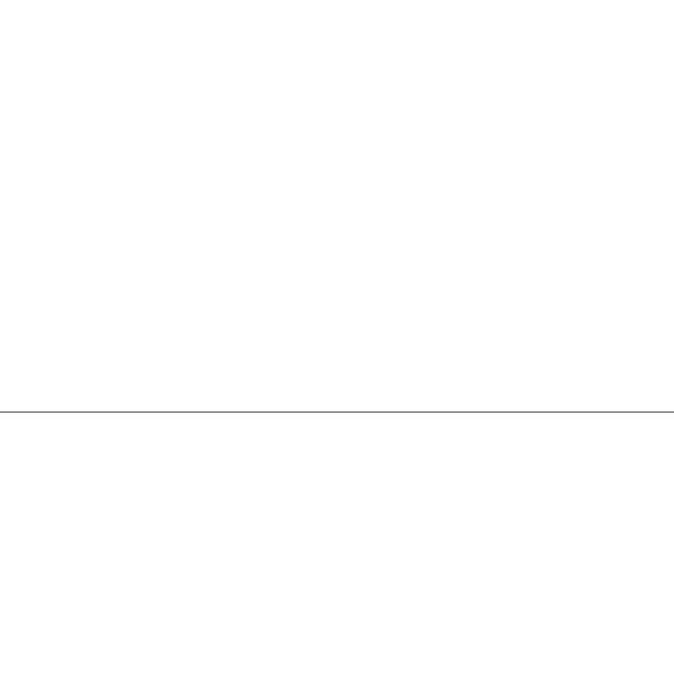
Implementation Plan
TODAY
1-2 weeks
2-3 weeks
Success!
Integration Call
Build Dashboard
Training Call(s)
Onboarding Complete
Your Action Items
Complete addition of users to third party platform
Superorder Action Items
Use the new users created to build the Superorder Dashboard & setup the account
Department Trainings
Set up training calls with various decision makers for the Operations team, Marketing team, Accounting team, etc
Check-ins & Results
Schedule regular check-ins and discuss results after being active for 30 days
Second Party & Surveys
Send onboarding instructions to complete integrations
PROPRIETARY AND CONFIDENTIAL
‹#›

Slide 11



Help Resources
Help Center Main Page
General business support
General Billing Questions answered
A walkthrough of all the Superorder products on the Superorder dashboard.
Common FAQ
Billing FAQ
Dashboard Guide
For general inquiries - please reach out to Support
help@superorder.com
PROPRIETARY AND CONFIDENTIAL
‹#›

