Slide 1
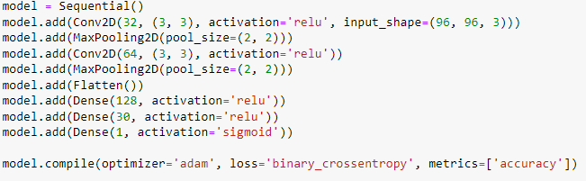

Anomaly Detection Tabular Data
Własny model:
Wyniki:

Slide 2
Anomaly Detection Tabular Data
Własny model:
Wyniki:

Slide 3
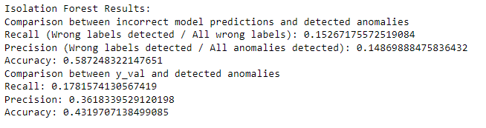
Anomaly Detection Tabular Data
ISOLATION FOREST

Slide 4
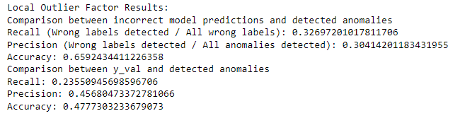
Anomaly Detection Tabular Data
LOF

Slide 5
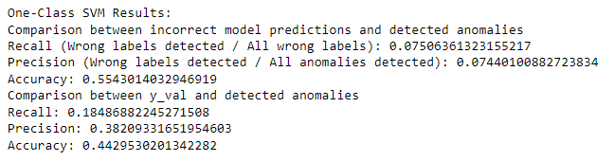
Anomaly Detection Tabular Data
SVM

Slide 6
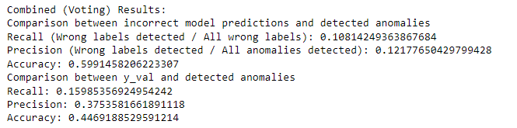
Anomaly Detection Tabular Data
VOTING

Slide 7
Anomaly Detection Tabular Data
Własny model:
Wyniki:

Slide 8

Anomaly Detection Tabular Data
ISOLATION FOREST

Slide 9

Anomaly Detection Tabular Data
LOF

Slide 10

Anomaly Detection Tabular Data
SVM

Slide 11

Anomaly Detection Tabular Data
VOTING

Slide 12
Anomaly Detection Tabular Data
Własny autoenkoder:
Wyniki:

Slide 13

Anomaly Detection Tabular Data
ISOLATION FOREST

Slide 14

Anomaly Detection Tabular Data
LOF

Slide 15
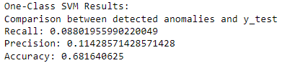
Anomaly Detection Tabular Data
SVM

Slide 16

Anomaly Detection Tabular Data
VOTING

Slide 17
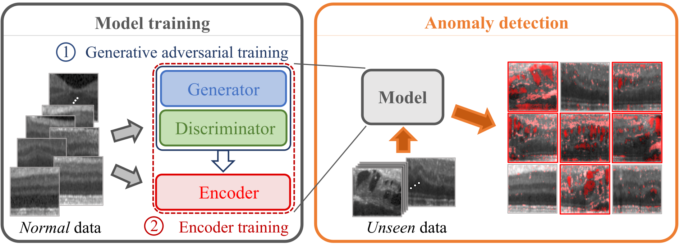
Anomaly Detection Without Feature Extraction
f-AnoGAN
https://github.com/tSchlegl/f-AnoGAN/blob/master/paper/GraphicalAbstract.png

Slide 18
Anomaly Detection Without Feature Extraction
f-AnoGAN: the implementation
Implementation based on f-AnoGAN Python package: (source: https://github.com/A03ki/f-AnoGAN)
A random set of 4096 images was used.

Slide 19
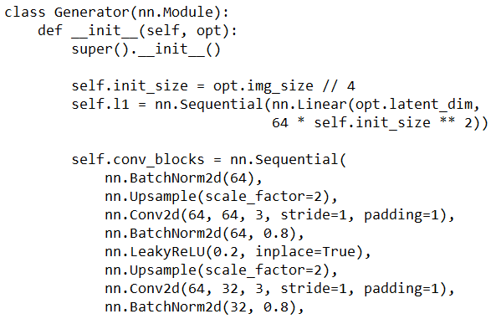
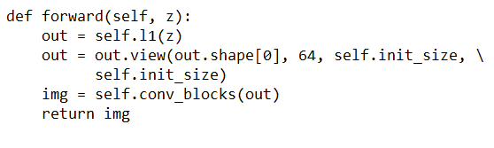
Anomaly Detection Without Feature Extraction
f-AnoGAN: the implementation
Generator:

Slide 20
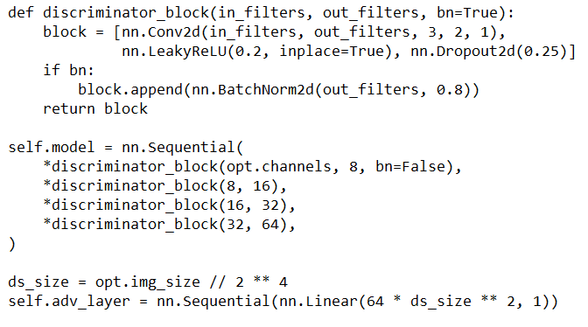
Anomaly Detection Without Feature Extraction
f-AnoGAN: the implementation
Discriminator:

Slide 21
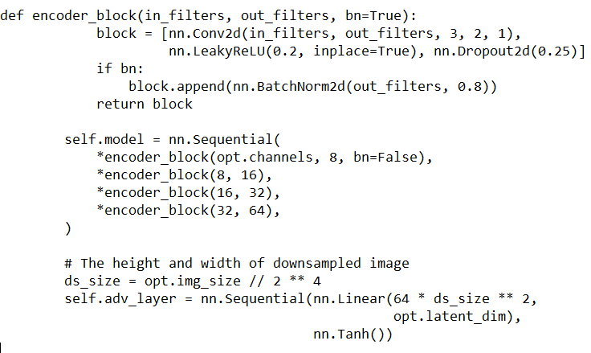
Anomaly Detection Without Feature Extraction
f-AnoGAN: the implementation
Encoder:

Slide 22
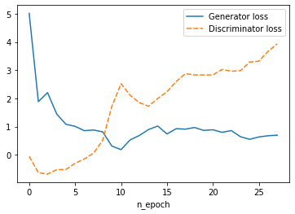
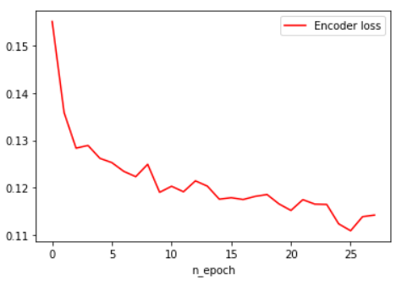
Anomaly Detection Without Feature Extraction
f-AnoGAN – training
Loss over epochs (total: 28)

Slide 23
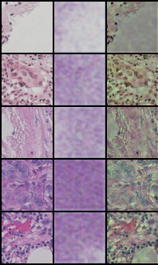
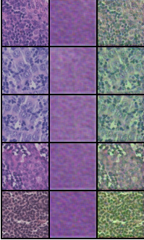
Anomaly Detection Without Feature Extraction
f-AnoGAN: results
Real Fake Diff
Real Fake Diff

Slide 24
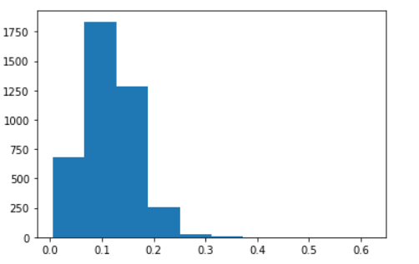

Anomaly Detection Without Feature Extraction
f-AnoGAN: results
Anomaly score histplot

