Slide 1
Anomaly Detection
​ | Kategoria 1 | Kategoria 2 | Kategoria 3 | Kategoria 4
Whole Slide Image Classification
Wojciech Kosiuk | Szymon Matuszewski | Michał Mazuryk
Tomasz Modzelewski | Tymoteusz Urban

Slide 2
Agenda
Introduction to Anomaly Detection
Our Notes
Plan

Slide 3
1. Introduction to Anomaly Detection

Slide 4
What are Anomalies?
Anomaly detection is the task of identifying out of distribution examples.

Slide 5
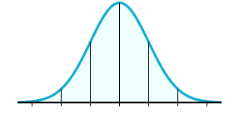
What are Anomalies?
Anomaly detection is the task of identifying out of distribution examples.
For example:

Slide 6
What are Anomalies?
Anomaly detection is the task of identifying out of distribution examples.
For example:
outlier
outlier

Slide 7


Our Approach

Slide 8
Our Approach
=
Anomaly

Slide 9
Our Approach
=
Anomaly
or…

Slide 10
Our Approach
=
Anomaly

Slide 11
2. Our Notes

Slide 12
Main articles to focus on
Deep Learning for Medical Anomaly Detection - A Survey
Overall Information
Alghoritms without Feature Extraction
Alghoritms with Feature Extraction
ReMix: A General and Efficient Framework for Multiple Instance Learning based Whole Slide Image Classification
Unsupervised Anomaly Detection in Digital Pathology Using GANS

