Slide 1
Whole Slide Images Anomaly Detection
Wojciech Kosiuk | Szymon Matuszewski | Michał Mazuryk | Tomasz Modzelewski | Tymoteusz Urban

Slide 2
Table of contents
01
02
Workflow
What is Anomaly Detection?
03
04
Best Solution
Conclusions

Slide 3
01
What is Anomaly Detection?

Slide 4
02
Workflow

Slide 6
?

Slide 8
After feature extraction
Algorithms
Before feature extraction

Slide 9
After feature extraction
Algorithms
Before feature extraction

Slide 10
Algorithms After Feature Extraction

Slide 11
Getting tabular data
Neural network
Vector representation

Slide 12
Getting tabular data
Autoencoder
Vector representation

Slide 13
Anomaly as:
-Cancer detection
-Model boosting

Slide 14
Anomaly as:
Predictions Ground Anomaly Truth
1 1 0
0 1 1
1 0 1
1 1 0
0 0 0
-Cancer detection
-Model boosting

Slide 15
ImageNet Pretrained Model

Slide 16
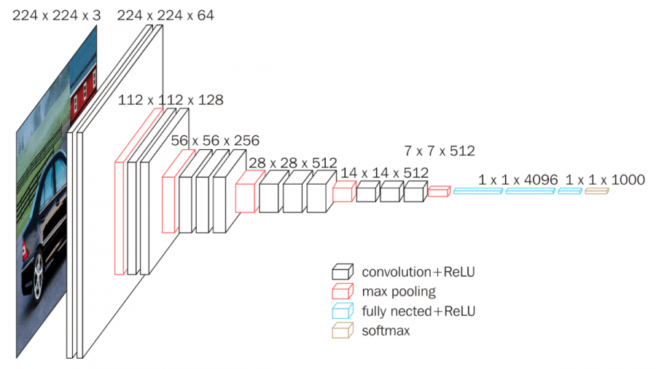
VGG 16
16 layers
13 convolutional – 3 dense
5 Max Pooling Layers
1 additional dense layer – 128 neurons

Slide 17
Results
 | Model Sigmoid | ImageNet
Accuracy | 0.76 | 0.75
Precision | 0.71 | 0.83
Recall | 0.89 | 0.62
F1 Score | 0.79 | 0.72

Slide 18
What about grayscale?

Slide 19
RGB

Slide 20
RGB
GRAYSCALE

Slide 21
RGB
GRAYSCALE
CLAHE
GRAYSCALE

Slide 22
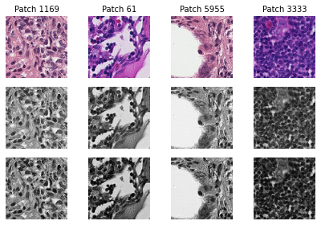
RGB
GRAY SCALE
CLAHE
GRAYSCALE

Slide 23
 | Model Sigmoid | ImageNet
Ratio 0-1 | 0.5 | 0.85
Accuracy | 0.5 | 0.85
Precision | 0.0 | 0.0
Recall | 0.0 | 0.0
F1 Score | 0.0 | 0.0

Slide 24
Always overfitted
 | Model Sigmoid | ImageNet
Ratio 0-1 | 0.5 | 0.85
Accuracy | 0.5 | 0.85
Precision | 0.0 | 0.0
Recall | 0.0 | 0.0
F1 Score | 0.0 | 0.0

Slide 25
Anomaly Detection to improve model quality
 | Isolation Forest | Local Outlier Factor | One-Class SVM | Voting
Ratio 0-1 | 0.85 | 0.85 | 0.85 | 0.85
Accuracy | 0.67 | 0.68 | 0.66 | 0.68
Precision | 0.12 | 0.17 | 0.12 | 0.14
Recall | 0.20 | 0.29 | 0.19 | 0.20
Precision* | 0.12 | 0.27 | 0.12 | 0.14
Recall* | 0.20 | 0.29 | 0.19 | 0.20

Slide 26
Anomaly Detection to detect cancer from convolutional layer
 | Isolation Forest | Local Outlier Factor | One-Class SVM | Voting
Ratio 0-1 | 0.85 | 0.85 | 0.85 | 0.85
Accuracy | 0.81 | 0.80 | 0.82 | 0.90
Precision | 0.01 | 0.01 | 0.03 | 0.02
Recall | 0.05 | 0.18 | 0.09 | 0.05

Slide 27
Anomaly Detection with autoencoder
 | Isolation Forest | Local Outlier Factor | One-Class SVM | Voting
Ratio 0-1 | 0.85 | 0.85 | 0.85 | 0.85
Accuracy | 0.74 | 0.71 | 0.72 | 0.76
Precision | 0.16 | 0.05 | 0.12 | 0.14
Recall | 0.17 | 0.05 | 0.13 | 0.12

Slide 28
Algorithms Before Feature Extraction

Slide 29
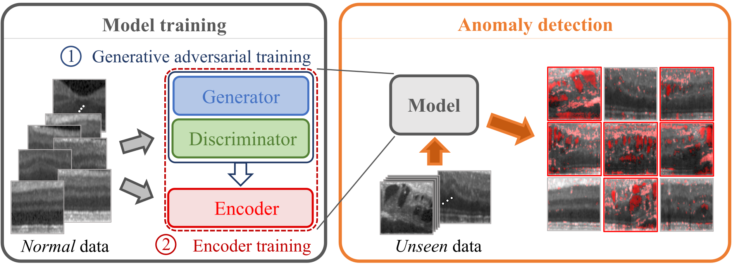
f-AnoGan

Slide 30
Default training
Label | Avg img distance | Avg anomaly score | Median of anomaly score | Avg vector z distance
0 | 0.089 | 0.122 | 0.125 | 0.016
1 | 0.099 | 0.132 | 0.127 | 0.019
GAN – 30 epochs, encoder – 20 epochs
Whole dataset

Slide 31
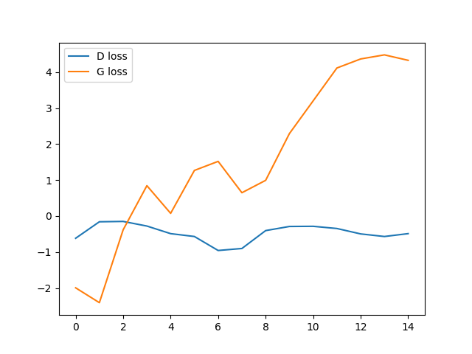
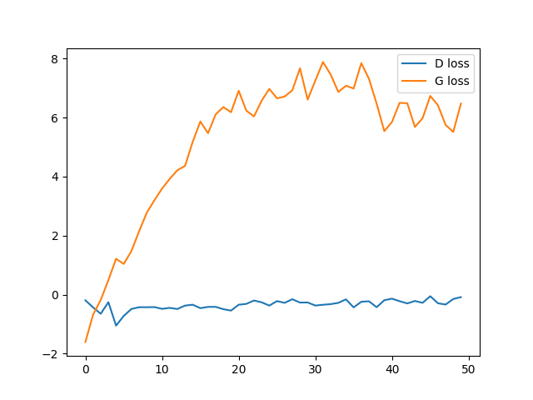
Loss functions
15 Epochs
50 Epochs

Slide 32
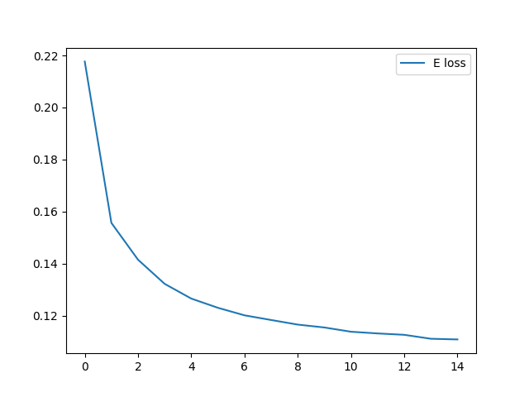
Loss functions

Slide 33
Crop images?
„A positive label indicates that the center 32x32px region of a patch contains at least one pixel of tumor tissue. Tumor tissue in the outer region of the patch does not influence the label.”

Slide 34
Cropped training
Label | Avg anomaly score | Median of anomaly score
0 | 0.099 | 0.100
1 | 0.112 | 0.103

Slide 35
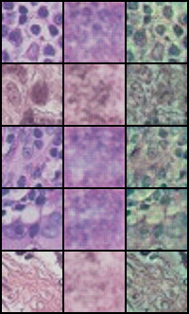
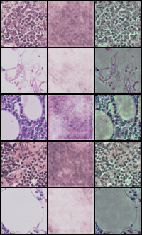
Cropped vs Default
Real
Fake
Diff
Real
Fake
Diff

Slide 36
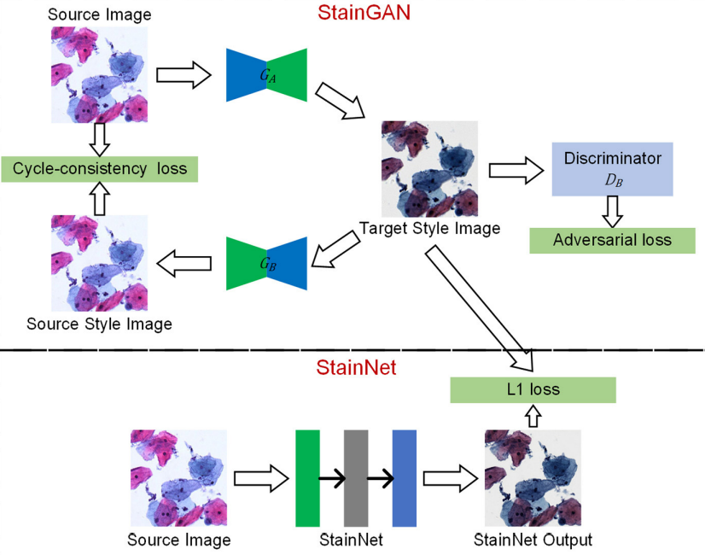
Stain normalization

Slide 37
Stain normalization
Paper:
StainNet: A Fast and Robust Stain Normalization Network
Model:
https://github.com/khtao/StainNet/blob/master/checkpoints/camelyon16_dataset/StainNet-Public-centerUni_layer3_ch32.pth

Slide 38
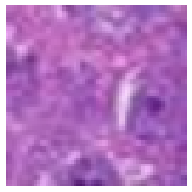
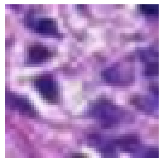
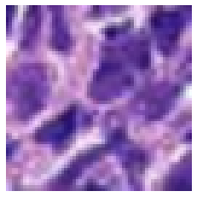
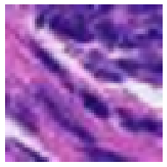
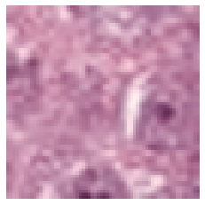
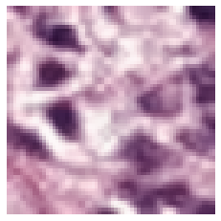
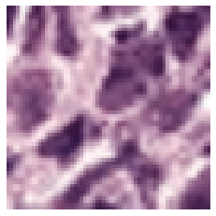
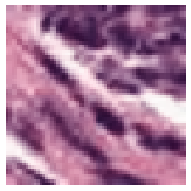
Stain normalization Examples

Slide 39
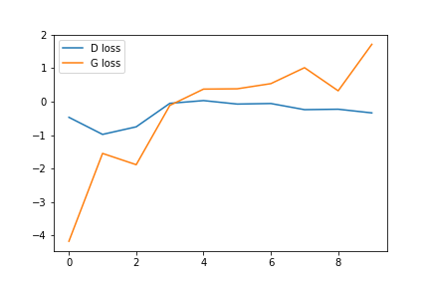
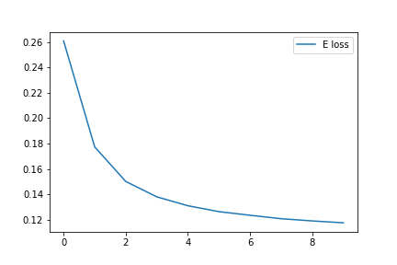
Stain normalization Loss functions (10 epochs)
Generator & Discriminator
Encoder

Slide 40
Normalized training
Label | Avg anomaly score | Median of anomaly score
0 | 0.107 | 0.111
1 | 0.106 | 0.101

Slide 41
Normalized training
 | Max anomaly score
Before StainNet | 1.686
After StainNet | 0.38

Slide 42
Perspectives
More epochs
Manipulation of the number of neurons
Data augmentation

Slide 43
03
Best Solution

Slide 44
?

Slide 45
04
Conclusions

Slide 46
Conclusions
1. RGB Colors
Colors do matter in terms of Anomaly Detection tasks

Slide 47
Conclusions
2. Hardware
Processing a large number of WSIs is computionally demanding

Slide 48
Conclusions
3. ImageNet
Pretrained models are useful but not essential

Slide 49
Conclusions
4. Data
Samples with cancer are not indespensable for anomaly detection

Slide 50
Conclusions
5.
opis

Slide 51
Bibliography
https://openaccess.thecvf.com/content_ECCVW_2018/papers/11134/Xie_Pre-training_on_Grayscale_ImageNet_Improves_Medical_Image_Classification_ECCVW_2018_paper.pdf
https://arxiv.org/pdf/2103.08945.pdf?fbclid=IwAR0RWq2p8IqSrZo1V7etNz-vaSQOPeP25OBKmP3O5mZR3w1cJ2JoUdppOjE
https://arxiv.org/pdf/2012.02364.pdf?fbclid=IwAR2PMr_Ta2ECayeGBGBWCwOgORG0of5OEYDXNPSvKG5cVl6okKVxeUYD1kw

Slide 52
Thanks for attention!

