Slide 1
Anomaly Detection
​ | Kategoria 1 | Kategoria 2 | Kategoria 3 | Kategoria 4
Whole Slide Image Classification
Wojciech Kosiuk | Szymon Matuszewski | Michał Mazuryk
Tomasz Modzelewski | Tymoteusz Urban

Slide 2
Agenda
Introduction to Anomaly Detection
Our Notes
Plan

Slide 3
1. Introduction to Anomaly Detection

Slide 4
What are Anomalies?
Anomaly detection is the task of identifying out of distribution examples.

Slide 5
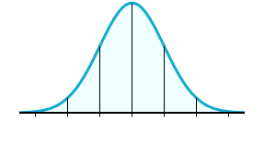
What are Anomalies?
Anomaly detection is the task of identifying out of distribution examples.
For example:

Slide 6
What are Anomalies?
Anomaly detection is the task of identifying out of distribution examples.
For example:
outlier
outlier

Slide 7


Our Approach

Slide 8
Our Approach
=
Anomaly

Slide 9
Our Approach
=
Anomaly
or…

Slide 10
Our Approach
=
Anomaly

Slide 11
2. Our Notes

Slide 12
Main articles to focus on
Deep Learning for Medical Anomaly Detection - A Survey
Overall Information
Alghoritms without Feature Extraction
Alghoritms with Feature Extraction
ReMix: A General and Efficient Framework for Multiple Instance Learning based Whole Slide Image Classification
Unsupervised Anomaly Detection in Digital Pathology Using GANS

Slide 13
...

Slide 14
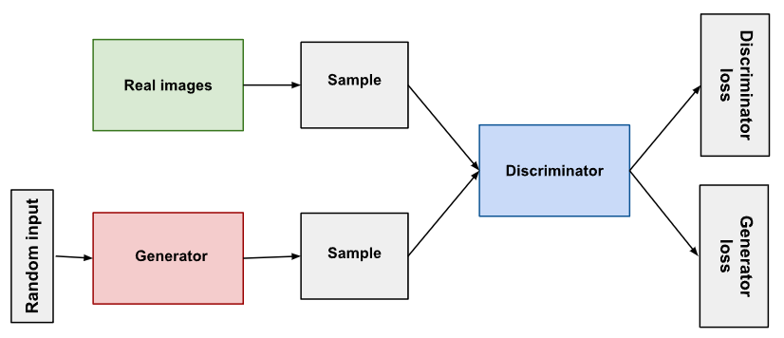
About GANs
GAN - generative adversarial network
Notes:
Generative Adversarial Networks train two networks, a ‘Generator’ (G) and a
‘Discriminator’ (D), which play a min-max game. G tries to
fool D, while D tries avoid being fooled.

Slide 15
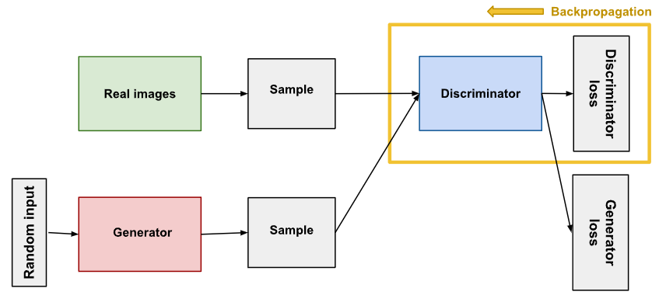
Discriminator
Classifier – fake or real
Penalizes the generator for producing implausible results.
Notes:
The discriminator connects to two loss functions. During discriminator training, the discriminator ignores the generator loss and just uses the discriminator loss. During discriminator training:
The discriminator classifies both real data and fake data from the generator.
The discriminator loss penalizes the discriminator for misclassifying a real instance as fake or a fake instance as real.
The discriminator updates its weights through backpropagation from the discriminator loss through the discriminator network.

Slide 16
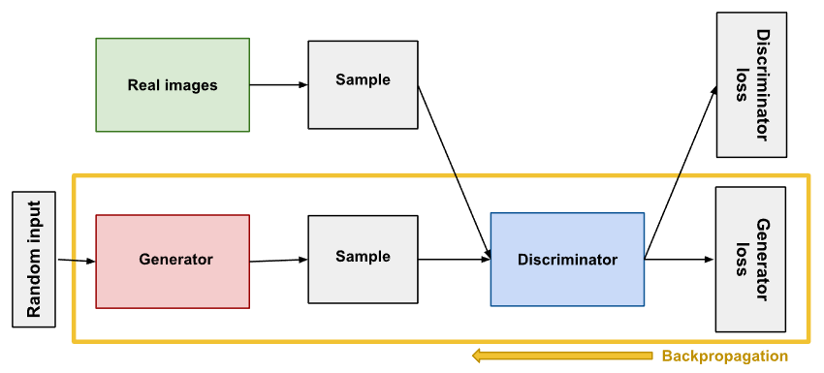
Generator
Learns to create fake data
Tries to make the discriminator classify its output as real.
Notes:
Generator training:
Sample random noise.
Produce generator output from sampled random noise.
Get discriminator "Real" or "Fake" classification for generator output.
Calculate loss from discriminator classification.
Backpropagate through both the discriminator and generator to obtain gradients.
Use gradients to change only the generator weights

Slide 17
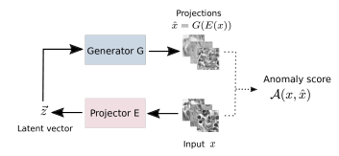
GAN-based unsupervised anomaly detection
Notes:
The original input image x is fed through projector E (estimated inverse of G) which outputs a latent vector ~z. This latent vector is used to generate a reconstruction image via generator (already trained) G. An anomaly score is a measure of some difference between the input image x and its reconstruction xˆ.

Slide 18
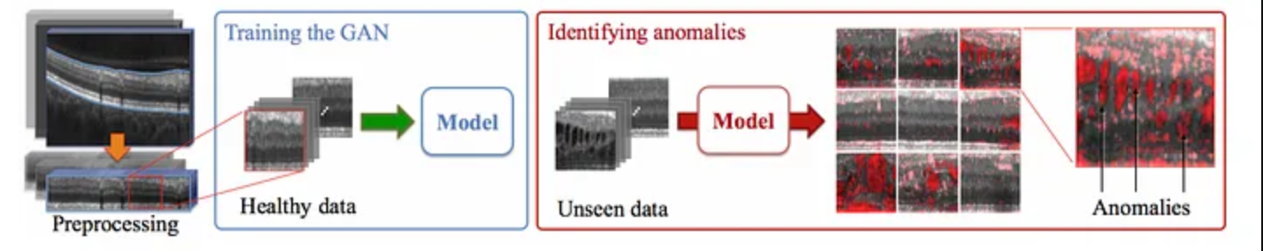
Whole process
Training generator – supervised
Anomaly detection - unsupervised
Notes:
While a supervised signal is provided to the discriminator
for training the real/fake classification task, the real/fake classification is not the primary task and the model is not shown any anomalous examples. Hence, no supervision is given to
the GAN framework regarding how to identify abnormalities,
making it unsupervised

