Slide 1


Premier League Data Warehouse
Matches & Betting Odds
Białe Misie

Slide 2
Table of contents
01
02
Process
Business Benefits
03
Presentation

Slide 3
01
Process

Slide 4

Import Data from 3 sources

Slide 5

Import Data from 3 sources
Prepare Data for ETL in Python

Slide 6

ETL process
Import Data from 3 sources
Prepare Data for ETL in Python

Slide 7

ETL process
Import Data from 3 sources
Prepare Data for ETL in Python
Power BI reports

Slide 8
ETL process
Import Data from 3 sources
Prepare Data for ETL in Python
Repeat every gameweek
Power BI reports

Slide 9



3 Data Sources
Scores & Fixtures
Betting Archives
Fantasy Premier League
Repository
Information about single matches
Gives detailed information about the xG score
Updated every gameweek
Information about varios betting odds corresponding to the match
Contains precalculated measures like avg home win
Updated every gameweek
Information about teams strenght = difficulty of the opponent
Updated every gameweek or even more often

Slide 10
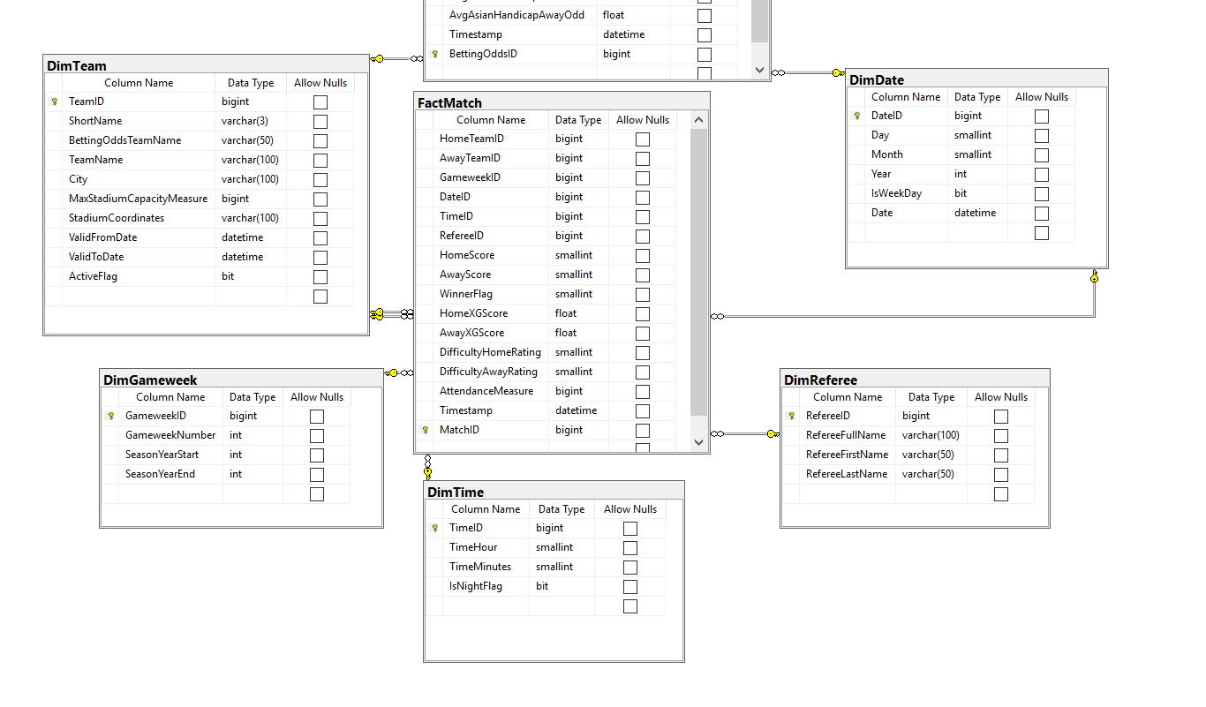
Star Schema

Slide 11
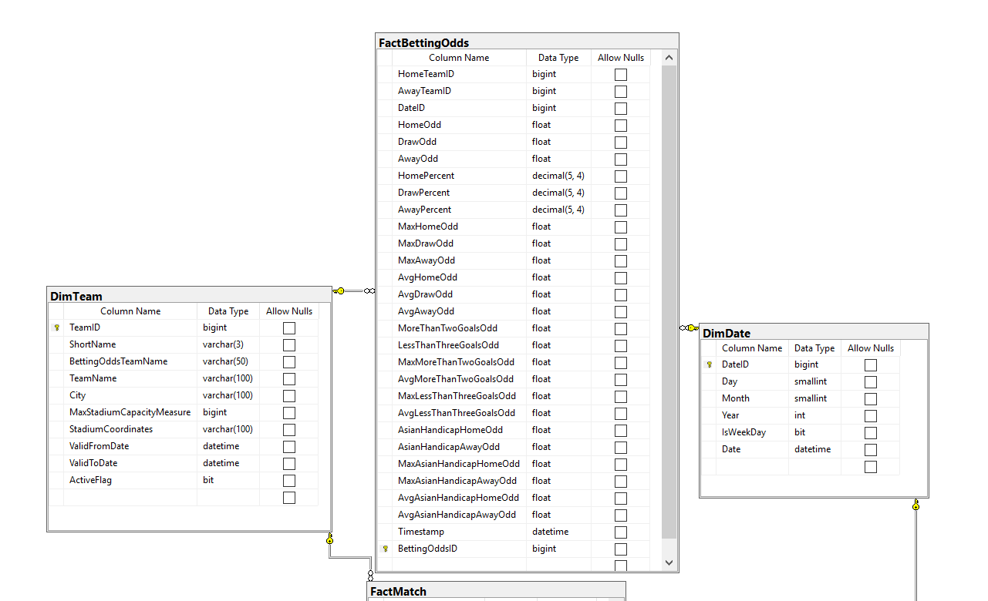
Star Schema

Slide 12
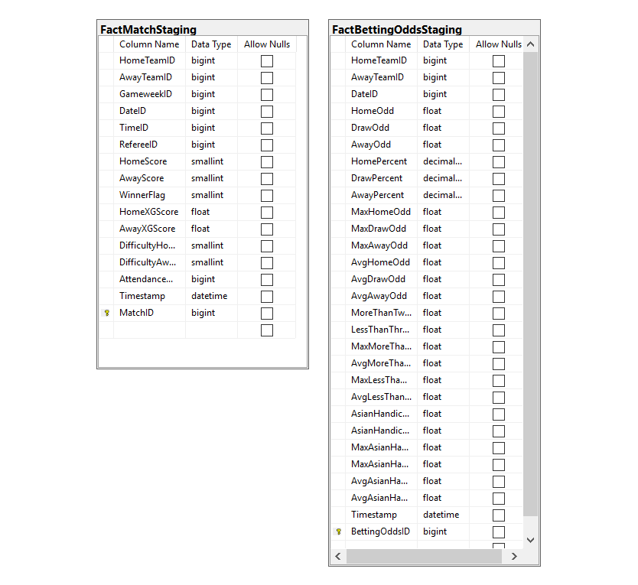
Star Schema

Slide 13
ETL

Slide 14
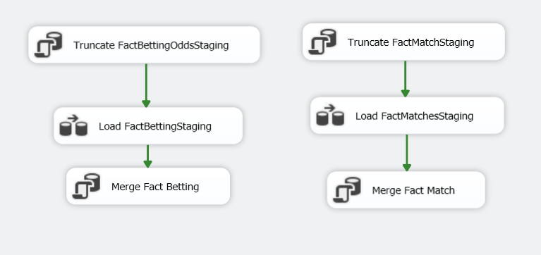
Fact Tables

Slide 15
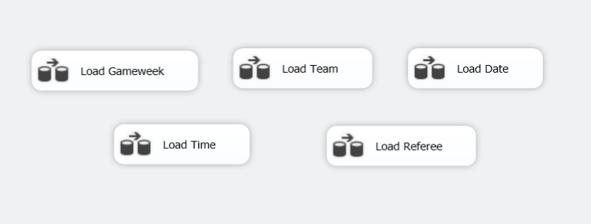
Dim Tables

Slide 16
ETL Tests
Validate amout of rows added
Validate data types
Validate another iteration
Validate specific row
Validate addition of the new row

Slide 17
Power BI Reports

Slide 18
Matches
Betting Odds
Attendance
Opponents
Referees
Match outcome Betting
Betting Sites comparison

Slide 19
TESTS: Manipulating with SLICER and DROPDOWN = checking reasonableness
Matches
Betting Odds
Attendance
Opponents
Referees
Match outcome Betting
Betting Sites comparison

Slide 20
End-to-End Test

Slide 21


Check ETL
Copy season 2020/21
Change dates for 2023/23
Check Power BI Reports

Slide 22
Check ETL
Copy season 2020/21
Change dates for 2023/23
Enjoy success!
Check Power BI Reports

Slide 23
02
Business Benefits

Slide 24




Journalists
Teams Stuff
Sport Marketing Companies
Betting tipsers
Sport Analysts
Constant access to interesting facts about referees and attendance at Premier League Matches
Possibility of opponent analysis while playing home match, manipulation of ticket prices
Choosing the best cities to start marketing campaign
Quick insight to valuable archive betting odds to enhance future performance
Easily accesible huge package of data to analyze

Slide 25
3 Examples of Interesting Facts

Slide 26
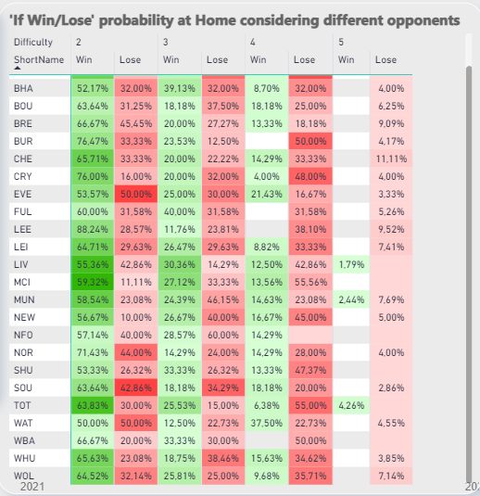
1. Tottenham
Tottenham has the biggest chances of beating the toughtest opponents at homeground.

Slide 27
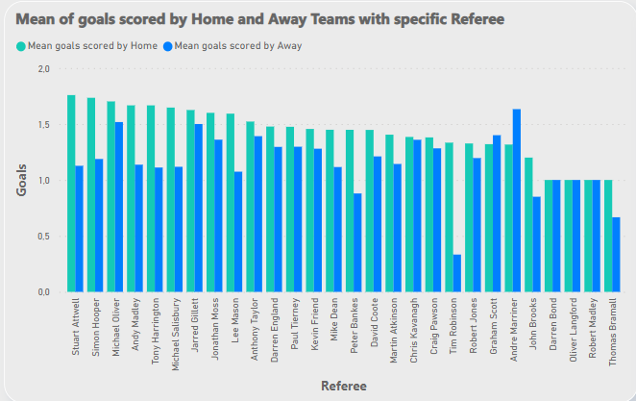
2. Andre Marriner
If you play at home it is better Andrew Marriner not to be the referee ☺

Slide 28
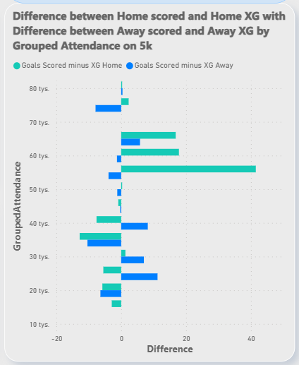
3. Optimal Attendance
With the attendance nearly 55000 your team will probably score more than should

Slide 29
03
Presentation

