Slide 1


Circuit sandbox
Kevin Barabash
Willy McAllister
Khan Academy

Slide 2
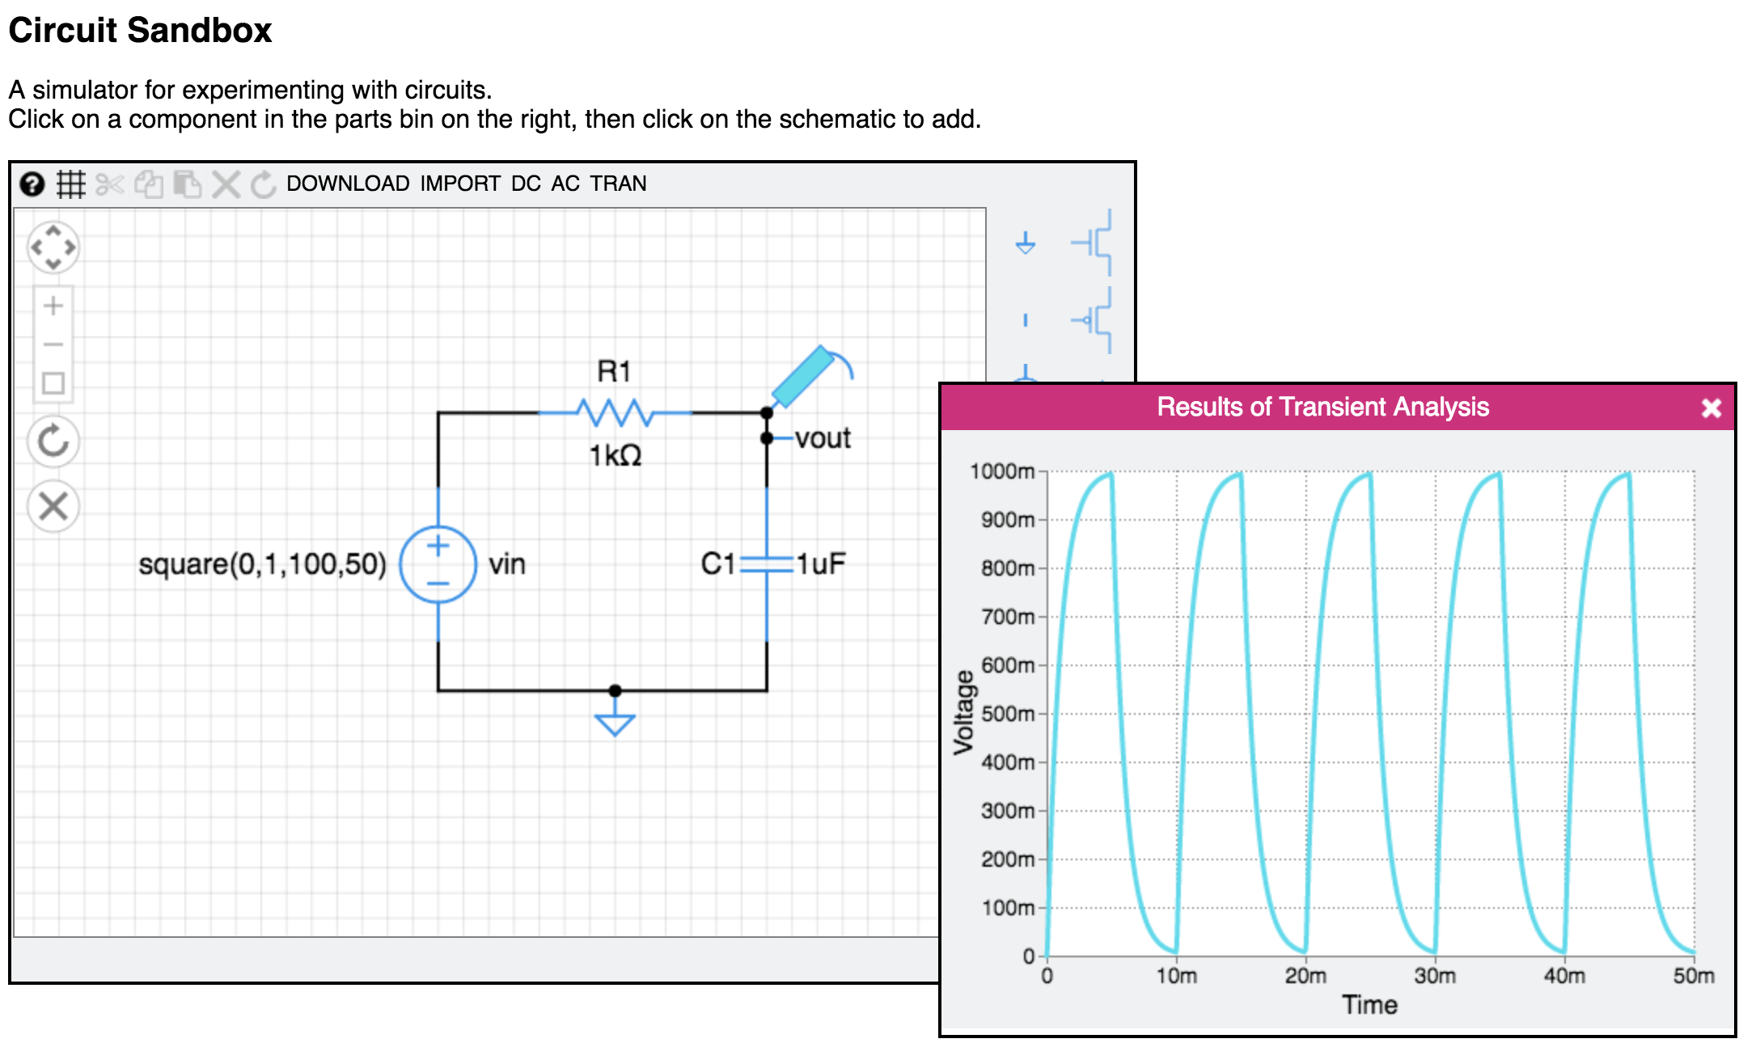

Slide 3
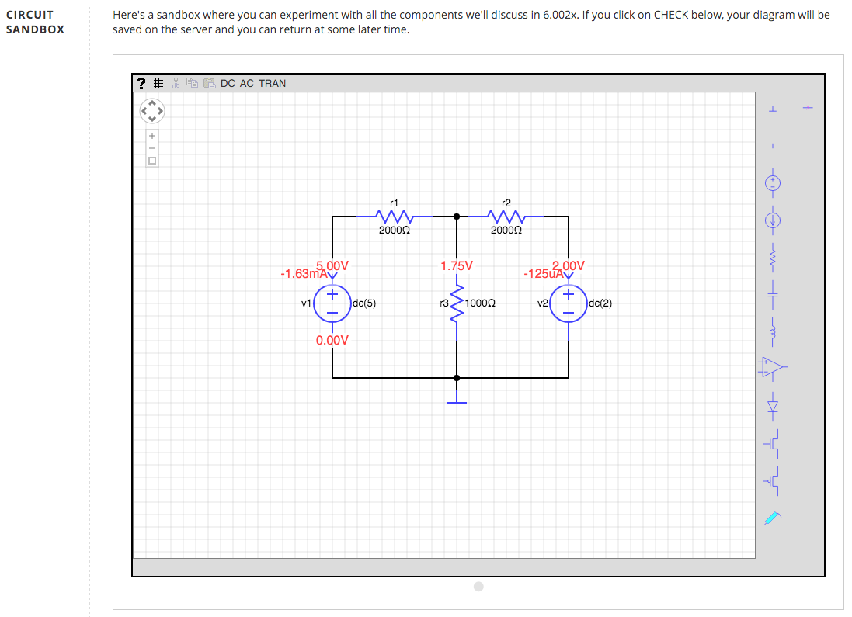
Available simulations:
DC, AC, Transient
Original:
Developed by Chris Terman for
MIT 6.002x (the first MOOC)
Written entirely in javascript.
MIT transferred the code to EdX.
Parts Bin:
drag/drop parts to schematic area
https://6002x.mitx.mit.edu/courseware/6.002_Spring_2012/Overview/Circuit_Sandbox/

Slide 4
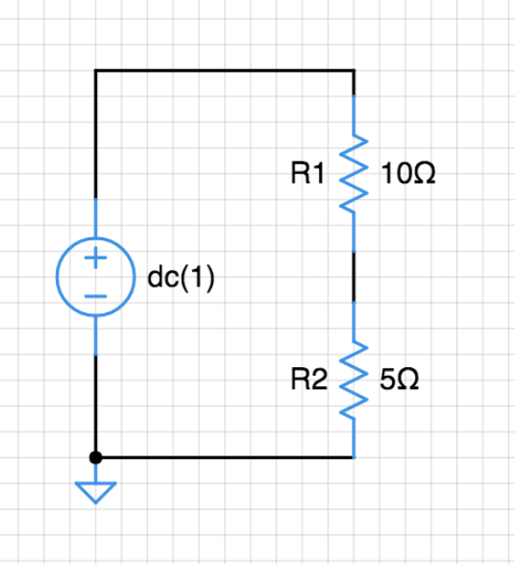
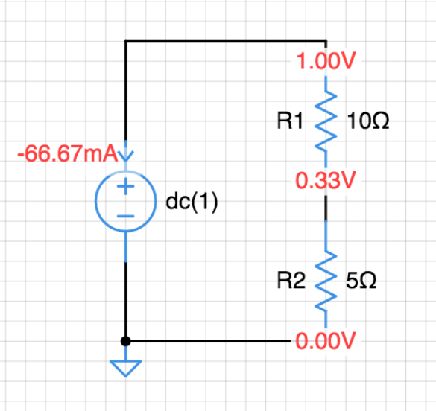
DC Operating Point
DC

Slide 5
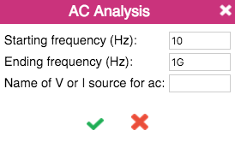
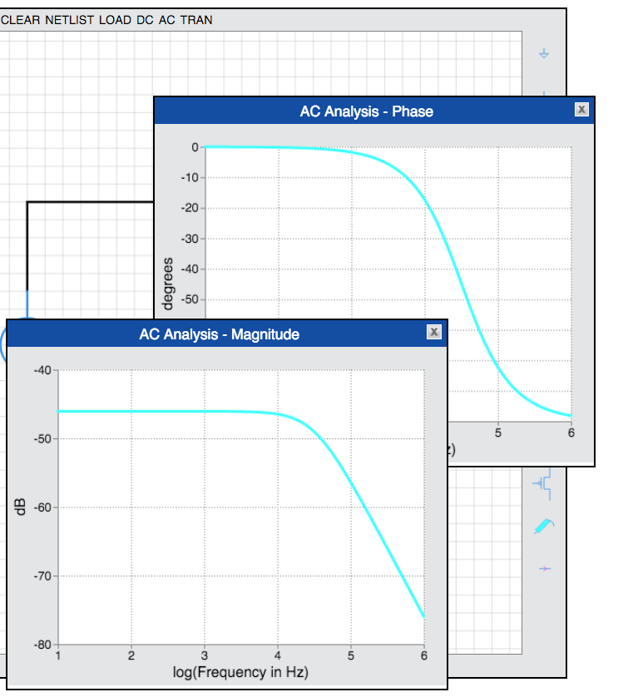
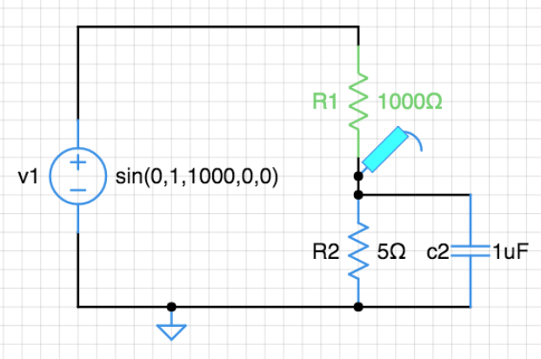
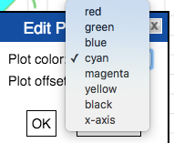
AC Analysis
AC
Magnitude and Phase
probe

Slide 6
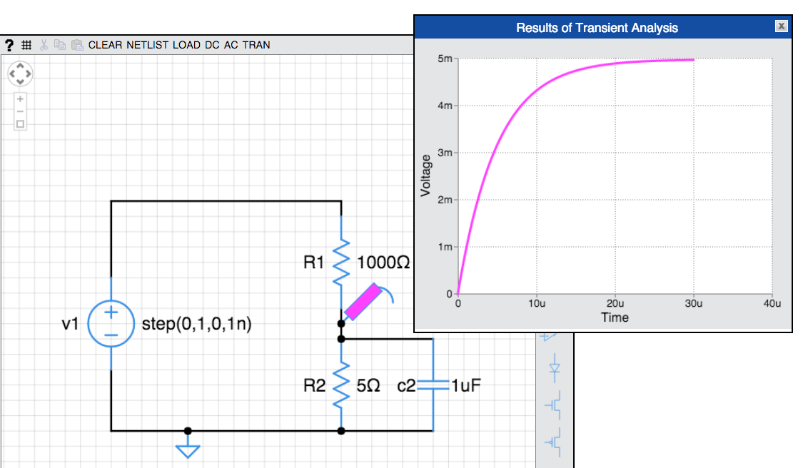
Transient analysis

Slide 7
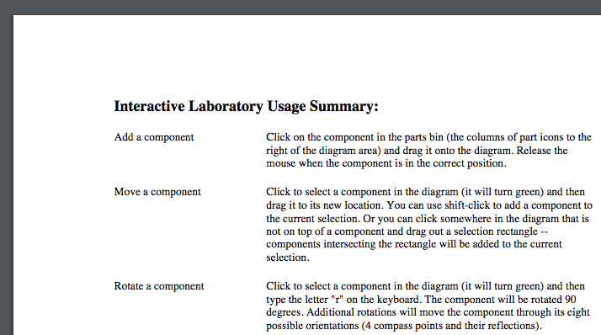
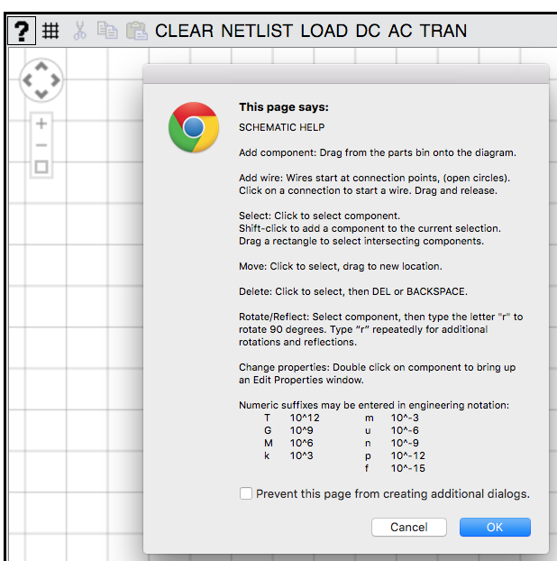
New:
Embedded Help
MIT version: .pdf file opens in separate tab
KA: new embedded help

Slide 8
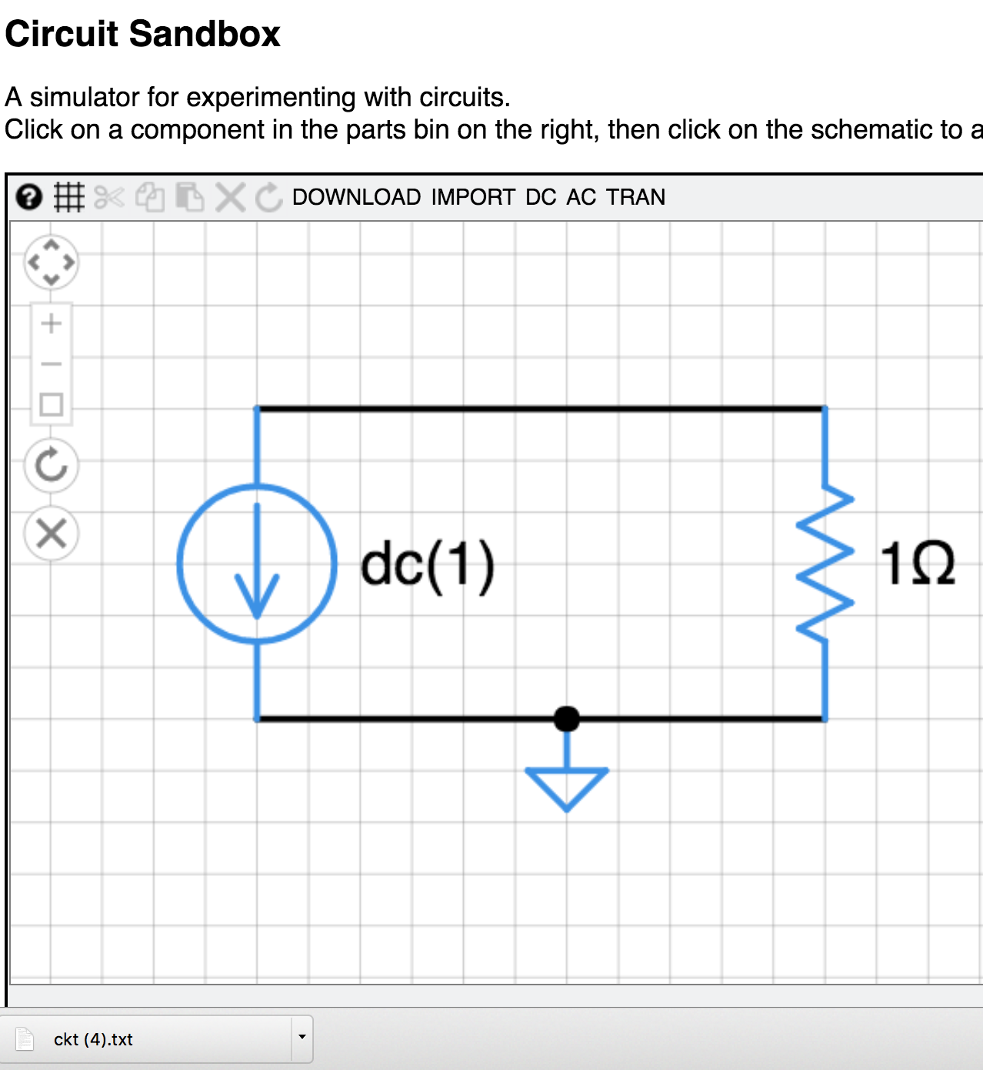
New:
DOWNLOAD netlist
DOWNLOAD saves JSON netlist file to client’s Download folder. File name: ckt.txt

Slide 9
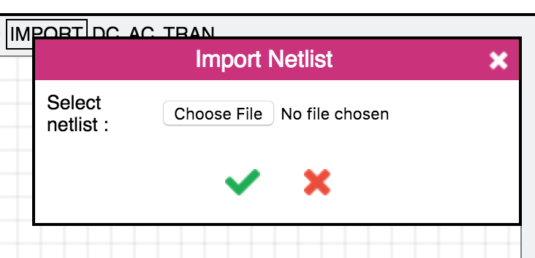
New:
IMPORT netlist
IMPORT uploads a user-selected JSON netlist file into the Circuit Sandbox.

Slide 10
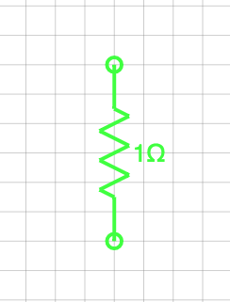
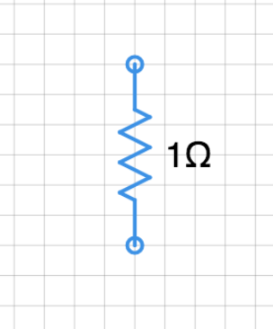
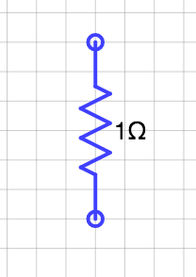
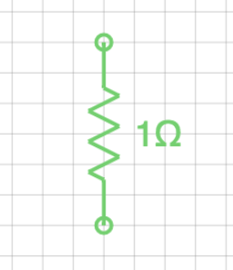
New:
KA colors
Selected component
MIT color
MIT color
KA color
KA color

Slide 11
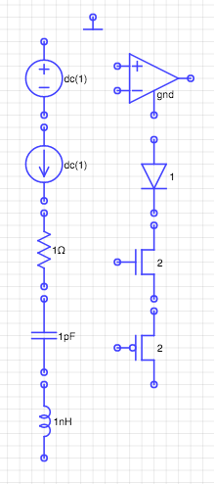
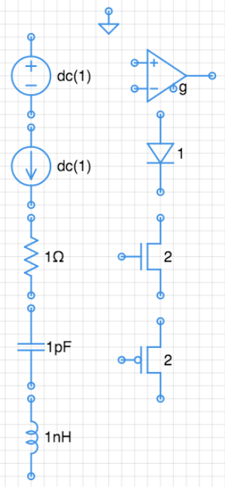
Components
KA colors
Larger font
Revised shapes for:
op-amp
diode
Ground symbol

Slide 12
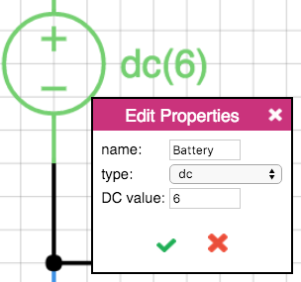
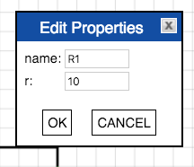
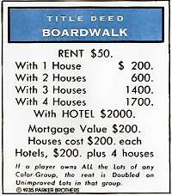
New styling:
Edit properties window
new:
KA Science color
Double-click on component to edit properties.
Pop-up window now has KA styling.
was:

Slide 13
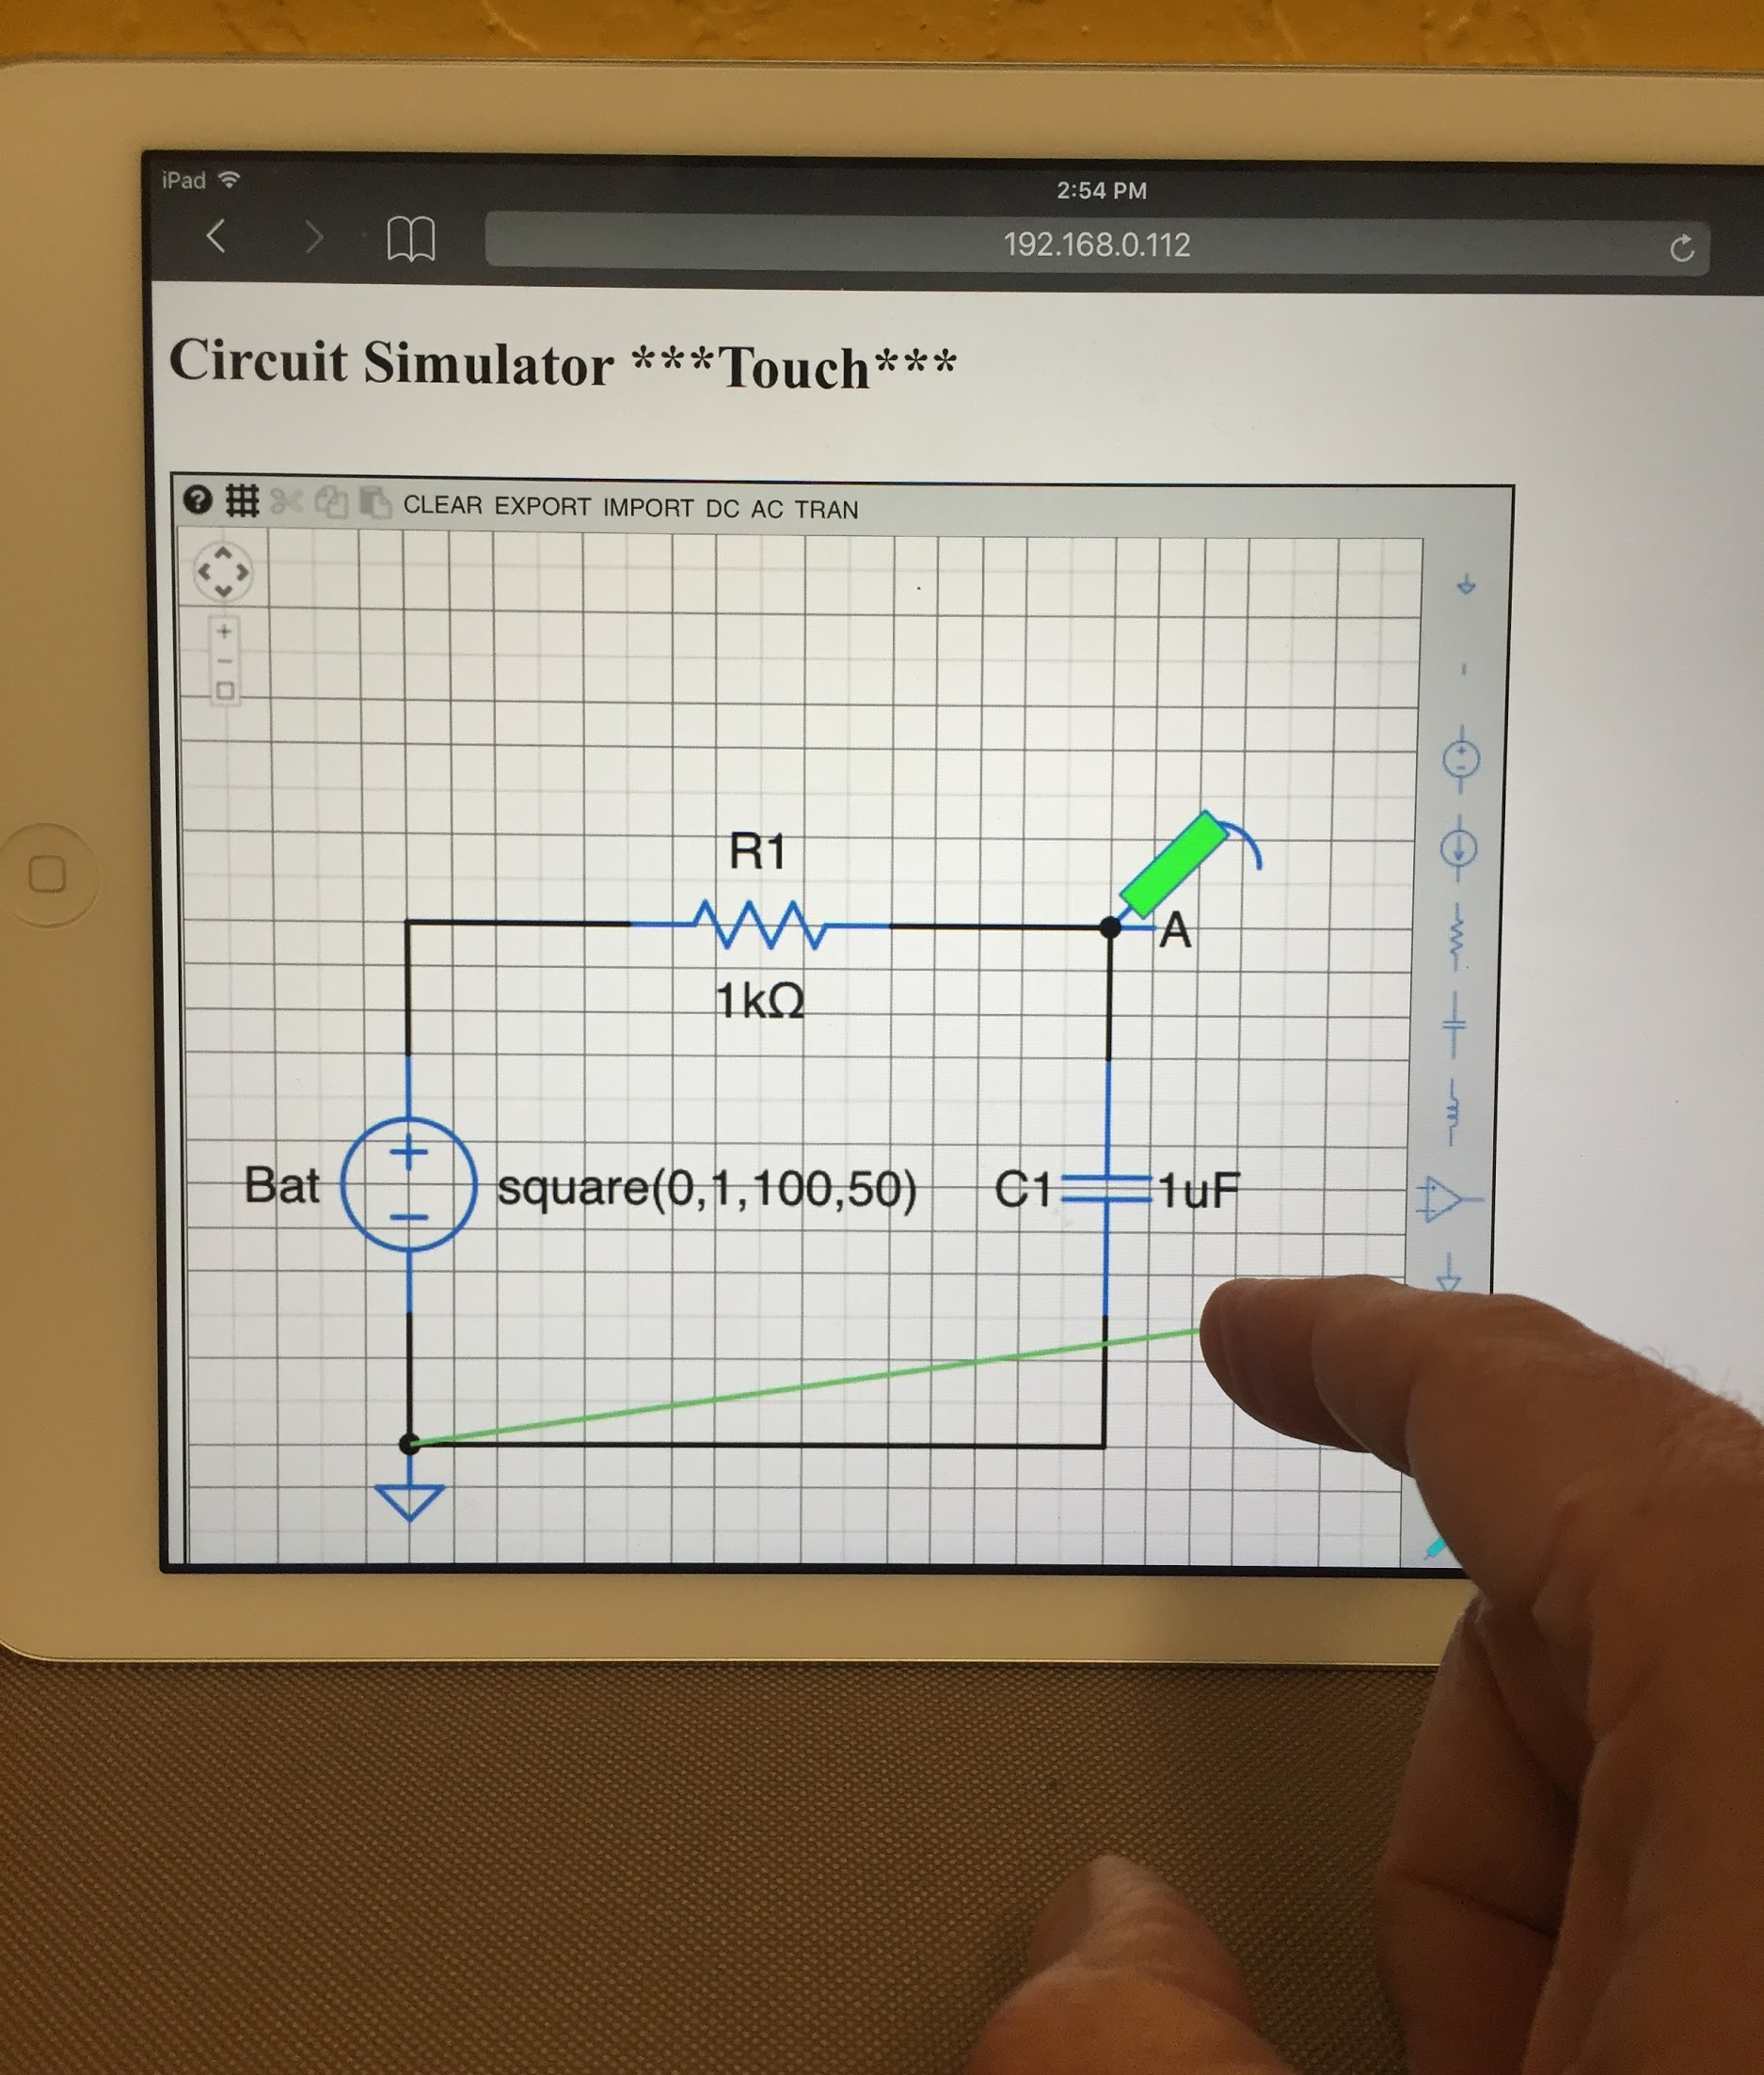
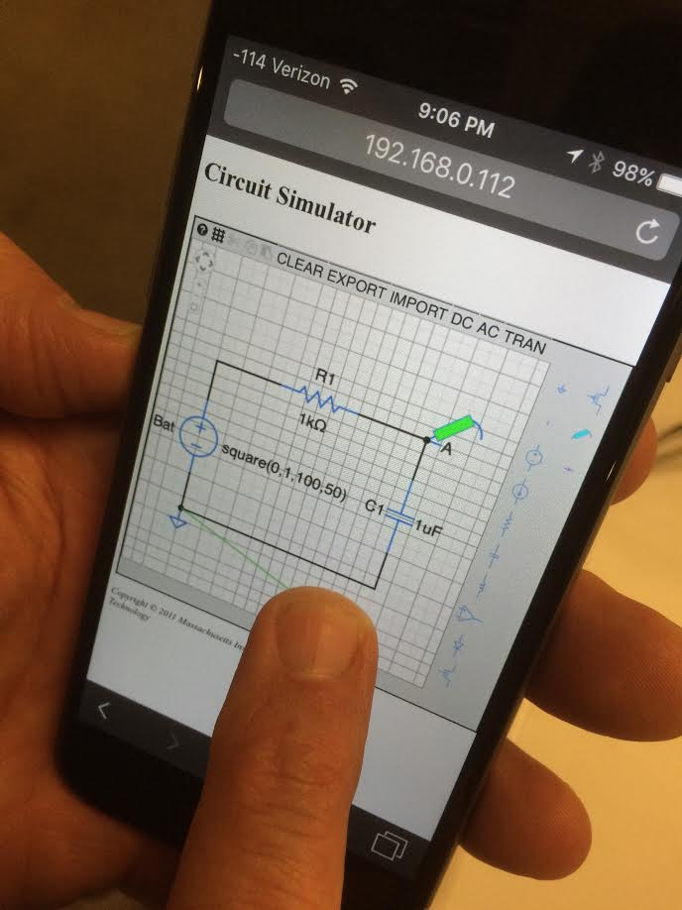
New:
Touch

Slide 14
Summary
Design
Revised KA colors/sizing/style.
New Download and Import functions to save/recover circuit files to/from client’s browser
Tablet/Mobile
New touch event handlers added.
New icons for Rotate and Remove added for touch.
Newly referenced libraries
download.js - for download function
Hammer.js - for touch interface, particularly double-tap
Licensing: The MIT and EdX versions appear to be under the MIT License, which is the same as we use at Khan Academy. Further review of licensing terms is planned.

Slide 15
Files
Schematic.js - Main file with both circuit simulation and schematic capture.
js/download.js - Open source library to download file to client’s download folder.
js/hammer.js - Open source library of touch event handlers. In particular, we use the doubletap function to detect double-tap and double-click.
icons/* - various icons used in the revised interface, inspired by font awesome.
icons/make_icon_uri.html - instructions for creating an icon

Slide 16
Ideas
Improve zooming with Apple magic mouse (currently too sensitive)
Rubber band wires when moving components
Undo/Redo
Movable component labels
Plotting features (zoom, pan)
Saving files on tablet

