Slide 1
Goodenough Cathode Material
Group member: Chao Zhao
Hao Liu
Yumu Deng
Peng Xin
Yingang Xu
Yuguo Gan
2019.12.25

Slide 2
01
A New Cathode Material
CONTENTS
02
Lithium Insertion
03
Phospho-olivines

Slide 3
1
PART
LixCoO2(0<x≤1)：
A NEW CATHODE MATERIAL FOR BATTERIES OF HIGH ENERGY
——J.B.Goodenough

Slide 4
Part 1 LixCoO2(0<x≤1)：A NEW CATHODE MATERIAL FOR BATTERIES OF HIGH ENERGY
Overview
Introduction
1.Background
2.How to find out？
Electrochemical Studies
Conclusion

Slide 5
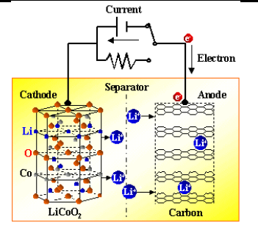
Part 1 Overview
Lithium-ion batteries currently in use
Discharge reaction:
Cathode: Li_{1-x}MO₂+xLi⁺+xe⁻=LiMO₂
Anode: Li_{x}C=C+xLi⁺+xe⁻
Notes:
开始介绍之前，我们来看一下现在常用的锂离子电池的结构以及反应方程

Slide 6
Part 1 Introduction
Background
1976, Stan Whittingham proposed Li_{x}TiS₂/Li cell
0≤x≤1, Realization of lithium insertion and extraction
Stay above 2V most of the time, current density：1-10mA/cm²
Main problems：poor stability, changes in lithium negative electrode reduce voltage
How to find out?
Goodenough according to research experience on transition metal oxide
Focus on use metal oxides instead of titanium sulfide as battery cathode materials
Discovered a new system: Li_{x}CoO₂ /Li cell
Open circuit voltage：twice as much as Li_{x}TiS₂/Li
High theoretical energy density：1.1kWh/kg
Wide range x：when the current density is as high as 4mA/cm², the overpotential is low and the battery is reversible.
Notes:
1976年，英国科学家Whittingham发现了Li_{x}TiS₂/Li电池，实现在0≤x≤1范围内在Li_{x}TiS₂内可逆的嵌入和锂离子，电池在大部分时间内，电池电压均可保持在2V以上，电流密度为1-10mA/cm²，但存在电解质和锂负极的可逆沉积，限制了电池的便携使用，同时锂负极的改变也会降低电池电压。为了找到更好的正极材料，Goodenough根据自己多年对金属氧化物的研究，从母体LiCoO₂有序岩盐结构中电化学提取锂，制备了Li_{x}CoO₂（0<x≤l）新体系。测量的相对于Li金属的开路电压约为Li_{x}TiS₂（0≤x≤1）的两倍，计算Li_{x}CoO₂/Li的理论能量密度为1.1kWh/kg。同时在大范围x时，电流密度高达4mA/cm²时，过电位低，电池可逆性好。

Slide 7
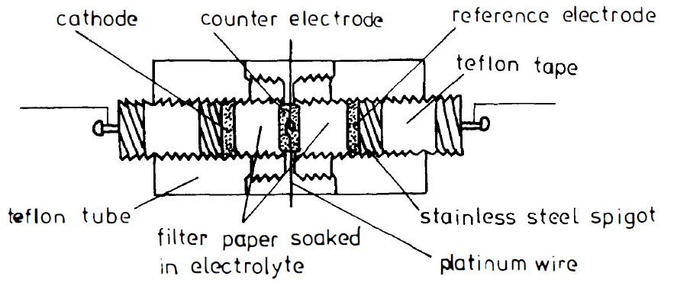
Part 1 Electrochemical Studies
Use LiCoO₂ to make up an electrochemical cell as shown figure 1:
Cathode：LiCoO₂ powder pressed onto a l-cm diameter stainlesssteel gauze disc
Electrolyte：I M LiBF₄ solution
Figure 1
Initially, lithium metal was used as both reference and counter electrodes
As the measured open-cell voltages were found to be in excess of 4 V, there was a risk of electrolyte breakdown
Notes:
使用LiCoO₂组成电化学电池：阴极LiCoO₂粉末压在直径1厘米的不锈钢网片上。电解液为I M-LiBF₄碳酸丙烯酯溶液，起初，锂金属作为参考电极和对电极，当测量到的开电池电压超过4V时，有电解液击穿的危险

Slide 8
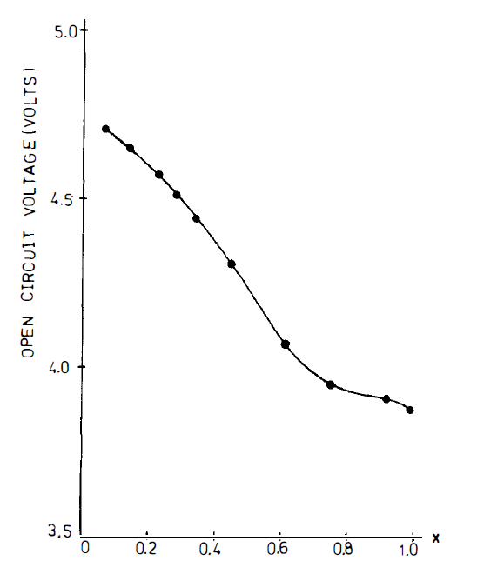
Part 1 Electrochemical Studies
After improvement: use Li_{0.1}V₂0₅ as reference and counter electrodes
It enabled measured voltages to be kept below 1.5 V . The compositions, as determined coulometrically at very low current density, indicated that lithium could be almost completely removed
E-x curve as shown as figure 2
The E vs x curve corresponds to a theoretical energy density of 1.1kWh/kg for the reaction:
0.923Li⁺+ Li_{0.067}Co_{1.01}O₂ = Li_{0.99}Co_{1.01}O₂
Figure 2
Notes:
改进后，使用了Li_{0.1}V₂0₅作为对电极和参比电极，使测量的电压保持在1.5V以下。在极低电流密度测定的成分表明，锂几乎可以完全脱出。实验测得的图2所示的开路电压-X曲线是可重复的，没有电解液分解的迹象。E vs x曲线对应于反应0.923Li+Li0.067Co1.0102=Li0.99Co1.01O2的理论能量密度1.11 kWh/kg

Slide 9
Part 1 Conclusion
This article gives a few conclusions
Open-circuit voltages of 4-5 V for LixCoO2/Li cells are consistent with the oxidizing power of the Co(IV)/Co(lll) couple. The high voltages permit consideration of alternate negative electrodes, and two cell configurations become possible options.
Use of an insertion compound of low work function for the negative electrode and a liquid electrolyte. Such a cell would have a lower open-circuit voltage and a larger variation in voltage with state of charge
Use of a solid electrolyte of large breakdown voltage to enable a greater fraction of the potential energy density to be utilized.
Notes:
这篇文章最后给了几个结论
对于Li_{x}CoO₂/Li电池，在大的x范围内保持在4V以上，于是高电压下允许考虑可交替的负极，使得两个电池配置成为可能的选择。
a）对负极和液体电解质可以使用低功函数的可嵌入化合物。这种电池的开路电压较低，电压随充电状态的变化较大。
b）使用大击穿电压的固体电解质，以使更多的势能密度得到利用。
最后我想说一点的是Goodenough对于新正极材料的发现使得锂离子电池可以做的非常便携，尽管锂离子电池在90年代年被索尼负责实现了商业化，但Goodenough被广泛认可为是锂离子电池的创始人，最终他获得了今年年的诺贝尔化学奖

Slide 10
2
PART
LiMn2O4：
LITHIUM INSERTION INTO MANGANESE SPINELS
——M.M. Thackeray

Slide 11
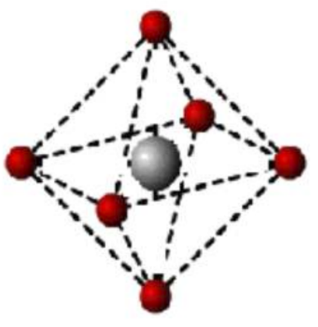
Part 2 Conception
Octahedral configuration complex
Jahn-Teller distortion （姜-泰勒效应）
The asymmetric occupation of electrons in degenerate orbitals will lead to the distortion of the molecular geometry, thereby reducing the symmetry of molecules and the degeneracy of orbitals, and further reducing the energy of the system. This effect is called the Jahn-Teller effect.
Notes:
电子在简并轨道中的不对称占据会导致分子的几何构型发生畸变， 从而降低分子的对称性和轨道的简并度， 使体系的能量进一步下降， 这种效应称为姜－泰勒效应。

Slide 12
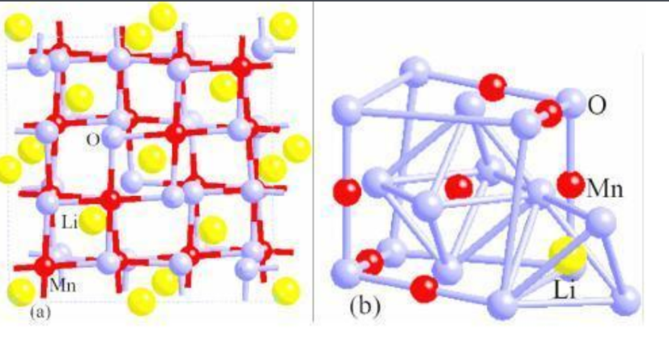
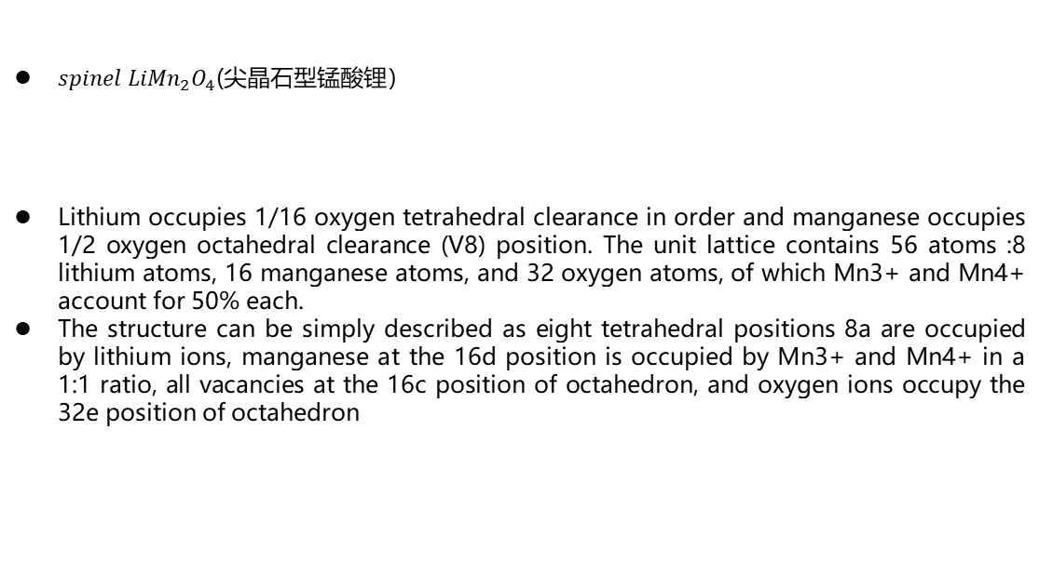
Part 2 Conception
$spinel LiMn_{2}O_{4}$(尖晶石型锰酸锂）
Lithium occupies 1/16 oxygen tetrahedral clearance in order and manganese occupies 1/2 oxygen octahedral clearance (V8) position. The unit lattice contains 56 atoms :8 lithium atoms, 16 manganese atoms, and 32 oxygen atoms, of which Mn3+ and Mn4+ account for 50% each.
The structure can be simply described as eight tetrahedral positions 8a are occupied by lithium ions, manganese at the 16d position is occupied by Mn3+ and Mn4+ in a 1:1 ratio, all vacancies at the 16c position of octahedron, and oxygen ions occupy the 32e position of octahedron

Slide 13
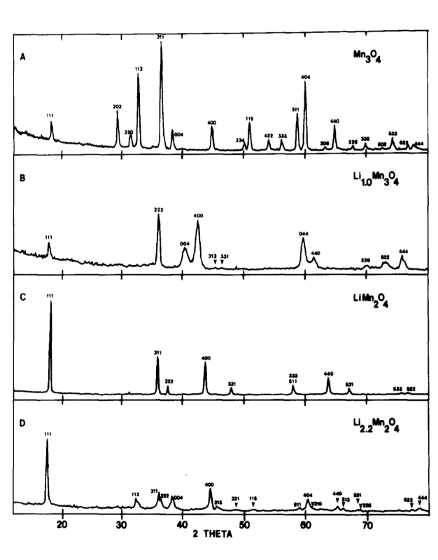
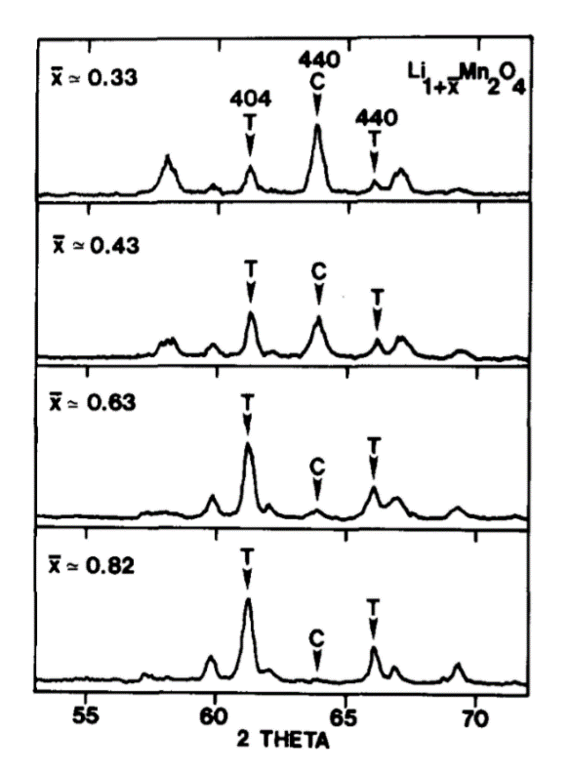
Part 2 Method
X-ray diffraction(X射线衍射）
axial ratio x=c/a (轴比）
Different material Different axial ratio

Slide 14
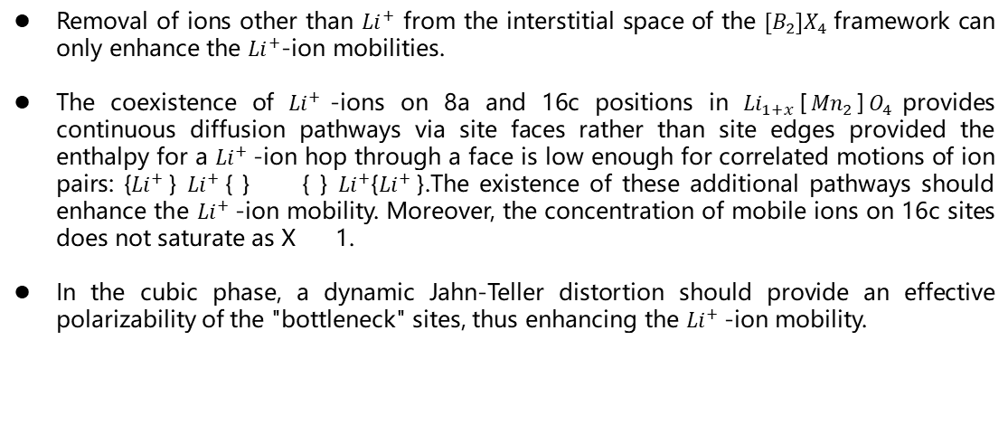
Part 2 Conclusion
Removal of ions other than ${Li}^{+}$ from the interstitial space of the ${[B}_{2}]X_{4}$framework can only enhance the ${Li}^{+}$-ion mobilities.
The coexistence of ${Li}^{+}$-ions on 8a and 16c positions in ${Li}_{1+x}$[${Mn}_{2}$]$O_{4}$provides continuous diffusion pathways via site faces rather than site edges provided the enthalpy for a ${Li}^{+}$-ion hop through a face is low enough for correlated motions of ion pairs: {${Li}^{+}$} ${Li}^{+}${ } { } ${Li}^{+}\text{\{}{Li}^{+} \text{\}}$.The existence of these additional pathways should enhance the ${Li}^{+}$-ion mobility. Moreover, the concentration of mobile ions on 16c sites does not saturate as X 1.
In the cubic phase, a dynamic Jahn-Teller distortion should provide an effective polarizability of the "bottleneck" sites, thus enhancing the ${Li}^{+}$-ion mobility.
Notes:
1.将除了锂离子以外的离子从${[B}_{2}]X_{4}$结构中移除之后可以提高锂离子的电子迁移率。
2在锂离子的跳跃点通过一个位点面时的han足够低的条件下，锂离子在8a和16c这两个位置的共存是通过提供位点面而不是位点边缘的连续扩散路径。 在这个基础上，可以将这些这些路径用来做离子对的相关运动，而且这些路径在x趋近于1的时候也不会完全浸透，依然是有效的。
3.在立方晶相中，姜-泰勒效应在锂离子迁移遇到瓶颈的时候会提供有效的极化位点，从而提高离子迁移率。

Slide 15
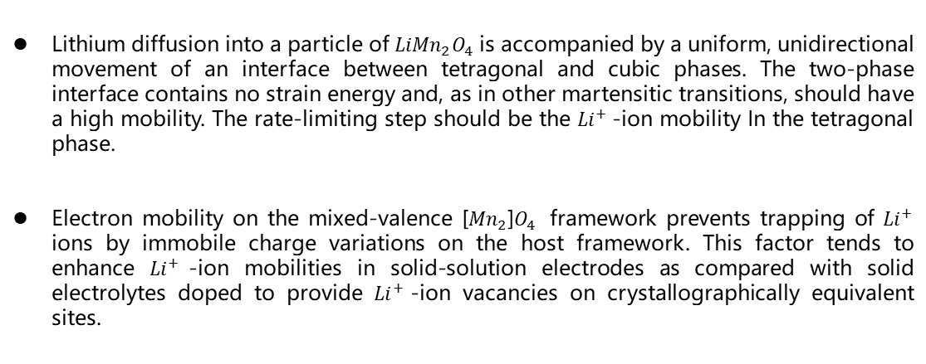
Part 2 Conclusion
Lithium diffusion into a particle of ${LiMn}_{2}O_{4}$ is accompanied by a uniform, unidirectional movement of an interface between tetragonal and cubic phases. The two-phase interface contains no strain energy and, as in other martensitic transitions, should have a high mobility. The rate-limiting step should be the ${Li}^{+}$-ion mobility In the tetragonal phase.
Electron mobility on the mixed-valence [${Mn}_{2}$]$O_{4}$ framework prevents trapping of ${Li}^{+}$ ions by immobile charge variations on the host framework. This factor tends to enhance ${Li}^{+}$-ion mobilities in solid-solution electrodes as compared with solid electrolytes doped to provide ${Li}^{+}$-ion vacancies on crystallographically equivalent sites.
Notes:
1.锂在锰酸锂中的扩散伴随着四方相和立方相界面的均匀、单向运动。由于这两相界面不含应变能，因此他与其它马氏体相变一样，应具有高迁移率。因此我们的速率限制步骤应该是Li+-lon在四方相和立方相。
2.电子的迁移在混合价态的框架可以通过主框架上的固定电荷来阻止锂离子的捕获。这个事实可以说明在固溶体电极上相比于固体电极，锂离子的迁移率会更高。也就是说这是在晶体的等效位置上提供锂离子空位。

Slide 16
3
PART
LiFePO4
Phospho-olivines as Positive-Electrode Materials for Rechargeable Lithium Batteries
——A. K. Padhi, K. 5. Nanjundaswamy, J.B.Goodenough
Notes:
磷橄榄石作为可充电锂电池的正极材料

Slide 17
Part 3 Development
What do people hope to identify?
Other lithium-insertion compounds that can be used as the cathode for a secondary lithium battery.
What the desired material like?
A relatively flat open-circuit voltage over a large lithium solid solution within the voltage range of 2.5 <Voc< 4.0 V
Be inexpensive, easy to fabricate, environmentally benign
Be safe in handling and operation
Notes:
自从在TiS₂层之间演示了可逆的锂插层后，人们花了相当大的精力来鉴别其他可作为二次锂电池正极的锂离子化合物。理想的材料在2.5~4.0 V电压范围内的大型锂固溶体上具有相对平坦的开路电压，而且价格便宜，易于制造，环保及操作安全。

Slide 18
Part 1 Development
What is now commercially used?
Among the known Li-insertion compounds, the layered rock salt systems Li1-xCoO2, Li1-xNiO2, and the manganese-spinel framework system Li1-x[Mn2] O4 are now used as 4.0V positive-electrode materials in rechargeable lithium batteries.
Disadvantages
The voltages in excess of 4.0 V on higher charge in these oxides can lead to the decomposition of the electrolyte
The fully charged compounds are metastable
A lower lithium mobility within the [Mn2]O4 spinel framework limits its power capability
Notes:
在已知的锂离子插入化合物中，层状岩盐体系Li_{1-x}CoO₂、Li_{1-x}NiO₂和锰尖晶石骨架体系Li_{1-x}[Mn₂]O₄现在是商业上用作4.0V正极材料的可充电锂电池。
然而,在超过4.0 V的电压的更高负载条件的情况下，这些氧化物会导致电解质的分解。
完全充电的化合物处于亚稳态: [Mn₂]O₄在190℃转变为e-MnO₂同时Li_{1-x}CoO₂和Li_{1-x}NiO₂的完全充电状态分别在180℃和250℃失去氧气。
此外，在[Mn₂]O₄尖晶石骨架内较低的锂迁移率限制了其功率能力。

Slide 19
Part 1 Development
In addition, the availability and cost of the transition metals used in these compounds are unfavorable
In the case of large batteries to be used in an electric vehicle or a load-leveling system
Wh/$> Wh/g
Motivate
The investigations of iron-based oxides
LiFePO4 ：Low price, good thermal stability, high theoretical capacity and good cycling performance, especially overcharge resistance
Notes:
此外，在这些化合物中使用的过渡金属的有效性和成本都是不利的，因为在电动汽车或负载均衡系统中使用的大电池中，Wh/$是比Wh/g更重要的数据。这些考虑推动了铁基氧化物的研究。
价格低、热稳定性好、理论容量较高和循环性能好等特点，近年来作为电池正极材料得到广泛的研究，特别是它具有的耐过充的性能，而成为应用于动力电池最有希望的正极材料

Slide 20
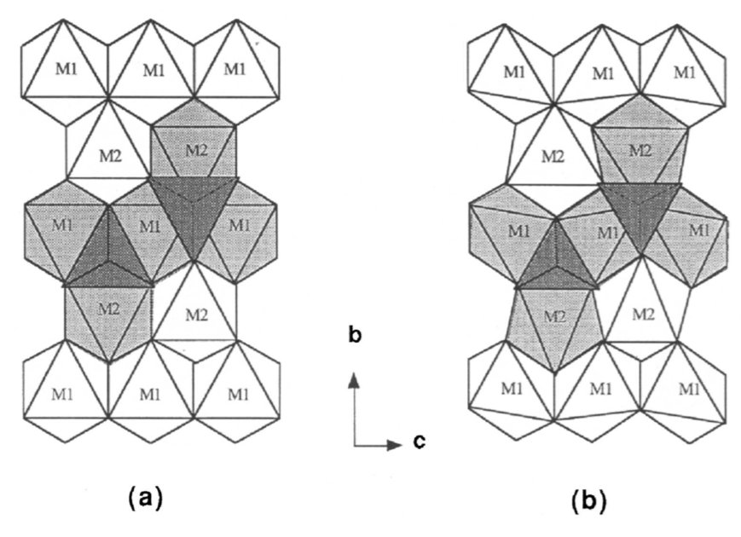
Part 3 Electrochemical Studies
NASICON framework
In the LiMPO4 compounds
(M = Mn, Fe, Co, or Ni)
With Li in the continuous chain of edge-shared octahedra on alternate a-c planes, a reversible extraction/ insertion of lithium from/into these chains would appear to be analogous to the two-dimensional extraction or insertion of lithium in the LiMO2 layered oxides with M = Co or Ni.
Figure 1 the crystal structure of olivine
(a) ideal hcp model (b) the actual structure
Notes:
LiFePO4具有有序的橄榄石结构, 属于正交晶系, 其空间群为Pnmb。
在LiFePO4结构中, 氧原子近似于六方紧密堆积, 磷原子在氧四面体的4c位, 铁原子、锂原子分别在氧八面体的4c位和4a位, 在b-c平面上FeO6八面体通过共点连结起来。一个FeO6八面体与两个LiO6八面体和一个PO4四面体共棱, 而一个PO4四面体则与一个FeO6八面体和两个LiO6八面体共棱。锂离子在4a位形成共棱的连续直线链, 并平行于c轴。
在LiMPO₄ (M = Mn、Fe、Co或Ni)化合物中，锂基占据M(1)位点，M原子占据M(2)位点。由于Li在交替的a-c平面上处于边共享八面体的连续链中，从这些链中提取/插入锂的可逆过程似乎类似于从M = Co或Ni的LiMO₂层氧化物中提取或插入锂的二维过程。从而锂离子具有二维可移动性, 使之在充放电过程中可以脱出和嵌入，这就是LiFePO4可作为锂离子电池正极材料的理论依据。
LiFePO4的脱锂产物为FePO4，实际的充放电过程是处于FePO4/LiFePO4两相共存状态的。FePO4与LiFePO4的结构极为相似, 体积也较接近, 相差6.81%。
由于充放电过程中结构与体积变化很小, 减小了由于结构变化过大甚至结构崩塌造成的容量损失，因此LiFePO4具有良好的循环性能。此外，强的P-O共价键形成离域的三维立体化学键使LiFePO4具有很高的热力学和动力学稳定性，保证了材料在高温条件下的安全性能。
但是从结构上看, PO4四面体位于FeO6层之间，这在一定程度上阻碍了锂离子的扩散运动。此外, 相邻的FeO6八面体通过共顶点链接,

Slide 21
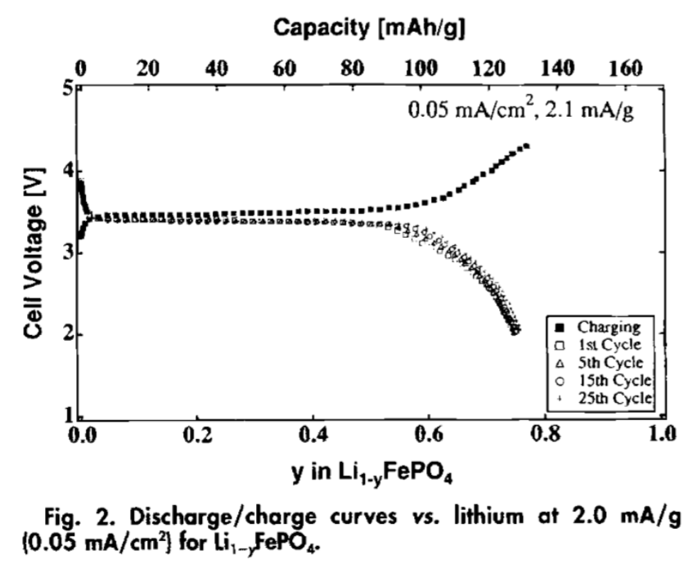
Part 3 Conclusion and Discussion
Approximately 0.6 lithium atoms per formula unit can be extracted at a closed-circuit voltage of 3.5 V vs. lithium and the same amount can be reversibly inserted back into the structure on discharge.
The extraction and insertion of lithium ions into the structure of LiFePO4 is not only reversible on repeated cycling;
The capacity actually increases slightly with cycling.
A voltage that is independent of x
The extraction/insertion reactions proceed by the motion of a two-phase interface.
Notes:
LiFePO₄的电化学充放电曲线如图2所示，在相对于锂的3.5 V的闭合电路电压下，每个公式单位大约可以提取0.6个锂原子，同样的数量可以在放电时可逆地插入到结构中。
锂离子的提取和插入LiFePO₄的结构不仅在重复循环中是可逆的;
容量在实际循环过程中略有增加。
图2中Li_{1-x}PO₄的V(x)曲线显示，在x的大范围内，电压与x无关，这表明，根据吉布斯相位规则，提取/插入反应是通过两相界面的运动进行的。
为了确定第二相的存在和结构，将LiFePO₄与不同量的N0₂PF₆在乙腈中反应，进行部分化学脱锂反应。化学脱锂反应可以在干净的样品上进行XRD图谱分析。

Slide 22
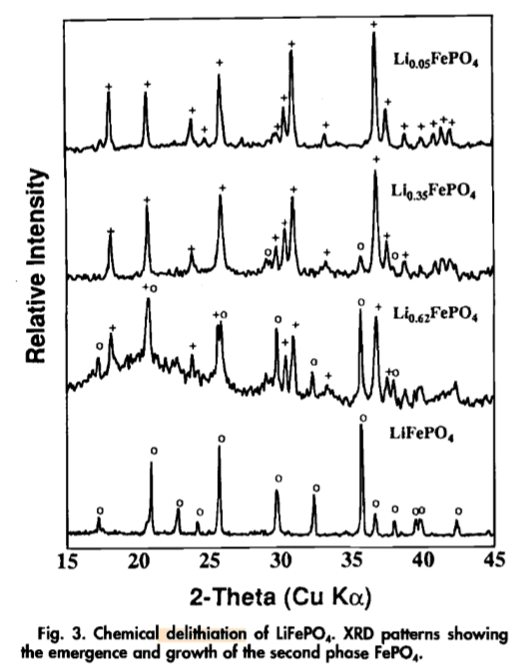
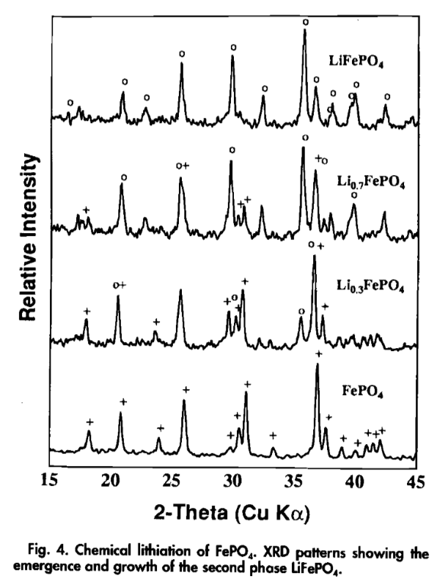
Part 3 Conclusion and Discussion
The emergence and growth of a second phase at the expense of LiFePO4 as more and more lithium is extracted.
The emergence and growth of LiFePO4 at the expense of FePO4 on more lithiation
Notes:
从图3的XRD图谱可以看出，随着锂的提取越来越多，第二相的出现和生长是以LiFePO₄的消耗为代价的。利用全化学脱锂，通过化学分析和对XRD数据的Rietveld拟合，可以确定第二相为FePO₄。FePO₄化学锂化的XRD图谱如图4所示，显示了LiFePO₄的出现和生长，而FePO₄的出现和生长是以更多的锂化为代价的。
lithiation_——锂化

Slide 23
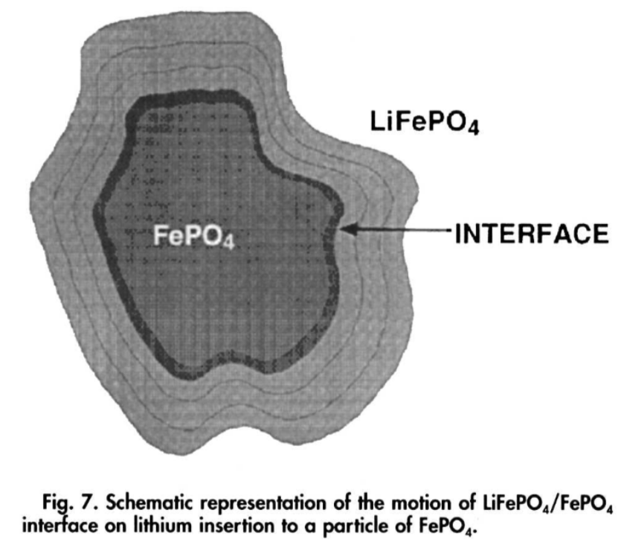
Part 3 Conclusion and Discussion
Charge the cathode:
Discharge:
Increasing the current density decreases, reversibly, the cell capacity. Reducing the current restores the capacity.
Notes:
由此我们可以写出从LiFePO4中提取锂来给阴极充电可以写成：
以及放电时锂插入FePO4的反应
增加电流密度并不会降低开路电压;相反，它会可逆地降低电池容量。减小电流可恢复容量。这一观察结果表明，容量损失是一种扩散限制现象，与插入过程的两相特性有关。
在对锂离子脱/嵌机理进行的各种描述中，我们应用辐射迁移模型来解释：即脱嵌过程是从LiFePO4颗粒的表面经过两相界面LiFePO4/FePO4进行的。充电时，随着锂离子的迁出而形成的FePO4层逐渐向内核推进，则LiFePO4/FePO4界面会不断减小。在这个过程中，锂离子和电子必须通过新形成的FePO4层。但是锂离子的扩散速率在一定条件下为常数，党LiFePO4/FePO4界面继续减小到某一个临界值时，通过界面的锂离子扩散通量将不足以维持恒电流，此时位于颗粒核心的LiFePO4就不能得到利用，成为容量损失的来源。
放电时，锂离子嵌入的模式与此相同。脱嵌过程中，电流密度越大，未反应的LiFePO4占整个颗粒的体积越大，可利用部分减少，比容量下降。
因此，电流越大，总临界界面面积越大，在电池性能受到扩散限制之前插入锂的浓度x越小。在锂的提取过程中，颗粒核心的母相向颗粒表面内方向生长，这就是为什么在重复循环中母相可以得到保留，电池电流密度降低时，容量损失是可逆的。这种容量的损失不是由于体积变化造成的粒子间电接触的中断（这种过程通常是不可逆的）

Slide 24
Part 3 Conclusion
This material is very good for low-power applications; at higher current densities there is a reversible decrease in capacity that is associated with the movement of a two-phase interface.
We hope
LiFePO₄ continues to make progress in nanometer and material processing.
The battery can withstand the temperature of the electric and hybrid cars.
Notes:
这种材料非常适合低功耗应用;我们认为，在较高的电流密度下，容量的可逆下降与两相界面的运动有关，这是阴极在放电循环中穿越两相组成域的一个特征。由于从FePO₄开始可以得到相同的V(x)曲线，而且基本上所有的锂都可以通过化学方法从LiFePO₄中提取出来，因此，LiFePO₄仅有0.6原子/公式单位Li的插入可能是一个外部问题。
磷酸铁锂在纳米化以及材料加工方面继续进步.如何实现磷酸铁锂颗粒表面均匀的导电层包覆和实现合理的金属离子参杂，如何保证材料有良好的性能等也时研究者们值得注意的点。
电池能承受电动车以及混合动力车所要求的或高或低的操作温度。锂嵌入/脱嵌机制的相关研究有利于更好的基本理解结构和电化学特性之间的关系，但电极与电解质之间强烈影响磷酸铁锂阴极材料循环性能的界面行为仍不清楚。为了广泛的工业化应用，情节、易控制的生产高品质磷酸铁锂材料的路线应该不断发展。

