Slide 1
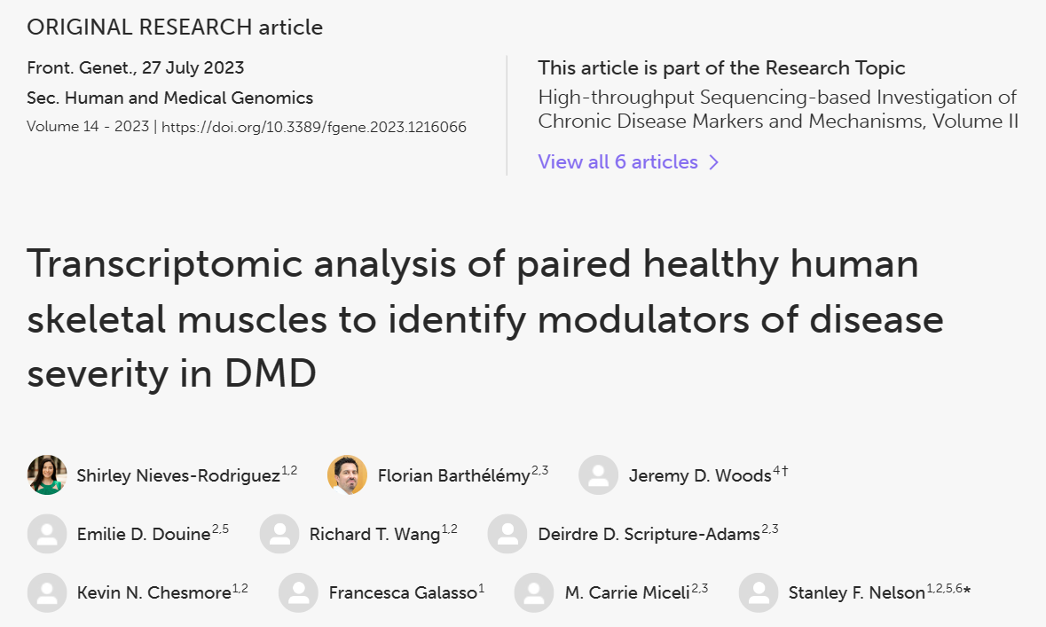

Slide 2

What’s interesting
Duchenne’s Dystrophy:
Genetic, yet 1/3 is not hereditary
Some muscles are spared
Proximal muscles are more affected

Slide 3
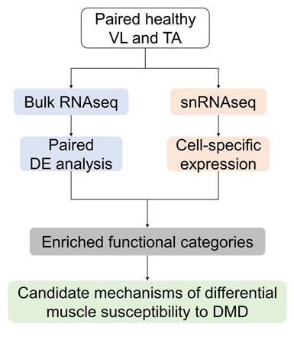
What was done
Single cel RNA-Seq: different muscles from same patients
Bulk-RNA: control vs DMD
Differential expression analysis

Slide 4
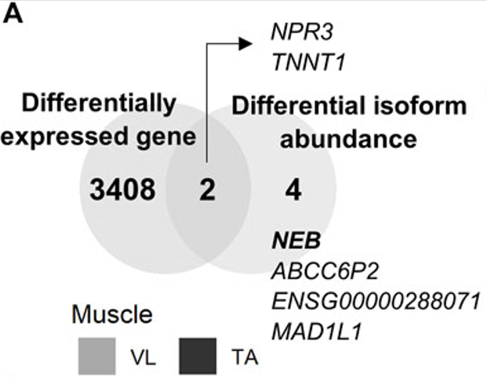
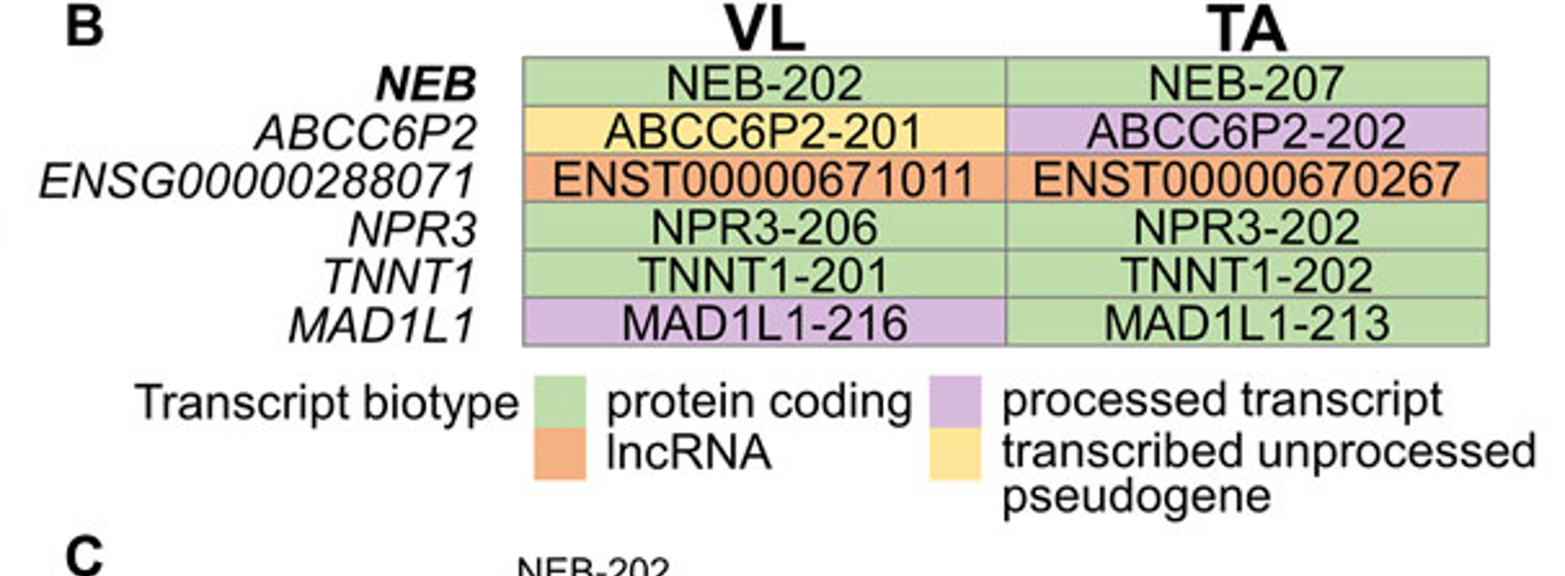

Goal / ideas
Partially reproduce the research
Repeat the analysis for mouse biopsies: can we identify the same pathaways and genes? (other research paper)
What contributes to protection of some muscle groups? – authors focused on DMD vs healthy, maybe VL vs TA
Can we identify same genes in other samples?

Slide 5
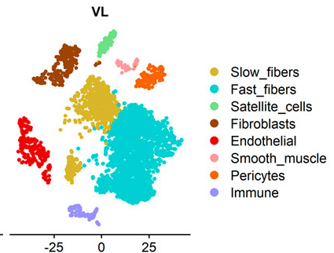
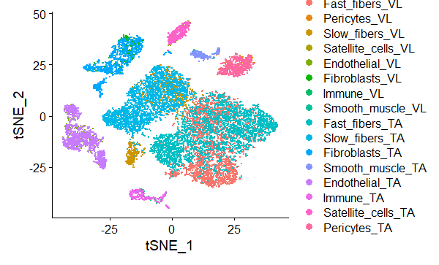
Reproduced
Original paper

