Slide 1

Universe Rampage

Slide 2
Table of Content
1. Overview
2. Game Principles
3. Gameplay
4. Concepts

Slide 3
Overview
Asteroids x World of Tanks x SPAZ

Slide 4
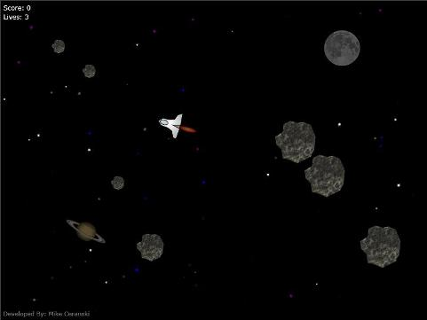
Overview

Slide 5
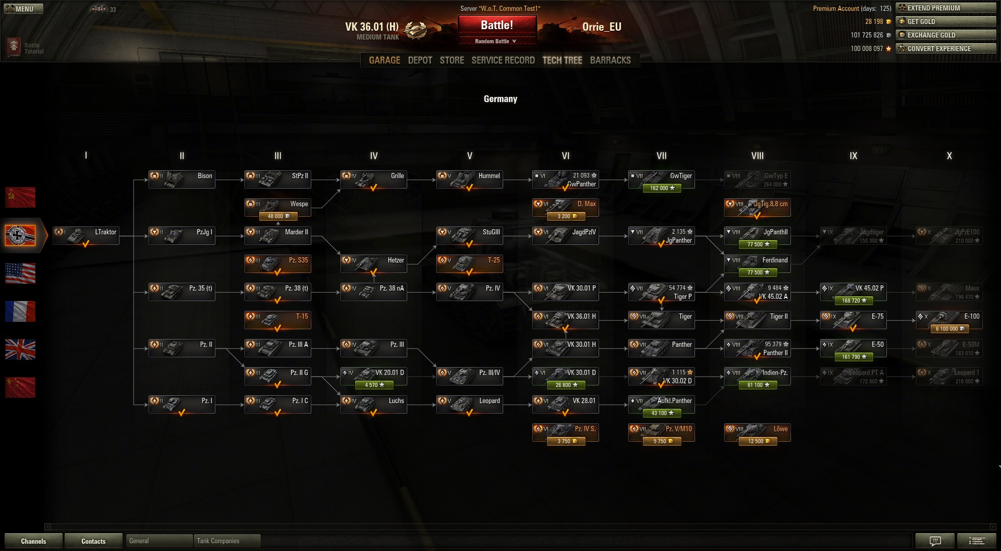
Overview

Slide 6
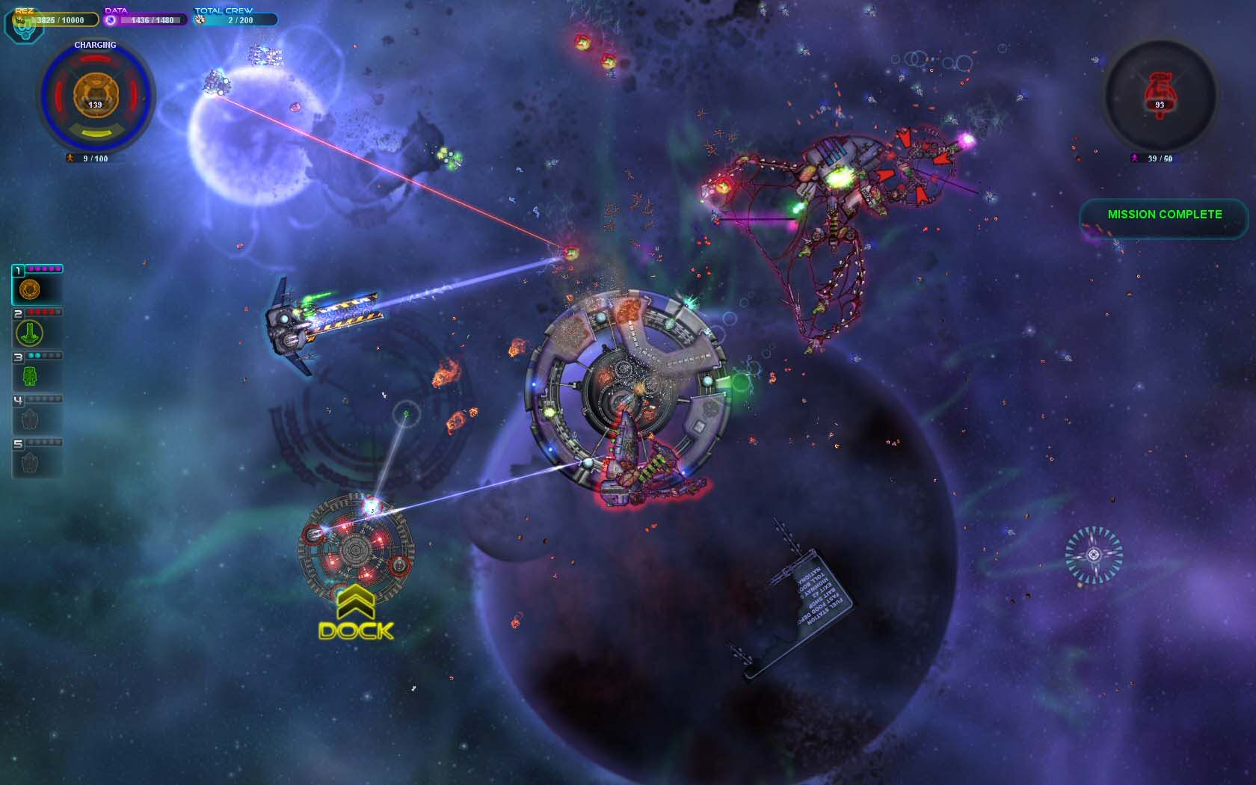

Slide 7
Game Principles
Session based gameplay
Sessions reward points and currency
Unlock new ships and modules via blueprints
Compete with other players in a leaderboard
Multiple difficulty levels

Slide 8
Gameplay
Choose one from many ships
Buy modules for a session
Manage your resources
Master space movements
Defeat many different enemies
Avoid Asteroids
Scavenge Wreckages

Slide 9
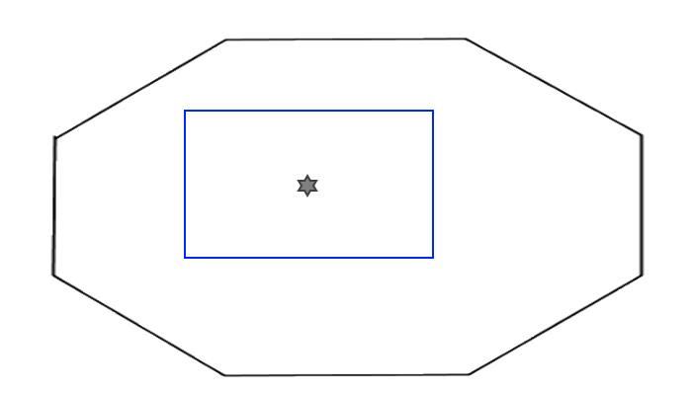
Concepts

Slide 10
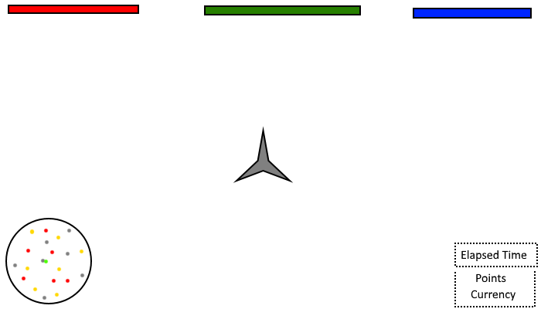
Concepts

Slide 11
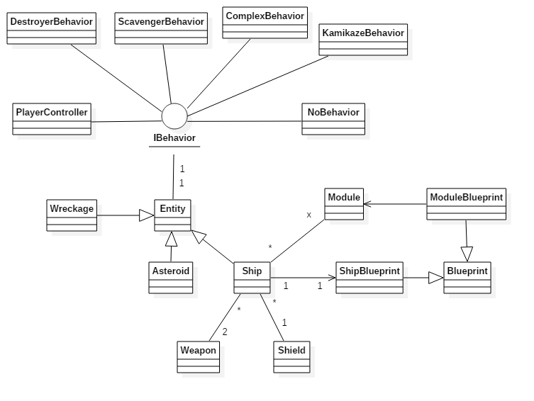
Concepts

Slide 12


Slide 13
Sources
http://i.imgur.com/imToXfu.jpg
http://www.codeproject.com/KB/silverlight/SpaceRocks/spacerocks.jpg
https://memecrunch.com/meme/8GUXQ/thank-you-for-your-attention/image.png?w=500&c=1
http://www.spacesector.com/blog/wp-content/uploads/spaz_screenshot_1.jpg

