Slide 1



Universe Rampage
- Prototype -

Slide 2
Content
Communication
Version Control
Recapitulation
Goals
Features

Slide 3


Communication

Slide 4

Version Control

Slide 5
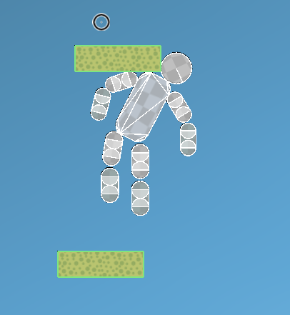
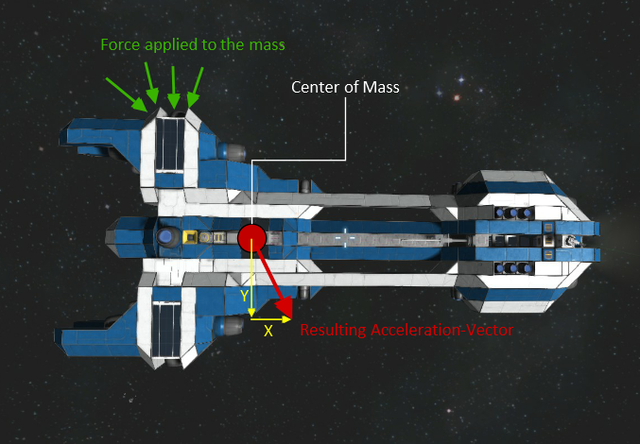
Recapitulation - Physics

Slide 6
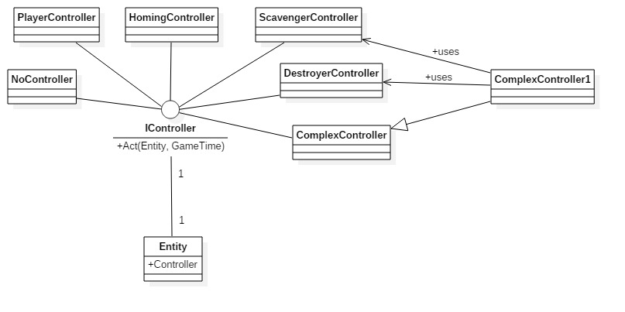
Recapitulation - Controller

Slide 7
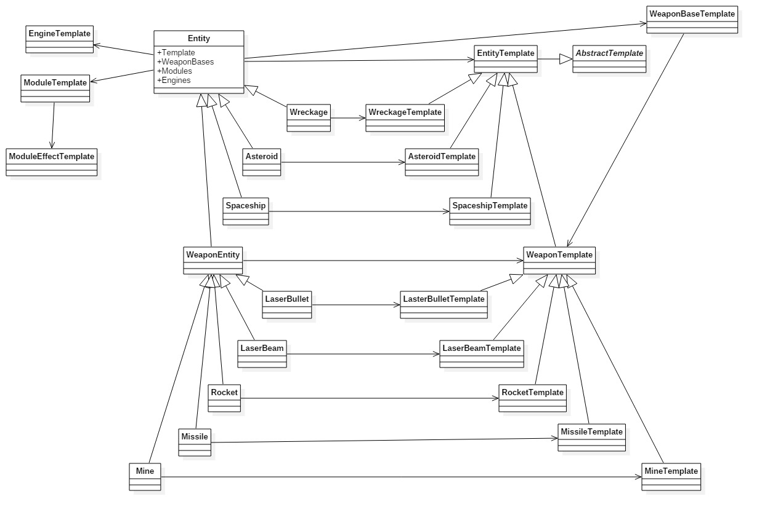
Recapitulation - Templates

Slide 8
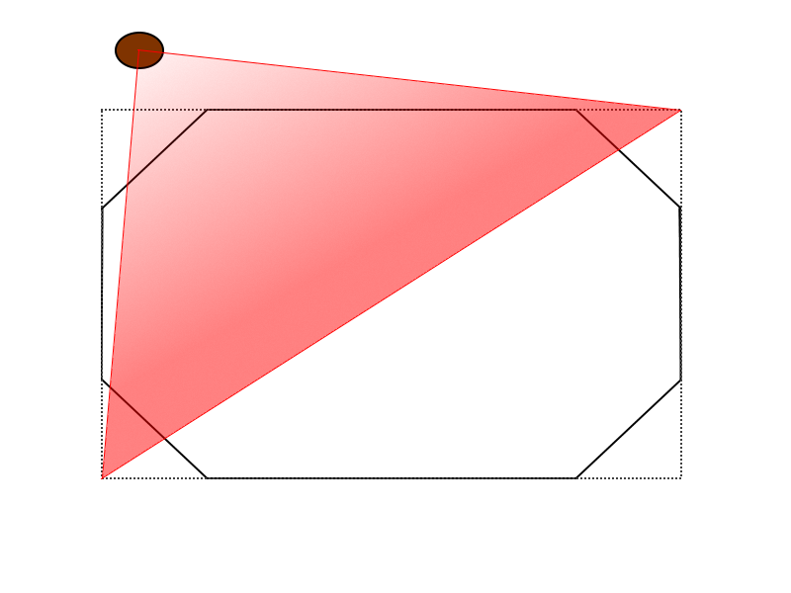
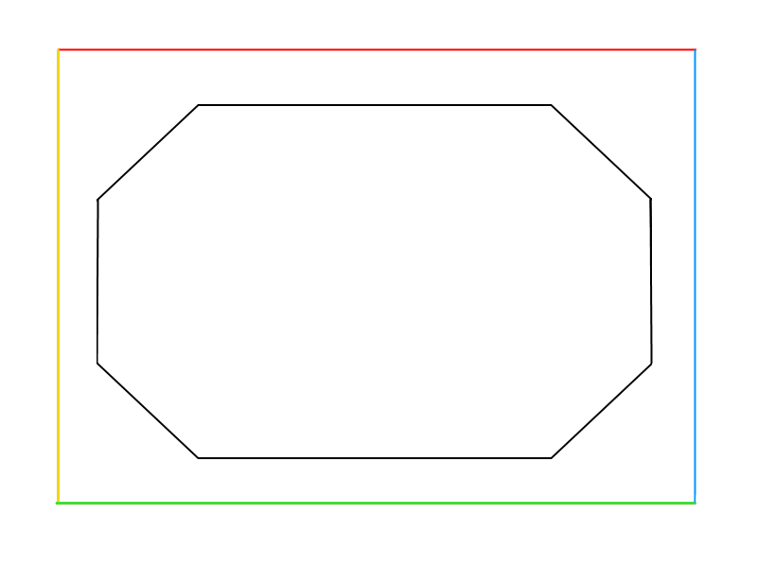
Recapitulation – Asteroid Spawns

Slide 9

Goals

Slide 10
Goals - Success
Entities from Templates
Physics
Different Behaviors
Online Database (Testsystem)
Challenging Game

Slide 11
Goals - Semi Success
GPU Particles
Balancing
Diversity
Minimap

Slide 12
Goals - Failures
Template Protection

Slide 13

Features

Slide 14

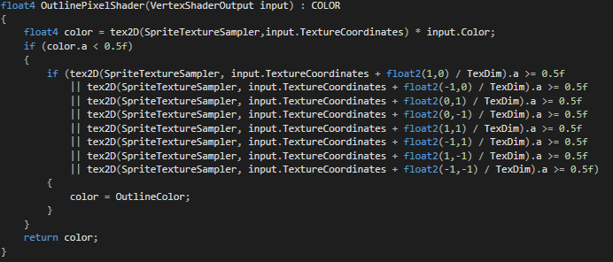
Features - Outlines
Distinguish friend from foe
Easy to understand
Cool

Slide 15
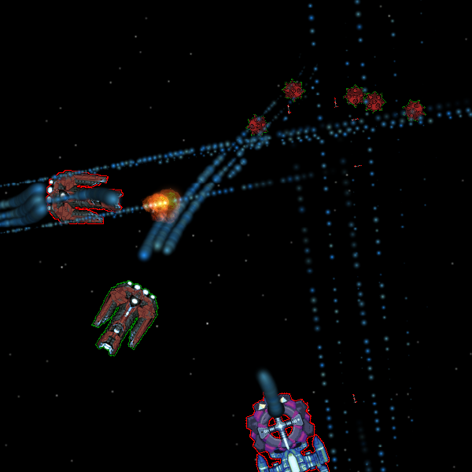
Features - Outlines

Slide 16
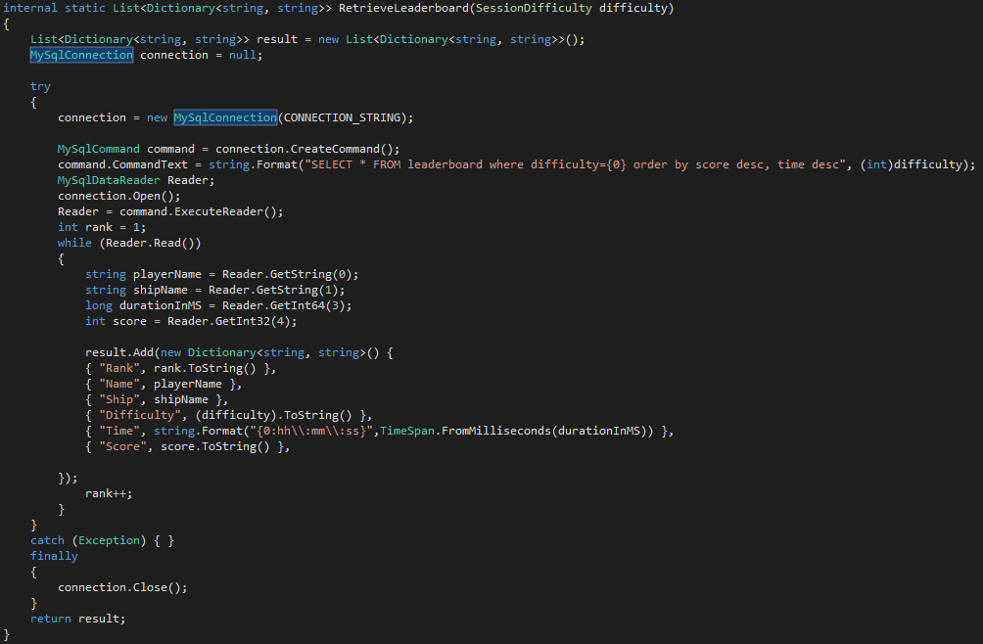
Features - Leaderboard

Slide 17
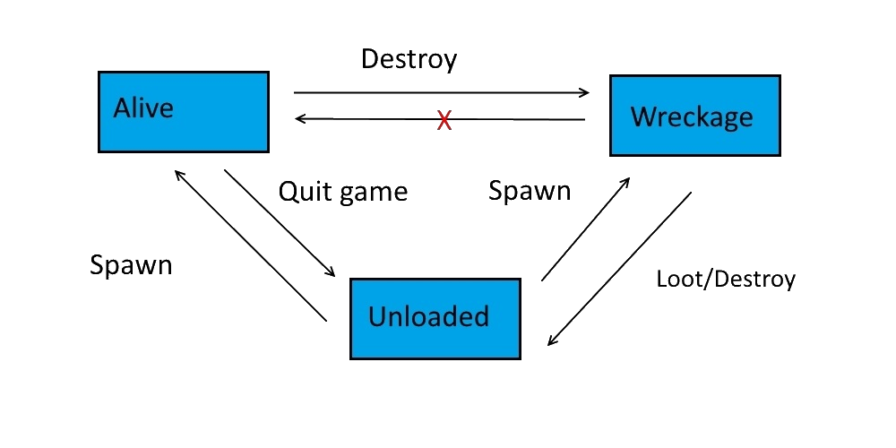
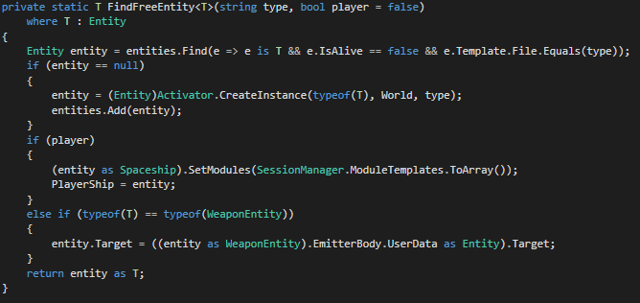
Features – Entity Lifecycle
Entity recycling when possible

Slide 18
Features – Spawn

Slide 19
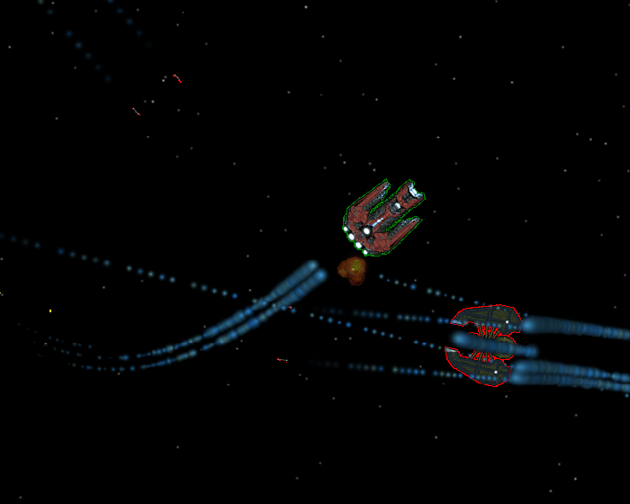
Game Presentation

Slide 20

The End

Slide 21
Sources
http://www.quotemaster.org/images/a1/a15f153a938fd2b5f7e5159872ffef85.png

