Slide 1



Universe Rampage
- Prototype -

Slide 2
Content
Physics
Entities
Particles
Controls
Prototype

Slide 3
Physics
Physics handled by Farseer Engine
Body and World as central physics elements
Physics devided in movement and collision
Physics properties tweaked per body
-> physical behavior different per entity type
Body with mass and center of mass

Slide 4
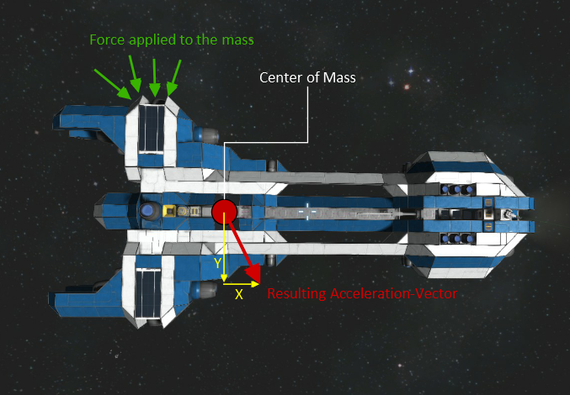
Physics - Movement

Slide 5
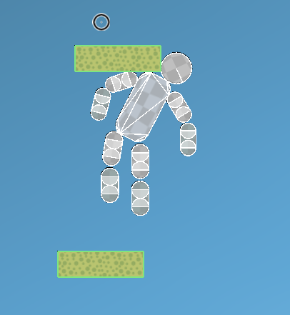
Physics - Collision

Slide 6
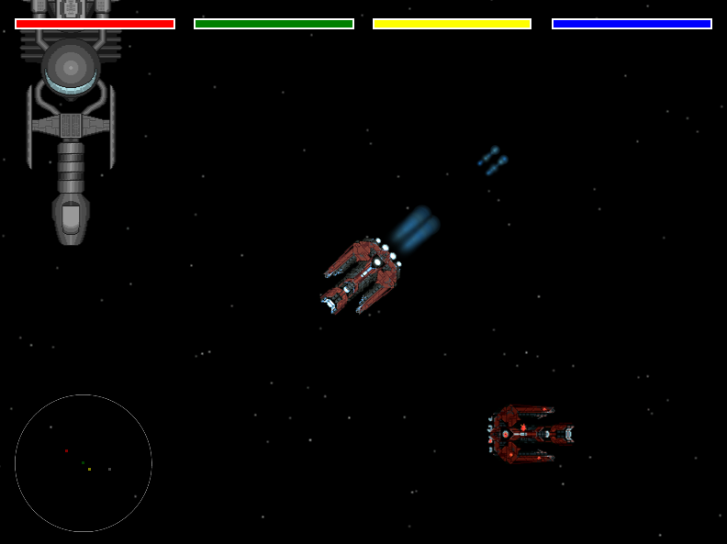

Entities

Slide 7
Entities - Controllers
Entities are controlled by Controller Interface
Controller defined for different behaviors
Complex behaviors by combining controllers in a complex controller

Slide 8
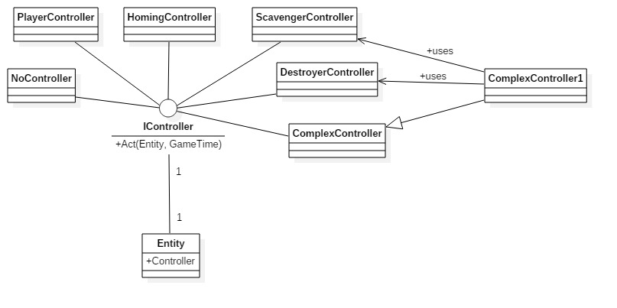
Entities - Controllers

Slide 9
Entities - Templates
Own Template for each object type
Templates loaded from xml files
Xml Files encrypted through content pipeline
Entities initialized dynamically

Slide 10
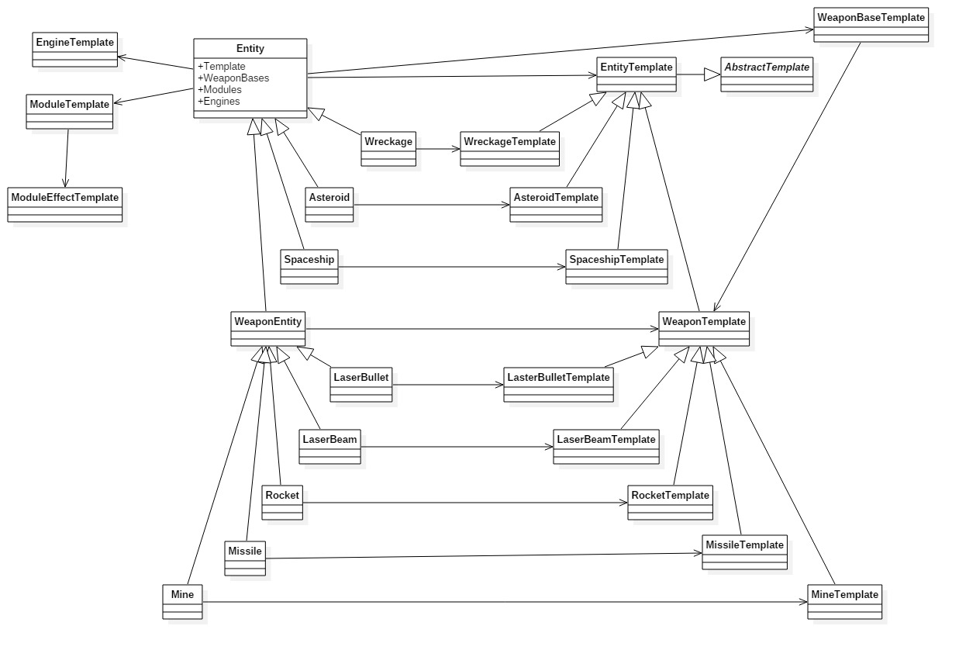
Entities - Templates

Slide 11
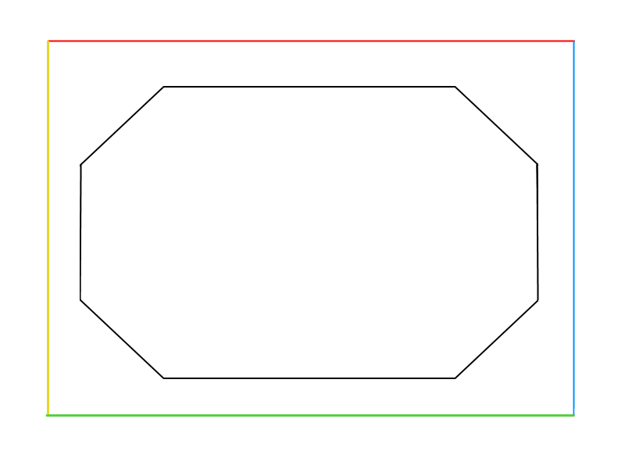
Asteroid Spawn

Slide 12
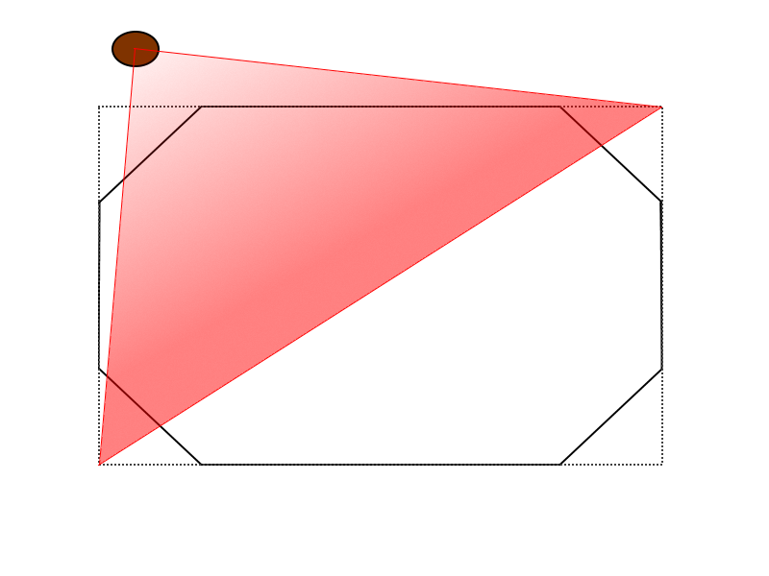
Asteroid Spawn

Slide 13
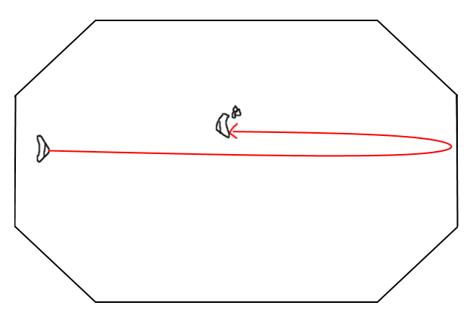
Entities - Fuel Capacity

Slide 14
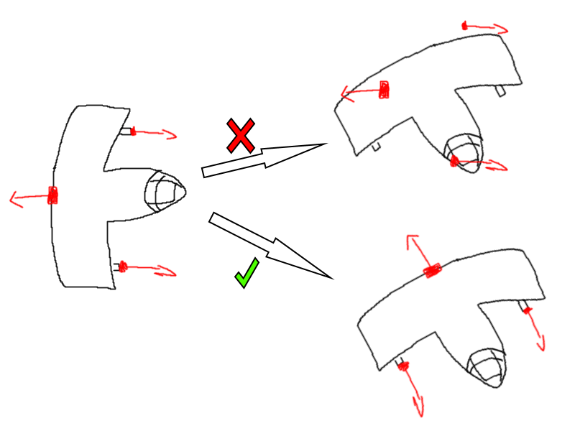
Entities - Local Transformation

Slide 15
Particles
Particles completely handled by GPU
Rendering and update with HLSL and DirectX
Lifetime attributes calculated per particle type

Slide 16
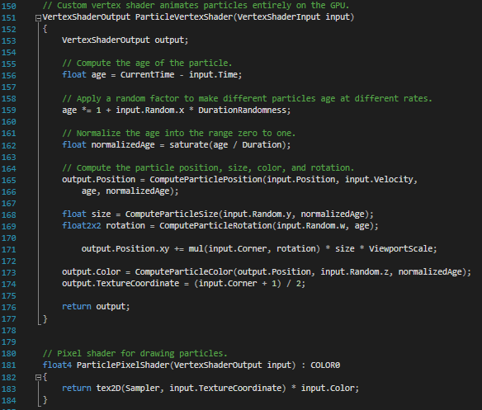
Particles

Slide 17
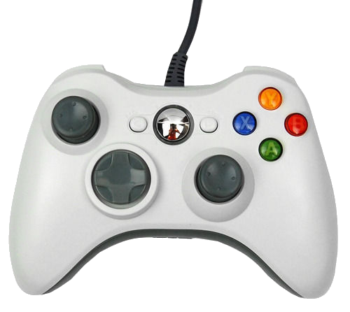
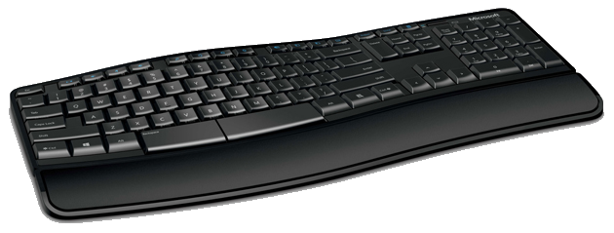
Controls

Slide 18
Prototype

Slide 19

The End

