Slide 1
Baxter catching ball
EECS 106B FINAL PROJECT
Yichi Zhang, Jingjun Liu, Jiarong Li
05/08/2018

Slide 2
Introduction
We want the baxter to catch a flying ball.
Decompose the task:
Detect the tennis ball and track the trajectory.
Predict the dropping point of the tennis ball.
Compute the robot configuration and path planning
Move!
Notes:
Not easy for both human and robot. For robot, It demands for a tight interplay of skills in mechanics, control, planning and visual sensing to reach the necessary precision in space and time. All is about system cooperation, accuracy and speed.
Because of this, ball catching has been used for almost 20 years now as a challenging benchmark system to develop and test robotics key technologies.
1. A stereo vision system tracks the ball and predicts the balls trajectory.
2. Then the point and time, where and in which orientation the robot should intercept the ball on its trajectory, is determined.
3. Next, the robot conﬁguration to reach the catch point is computed and ﬁnally a path is generated, which brings the robot from its start conﬁguration to the desired catch conﬁguration.

Slide 3
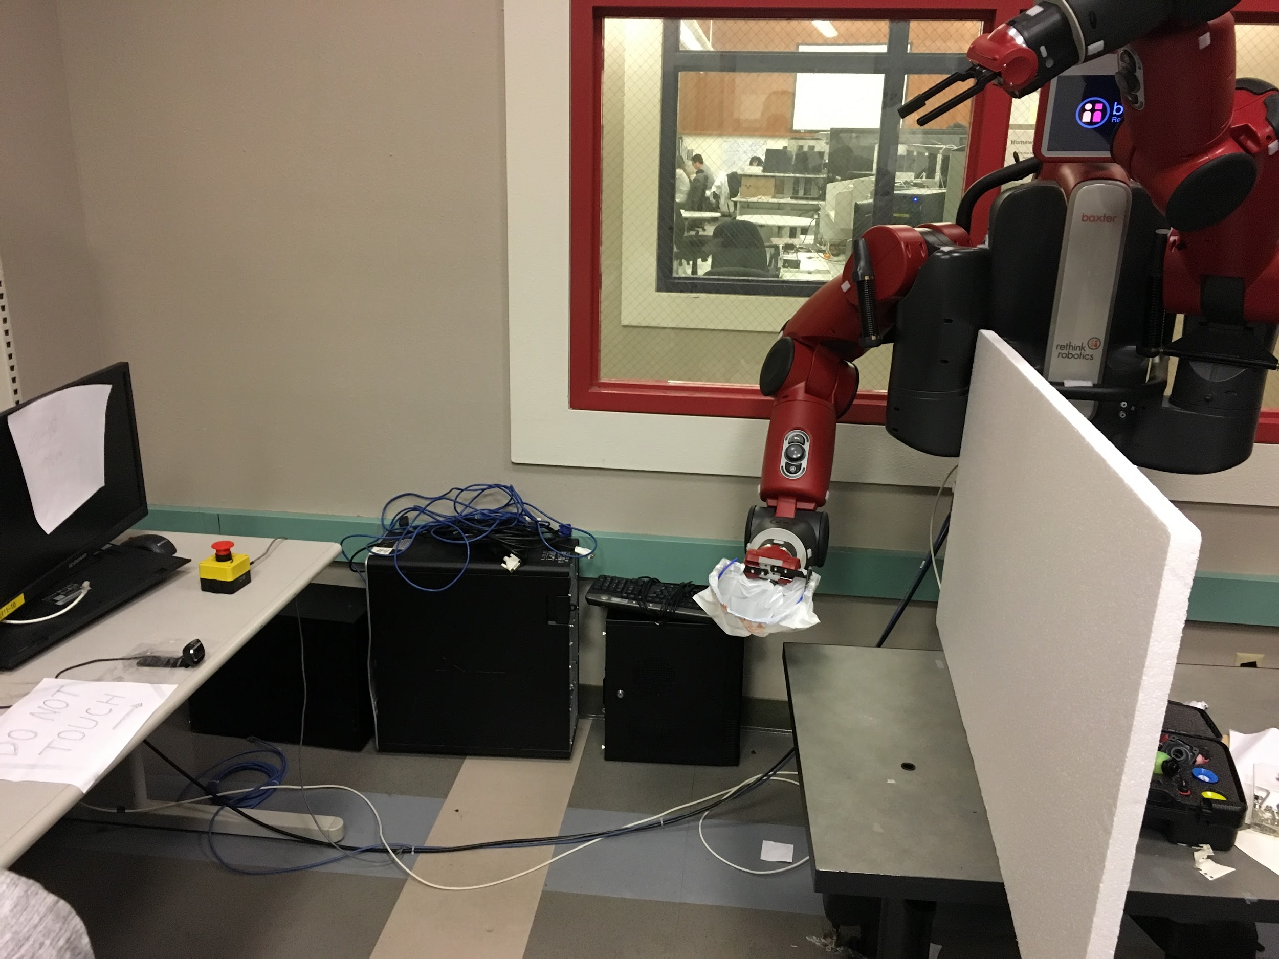
system configuration
Notes:
Camera
Basket
Board
Orientation

Slide 4
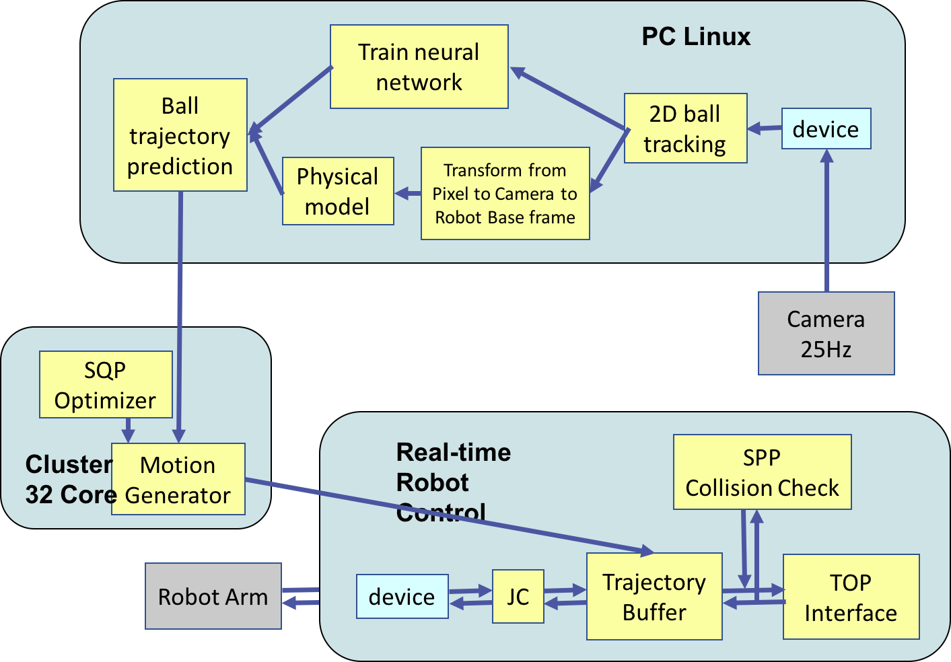
system architecture
Notes:
we use this to clarify processing modules and their mapping to the computation hardware as well as the cycle times and delays.
The ﬂying ball is observed by a stereo camera system (standard usb cameras, 25Hz video ﬁeld rate) which sends every 40ms the two video ﬁelds to a Linux PC, where the 2D-Tracking modules and the estimation and prediction modules for the trajectory are running by physical model and machine learning model. The resulting prediction is sent to the online realtime planning module running on the same PC. And the “move generator” which coordinates the slaves and communicates with the vision and the robot control system. The planner outputs a path with, which contains for each time step the desired arms joint angle. The robot arm and hand controllers, execute the path at the desired catch time. The overall delay from camera shutter to robot movement is about 0.2s.
(The planner consists of two parts: the “compute slaves” (one for each CPU core), which are actually executing the sequential quadratic programming (SQP) optimization algorithm in parallel,)
The system architecture has to provide distributed computational resources while meeting hard realtime constraints for the parallel planning as well as the robot controllers. Control the delay.

Slide 5
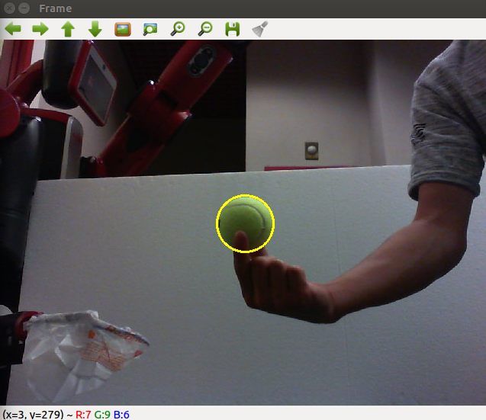
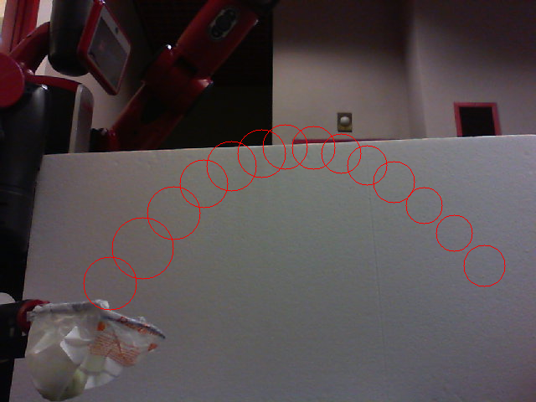
Detect the tennis ball
Transform the image into HSV color space.
Filter out all non-green colors.
Notes:
From the image we received from the camera, we extract the ball trajectory by pushing the RGB image into the HSV color space and ﬁlter out all non-green colors. With the help of OpenCV, we can read the pixel position of ball in camera frame.
In physical model, we use the ﬁrst 3 points as well as their time intervals for prediction.
In machine learning model, we choose the ﬁrst 5 points as a set of training data.

Slide 6
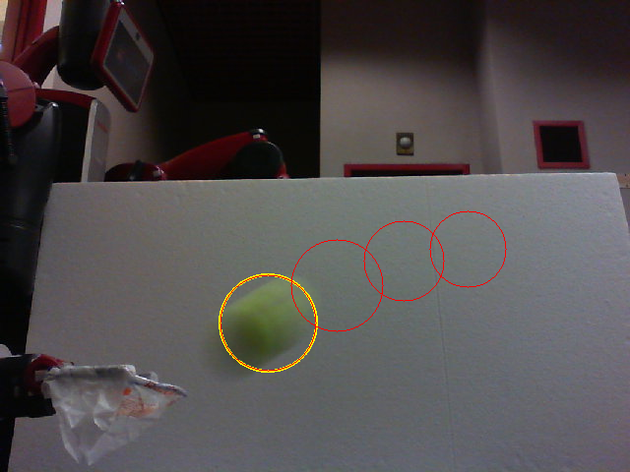
Why we give up 3d scenaerio - one camera
Esay to extend to 3D using two cameras.
Notes:
Our project intended to catching the ball at 3d dimension at first.
Firstly, we tried Baxter head camera to detect the ball, because but the resolution is bad, half of a meter.
We set a separated camera to detect the ﬂying tennis ball and calculate the transformation from separated camera to baxter base frame. (How we get transformation) We tried to use a Kinect at first to get the depth data, but the speed of returning data is two slow. We have measured the time from throwing the ball to reaching the catching point, which is only 0.26s, so we could not use it. Everything needs to be fast.
So we use the usb camera in lab. However, due to the low frequency of our 2D camera (25Hz), we cannot read the radius of tennis ball and then get the distance accurately, so we decided to make the ball ﬂy on a 2D plane. You can see the circle is big or small. Actually, the position is also not that accurate, but it is enough for us to predict the trajectory.
Also, we can easily extend it into 3D space by add one more camera or just use a camera with faster shutter speed.

Slide 7
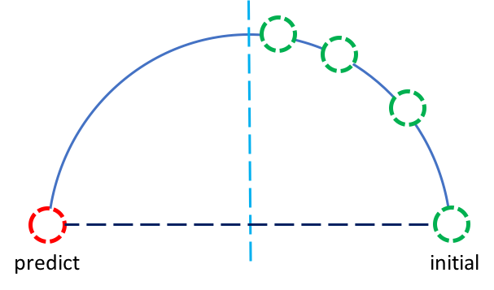
prediction model 1: physical model
Prediction rule:
Find the mirror location of the first point captured by the camera with respect to the symmetry axis of the parabola.
(because it maximizes the flying time of the ball)
Notes:
The first model we used is the physical model. It is like some other previous works and use the classic mechanics to make the prediction

Slide 8
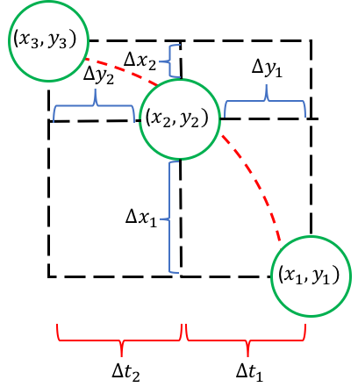
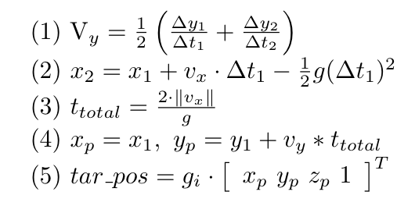
prediction model 1: physical model
Notes:
Here are some calculations, it’s an easy dynamic question. First equation we get vy, second we can have vx, then from vx get total time, and make the prediction. Finally transformed is into base coordinate.

Slide 9
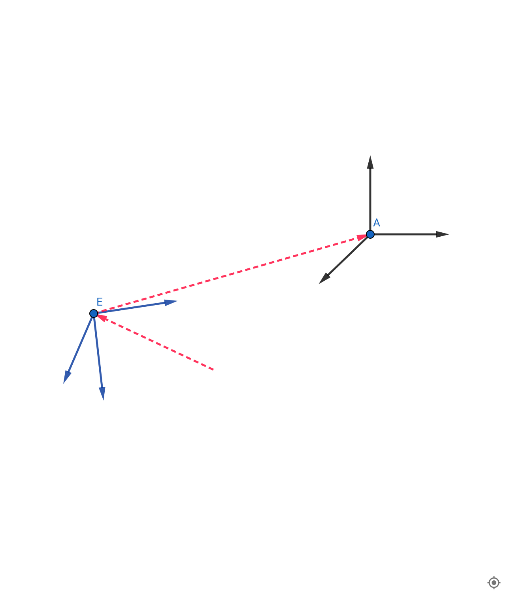



prediction model 1: physical model
Calculate inverse kinematics
Pixel coordinate
3D coordinate (in camera)
Notes:
An important thing in this model is the transformation of coordinates. What the camera read is the position with respect to camera with pixel unit, say pixel coordinate, firstly we map it to real distance in meter unit, this transform is measured by hand so it is not very accurate, then transform it into the robot base frame, we use an arTag to calculate this transformation.

Slide 10
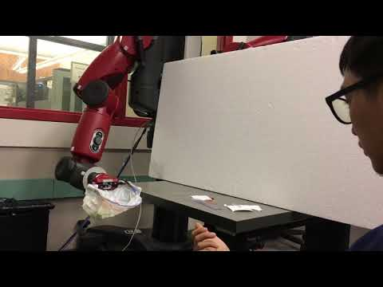
Result

Slide 11
Goodness and badness
Goodness :
Good generalization
Larger reachable set of Baxter arm
Do not need to store too many parameters
Badness:
Not very accurate
Camera has distortion and need to be calibrate
Transformation mapping error
Hard to control
Inverse kinematics unstable because of larger reachable set
High requirement on devices

Slide 12
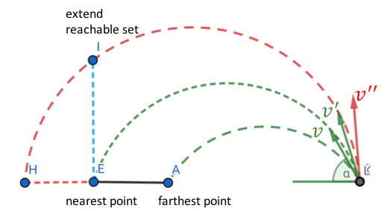
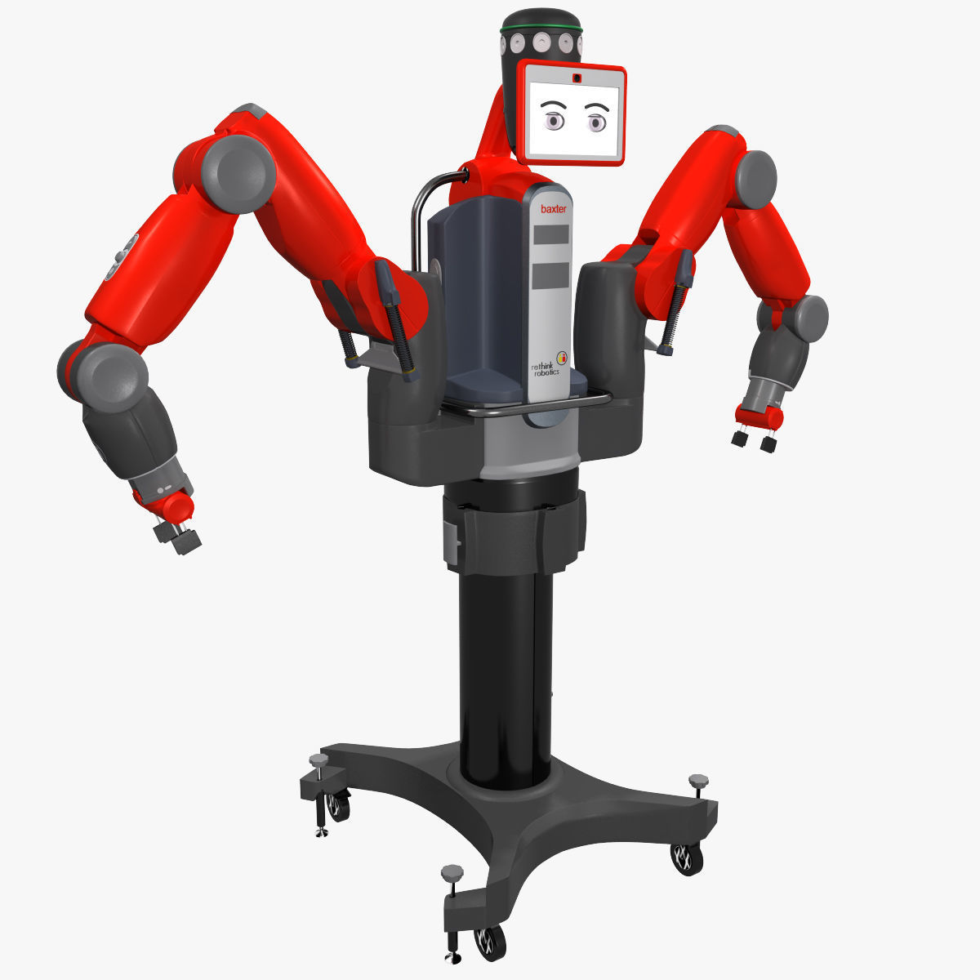
prediction model 2: machine learning model
Step 1: Determine reachable set

Slide 13
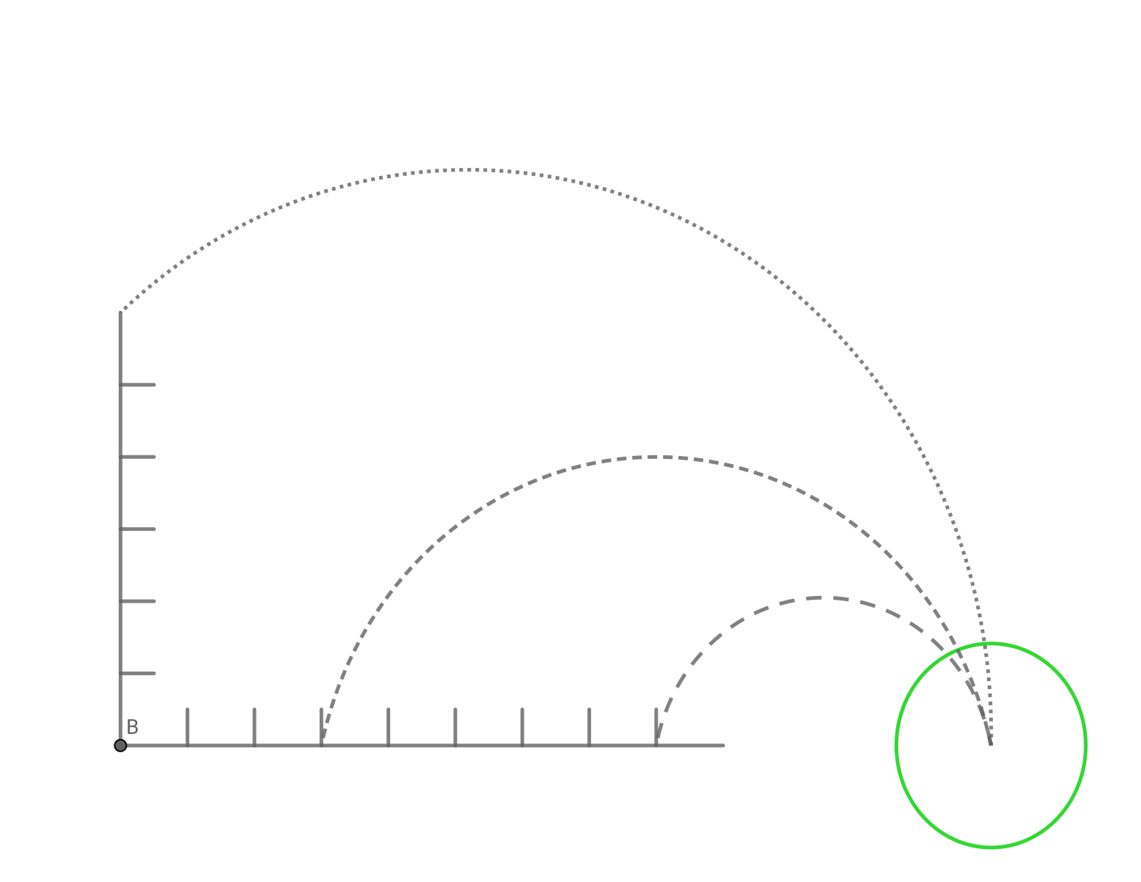
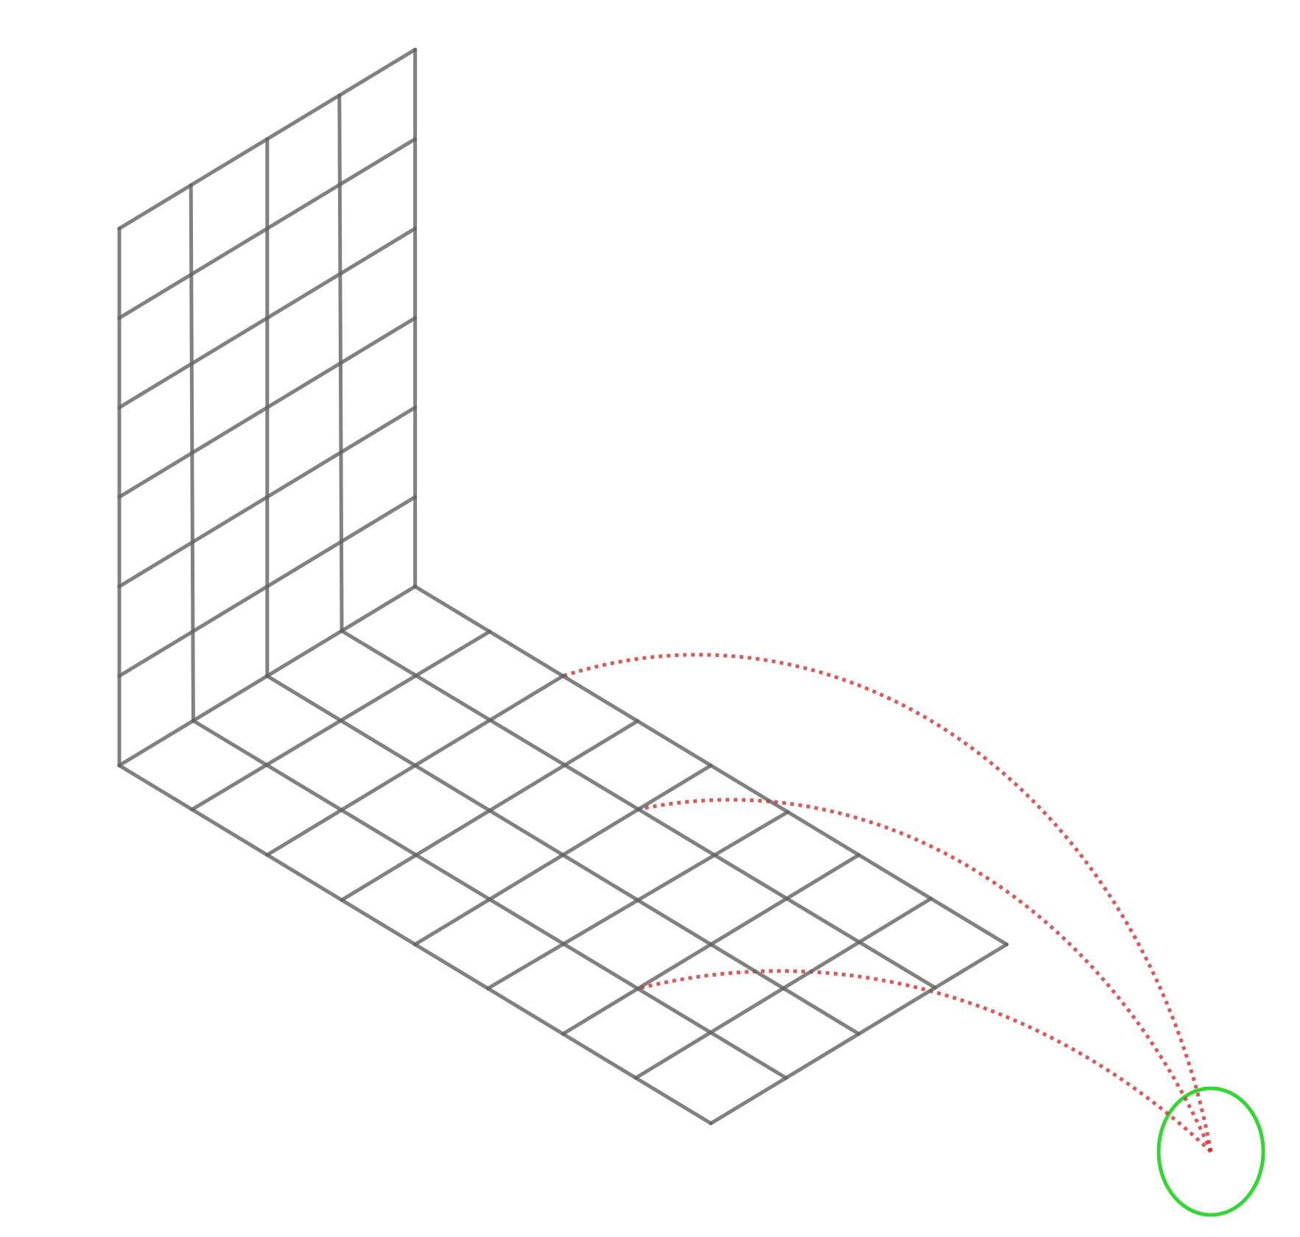
prediction model 2: machine learning model
Step 2: Grid reachable set & Collect data.
(To ensure the data evenly disperse the reachable set)
extend dimension
2D model
3D model

Slide 14
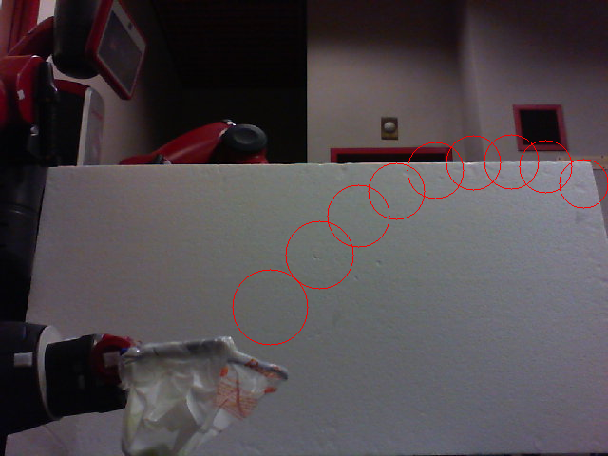
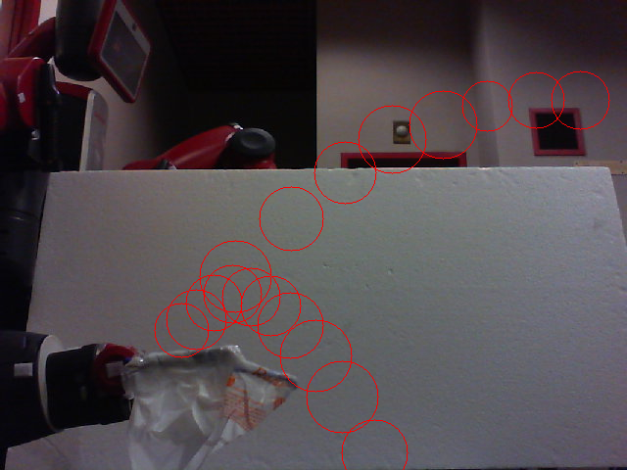
prediction model 2: machine learning model
Succeed & Collect
Fail & Abandon

Slide 15
prediction model 2: machine learning model
Step 3: Training
Standard fully connected neural net (NN) Tune # layers & # widths
K nearest neighbors (KNN)
Feather matrix X∈R(nXm), m = 2p, p is # points we use to predict.
Exhaustively search # neighbors, choose m = 5
Training Error: 0.02 (2 cm)
Validation Error: 0.016 (1.6 cm)
? Dimensionality reduction

Slide 16
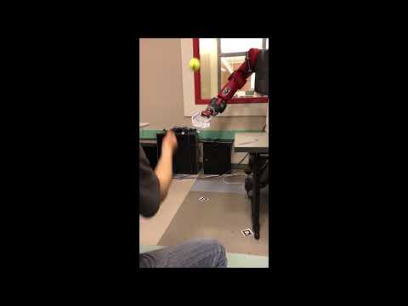
Result

Slide 17
Goodness and badness
Goodness :
Fast and more accurate (if enough data: we collect 284 data points)
Safer (all predictions lie in the convex hull of training data)
Reduce the complexity of system. (because we do not need to calibrate camera or measure any mappings)
Badness:
Cost time to collect data
Unable to deal with the trajectory out of the reachable set

Slide 18
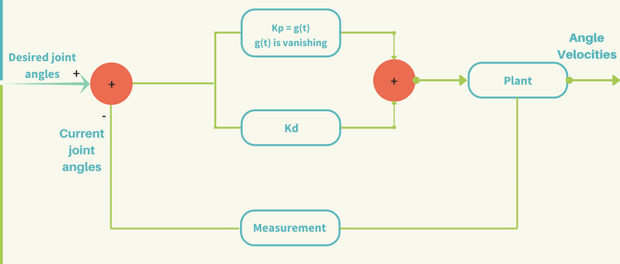
fast controller implementation
We need the Baxter to move extremly fast.
Why vanishing KP?
Initially large because we need huge speed
Vanishing because we need it stable
Notes:
We design the controller by the total flying time we measured, which is about 0.2 s. We should balance the speed and accuracy. Due to hardware problem, we could not let the controller move to fast. We try to use moveit and function setjointpostion in package baxter_interface.Limb directly at first, but the speed is more than 1 second, which is too slow. So we write a joint velocity controller to set joint velocity directly.
In order to reach the prediction point in time, a fast and stable controller is needed for robot arm. After several test, we decide to use a PD controller with a decaying parameter K p on the proportional element. In our design, K p is initially large so that the arm can move quickly. It declines to make the arm stay stable at the prediction point.
Also, sometimes inverse_kinematics are very large due to unknown problems, so we try to call the function several times and select the midian of the ik numbers, which make the motion more stable.

Slide 19
THANK YOU!
Notes:
The robot can use either physical way or machine learning way to catch the ﬂying ball thrown by human. However, the success rate and stability of machine learning model is better.

