Slide 1

News Recommender System using Content-based filtering
Taylor Herb
INFSCI 2480

Slide 2
Introduction
News websites and blogs are a highly popular aspect of the internet we use today.
With a decrease in printed newspapers, online news websites have become an increased source for people to access news
Since these news sources are being used by people so frequently, they would likely benefit from including a recommender system to personalize the user’s experience
- For example, if a user reads an article about the stock market in Europe, they may want to read additional articles on the topic. This could mean they want to see more articles about the stock market in general, Europe, the stock market in US, or maybe they aren’t sure where to look next.

Slide 3
Introduction
In this project, I will begin the process of designing a news recommender system by first using content-based recommendation methods
Since there is no user data on this dataset yet, the recommender system must rely on the information about the articles themselves rather than the user
The goal of the current system is to allow the user to search for recommendations based on the article’s text body or the article’s tagged keywords.

Slide 4
Dataset & Preprocessing
The original dataset was pre-processed in order to remove unnecessary columns, missing data and duplicate entries.
The final dataset included the five columns to be used in the recommender system (id, title, text, keyword, link) and 1720 rows that did not include any missing data or duplicates.
Additionally, traditional text cleaning methods (i.e. removing stop words & special chars) were used to clean the article text data and keywords text data

Slide 5
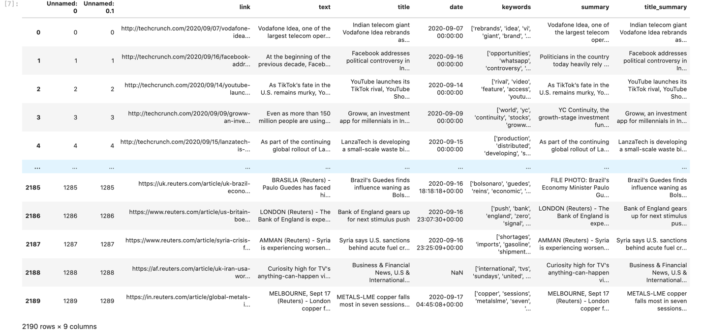
Original dataset (2190 rows, 9 columns)

Slide 6
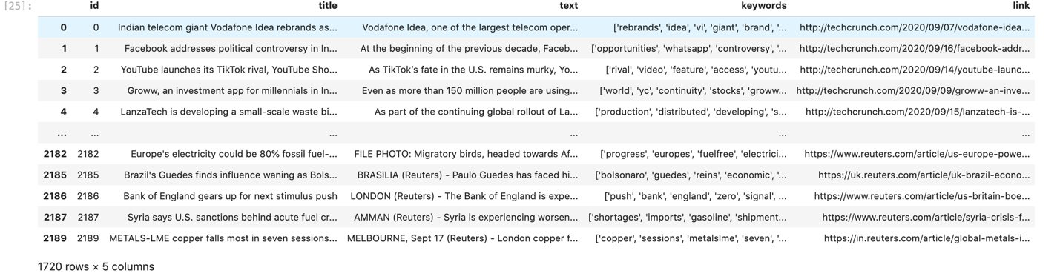
Original dataset (1720 rows, 5 columns)

Slide 7
Technologies
Python and Jupyter notebook
-small .csv database can be stored as dataframe within notebook
-ipywidgets interact library to handle user interactions
-web application is created using Voila server extension

Slide 8
Design
Content based filtering
Two recommenders
- one recommender based on article text and one recommender based on keywords
Does article text recommender perform better than keyword recommender?
- keywords not necessarily representative of article text (chosen by article publisher)

Slide 9
DESIGN
Term Frequency-Inverse Document Frequency (TF-IDF) was used on the text to evaluate term importance to the document within the corpus
Keyword-based recommender:
- ngram range of 1-2 was used because keywords typically exist of a maximum of 2 terms
- min_df of 0 to include all keywords regardless of document frequency

Slide 10
Design
Text-based recommender
- an ngram range of 1 to 3 was used to allow for longer combinations of terms within the article
- Although stopwords were removed, a max_df of 0.8 was also selected to ignore terms that occur too often in the corpus because they are unlikely useful for recommendations
- multiple min_df values were tested (0.0, 0.01, 0.02, 0.1) which yielded different matrix dimensions based on the amount of terms used [(1720, 1023226), (1720, 4705), (1720, 2546), (1720, 321)]. - min_df of 0.1 was not tested due to small number of terms
- all accurate at first glance – 0.0 was chosen for now but user feedback should be used to fine tune parameters in future development

Slide 11
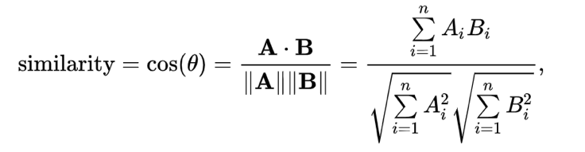
Design
Once article text or keywords are encoded into tf-idf matrices, cosine similarity is used to obtain a similarity measure
Cosine similarity is useful here because it is a measure of distance and orientation rather than magnitude (i.e. Euclidean distance).
Cosine similarity equation showing similarity ranging from -1 (opposite) to 1 (equal) where 0 indicates no relationship.

Slide 12
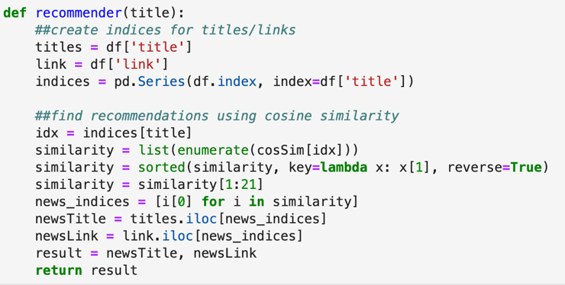
Design – Recommender Function
The recommender function was built to create indices for titles then find recommendations based on the cosine similarity (cosSim).
This function returns the top 20 most relevant items and shows the user the title of the article as well as the link to the article.

Slide 13
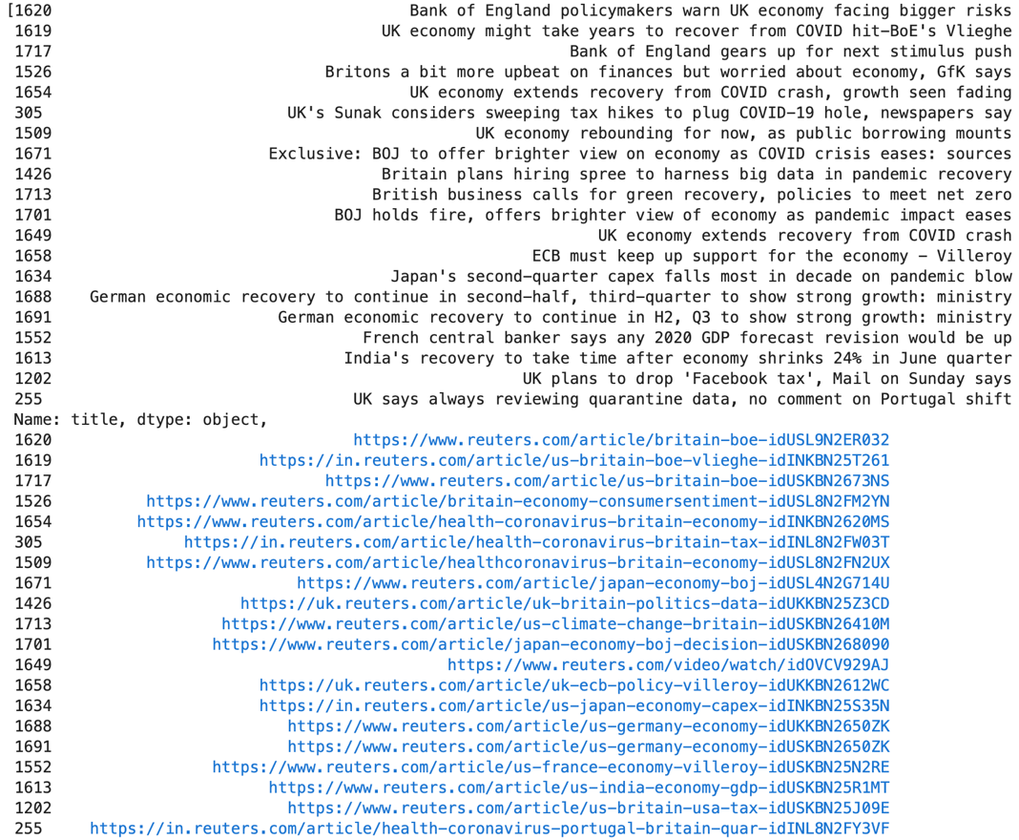
Results for text-based recommender (title “Bank of England policymakers warn of bigger risks for UK economy”

Slide 14
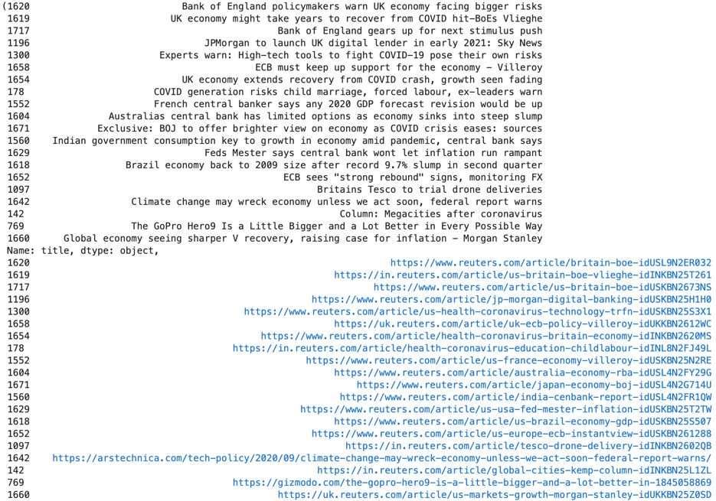
Results for keyword-based recommender (title “Bank of England policymakers warn of bigger risks for UK economy”

Slide 15
Front End
This recommender system was developed across 3 Jupyter notebooks
-Development notebooks
-recommender-textBased.ipynb
-recommender-keywordBased.ipynb
-Production notebook
-full-recommender.ipynb

Slide 16
FRONT END – development Notebooks
These notebooks allow for testing of new parameters such as the min_df or editing the results to include a different number of recommendations . (build your own recommender)
When using Jupyter lab, these notebooks can be quickly tested using the interact widget at the bottom of the screen.

Slide 17
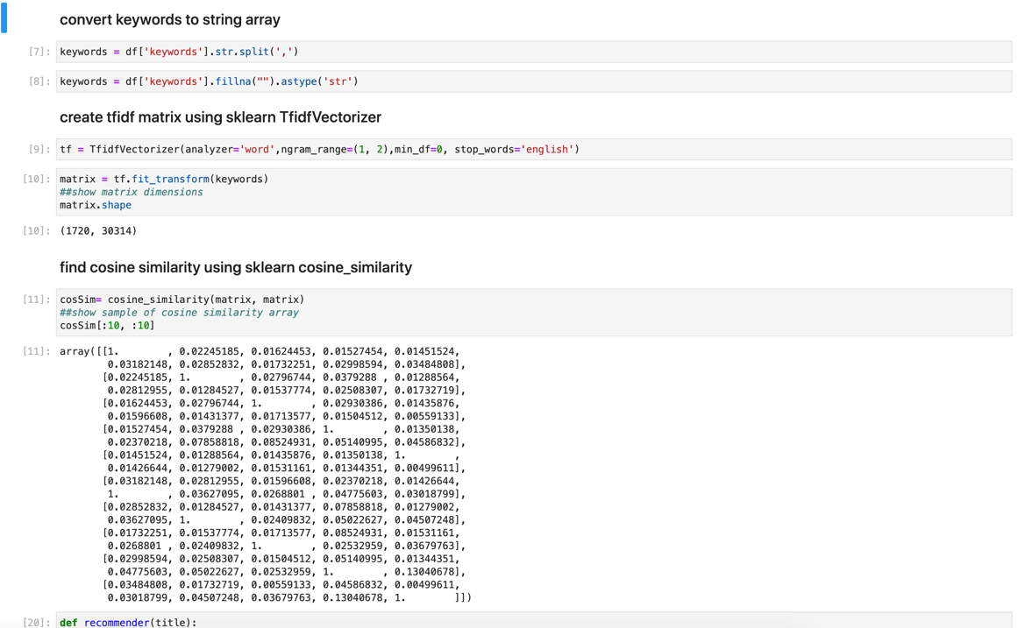

Slide 18
FRONT END – Production Notebooks
The third notebook (i.e. production notebook) contains the code for both recommender systems but is formatted to be presented in a Voila web application
This notebook does not contain any output or markdown, but is useful for presenting the recommender systems outcome

Slide 19
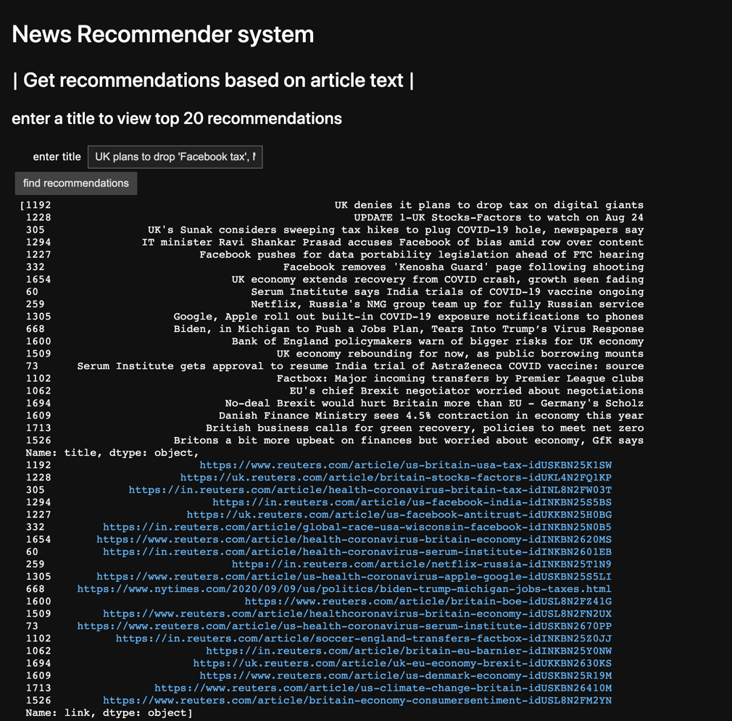

Slide 20
Conclusions & Future Work
I have developed a news recommender system based on article text and article keywords.
Since there is not yet any user data, content based methods were used to provide the recommendations about the articles.
TF-IDF feature extraction and cosine similarity methods were used to create similarity measures for the recommendations.

Slide 21
Conclusions & Future Work
Seems that both recommendation systems perform quite well despite the absence of any additional user data
At first glance it seems as though the text based recommender is more consistently accurate, however, it is impossible to guess which model performs better without user feedback

Slide 22
Conclusions & Future Work
As the project develops, collaborative filtering methods can be employed based on user behavior data that is gathered while they interact with the system
Future users will be able to give feedback about their recommendations in order to fine tune the algorithms and personalize their experience
Additional features such as creating profiles, “favoriting” articles and searching by other terms (i.e. search by author) will be implemented during continued front-end development make the system more adaptive and customizable

