Slide 1
CSS

Slide 2
CSS
Introduction
CSS stands for Cascading Style Sheets
CSS describes how HTML elements are to be displayed on screen,
CSS saves a lot of work. It can control the layout of multiple web pages all at once

Slide 3
CSS
Benefits of CSS
Saves a lot of work.
It can control the layout of multiple web pages all at once,
With an external stylesheet file, you can change the look of an entire website by changing just one file!

Slide 4
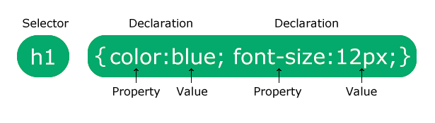
CSS
CSS Syntax
Example:
p { color: red; text-align: center;}

Slide 5
CSS
CSS Selectors
CSS selectors are used to "find" (or select) the HTML elements you want to style.
Types
CSS element selector
CSS id selector
CSS class selector
CSS universal selector

Slide 6
CSS
CSS element selector
The element selector selects HTML elements based on the element name.
CSS id selector
The id selector uses the id attribute of an HTML element to select a specific element.
The id of an element is unique within a page, so the id selector is used to select one unique element!
CSS class selector
The class selector selects HTML elements with a specific class attribute.
CSS universal selector
The universal selector (*) selects all HTML elements on the page.

Slide 7
CSS
How to add CSS
There are three ways of inserting a style sheet:
External CSS
Internal CSS
Inline CSS

Slide 8
CSS
External CSS
With an external style sheet, you can change the look of an entire website by changing just one file!
Each HTML page must include a reference to the external style sheet file inside the <link> element, inside the head section.

Slide 9
CSS
Internal CSS
An internal style sheet may be used if one single HTML page has a unique style.
The internal style is defined inside the <style> element, inside the head section.

Slide 10
CSS
Inline CSS
An inline style may be used to apply a unique style for a single element.
To use inline styles, add the style attribute to the relevant element. The style attribute can contain any CSS property.

Slide 11
CSS
Inline CSS
An inline style may be used to apply a unique style for a single element.
To use inline styles, add the style attribute to the relevant element. The style attribute can contain any CSS property.

Slide 12
CSS
CSS Box Model
All HTML elements can be considered as boxes.
The CSS box model is essentially a box that wraps around every HTML element. It consists of: margins, borders, padding, and the actual content.

Slide 13
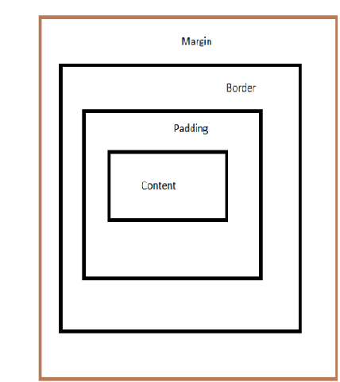
CSS
CSS Box Model
The image below illustrates the box model:

