Slide 1
Capstone 2
Epa Fuel Economy

Slide 2
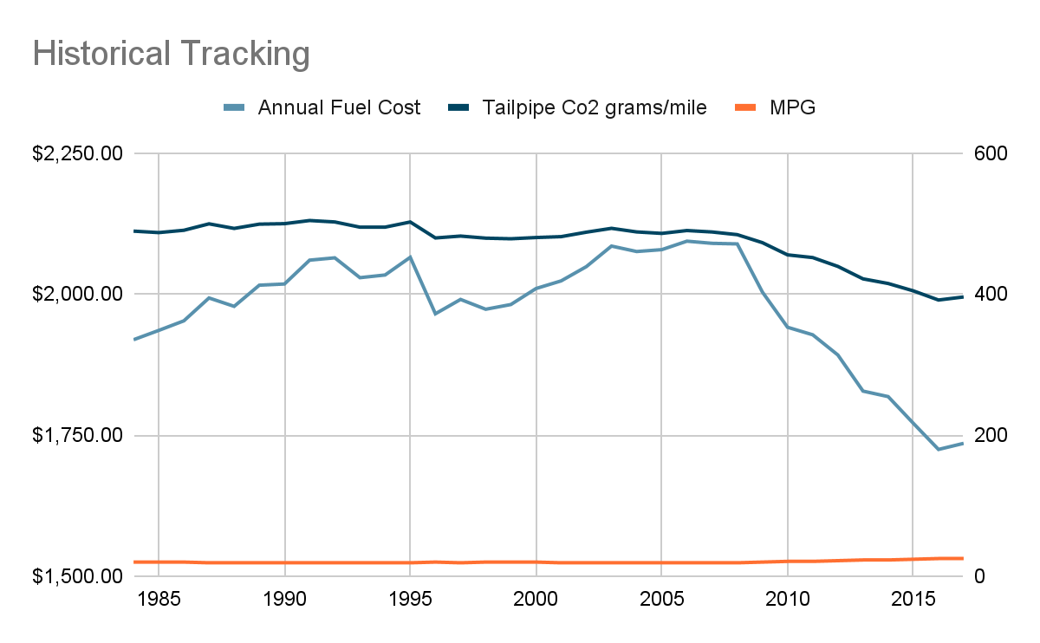
Introduction
How do Vehicle Types, Manufacturers, and Technical Specs impact fuel costs, emissions, and efficiency?
Combined fuel economy (Combined MPG): weighted average of City and Highway MPG
Annual Fuel Cost & Tailpipe Emissions: based based on provided EPA data

Slide 3
Data
38,113 vehicle records from years 1984 to 2017 covering 133 unique car makes
Data includes manufacturer information, vehicle type, technical specs and EPA ratings for Fuel Economy and Co2 emissions
Descriptive Statistics confirm normal distributions for Annual Fuel Cost & Tailpipe Co2 emissions (vehicle and fuel type)
There is a positive correlation with Annual Consumption of Barrels/Tailpipe C02 and Combined MPG/Annual Fuel Cost

Slide 4
Hypotheses
Hypothesis 1
Ho: There is no significant difference in Annual Fuel Costs between compact and midsize cars
Ha: There is a significant difference in Annual Fuel Costs between compact and midsize cars
Hypothesis 2
Ho: There is no significant difference in Tailpipe CO2 emissions between compact and midsize cars
Ha: There is a significant difference in Tailpipe CO2 emissions between compact and midsize cars
Hypothesis 3
Ho: There is no significant difference in Tailpipe CO2 emissions between regular and premium fuel
Ha: There is a significant difference in Tailpipe CO2 emissions between regular and premium fuel

Slide 5
Method
Confirmed normal distribution using descriptive statistics and histograms
Split data into sample populations using pivot table filters
Tested hypotheses using Analysis Toolpak’s Two-Sample t-Test Assuming Unequal Variances

Slide 6
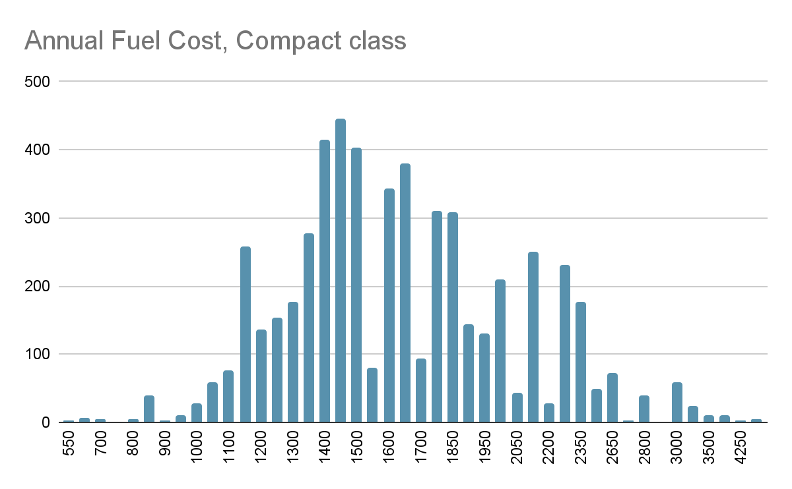
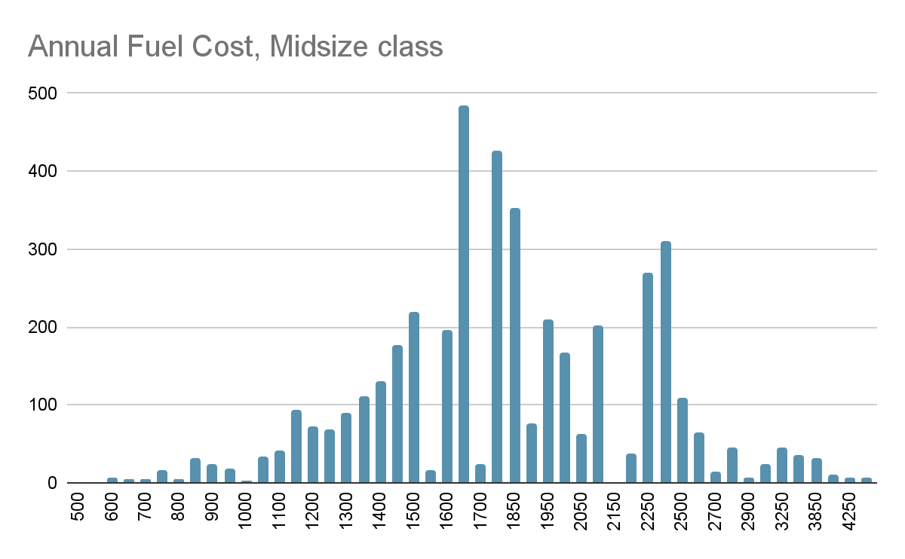
DISTRIBUTION: Compact vs Midsize

Slide 7
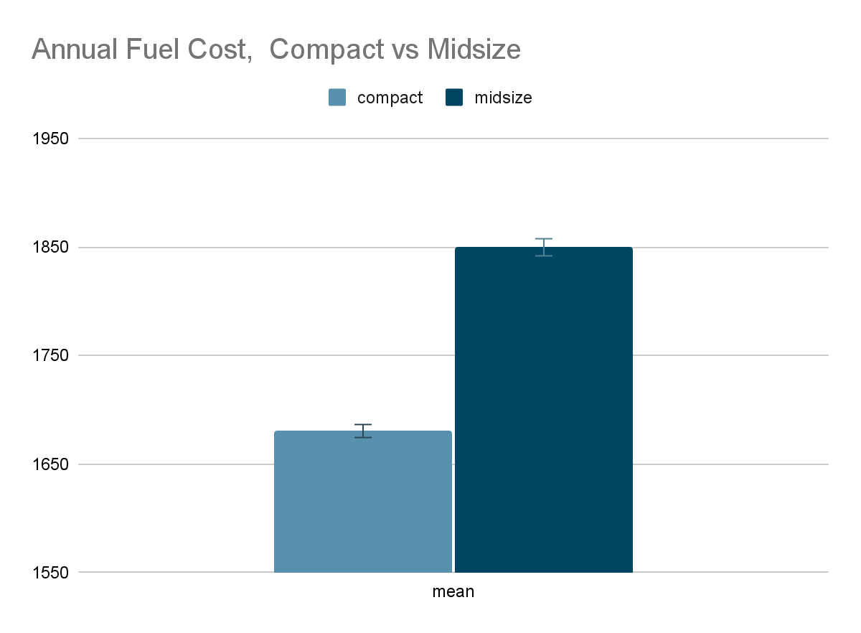
T-TEST: Compact vs Midsize
P-value: 2.28E-64
Null rejected, there is a significant difference in annual fuel costs between Compact and Midsize vehicles
With 95% confidence, fueling a Midsize vehicle costs between $149 and $188 more annually than a Compact cars

Slide 8
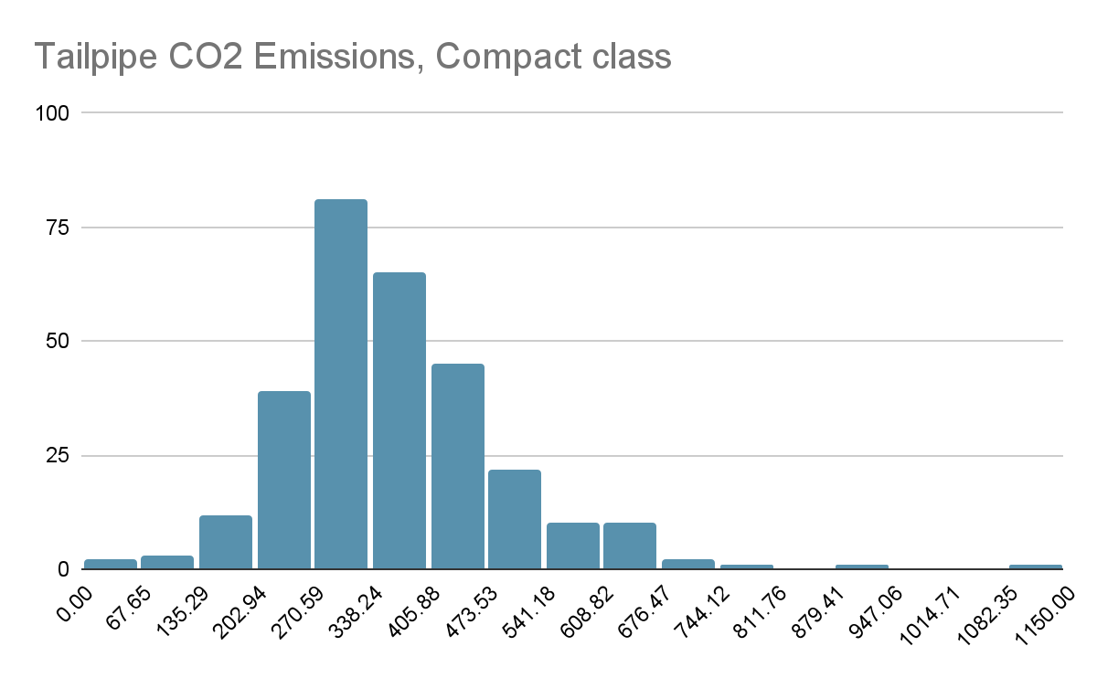
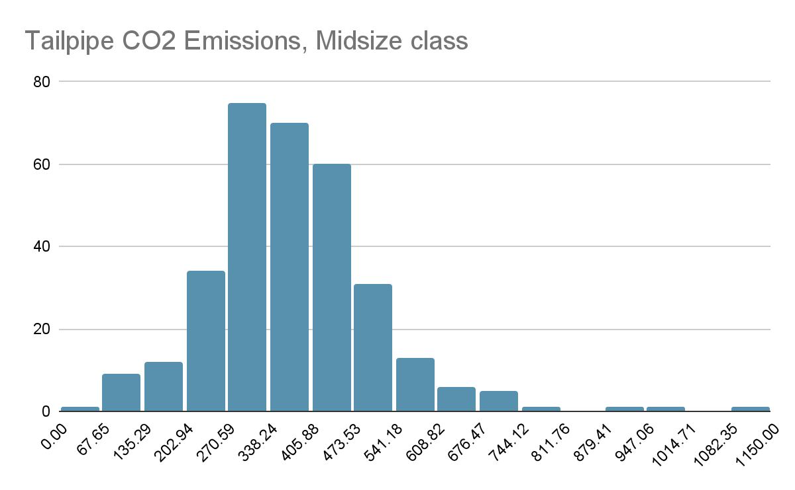
DISTRIBUTION: Compact vs Midsize

Slide 9
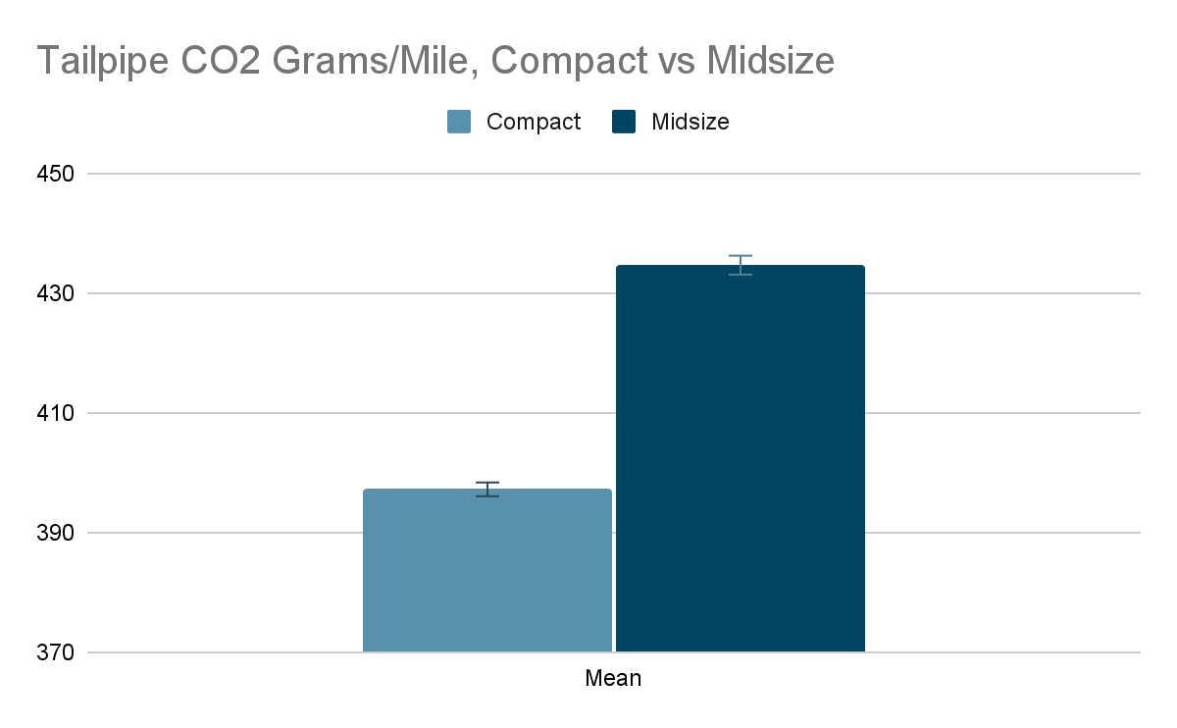
T-TEST: Compact vs Midsize
P-value: 6.39488E-80
Null rejected, there is a significant difference in tailpipe emissions between Compact and Midsize vehicles
With 95% confidence, Midsize vehicles emit between 33.6 g/m and 41.8 g/m more Tailpipe CO2 than Compact cars

Slide 10
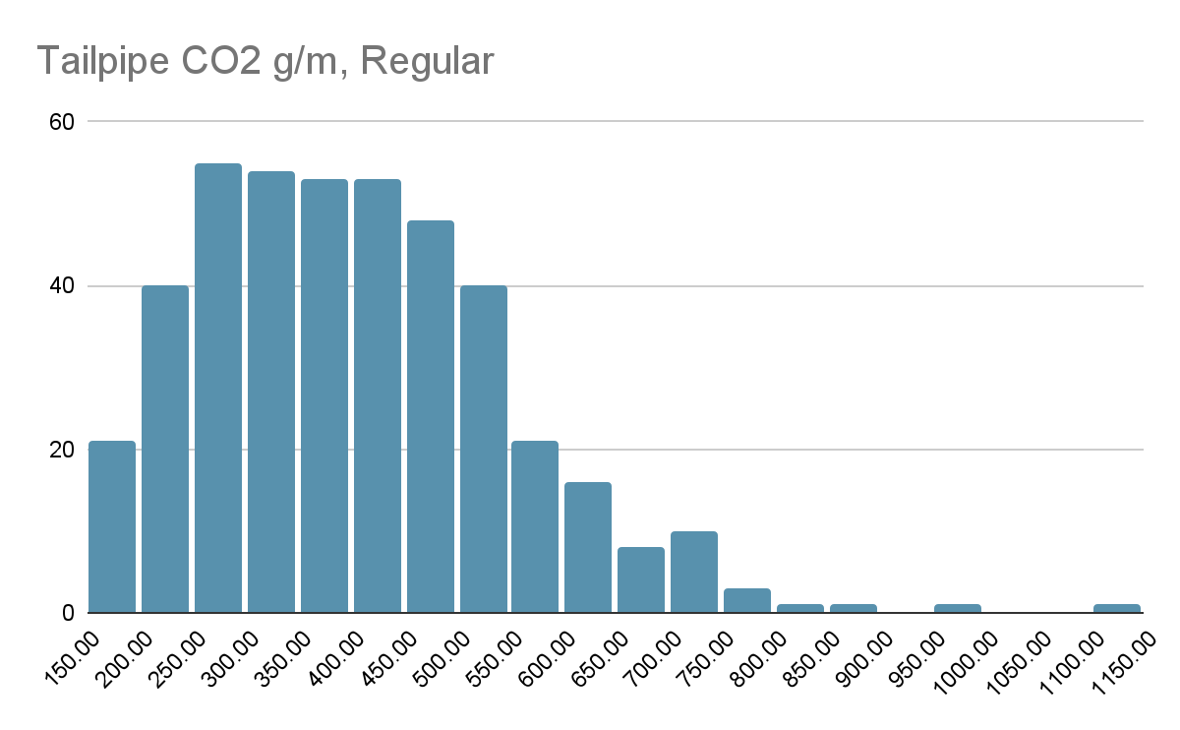
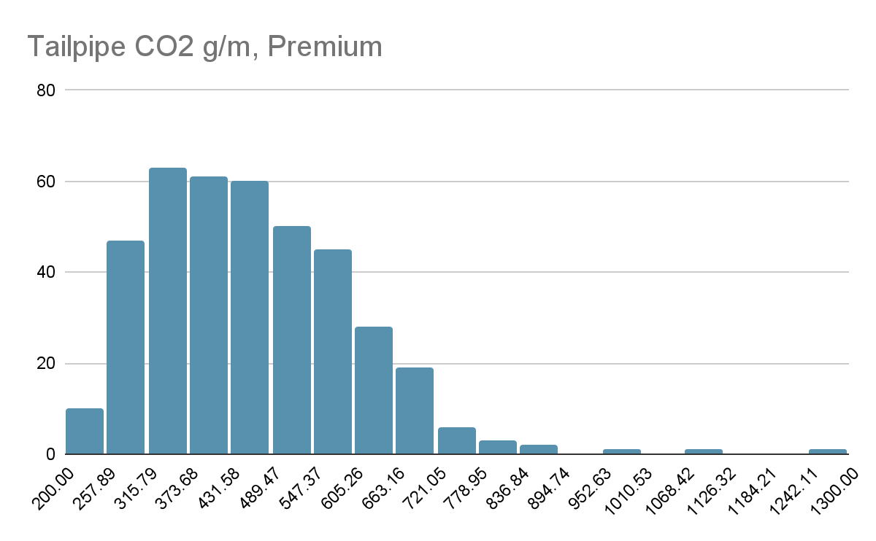
DISTRIBUTION: Regular vs Premium

Slide 11
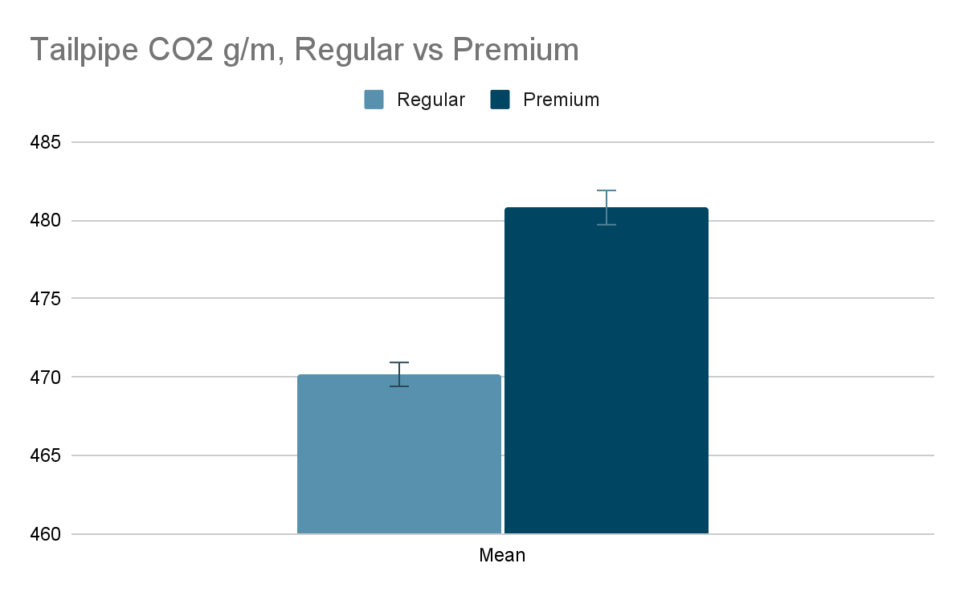
T-TEST: Regular vs Premium
P-value: 1.35115E-15
Null rejected, there is a significant difference in tailpipe emissions between Premium and Regular fuel
With 95% confidence, Premium fuel emits between 8.02 g/m and 13.2 g/m more Tailpipe CO2 than regular fuel

Slide 12
Recommendations
Drive Compact Vehicles to save money on Annual Fuel Cost
Drive Compact Vehicles to reduce Tailpipe CO2
Drive Vehicles that do not require premium gas to reduce Tailpipe CO2

