Slide 1
Names and why you’re interested in learning to build websites with Python
I’m Taj, and I’m working on a marketplace for writing.

Slide 2
Making Websites with Python

Slide 3
Multiple frameworks
There are multiple ‘frameworks’ for building websites. Today we’ll be using a Python framework called Django.
We’ll also be using the Nix package manager, and the w3m (text based) web browser

Slide 4
Identify your operating system
One of the following: Windows, MacOS, Linux, other?
Multiple options:
  1. Try to get everything working using your operating system (limited help from me if it’s not linux)
  2. Try to virtualize linux so I can help you more easily (you will learn, but if you don’t have it already set up
  it will take you longer to get a site up and running)

Slide 5
Install Nix
https://nix.dev/install-nix.html or https://nixos.org/download/#download-nix
create a nix shell with the following
  python, pip, django, w3m

Slide 6
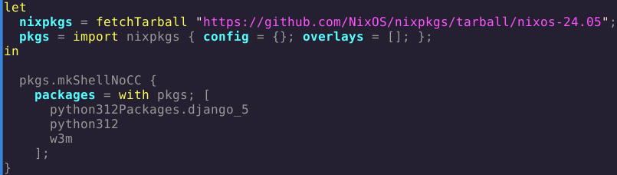
You shell file should look like this
code can be found at https://github.com/t-a-m-e/django-nix-shell/blob/main/shell.nix

Slide 7
Setting up your virtual environment
run ‘nix-shell’ in your terminal (or what the equivalent is on your OS (operating system)
make a virtual environment by typing
  python -m venv sandbox

Slide 8
Activate your environment
type ‘source sandbox/bin/activate’ into your nix shell
type ‘source sandbox/bin/activate’ into your nix shell

Slide 9
You are set up and ready to start Web development!

Slide 10
Go to
https://docs.djangoproject.com/en/5.0/intro/tutorial01/
(once on this page make sure the django version you’re using is 5.0)
Once you’ve run ‘django-admin startproject mysite’ you may need to (assuming your site isn’t opening in your preffered browser) run ‘nix-shell’ in another terminal window to use w3m to see your site.

Slide 11
Build a website with Django
If you need help think first - ask yourself if you’ve tried everything, then search the documentation/online, then ask a neighbor, then ask me.

Slide 12
Basic Command Line Commands
cd (change directory)
cd .. (change to previous directory
python3 (run a .py file)
rm (permanently delete a file)
mkdir (make a new directory)
rmdir (permanently remove a directory

Slide 13
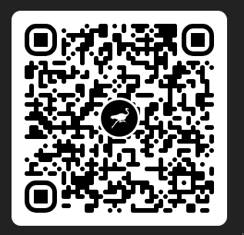
End
contact available on nostr via message or by posting an ‘event’: npub1h7plvjaelzspdshmleazfh4l4jw9t7qhm5v2fn8jzp0lhnw3ay6sy0vt9k
New account, the post is:
  “Making websites with Python and Nix is the goal here”

Slide 14
Making a virtual environment
Make a virtual environment.
  mkdir webdevhowto
  python -m venv
  source /bin/activate
Install python, and django (works for debian/ubuntu and other debian based OS’s)
  apt-get python3
  apt-get pip
  pip install django

Slide 15
Set up (virtualization of Linux)
Step 1: Install multipass
https://canonical.com/multipass/install
Step 2: Make/Launch a multipass instance
if you get stuck in multipass, go to the multipass
documentation
Launch a multipass instance

