Slide 1
Evaluation of the Sentiment of Tweets
Tem

Slide 2
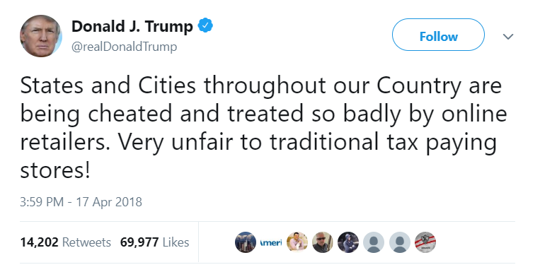

Sentiment of Tweets
Can you measure the sentiment of a tweet?
Is it positive or negative?
Can you do so by measuring the individual words in the tweet?

Slide 3
K-means Clustering
Divide the data into two clusters
The hope is that the algorithm will understand that the more “positive” or “negative” the words in a tweet are, the more positive or negative the tweet is overall

Slide 4
K-means Clustering
Failure rate for Cluster 1 (pre-regularization): 65%
Failure rate for Cluster 2 (pre-regularization): 6.4%

Slide 5
K-means Clustering
Failure rate for Cluster 1 (post-regularization): 4.1%
Failure rate for Cluster 2 (post-regularization): 0.15%
Method: removing “noise” of relatively “neutral” tweets, allowing model to more accurately predict “extreme” tweets
Based on the fact that some tweets are simply “neutral,” not positive or negative, and more “extreme” tweets are easier to categorize
Some Twitter datasets indeed use this third category of classification

Slide 6
Linear Regression
Used my own sentiment model for the x-axis, and the polarity scaled by tweet-length for the y-axis
The y value were equivalent to:
  Length*(1+polarity)

Slide 7
Linear Regression
The b0 = 41.349010747726425
The b1 = 65.81882750005907

Slide 8
Linear Regression
Divided polarity by tweet length rather than multiply
The b0 = 0.3562528187405122
The b1 = 1.6739996831175603

Slide 9
Logistic Regression
Pr(tweet=positive | sentiment)
The b0 = -395
The b1 = 99
Success rate of approximately 10%

Slide 10
Logistic Regression
However, upon regularizing the data using the same method as was done with linear regression (eliminating relatively “neutral” tweet noise from sample set)…
Success rate skyrockets to 60%

Slide 11
Application
Determining public perception of tweets of high-profile individuals
  Presidents
  Senators
  CEOs
  Journalists
Gauging excitement (or lack thereof)

