Slide 1

IISER Project Report
Submitted By-Tanisha Basu
Submitted To-Dr.Kuntal Roy

Slide 2
CONTENTS-
1.Need of ML in Autonomous Cars
2.Object Detection
3.Traffic signal detection
4.Yolov real time prediction
5.Intro to Seat Yolo Prediction
6.Explanation of various layers in them
7.Comparative differences between CNN and Yolov
as did in code
8.Code snippets and images
9.Future works

Slide 3
TOPIC-AUTONOMOUS VEHICLE
Autonomous vehicles, often referred to as self-driving cars, represent a groundbreaking advancement in transportation technology. These vehicles are capable of navigating and operating without direct human intervention, relying on a combination of sensors, cameras, radar, and artificial intelligence to perceive their environment, make decisions, and drive to their destinations. The development of autonomous vehicles promises to transform the automotive industry by enhancing safety, increasing efficiency, and reducing the need for human drivers.As technology continues to evolve, autonomous vehicles are poised to revolutionize the way we travel, offering potential benefits such as reduced traffic congestion, lower emissions, and greater accessibility for individuals unable to drive.

Slide 4
1.USE OF ML IN AUTONOMOUS VEHICLES-
Machine learning (ML) plays a pivotal role in the development and functionality of autonomous vehicles. It is crucial for several reasons:
1.Object Detection-
ML algorithms analyze data from cameras and LIDAR to identify and classify objects like pedestrians, other vehicles, traffic signs, and lane marking
2. Decision Making and Planning
ML is used to predict the behavior of otherroad users, which helps in making informed decisions about speed, lane changes, and turns.
3.Anomaly Detection and Safety
ML algorithms can detect anomalies in the vehicle systems and predict potential failures before they occur, enhancing reliability and safety.
4.Traffic Management and Optimization
ML allows autonomous vehiclesto communicate with traffic management system.

Slide 5
2. Object Detection-
The dataset used for object detection that can be done in Autonomous vehicle contains verious
medias of car that can be used for testing as well as training data.(as well as videos) .
Here the detection can be done with help of RNN and SSD that can carry out follows-
1.Faster R-CNN
a.Region Proposal Network (RPN): Generates region proposals where objects might be located.
b.Region of Interest (RoI) Pooling: Extracts fixed-size feature maps from these proposals.
c.Classification and Regression Heads: Classifies the object within each proposal and refines the
bounding box coordinates.
2.Single Shot MultiBox Detector (SSD)
a.Convolutional Layers: Extract features from the input image.
b.Multi-scale Feature Maps: Predict objects at multiple scales.
c.Default Boxes: Uses predefined boxes of different aspect ratios to detect objects at various scales.
Faster R-CNN offers high accuracy through precise region proposals and detailed classification.
SSD provides real-time detection.

Slide 6
3.Traffic Signal Detection-
The dataset used for the traffic detection contains various cropped images of traffic signal that can be used for test and training purpose.
Approach used is CNN that helps to to identify and classify various traffic signs from input images, improving the accuracy and reliability of an autonomous vehicle's navigation system.
Explanation-
1.Input Layer: Processes images of traffic signs, typically standardized in size and format.
2.Convolutional Layers: Detect key features of traffic signs, such as shapes, colors, and patterns, crucial for distinguishing between different signs (e.g., stop sign vs. speed limit sign).
3.Pooling and Dropout Layers: Reduce the data complexity and enhance the generalization of the model, making it more robust to variations in traffic sign images.
Layers and Functions-
1.Conv2D Layers:
First Layer: Applies 64 filters of size 2x2 to the input image, enhancing feature extraction (like edges and textures) important for recognizing traffic signs.
2.Second Layer: Adds another set of 64 filters, refining the features identified in the previous layer.
3.Third Layer: Uses 128 filters of size 2x2 to capture more complex features and patterns.
BatchNormalization Layers: Normalizes the output from the convolutional layers, speeding up training and improving model stability.

Slide 7
3.MaxPooling2D Layers:
Reduces the spatial dimensions of the feature maps, helping to downsample the data and highlight the most important features.
4.Dropout Layer:
With a dropout rate of 0.1, this layer helps to prevent overfitting by randomly setting some of the activations to zero during training.
3.Lane Detection-
CNN can help out to detect the lane as well boundaries .CNN architectures often include multi-scale analysis through techniques like pooling layers or multi-resolution input. This allows the network to detect lane markings at different scales, such as both close-up markings and distant lane boundaries visible on the horizon.
We used a similar approach for marking along the layers and boundaries that can help out to the autonomous vehicles
4.3D Object Detection-
Detecting 3D objects involves understanding their spatial layout and attributes in a given scene. Convolutional Neural Networks (CNNs) are a popular choice for this task due to their ability to learn hierarchical features from 2D images and their extensions to handle 3D data, such as volumetric convolutions or point cloud processing.
5.MOTION DETECTION-
Machine learning can be effective for motion detection, it's not the only
approach. Traditional computer vision techniques like background
subtraction or optical flow are also commonly used for motion detection

Slide 8
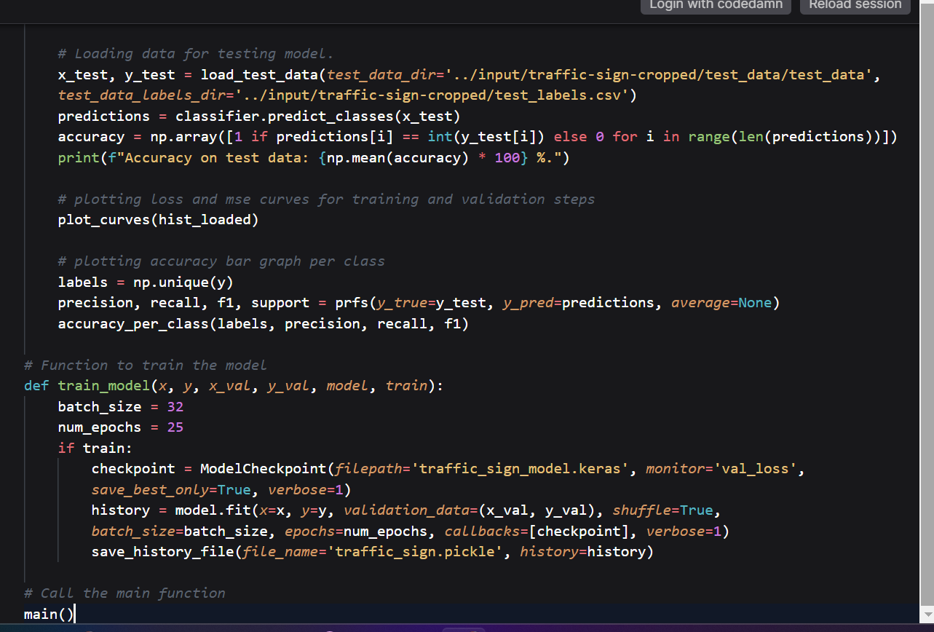
Code snippet-
Traffic signal detection

Slide 9
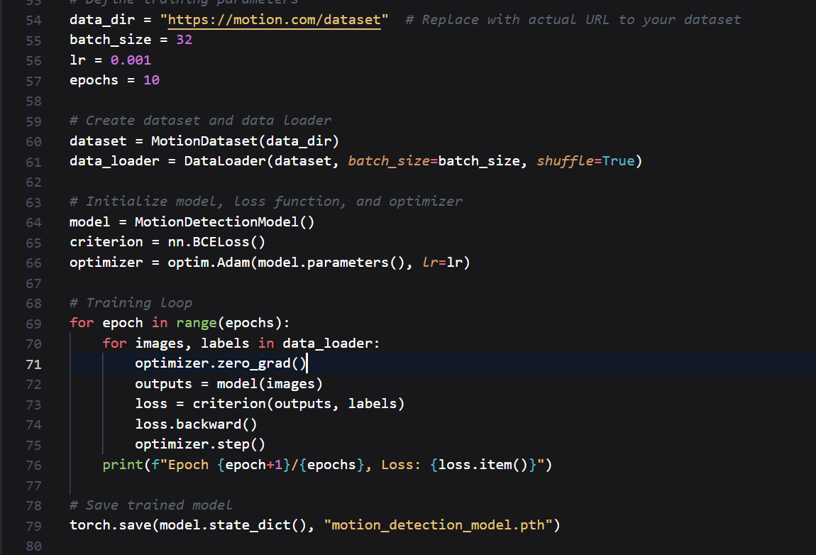
Code snippet Motion detection

Slide 10
6.YOLOV DETECTION-
YOLOv (You Only Look Once version n) is a family of deep learning models used for object detection.
The key idea behind YOLO isto divide the input image into a grid and predict bounding boxes and probabilitiesfor each grid cell.YOLO (You Only Look Once) models can be integral to the functionality of autonomous vehicles by providing real-time object detection capabilities.
These models are adapt at recognizing and localizing various objects in a vehicle
Versions of YOLOv are_x0002_YOLOv 1,YOLOv2,YOLOv3,YOLOv4, YOLOv5, YOLOv6, and YOLOv7,YOLOv8,YOLOv10 models.

Slide 11
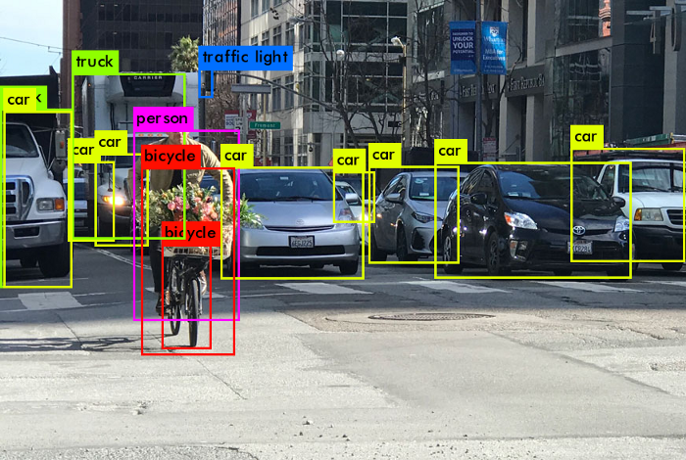
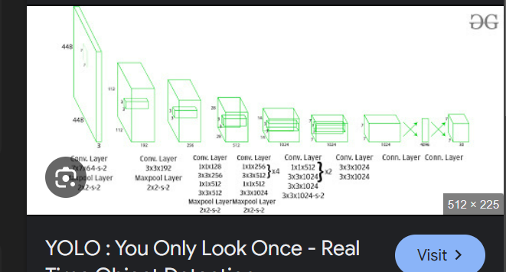

Slide 12
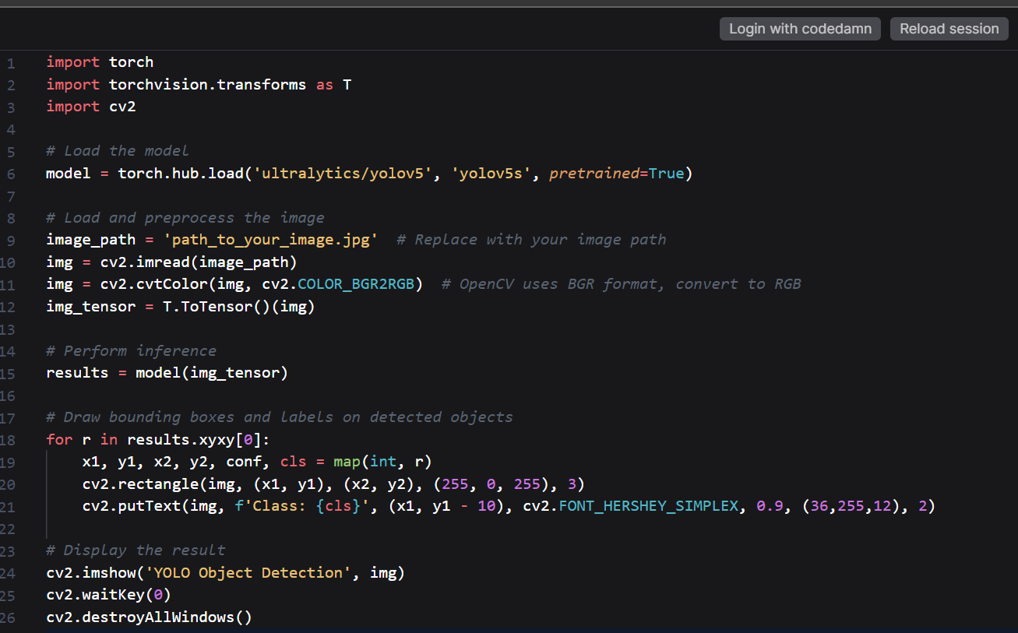
Code Snippet(YOLOV)
Real time object
prediction

Slide 13
7.Seat Yolo Prediction-
Several deep learning-based architectures have been utilized for the recognition of shadow regions in images and videos with the aim of classification and segmentation of shadow instances. The present work aims towards solving the problem of shadow recognition as a detection and regression problem. To solve the problem of shadow detection in images and videos, we have developed SEAT-YOLO, a deep learning-based shadow detection architecture
The SEAT-YOLO is a novel deep learning architecture that combines squeeze-excite blocks, spatial attention module, and spatial pyramid pooling along with three YOLO detection heads for accurate detection of shadow regions in images and videos.
The present work addresses the problem of shadow region detection from the perspective of shadow detection and scene interpretation for autonomous vehicles. To propose a deep learning-based solution that can detect shadow regions in images and video frames with high accuracy and precision, the selection of the base architecture which has proven its competency is a must need.
References-https://www.sciencedirect.com/science/article/abs/pii/S0030402623000098

Slide 14
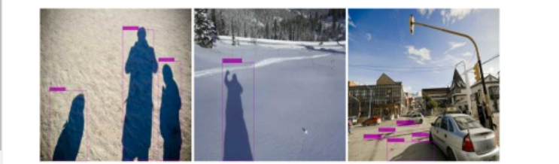
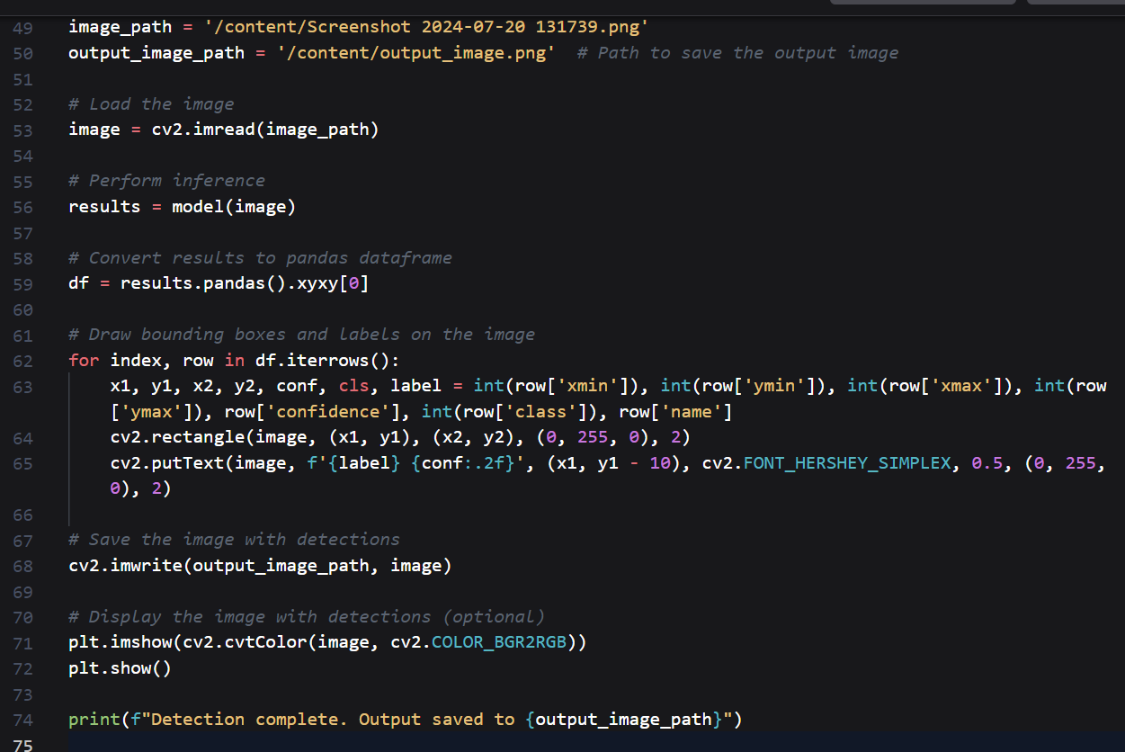
CODE SNIPPET SEAT YOLOV

Slide 15
pect | Traditional CNN-based Object Detection | YOLO Object Detection
Approach | Region-based: Proposes regions, then classifies them | Single shot: Predicts bounding boxes and classifies in one pass
Speed | Slower due to region proposal and multiple passes | Faster due to single pass prediction
Real-time Performance | Typically slower, especially with high-resolution inputs | High real-time performance, suitable for video streams and real-time applications
Accuracy | Can achieve high accuracy with refined region proposals | Generally good accuracy, trade-off with speed and network size
8.STUDY ON RESULTS
ASPECT | CNN BASED DETECTION | YOLOV OBJECT DETECTION
Approach | Proposes Regions and classifies them | Predicts bounding boxes and classifies
Speed | Slower due to multiple passes | Faster due to single pass prediction
Performance | Typically slower | High real time performance
Accuracy | Can achieve high accuracy proposals | Generally good accuracy with speed
Object Detection Prediction | May require multiple scales for detection | Unified detection across scales
Application | Suitable for accurate | Ideal for autonomous drive,surveillance
Usage | Used for real time processing | Widely used for better accuracy and speed
Model Size | Larger due to multiple stages | Generally compact especially YOLOV4
Examples | R-CNN,FASTER R-CNN | yolov2,yolov3,yolov5
Object Detection Precision | May require multiple scales for detection | Unified detection across different scales
Application Suitability | Suitable for accurate but slower applications | Ideal for real-time applications like autonomous driving, surveillance
Training Complexity | Requires careful tuning of region proposals | Easier to train due to unified architecture
Model Size | Larger due to multiple stages | Generally compact, especially YOLOv4 and later
Usage in Autonomous Vehicles | Used but challenged by real-time processing requirements | Widely used due to its speed and accuracy balance
Examples | R-CNN, Fast R-CNN, Faster R-CNN | YOLO, YOLOv2, YOLOv3, YOLOv4, YOLOv5

Slide 16
FUTURE WORKS AND CHALLENGES-
1.Work on other pretrained models on yolo10 version.
2.Try to work on seat yolo algorithm

Slide 17
Thank You

