Slide 1
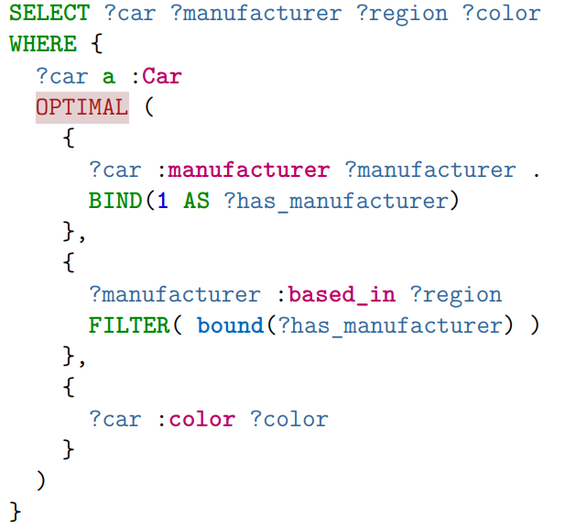

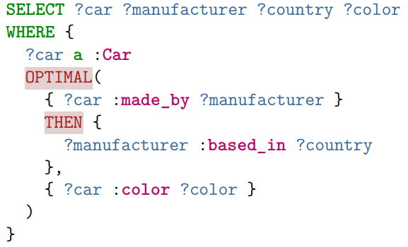
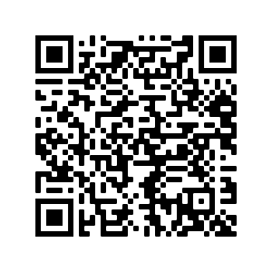


OptiSparql
Modeling Interdependent Preferences over Incomplete Knowledge Graph Query Answers
Examples
Preferences offer an intuitive way to retrieve complex data structures from incomplete knowledge graphs.
Minimal example of our framework
MOTIVATION
Conjunctive queries (AND operations) can unexpectedly lead to empty result sets
OPTIONAL queries can lead to extensively massive and intransparent result sets
Preferences model explicit wishes naturallly over incomplete data sets
Some preferences may depend on other wishes to be fulfilled (as shown in the example)
Our previous work lacks this ability
STRUCTURE
Isolate common types of use cases of inter-dependent preference models
Develop a syntax that is easy to understand and as concise as possible
Derive how these queries should be handled semantically
Extend our existing query rewriting technique to accomodate for our modifications
Discuss performance implications
RESULTS
Preferences deliver results somewhere between conjunctions and OPTIONAL patterns
Framework already usable vie query rewriting
New operators solve modeling problems of our framework
No known performance impacts compared to our original framework
Dependencies prior to our revision
I prefer the color red when it comes to sports cars.
Dependencies after our revision
Till Affeldt, Stephan Mennicke, Wolf-Tilo Balke
Take a picture to download the full paper
Notes:
Notes:
In Powerpoint, click View > Guides
Keep text within gutter guides.
Author list: Don’t split names onto two lines (e.g., “Jimmy [break] Smith”). If that happens, use a new line, unless you need the space. Bold the first names of anybody who’s presenting in person.
Intro/methods/result: Do not drop below font size 28, but if you have extra space, jack up the font size until the space is full.
Do not use color in the sidebars except in graphs/figures. It’ll pull attention from the center and slow interpretation for passersby.
<Foliennummer>

