Slide 1
KRAFT-WORK
Your CP Companion

Slide 2
Features
Text Editor: A simple yet powerful text editor for taking notes.
Draw Board: A canvas for drawing diagrams, algorithms, or any other visualization needed for Competitive Programming.
Graph Editor: A tool for creating and editing graphs.
Calculator: A scientific calculator that can handle complex expressions, including mathematical functions and constants used in Competitive Programming.
Bookmarks: A bookmark manager that allows you to save and organize important links and resources for Competitive Programming.
Charts: Various charts and visualizations commonly used in Competitive Programming.

Slide 3
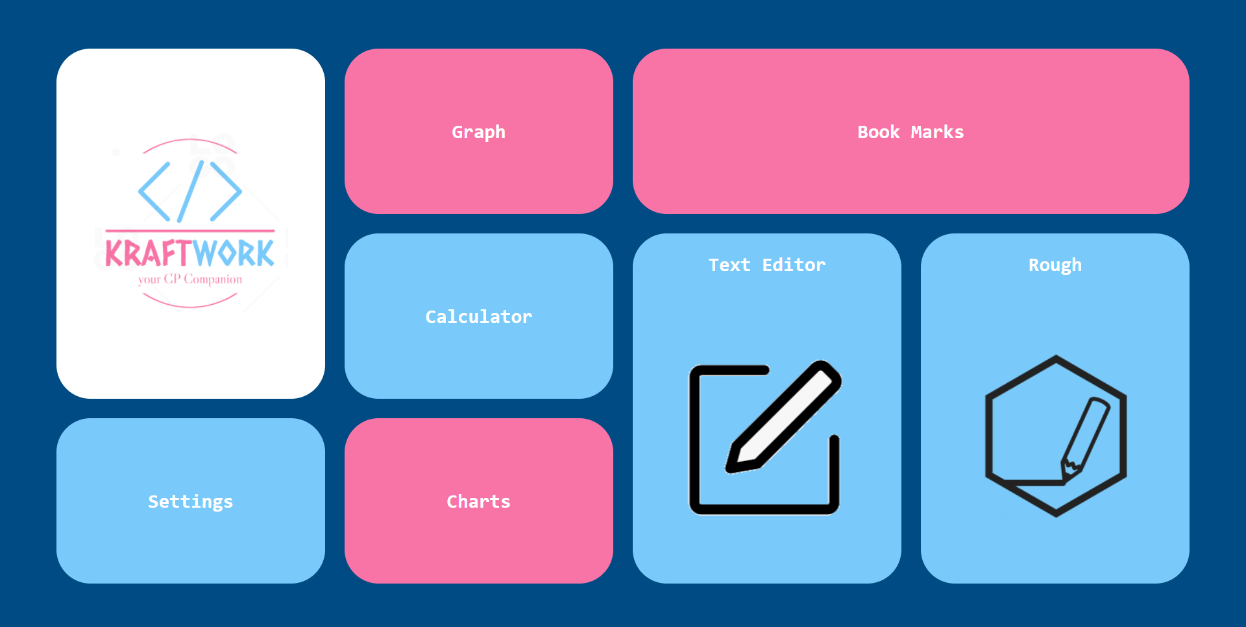
Preview
Home Page

Slide 4
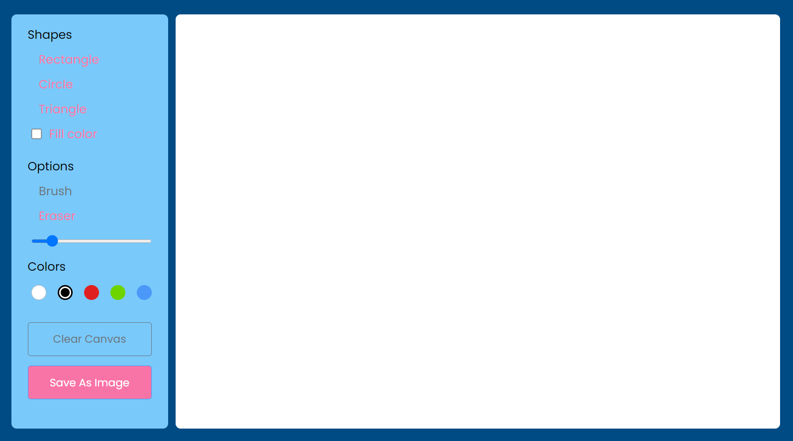
Preview
Draw
Board

Slide 5
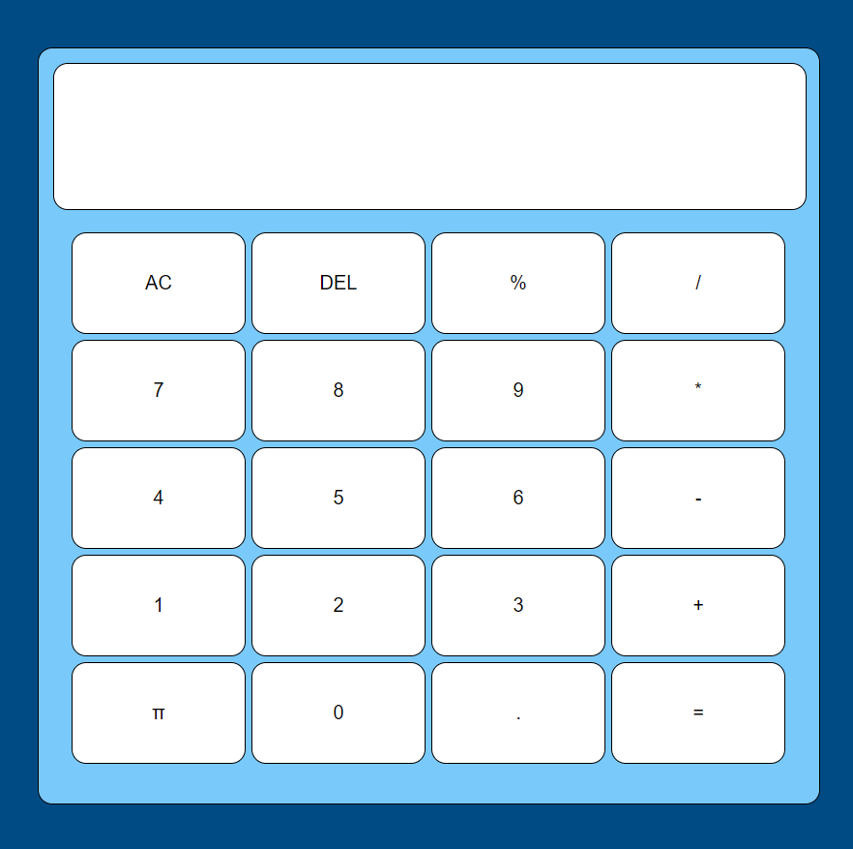
Preview
Calculator

Slide 6
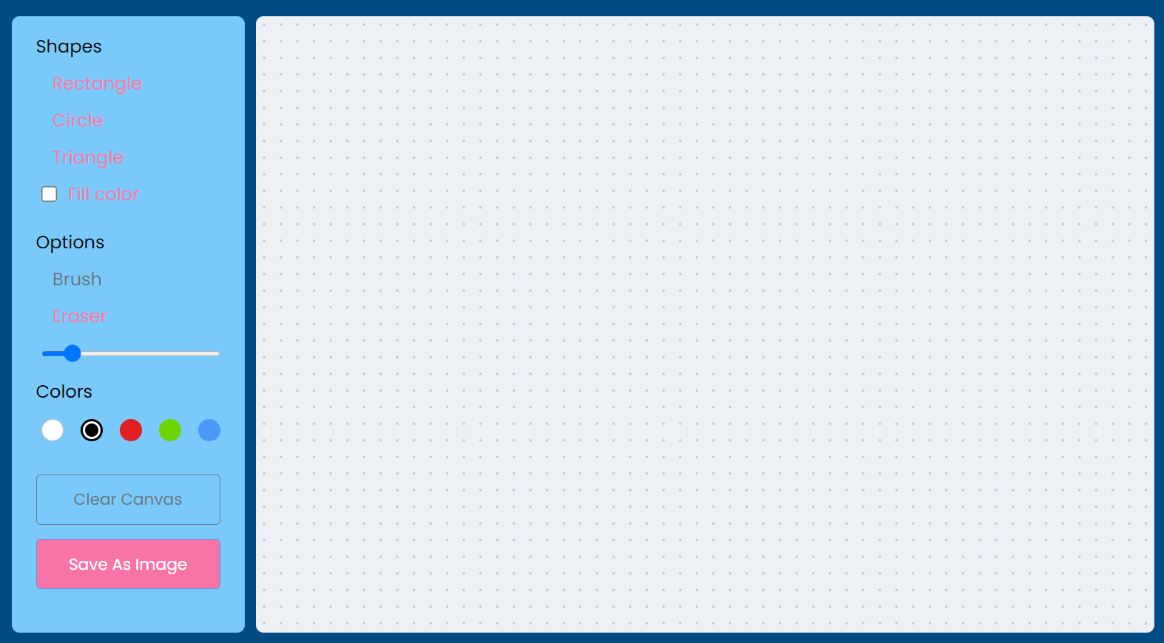
Preview
Graph

Slide 7
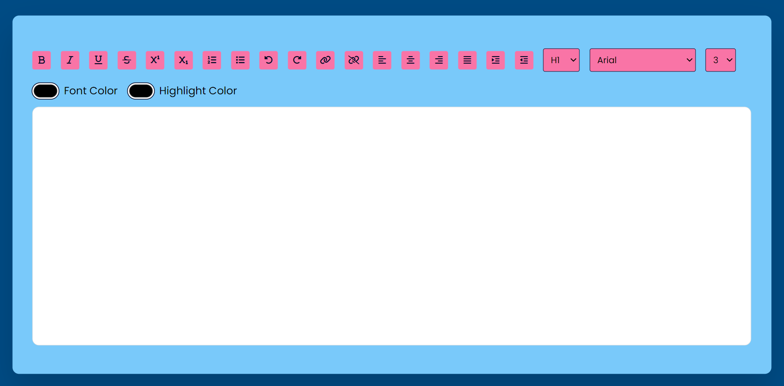
Preview
Text
Editor

Slide 8
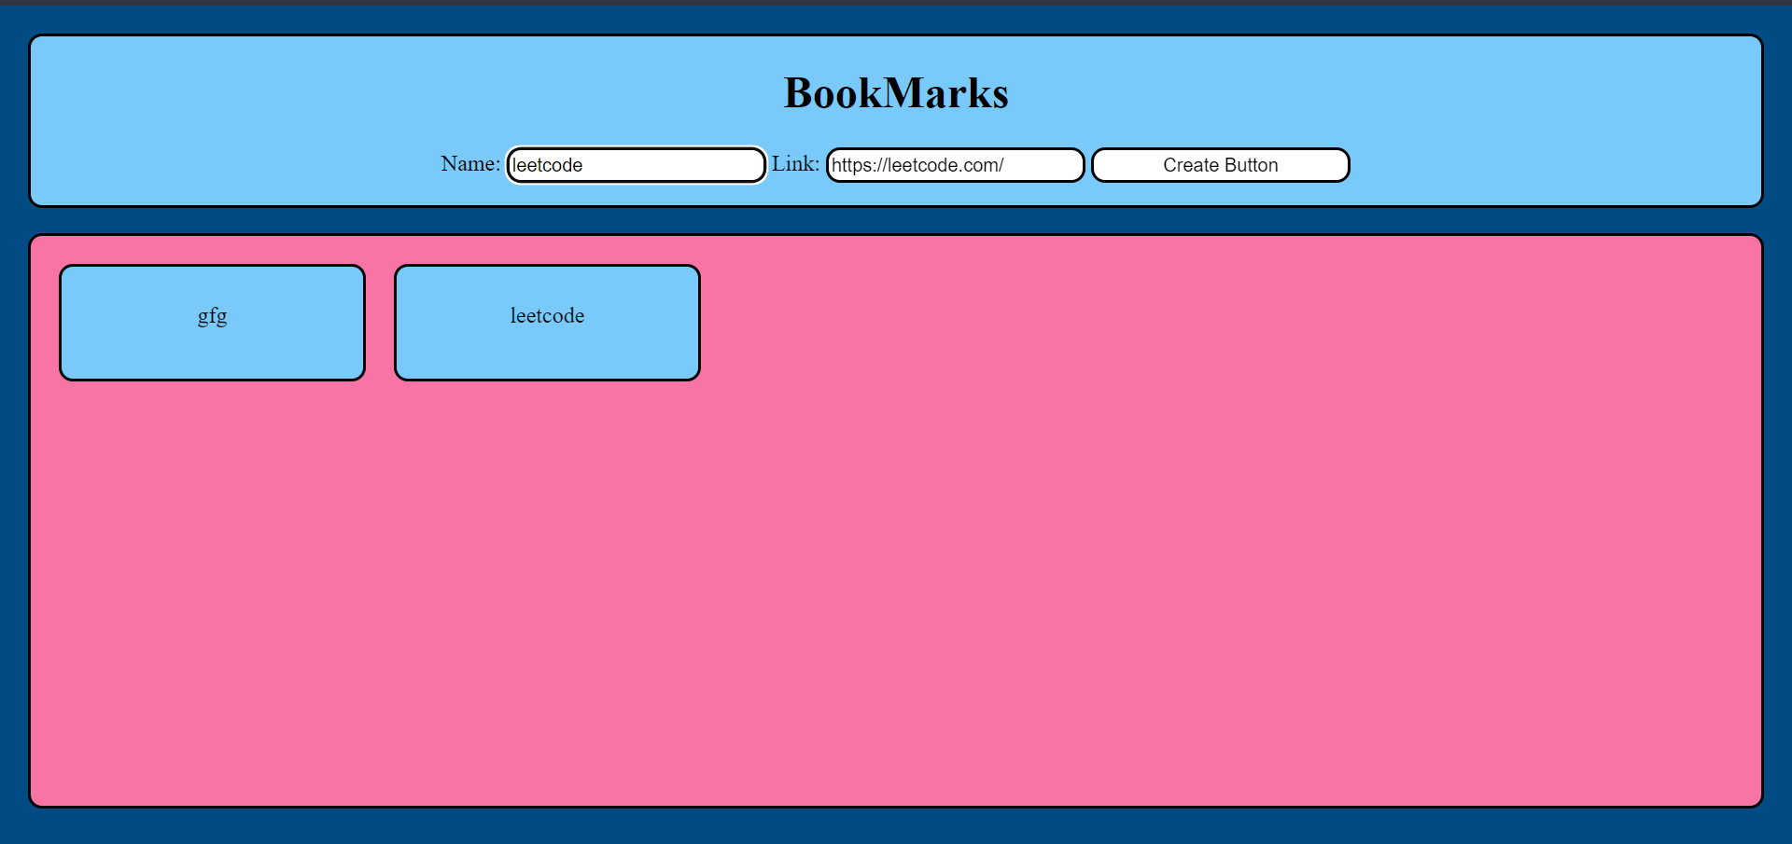
Preview
Book
marks

Slide 9
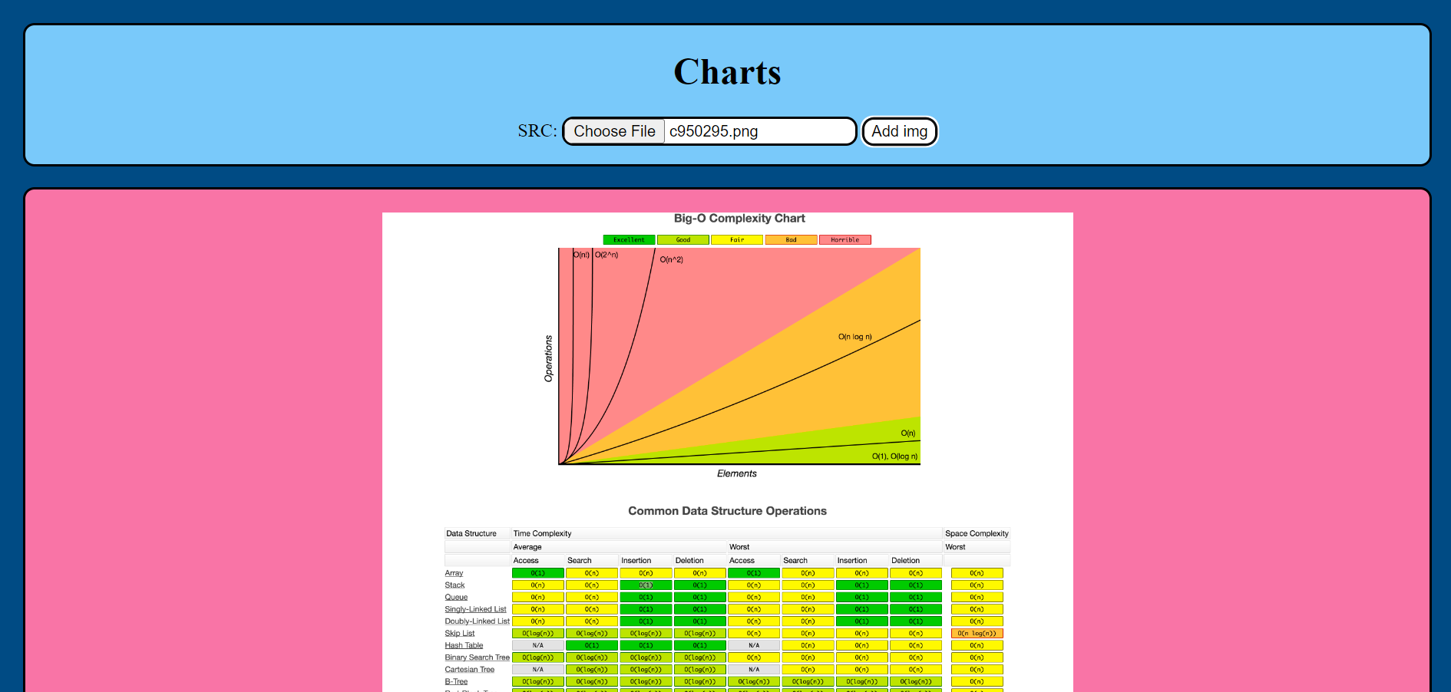
Preview
charts

Slide 10
Preview
charts

Slide 11
GITHUB
If you find any issues or have ideas for new features, feel free to open an issue or submit a pull request on the GitHub repository. Contributions are always welcome!
profile

