Slide 1
Scheduling in a Real-time Network-on-Chip
Period minimization using metaheuristics
Mark Ruvald Pedersen
Rasmus Bo Sørensen
Jaspur Højgaard

Slide 2
Background
Our background and work – CS&E, ESE-section DTU. NoCs, CPUs, compilers, HW-design, i.e. ”the nitty-gritty stuff”.
Embedded systems have a clear purpose and function.
Embedded systems are pervasive – mp3-players, ovens, traffic lights, …
Hard real-time requirements, e.g. missed deadline ⇒ death (or worse!)
  Navigation controllers in an airplane, train control system
Future: Performance implies parallel.
Performant embedded systems ⇒ many (heterogeneous) cores = MPSoC
  Must remain WCET-analyzable! Desktop CPUs
DTU seeks to design and implement such a time-predictable MPSoC; CPU, interconnect and tools. Part of EU-funded project T-CREST.
Many cores ⇒ scalable interconnect ⇒ NoC.
Cheap and time-predictable ⇒ NoC is statically scheduled.
Rasmus has implemented the NoC which we schedule here.

Slide 3
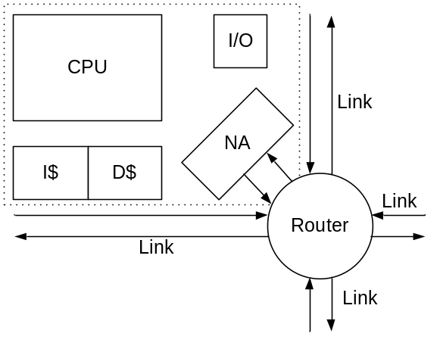
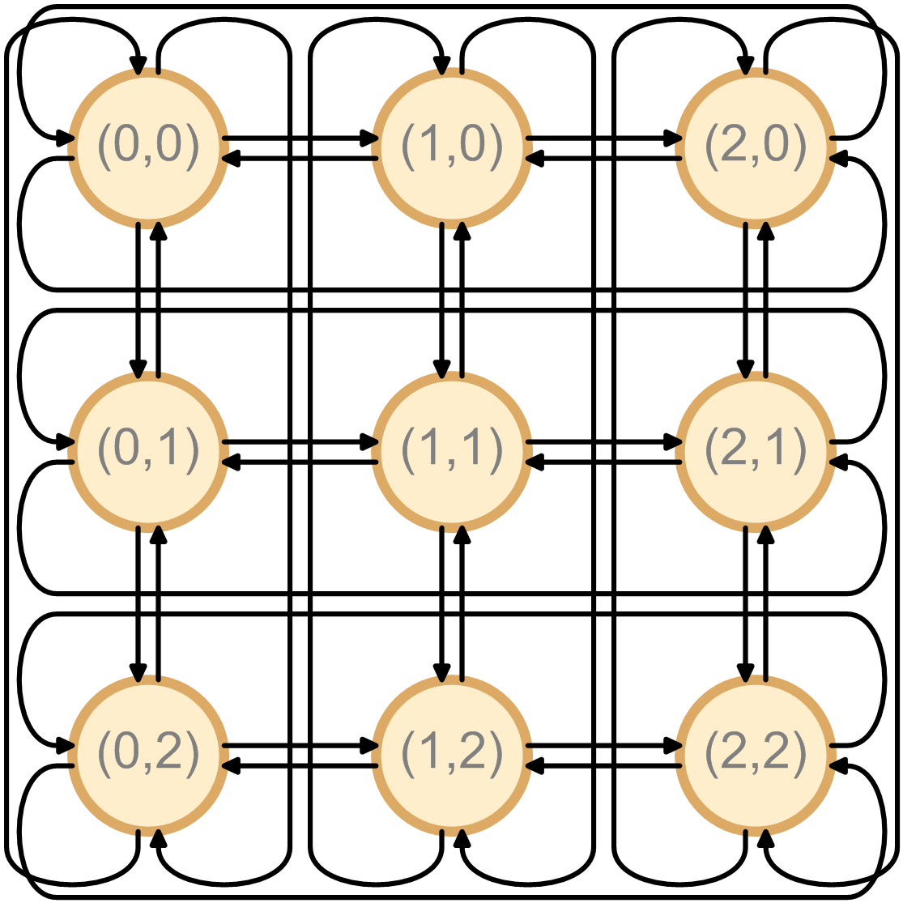
Problem
Static scheduling of our Network-on-Chip interconnect.
Input: Desired inter-processor communication
  Channels (from,to,BW)
A path is a contiguous sequence of links through time.
Objective: Route channels to paths, minimizing schedule length.
Constraints:
  A link can only carry 1 packet per unit time
  In-order arrival of packets (shortest path)
  No buffering on links (expensive HW)
Should support arbitrary channel specifications
  But focus on single-packet all-to-all
NP-complete: Integer multi-commodity flow problem on time-expanded graph

Slide 4
Prior work
Florian Brandner:
Optimal scheduler (using CPLEX)
Heuristic scheduler
Uniform local schedules
  much smaller search space
Used as baseline

Slide 5
Operators
No clear local neighborhood of feasible solutions.
ALNS-inspired: Destroy and rebuild entire paths.
Operators for destroy:
Dominating paths
Dominating rectangle
Late paths
Random
Operators are chosen adaptively.
Rebuild:
Greedy randomized first-fit.

Slide 6
Metaheuristics
Greedy randomized adaptive search procedure (GRASP)
Local search of GRASP is choose_operator, destroy and repair.
Random-operator not used.
No clear local neighborhood, so use ALNS-operators.
Very large solution spaces.
procedure our_grasp(β)
best = infinite
while (still time left)
  current = initial_solution(β)
  if (current shorter than best) then best = current
  op = choose_operator()
  chosen = op()
  destroy(chosen)
  repair(chosen)
  if (current shorter than best) then best = current
  punish_reward(op)
return best
Local search

Slide 7
Metaheuristics
Adaptive Large Neighborhood Search (ALNS)
Finds feasible solution easily.
Destroy and repair gives very large neighborhood.
Iteratively tries shortening the schedule.
procedure our_alns(init)
  best = current = init.initial_solution()
while (time left)
operator = choose_operator()
chosen = operator()
destroy(chosen)
repair(chosen)
if (current shorter than best) then best = current
punish_reward(operator)
return best

Slide 8
Parameter tuning
Real-world running time – in the days range
Test run 2 hours
Limited parameter tuning
Choose operator
GRASP
  β
ALNS
  Initial solutions

Slide 9
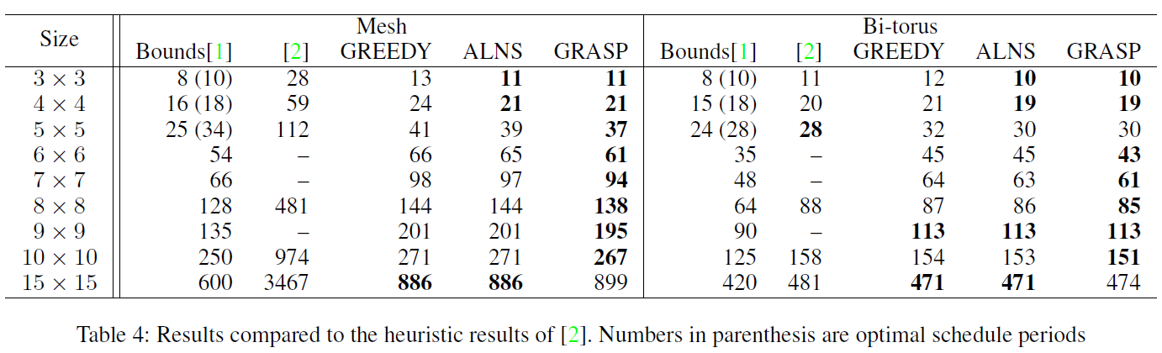
Results
Overall best metaheuristic GRASP.
Low relatedness between neighboring solutions. -> GRASP

Slide 10
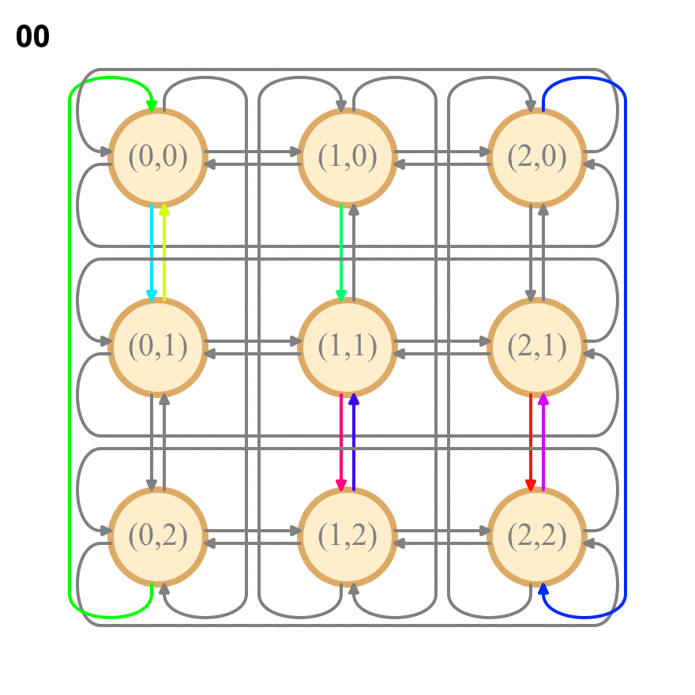
Scheduler output

Slide 11
Future work
More parameter tuning
  Simulated Annealing-like behavior for choose table
Elaborate on our GRASP-implementation, esp. local search
Operator-found dependencies are too approximate
Tie-break by schedule-homogeneity (router-density)
General performance improvements:
  Routing can be parallelized
  First step of Greedy first-fit: O(n) ⇒ O(log n)
  Delta-evaluation: Amortized O(1) objective function
Implement optional reply-packets
Need real-world application-specific use-cases
Article submission

Slide 12
Conclusion
Metaheuristics improve greedy initial solution.
All-to-all results within ~30% of the analytical bounds.
For all mesh networks, we improve by more than a factor of 2.
Also supports application specific cases.

