Slide 1
SMELLS LIKE A DATABASE
BERGAMOT ✦ SANDALWOOD ✦ MUSK ✦ PATCHOULI ✦ JASMINE ✦ VANILLA ✦ VETIVER
CS317 FINAL PROJECT · PROJECT OVERVIEW
A database and website for a niche fragrance stockist
01
02
03
WHAT IT IS
WHO USES IT
WHY WE CHOSE IT
Fragrances, brands, perfumers, notes and ingredients, plus the stores that stock them and every sale.
Shoppers find fragrances by note and see which store has one in stock. Staff record sales and check best sellers.
Perfume data is naturally connected: one fragrance links to a brand, a perfumer, many notes and many stores.
TJ DRAPE · AFONSO AZEVEDO · JOHN MARKHAM
Notes:
SPEAKERS: John, then Afonso, then TJ (about 15 seconds each)
JOHN: What it is
"Our project is called Smells Like a Database, and our app is called Sillage. It's a database and website for a niche fragrance stockist, a shop that sells hard-to-find perfumes across several stores. It tracks fragrances, brands, perfumers, notes and ingredients, plus the stores that stock them and every sale."
AFONSO: Who uses it
"Two kinds of people use it. Shoppers can search fragrances by scent note, like vanilla or bergamot, and see which store has one in stock. Staff use it to record sales, restock stores, and see what's selling."
TJ: Why we chose it
"We picked perfume because the data is really connected. One fragrance has a brand, a perfumer, a list of notes and ingredients, and it's stocked at many stores. That made it a good fit for a relational design."
Hand off (TJ): "John's going to walk through how we modeled it."

Slide 2
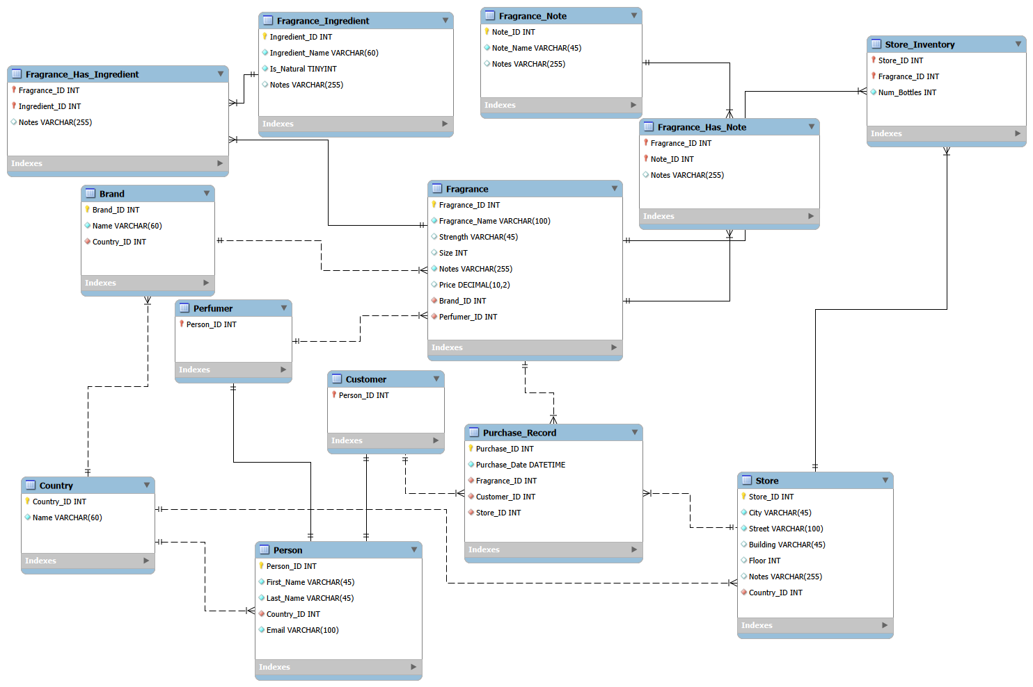
ER DIAGRAM
02 · DESIGN
13
THE HUB
TABLES IN OUR DATABASE
Fragrance is the hub
Brand, perfumer, notes, ingredients, stock and sales all connect to it
Person splits in two
Customer and Perfumer share one Person table
Three linking tables
Handle many-to-many: notes, ingredients, inventory
Notes:
SPEAKER: John (about 45 seconds)
This is our ER diagram straight from MySQL Workbench: 13 tables, with the same names you'll see in our code.
Fragrance is the hub. Almost everything connects to it: its brand, its perfumer, its notes and ingredients, the stores that stock it, and every purchase.
Person splits into two roles, Customer and Perfumer. They share one Person table for names, emails and country, so we don't store that twice. Customer and Perfumer each use Person_ID as both their primary key and a foreign key.
We have three linking tables for many-to-many relationships. A fragrance has many notes and a note appears in many fragrances, so Fragrance_Has_Note sits between them. Same idea for ingredients, and for Store_Inventory, which links stores and fragrances and also stores the bottle count.
Hand off: "Afonso will now go deeper into the database, highlighting the tables our app uses."

Slide 3
RELATIONAL SCHEMA
03 · WHAT OUR APP USES
01
02
03
PURCHASE_RECORD
FRAGRANCE
PERSON → CUSTOMER
PK Purchase_ID
Purchase_Date
FK Customer_ID → Customer
FK Fragrance_ID → Fragrance
FK Store_ID → Store
PK Fragrance_ID
Fragrance_Name, Size
Price (CHECK ≥ 0)
FK Brand_ID → Brand
FK Perfumer_ID → Perfumer
PK Person_ID
First_Name, Last_Name
Email (UNIQUE)
FK Country_ID → Country
PK FK Customer.Person_ID
04
05
06
STORE
STORE_INVENTORY
FRAGRANCE_HAS_NOTE
PK Store_ID
City, Street
FK Country_ID → Country
PK FK Store_ID → Store
PK FK Fragrance_ID → Fragrance
Num_Bottles (CHECK ≥ 0)
PK FK Fragrance_ID → Fragrance
PK FK Note_ID → Fragrance_Note
Fragrance_Note: PK Note_ID, Note_Name
Notes:
SPEAKER: Afonso (about 45 seconds)
These are the six tables our app's features actually use.
Purchase_Record is the center of the sales side. Each row has three foreign keys: one customer, one fragrance, one store.
Store_Inventory’s key is Store_ID plus Fragrance_ID together, because neither one is unique on its own. Each pair is one row: this fragrance at this store, with its bottle count. It’s the same idea as Sunrise’s Qualification table, where the key is InstructorID plus ModelID: one row for each instructor and aircraft model pair.
The constraints protect the data, and you'll see them in the demo. Email is UNIQUE, so the same person can't register twice. Price and Num_Bottles have CHECK constraints so they can't go negative.
Fragrance_Has_Note is what powers search by note.
Hand off: "TJ has some fun facts to share before the demo."

Slide 4
FUN FACTS
04 · FROM OUR CATALOGUE
SILLAGE
540
SAY IT: SEE-YAHZH · FRENCH
°C · BACCARAT ROUGE 540
Literally the wake a boat leaves behind it. In perfume, it's the scent trail someone leaves in the air as they walk past. That's why we named our app after it.
Baccarat Rouge 540 is in our database. It began in 2014 as just 250 crystal bottles for Baccarat's 250th anniversary. 540 °C is the heat that turns Baccarat crystal red.
Notes:
SPEAKER: TJ (about 30 seconds)
Two quick fun facts.
First, our app's name. Sillage is French for the wake a boat leaves behind it. In perfume, it means the scent trail someone leaves in the air as they walk past. If you can still smell someone's perfume after they've gone, that perfume has strong sillage. That's why we named our app after it.
Second, Baccarat Rouge 540, which is in our database, started in 2014 as just 250 crystal bottles for the crystal maker Baccarat's 250th anniversary. The 540 is the temperature in Celsius it takes to turn Baccarat's crystal red.
Hand off: "Now let's show you Sillage."

