Slide 1
Artificial skin
Magnus Liisberg & Thor Jensen

Slide 2
Project Motivation
Enabling robots to sense pressure
Creating a framework to build a classifier for different surfaces
Pressure mapping in prosthetic limbs

Slide 3
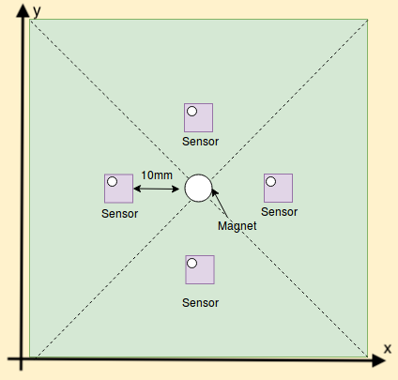
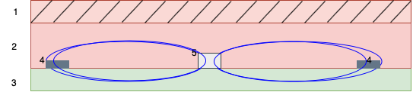
What are we doing?
Estimation of position with electromagnetic fields.
Notes:
Add sensor array top view
Add steps

Slide 4
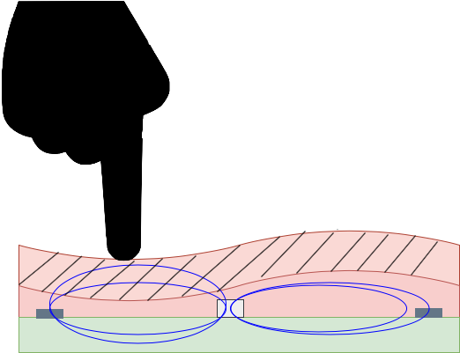
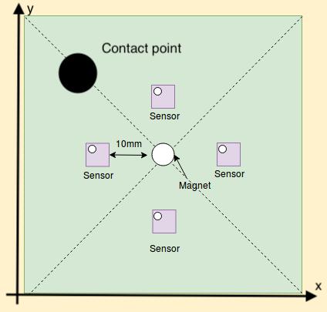
How it works

Slide 5
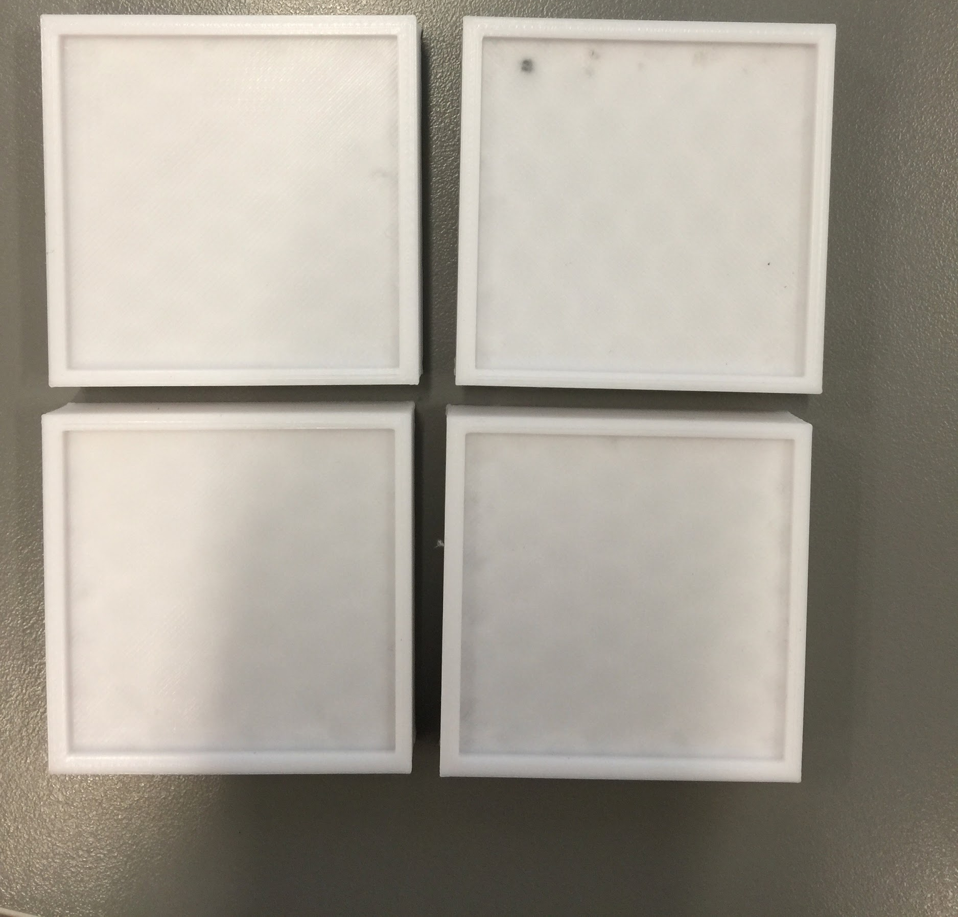
Skin creation
3D printed moulds
Metal “laced” upper skin layer

Slide 6
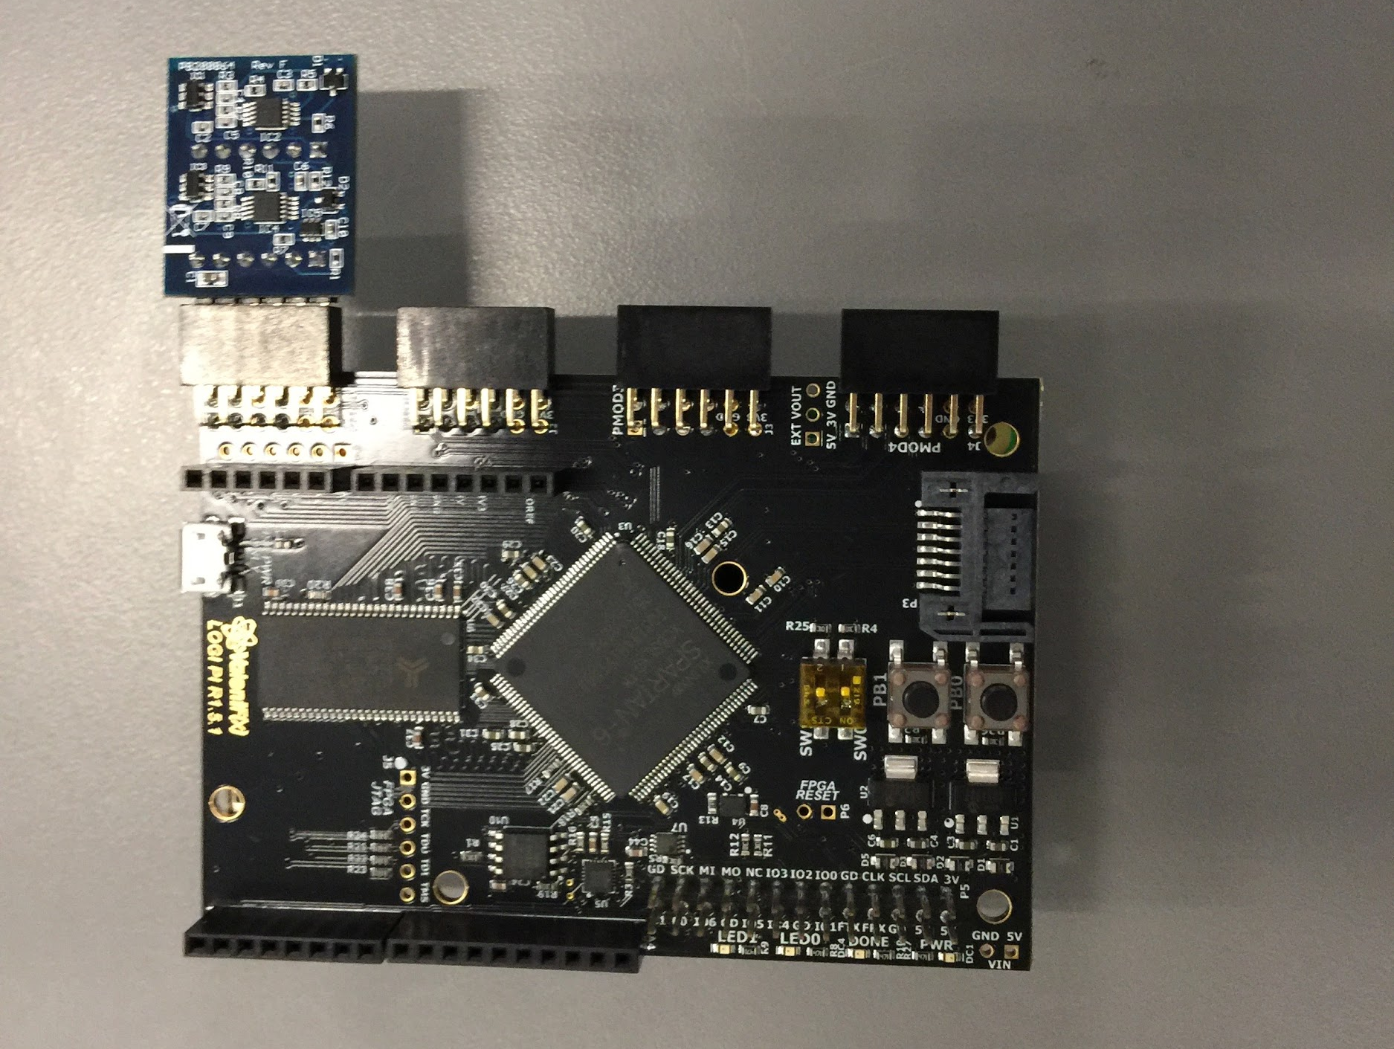
Hardware
Raspberry pi w/Fpga shield
A/D converter

Slide 7
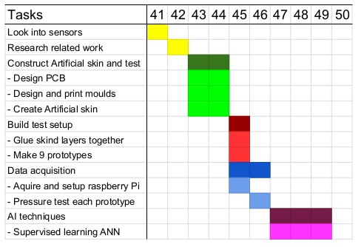
Timeline
Gantt chart
Agile
Cautiously optimistic !

