Slide 1
Crosstalk
What is Crosstalk? – Why should we care? 1/2min
How to calculate mutual capacitance? 1min
How to calculate mutual inductance? 1min
Ground planes – Lumbed & Distributed 1min
NEXT & FEXT 1min
NEXT becoming FEXT problem 1/2min

Slide 2
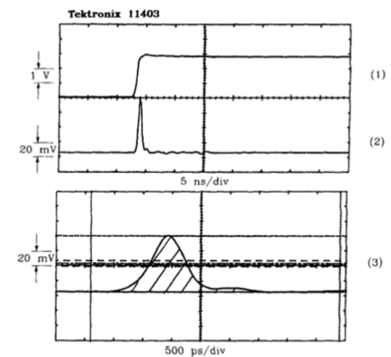
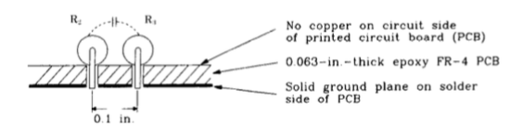




Capacitance

Slide 3
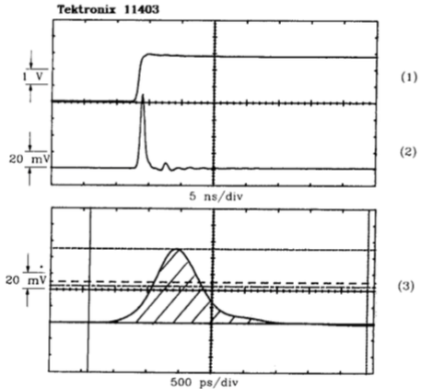
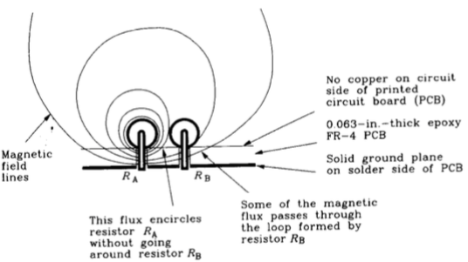





Inductance

Slide 4
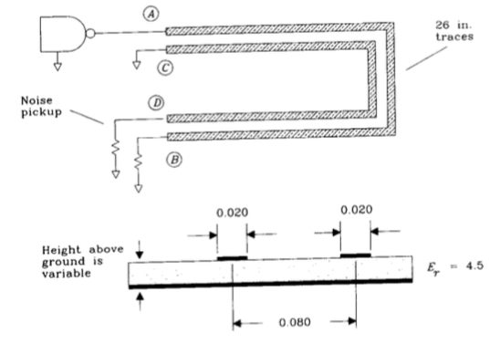
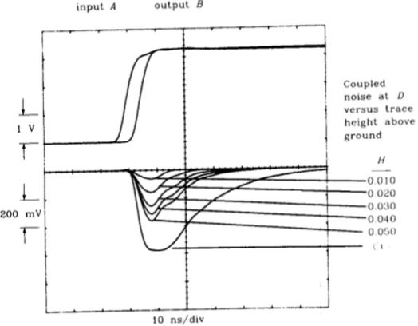
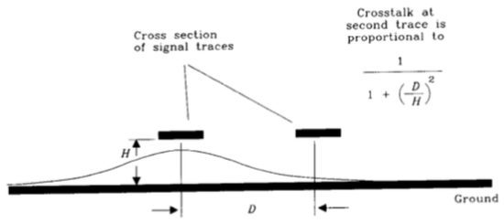

Ground planes – Lumbed

Slide 5
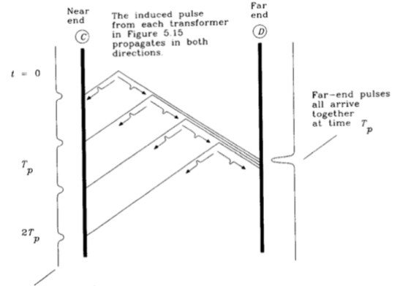
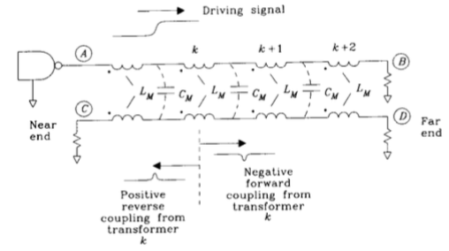
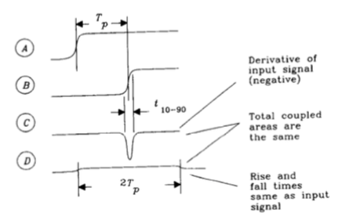
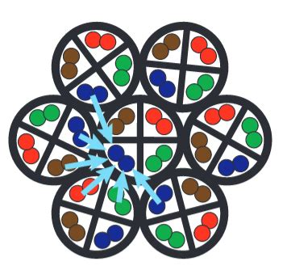
NEXT & FEXT - Distributed

Slide 6
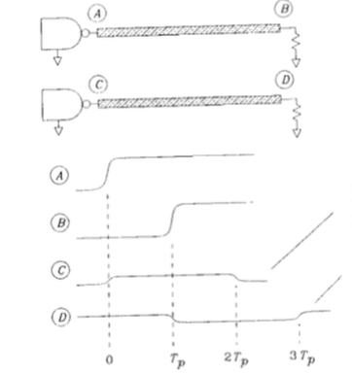
NEXT becoming FEXT problem

