Slide 1
ARP Spoofing
Attack & Defend

Slide 2
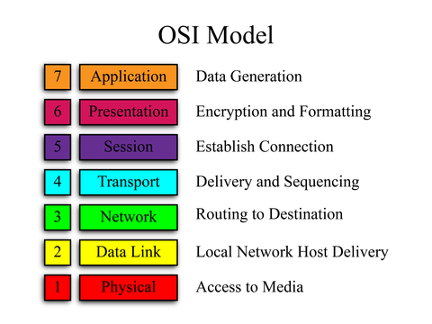
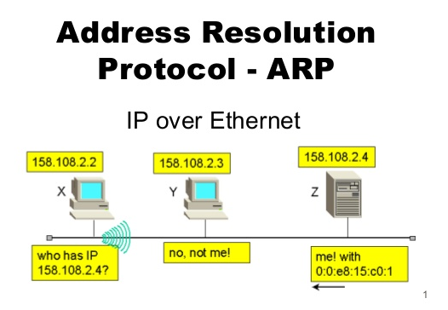
ARP (1min)
What is it?
Usage
Exploit

Slide 3
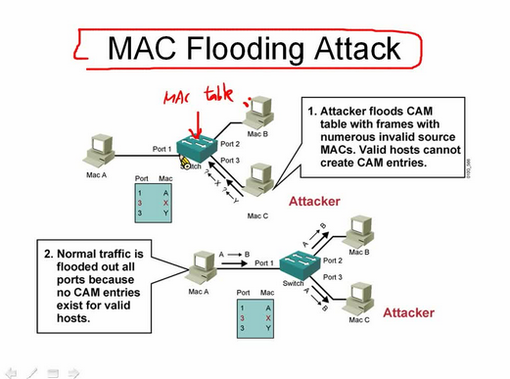
Denial Of Service (2min)
Macof
Untargeted
Targeted
Filtering ( Ettercap)
Associate large network to victims MAC

Slide 4
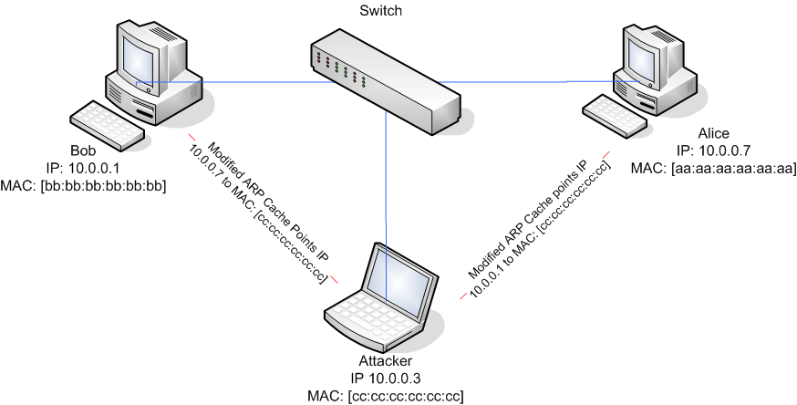
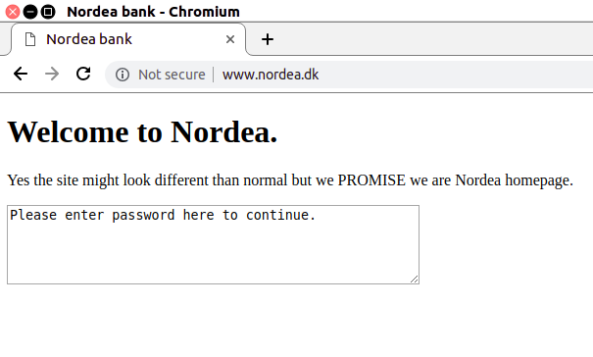
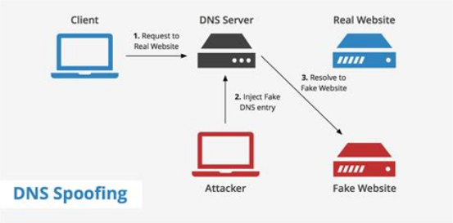
Man In The Middle (2min)
ARP spoof (and a little spice!)

Slide 5
Defence (1min)
Pro active
Static
Reactive
Monitoring traffic
Attack in progress.

Slide 6
Summarize
Authentication
ARP poisoning/exploit
Weird observation!
Firefox withstood fake site.
Chrome – not so much.

