Slide 1

github.com/tmux/tmux

Slide 2
Problems faced when working on a (remote) terminal
Serial connection provides only one terminal but you need twelve?
Need to copy/paste some text on the console but the mouse is borked?
Crazy firewall kills connection and crashes your remote process?
You have to log out but you want to start kernel compilation *and* interact with process later?

Slide 3
tmux
terminal multiplexer
Background a process (detach) and re-attach it later, from another session.
Manage views from multiple processes, arranged in a meaningful layout.
Keep the layout until next re-attachment
Protect remote processes against a flaky connection
Keyboard controlled copy/paste. Search, too!
Share a terminal with a fellow user (google ‘wemux’)

Slide 4
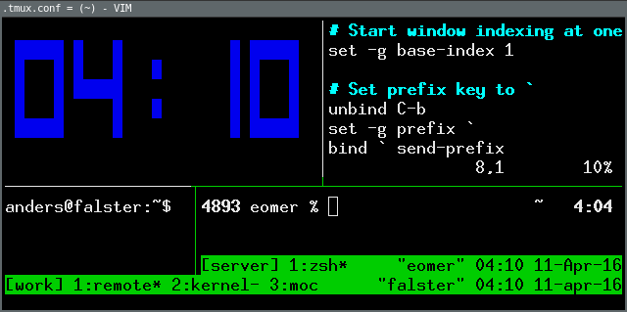
Boy, oh boy!
So what does it look like, then?
tmux sessions can be nested.
(Yes, that clock is a built-in, it is called clock-mode)

Slide 5
The tmux layout
- or what are sessions, windows, panes
Session
Window
Window
Pane
Pane
Pane
Illustration based on danielmiessler.com/study/tmux/

Slide 6
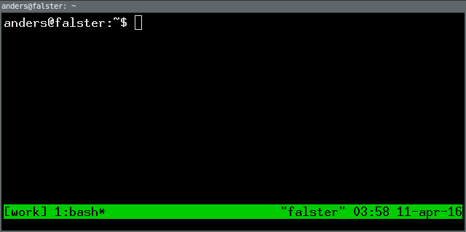
Basic screenshot
Default status bar shows [session name] and window names on the left. Right side has other misc. information.

Slide 7
Basic tmux usage
> tmux
> cd /usr/src/linux
> make
‘C-b d’
(go to lunch...)
> tmux attach
> exit
'C-b d' is tmux terminology for pressing <Ctrl-b>, then 'd'.
It understood that 'C-b' is the so called prefix, which is customisable, of course :)

Slide 8
Command examples
To start a new tmux session with a sensible name:
> tmux new-session -s fun_project
> tmux attach
Both command names and session names can be abbreviate:
> tmux new -d -s work
> tmux a -t fun
List existing sessions:
> tmux ls
fun_project: 1 windows (created Sun Apr 10 22:36:10 2016) [158x78]
work: 1 windows (created Sun Apr 10 22:37:16 2016) [158x78]
Interact with sessions, fx:
> tmux kill -t work

Slide 9
A few tmux key-bindings
List key-bindings | C-b ?
Command-prompt | C-b :
Split pane vertically | C-b %
Split pane horizontally | C-b “
Select another pane | C-b Up/Down/Left/Right
Break pane (convert current pane to window) | C-b !
Create new window | C-b c
Switch to next window | C-b n
Rename window | C-b , (←it is a comma)
Detach session | C-b d
Kill window (will ask for confirmation) | C-b &
For more, see the man page or do C-b ?

Slide 10
Basic tasks
On the Pi, do the following:
Become familiar with attaching and detaching a tmux session.
Make two or more windows in the same tmux session, switch between them.
Split a window several times, horizontally and vertically. Navigate the panes. Try switching windows again!
Detach the current session and close the ssh or serial connecting. Reconnect and attach the tmux session.
Is it still running?

Slide 11
More tmux tasks
Recreate the layout depicted on the “Boy, oh boy! So what does it look like, then?”-slide.
Attach the same tmux session from two different terminals of different dimensions—what happens?
Enable vi key-bindings for copy-mode in the ~/.tmux.conf file.
Try to copy and paste some text.
Add a key-binding for ‘r’ in ~/.tmux.conf to re-read the config file
Change the prefix to C-a
Make key-bindings so panes can be navigated with h, j, k, and l
Split an existing tmux window horizontally without attaching the session
Make the prefix work in a nested tmux session, ie. tmux inside tmux.
Make the numbering of panes and windows start from 1 instead of 0

