Slide 1
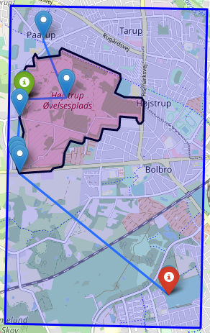
What &Why?
Visibility Graph
Bounding box
Buffer
Special cases

Slide 2
Pros & Cons ( Visibility graph)
Few vertices
Fast search time
Shortest path (Avoid ”sawtooth” pattern)
Flying close to NFZ
Time to construct Graph
”Unknown” construction time
Continues planning

Slide 3
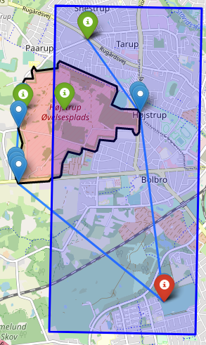
Reflections
Route outside Boundingbox
Dijkstra’s vs A*
Local planner
Rebuild Graph when new polygon is injected
Only plans in 2D
Consider SoC
Preemptive planning
(Close neighbours)
(DNFZ over drones/Deconflict)

