Slide 1

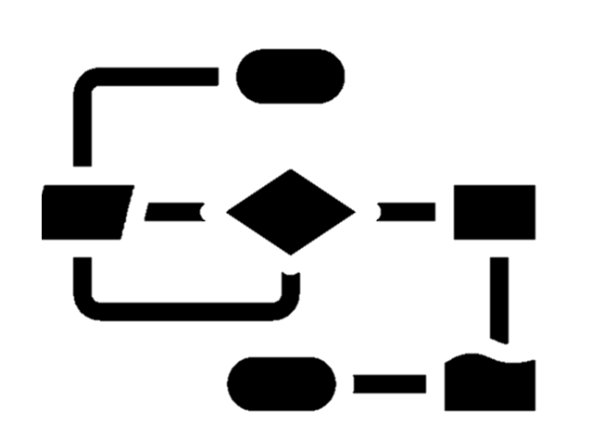



overview slide - example
BJSS was engaged to remotely support a council with an organisational restructure and operating model redesign with the aim of driving significant cost savings and efficiencies within a year. The team were also tasked with developing an implementation plan and a clear guide to implementing the recommendations as a response to the impact of Covid-19.
Summary of engagement:
Target operating model design
Operating model & process design
Change management approach
Improvement in ways of working with agile guidance
Cost savings with newly proposed team structure
Overview
Quickly gained an understanding of council’s overarching transformation strategy, cost-saving requirement and the outcomes of previous transformation programmes to inform approach taken. Captured as-is processes and ways of working, existing matrix org structure and capabilities present in the team through a series of workshops and desk analysis.
Conducted over 24 hours of remote interviews and workshops to complete the as-is analysis, capturing existing pain points, KPIs, SLA failures, handovers to other teams, and prioritising focus areas with project sponsor based on the findings.
Defined and validated to-be operating model and processes centred on agile ways of working with squads and tribe capabilities. Developed supporting capability map and organisational structure. Completed gap analysis between as-is and to-be to create a detailed transition plan, including the change approach required to upskill teams on agile ways of working.
Outcomes
As a result of the engagement the council were able to realise a 15% cost saving through implementing the new structure and operating model. They were able to implement agile ways of working and demonstrate the best in class agile operating model to other similar organisations.
EXAMPLE OVERVIEW SLIDE
Notes:
Client: LCC (Leeds City Council)
Service Line: OT&S – Op Model
Offering: Process Optimisation
Isn’t this the same as slide 2? (Do we keep this one or slide 2?)

Slide 2
overview slide - example
BJSS was engaged to remotely support a council with an organisational restructure and operating model redesign with the aim of driving significant cost savings and efficiencies within a year. The team were also tasked with developing an implementation plan and a clear guide to implementing the recommendations as a response to the impact of Covid-19.
Summary of engagement:
Target operating model design
Operating model & process design
Change management approach
Improvement in ways of working with agile guidance
Cost savings with newly proposed team structure
Overview
Quickly gained an understanding of council’s overarching transformation strategy, cost-saving requirement and the outcomes of previous transformation programmes to inform approach taken. Captured as-is processes and ways of working, existing matrix org structure and capabilities present in the team through a series of workshops and desk analysis.
Conducted over 24 hours of remote interviews and workshops to complete the as-is analysis, capturing existing pain points, KPIs, SLA failures, handovers to other teams, and prioritising focus areas with project sponsor based on the findings.
Defined and validated to-be operating model and processes centred on agile ways of working with squads and tribe capabilities. Developed supporting capability map and organisational structure. Completed gap analysis between as-is and to-be to create a detailed transition plan, including the change approach required to upskill teams on agile ways of working.
Outcomes
As a result of the engagement the council were able to realise a 15% cost saving through implementing the new structure and operating model. They were able to implement agile ways of working and demonstrate the best in class agile operating model to other similar organisations.
EXAMPLE OVERVIEW SLIDE
Notes:
Client: LCC (Leeds City Council)
Service Line: OT&S – Op Model
Offering: Process Optimisation
Isn’t this the same as slide 2? (Do we keep this one or slide 2?)

Slide 3
overview slide - example
BJSS was engaged to remotely support a council with an organisational restructure and operating model redesign with the aim of driving significant cost savings and efficiencies within a year. The team were also tasked with developing an implementation plan and a clear guide to implementing the recommendations as a response to the impact of Covid-19.
Summary of engagement:
Target operating model design
Operating model & process design
Change management approach
Improvement in ways of working with agile guidance
Cost savings with newly proposed team structure
Overview
Quickly gained an understanding of council’s overarching transformation strategy, cost-saving requirement and the outcomes of previous transformation programmes to inform approach taken. Captured as-is processes and ways of working, existing matrix org structure and capabilities present in the team through a series of workshops and desk analysis.
Conducted over 24 hours of remote interviews and workshops to complete the as-is analysis, capturing existing pain points, KPIs, SLA failures, handovers to other teams, and prioritising focus areas with project sponsor based on the findings.
Defined and validated to-be operating model and processes centred on agile ways of working with squads and tribe capabilities. Developed supporting capability map and organisational structure. Completed gap analysis between as-is and to-be to create a detailed transition plan, including the change approach required to upskill teams on agile ways of working.
Outcomes
As a result of the engagement the council were able to realise a 15% cost saving through implementing the new structure and operating model. They were able to implement agile ways of working and demonstrate the best in class agile operating model to other similar organisations.
EXAMPLE OVERVIEW SLIDE
Notes:
Client: LCC (Leeds City Council)
Service Line: OT&S – Op Model
Offering: Process Optimisation
Isn’t this the same as slide 2? (Do we keep this one or slide 2?)

Slide 4
overview slide - example
BJSS was engaged to remotely support a council with an organisational restructure and operating model redesign with the aim of driving significant cost savings and efficiencies within a year. The team were also tasked with developing an implementation plan and a clear guide to implementing the recommendations as a response to the impact of Covid-19.
Summary of engagement:
Target operating model design
Operating model & process design
Change management approach
Improvement in ways of working with agile guidance
Cost savings with newly proposed team structure
Overview
Quickly gained an understanding of council’s overarching transformation strategy, cost-saving requirement and the outcomes of previous transformation programmes to inform approach taken. Captured as-is processes and ways of working, existing matrix org structure and capabilities present in the team through a series of workshops and desk analysis.
Conducted over 24 hours of remote interviews and workshops to complete the as-is analysis, capturing existing pain points, KPIs, SLA failures, handovers to other teams, and prioritising focus areas with project sponsor based on the findings.
Defined and validated to-be operating model and processes centred on agile ways of working with squads and tribe capabilities. Developed supporting capability map and organisational structure. Completed gap analysis between as-is and to-be to create a detailed transition plan, including the change approach required to upskill teams on agile ways of working.
Outcomes
As a result of the engagement the council were able to realise a 15% cost saving through implementing the new structure and operating model. They were able to implement agile ways of working and demonstrate the best in class agile operating model to other similar organisations.
EXAMPLE OVERVIEW SLIDE
Notes:
Client: LCC (Leeds City Council)
Service Line: OT&S – Op Model
Offering: Process Optimisation
Isn’t this the same as slide 2? (Do we keep this one or slide 2?)

