Slide 1
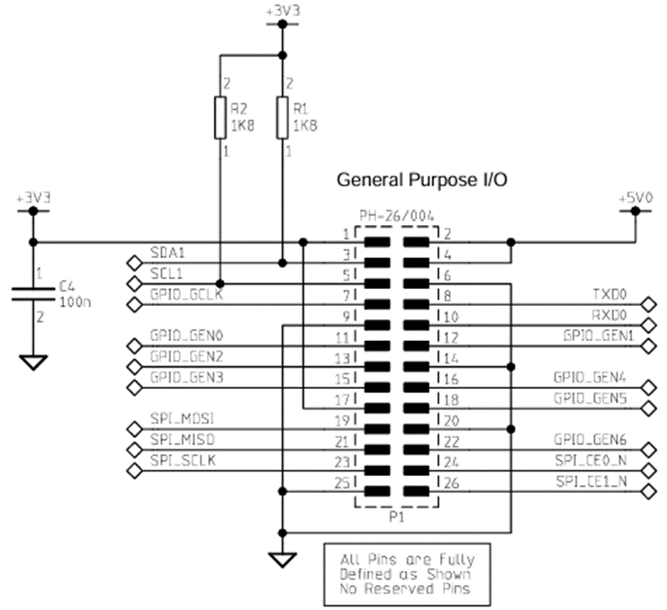
OpenPLC
Editor
OpenPLC
Runtime
Program
Windows
RaspberryPi

Slide 2
