Slide 1
Advertising Spend
& Sales Prediction
What drives sales: a linear regression analysis of 200 advertising campaigns
TV · Radio · Newspaper → Sales

Slide 2
The dataset at a glance
200
$147
15.1 units
2
Campaigns
Avg TV spend
Avg Sales
Missing values
What's in the data
Questions this analysis answers
TV — advertising spend on television ($)
Radio — advertising spend on radio ($)
Newspaper — advertising spend in print ($)
Sales — units sold for that campaign
Which medium drives sales the most?
How well does a linear model predict sales?
What's predicted for a new $200/$40/$50 spend?
Does normalization change model performance?
Advertising Spend & Sales Prediction
2

Slide 3
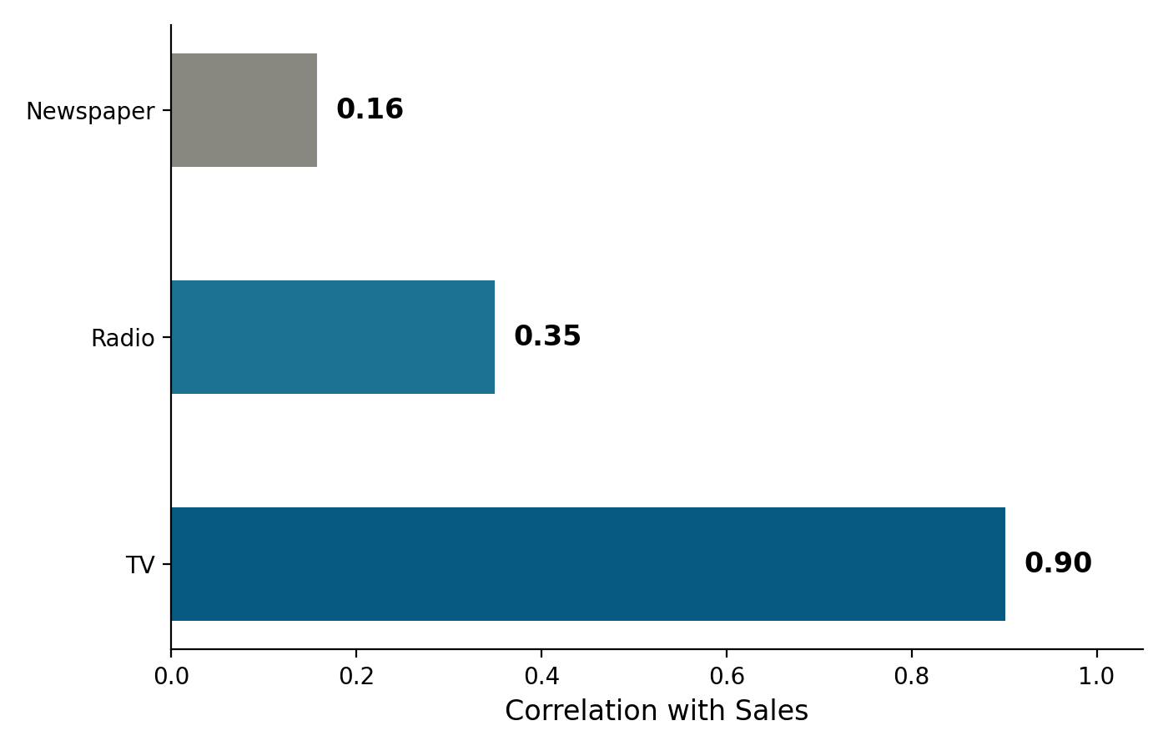
TV is the dominant driver of sales
Correlation of each ad medium with Sales
r = 0.90
TV vs Sales
r = 0.35
Radio vs Sales
r = 0.16
Newspaper vs Sales
Advertising Spend & Sales Prediction
3

Slide 4
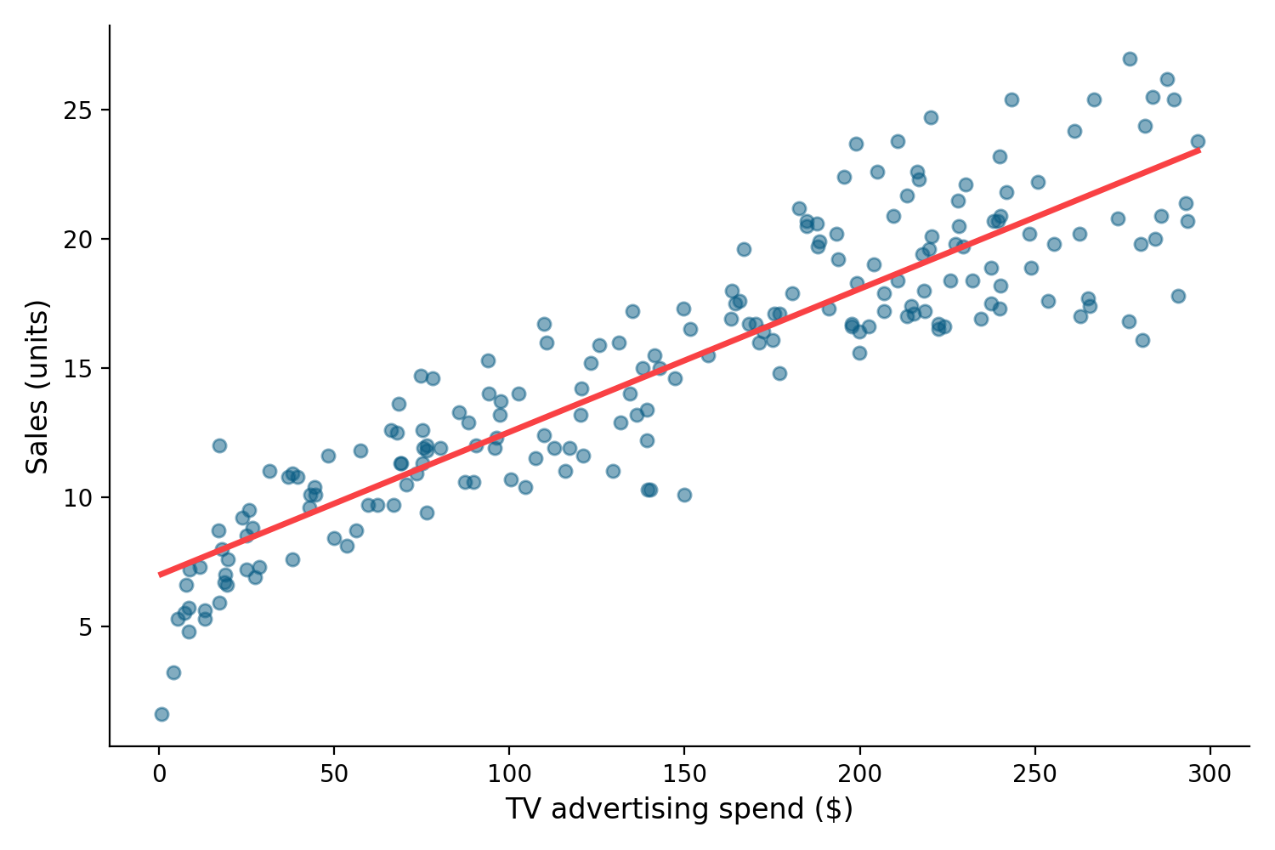
A clear linear relationship
TV advertising spend vs. Sales, with fitted trend line
Advertising Spend & Sales Prediction
4

Slide 5
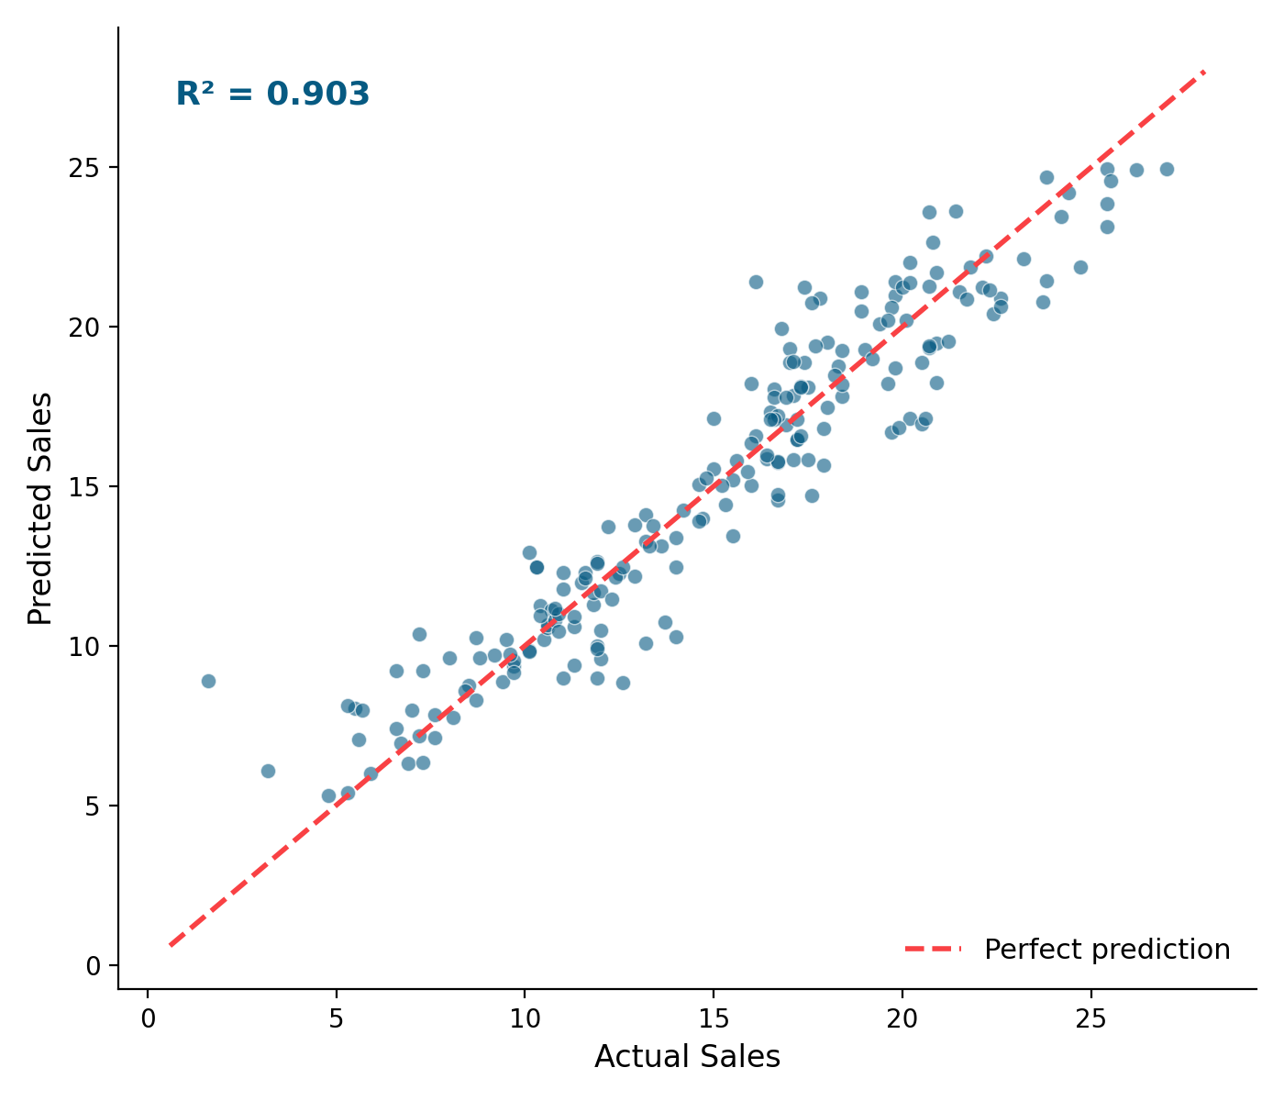
The full model fits well
Linear regression: TV + Radio + Newspaper predicting Sales
R² = 0.903
90% of sales variance explained
Model coefficients
TV: +0.054 per dollar spent
Radio: +0.107 per dollar spent
Newspaper: +0.0003 per dollar spent
RMSE: 1.64 units
Advertising Spend & Sales Prediction
5

Slide 6
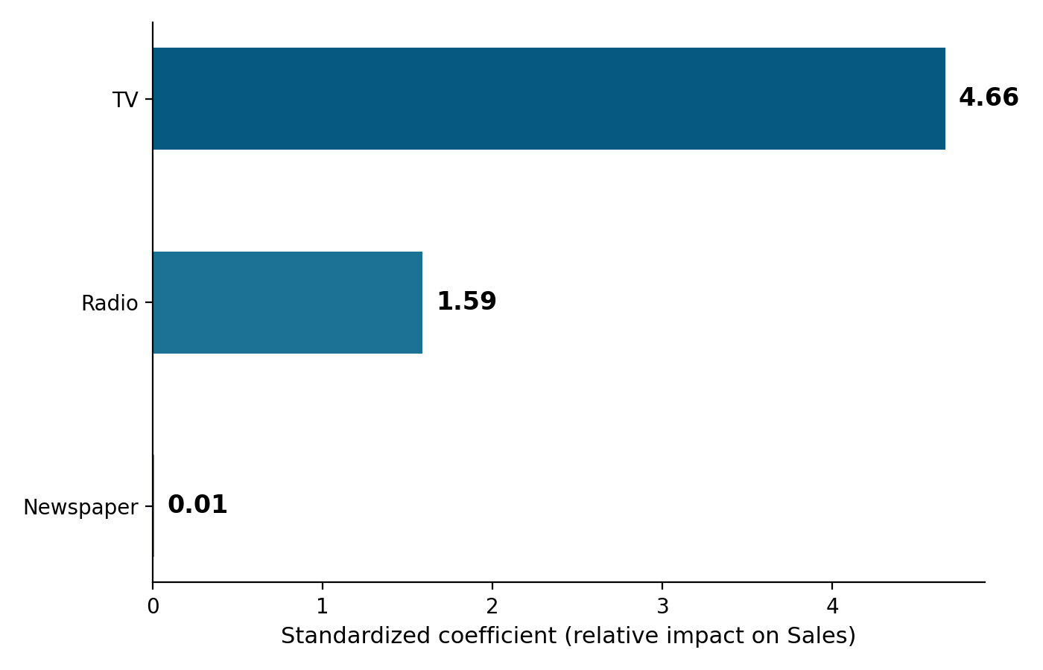
Ranking impact on a level playing field
Standardized coefficients — comparable across predictors regardless of scale
Why normalize?
Raw coefficients aren't comparable: TV spend ranges $0–296 while Newspaper ranges $0–114. Standardizing puts every predictor on the same scale, so coefficient size reflects true relative impact.
Result: TV's effect is roughly 3x Radio's and over 700x Newspaper's.
Advertising Spend & Sales Prediction
6

Slide 7
A worked prediction
New campaign: $200 TV, $40 Radio, $50 Newspaper
Does normalization change the result?
19.8 units
Normalized R²: 0.9027
Unnormalized R²: 0.9027
Identical — OLS regression fit quality is scale-invariant
Normalization helps compare coefficients, not predictive accuracy
predicted sales
Advertising Spend & Sales Prediction
7

Slide 8
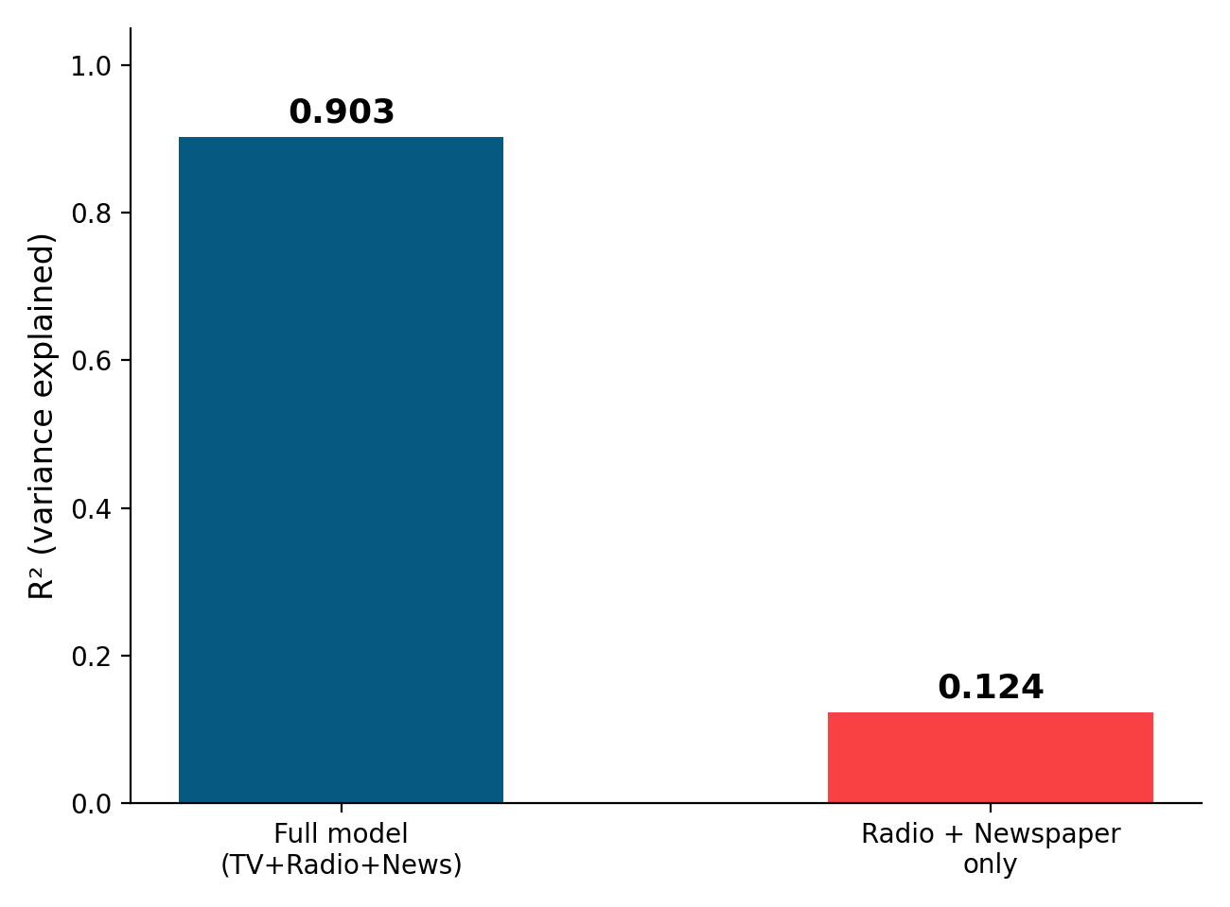
TV is not optional
Model performance with vs. without TV as a predictor
Dropping TV from the model:
R² falls from 0.90 to 0.12
RMSE rises from 1.64 to 4.93
Radio + Newspaper alone explain only 12% of sales variance
Advertising Spend & Sales Prediction
8

Slide 9
Key takeaways
1
TV drives sales
2
The model fits well
TV spend correlates strongly with sales (r=0.90) and carries by far the largest model coefficient.
The 3-variable regression explains 90% of sales variance, with predictions tracking actuals closely.
3
Newspaper barely matters
4
Normalization aids comparison, not accuracy
Its standardized coefficient is near zero — spend here has minimal measurable effect on sales.
R² is unchanged by scaling; standardizing only helps rank predictor impact fairly.
Advertising Spend & Sales Prediction
9

