Slide 1
Facebook Live Sellers
An engagement analysis of 7,050 posts from Thai fashion & cosmetics retailers
Dataset: UCI Machine Learning Repository | Facebook Marketplace data

Slide 2
The dataset at a glance
7,050
10
2012–2018
0
Total posts
Sellers
Date range
Missing values
What's in the data
Questions this analysis answers
status_type — photo, video, status, or link
status_published — date & time of post
num_reactions, num_comments, num_shares — core engagement
Reaction breakdown — likes, loves, wows, hahas, sads, angrys
Does posting time affect reactions?
How do reactions, comments & shares correlate?
What natural post segments exist? (K-Means)
Which post type performs best, and how?
Facebook Live Sellers — Thailand
2

Slide 3
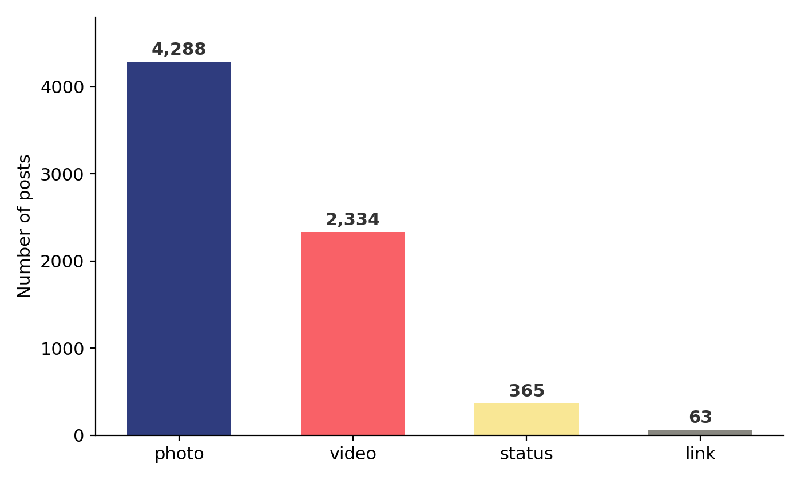
Photos dominate, but not equally
Post count by status type
61%
of posts are photos
33%
of posts are video
6%
status updates + links combined
Facebook Live Sellers — Thailand
3

Slide 4
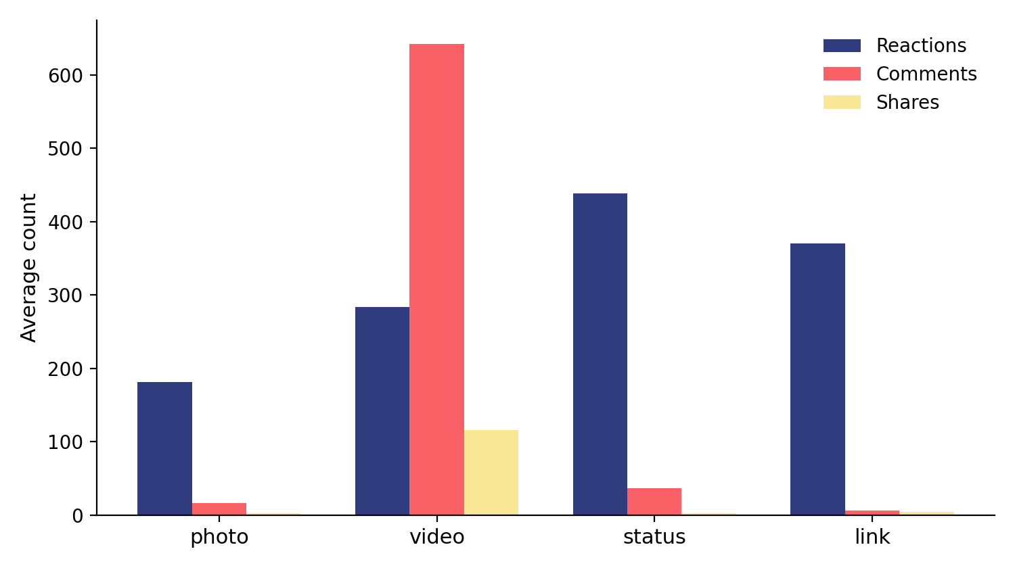
Video drives the conversation
Average reactions, comments & shares by post type
439
avg reactions on status posts
643
avg comments on video posts
116
avg shares on video posts
Facebook Live Sellers — Thailand
4

Slide 5
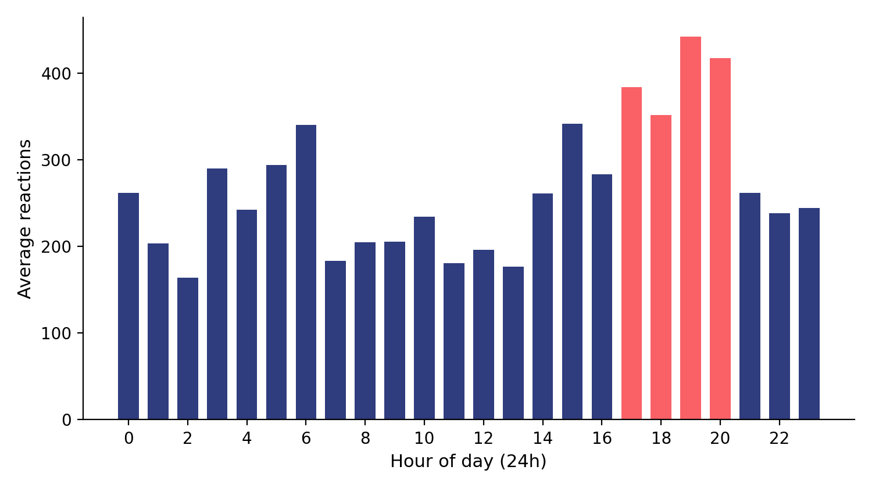
Evening posts win on reactions
Average reactions by hour of publication (24h, all years)
5–8pm
peak window for reactions
Thursday
strongest day of the week
Facebook Live Sellers — Thailand
5

Slide 6
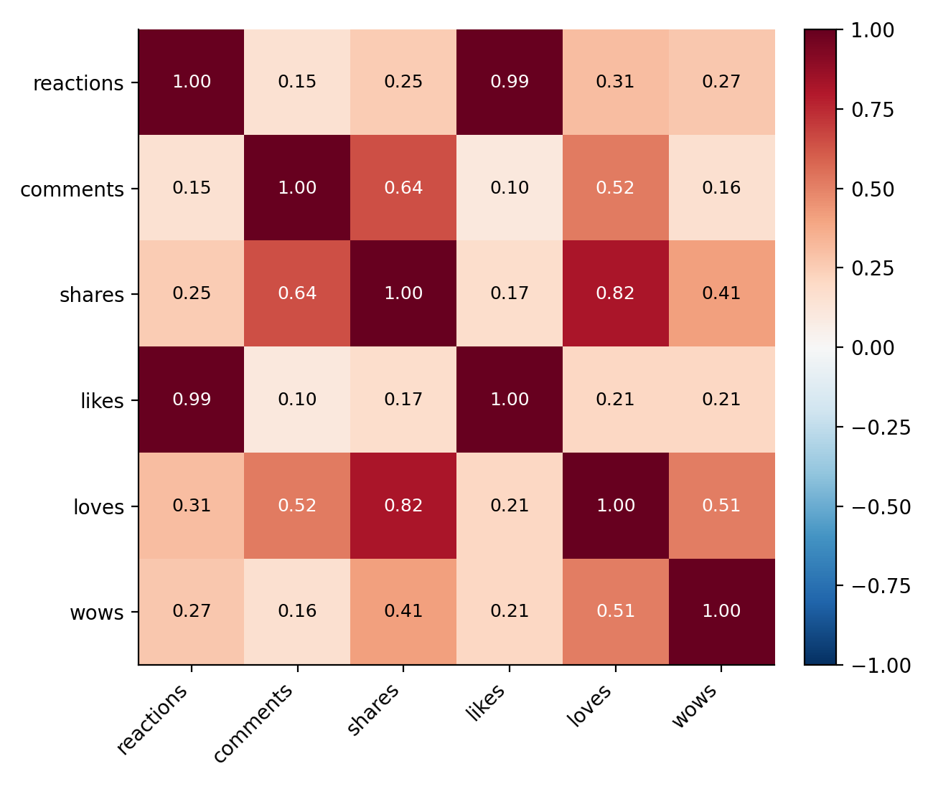
Reactions and conversation are different things
Correlation matrix of engagement metrics
Key relationships
Likes ≈ reactions (r = 0.99) — likes are nearly all of total reactions
Comments ↔ shares (r = 0.64) — discussion and sharing move together
Reactions ↔ comments (r = 0.15) — weak link; high reactions don't imply discussion
Reactions ↔ shares (r = 0.25) — also weak; approval ≠ amplification
Facebook Live Sellers — Thailand
6

Slide 7
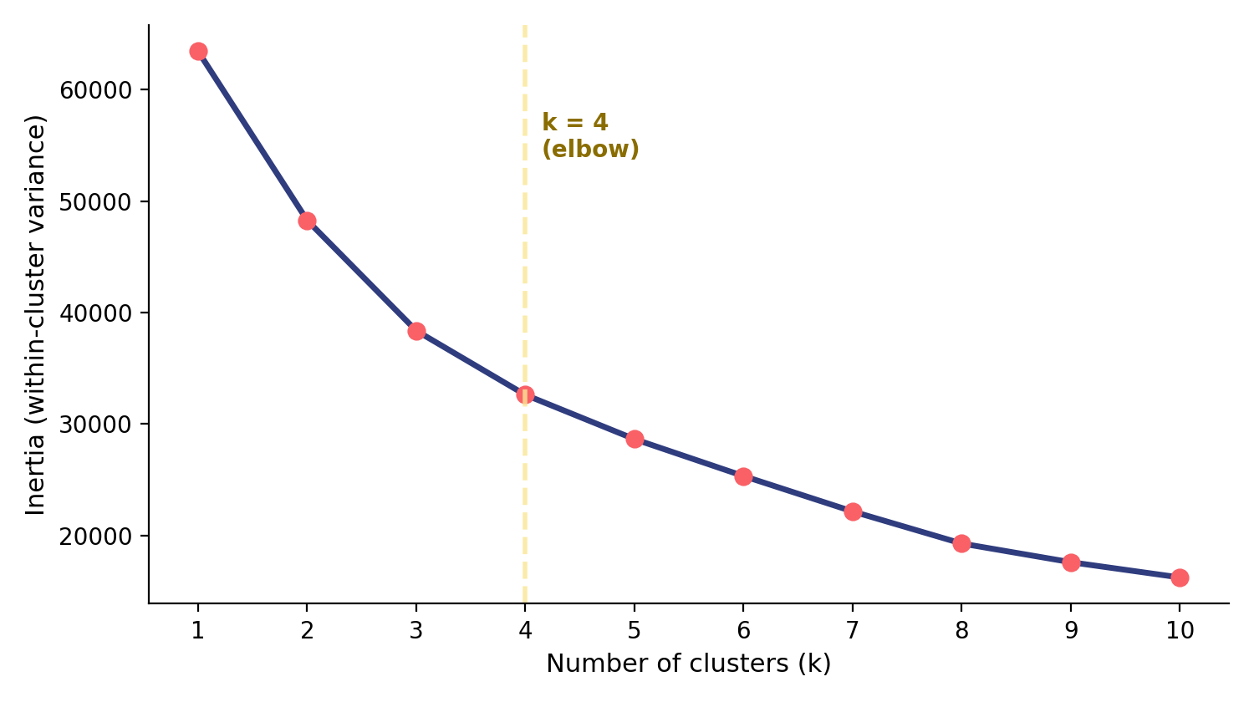
Finding the right number of clusters
Elbow method on the standardized engagement features
k = 4
clusters chosen at the elbow
Facebook Live Sellers — Thailand
7

Slide 8
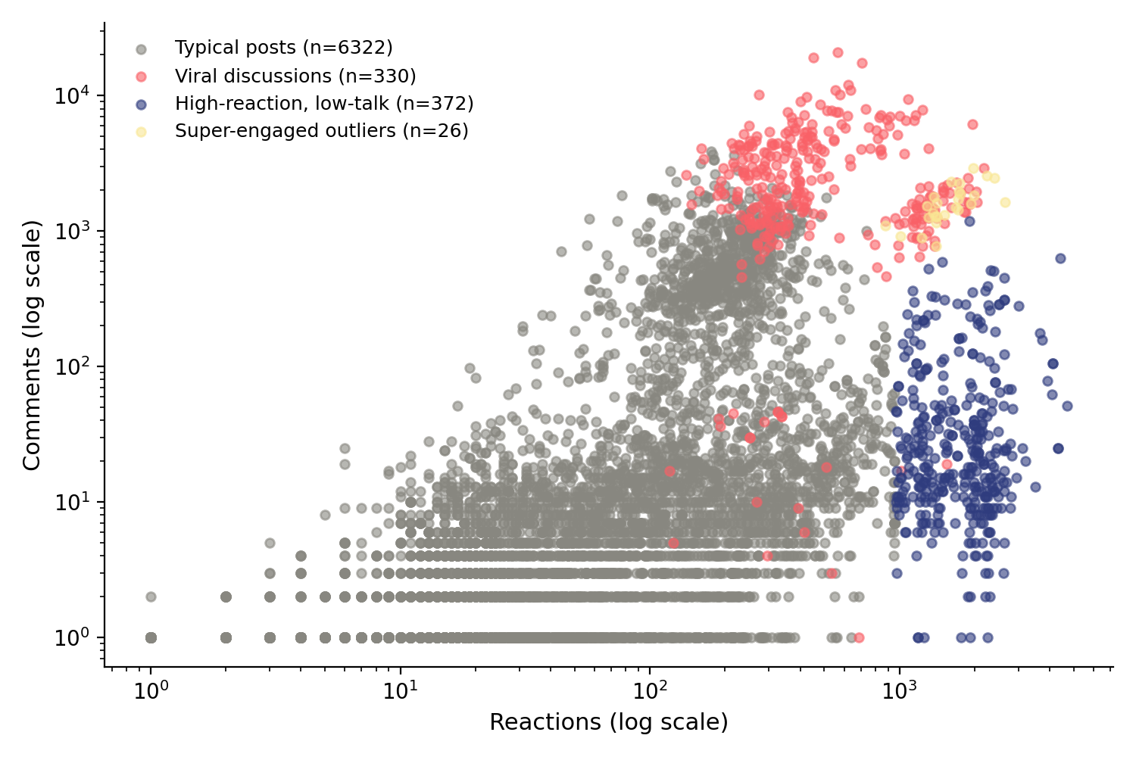
Four distinct post segments
K-Means (k=4): reactions vs. comments, log scale
6,322
Typical posts
330
Viral discussions (mostly video)
372
High-reaction, low-talk
26
Super-engaged outliers
Facebook Live Sellers — Thailand
8

Slide 9
Key takeaways
1
Timing has a modest effect
2
Reactions ≠ conversation
Evening posts (5–8pm) and Thursdays see higher average reactions, but content type matters more.
Likes drive almost all reactions (r=0.99), but reactions barely predict comments or shares.
3
Video earns engagement depth
4
Four natural segments exist
Videos average 643 comments and 116 shares per post — far above photos, status, or links.
K-Means (k=4) separates typical posts from viral-discussion, high-reaction, and outlier posts.
Facebook Live Sellers — Thailand
9

