Slide 1

test_harness.h
KISS unit testing for C
Thilo Fromm, 07/2012

Slide 2
Agenda
Scope
Common Tasks
test_harness.h
Q&A

Slide 3
Scope
What is a “Unit”?

Slide 4
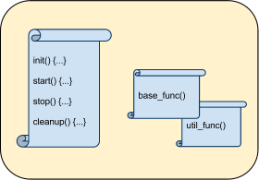
Scope
Unit: comprehensive set of specialized functions

Slide 5
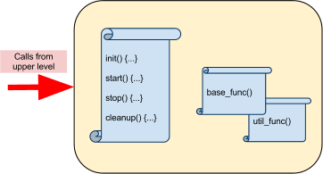
Scope
Unit acts on higher level stimuli

Slide 6
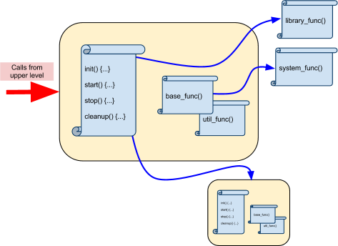
Scope
Unit utilizes lower level libs and other units

Slide 7
Scope
What is a “Unit”?
One Function (or a small set thereof)
- doing exactly one thing
- which can be separated

Slide 8
Common Tasks

Slide 9
Common Tasks
“Boilerplating”
What do I need in every new test I write?
How can I provide automation?

Slide 10
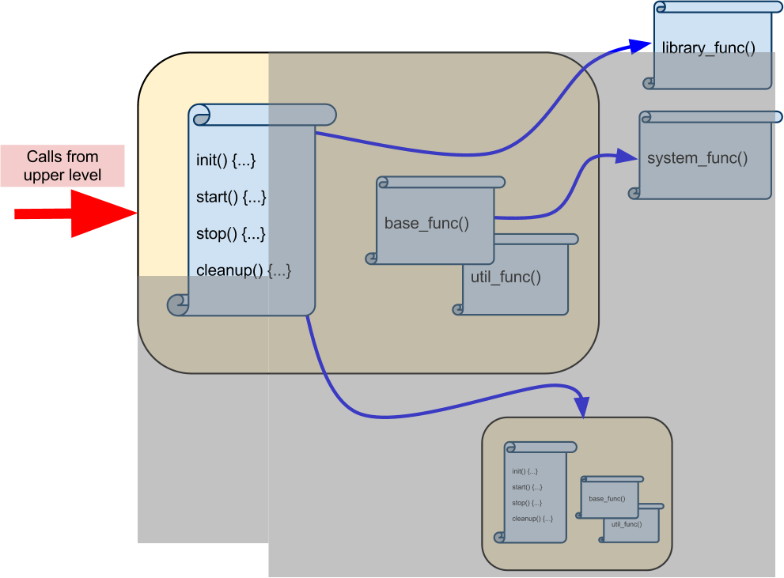
Common Tasks
Stimuli

Slide 11
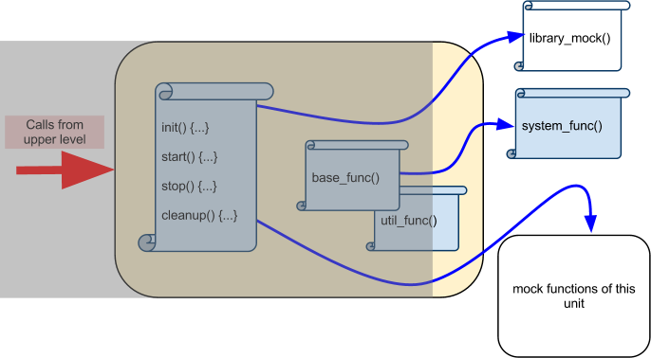
Common Tasks
Mock Functions

Slide 12
Common Tasks
Things to provide in every unit test. Ever.
Stimuli
Mocked back-end functions

Slide 13
test_harness.h
introducing

Slide 14
test_harness.h
A collection of unit testing and mocking tools.
Implemented in the C preprocessor.

Slide 15
test_harness.h
Let's do a quick unit test.
First, we include the Unit, and add a stimulus.

Slide 16
test_harness.h
Example unit test
#include <stdio.h>
int main(int argc, char ** argv)
{
/* our main test routine */
return 0;
}

Slide 17
test_harness.h
Access to higher level functions
#include <stdio.h>
#include "server_unit.c"
int main(int argc, char ** argv)
{
/* our main test routine */
return 0;
}

Slide 18
test_harness.h
Access to higher level functions' dependencies
#include <stdio.h>
#include "server_unit.c"
#include "server_lib.c"
int main(int argc, char ** argv)
{
/* our main test routine */
return 0;
}

Slide 19
test_harness.h
Using a stimulus
#include <stdio.h>
#include "server_unit.c"
#include "server_lib.c"
int main(int argc, char ** argv)
{
/* our main test routine */
int ret = server_unit_init("localhost", 12);
return 0;
}

Slide 20
test_harness.h test compile
  Now let's compile:
:(.text+0xf): undefined reference to `library_func'
:(.text+0x1e): undefined reference to `sub_unit_func'
:(.text+0x2d): undefined reference to `sub_unit_tool_func'
collect2: ld returned 1 exit status

Slide 21
test_harness.h
We need to mock functions used by the unit.
test_harness.h can help with this.

Slide 22
test_harness.h
Implementing a mock function
#include "test_harness.h"

Slide 23
test_harness.h
Implementing a mock function
#include "test_harness.h"
// int library_func( char * arg );
MOCK_1 (int, library_func, char *);

Slide 24
test_harness.h
Implementing a mock function
#include "test_harness.h"
// int library_func( char * arg );
MOCK_1 (int, library_func, char *);
// void* sub_unit_func( int val, uint32_t len, st..., int dbg);
MOCK_4(void*, sub_unit_func, int,uint32_t,struct netbuf *,int);

Slide 25
test_harness.h
Implementing a mock function
#include "test_harness.h"
// int library_func( char * arg );
MOCK_1 (int, library_func, char *);
// void* sub_unit_func( int val, uint32_t len, st..., int dbg);
MOCK_4(void*, sub_unit_func, int,uint32_t,struct netbuf *,int);
// void sub_tool_func( int count, void * bytes);
MOCK_2V(sub_unit_tool_func, int, void *);

Slide 26
test_harness.h
Integration
#include <stdio.h>
#include "server_unit.c"
#include "server_lib.c"
#include "test_harness.h"
MOCK_1 (int, library_func, char *);
MOCK_4(void*, sub_unit_func, int, uint32_t, struct netbuf *,int);
MOCK_2V(sub_unit_tool_func, int, void *);
int main(int argc, char ** argv)
{
/* our main test routine */
int ret = server_unit_init("localhost", 12);
return 0;
}

Slide 27
test_harness.h
Mock integration
#include <stdio.h>
#include "server_unit.c"
#include "server_lib.c"
#include "test_harness.h"
MOCK_1 (int, library_func, char *);
MOCK_4(void*, sub_unit_func, int, uint32_t, struct netbuf *,int);
MOCK_2V(sub_unit_tool_func, int, void *);
int main(int argc, char ** argv)
{
char * server_name = "localhost";
TEST_ASSERT( 42, server_unit_init(server_name, 12), int );
return 0;
}

Slide 28
test_harness.h
Mock function call setup
#include <stdio.h>
#include "server_unit.c"
#include "server_lib.c"
#include "test_harness.h"
MOCK_1 (int, library_func, char *);
MOCK_4(void*, sub_unit_func, int, uint32_t, struct netbuf *,int);
MOCK_2V(sub_unit_tool_func, int, void *);
int main(int argc, char ** argv)
{
char * server_name = "localhost";
MOCK_4_CALL( 0xbaba, sub_unit_func, 10, 99, NULL, 1);
TEST_ASSERT( 42, server_unit_init(server_name, 12), int );
return 0;
}

Slide 29
test_harness.h
Mock function call setup
#include <stdio.h>
#include "server_unit.c"
#include "server_lib.c"
#include "test_harness.h"
MOCK_1 (int, library_func, char *);
MOCK_4(void*, sub_unit_func, int, uint32_t, struct netbuf *,int);
MOCK_2V(sub_unit_tool_func, int, void *);
int main(int argc, char ** argv)
{
char * server_name = "localhost";
MOCK_4_CALL ( 0xbaba, sub_unit_func, 10, 99, NULL, 1);
MOCK_2V_CALL( sub_unit_tool_func, 12, DONT_CHECK_PARAM );
TEST_ASSERT( 42, server_unit_init(server_name, 12), int );
return 0;
}

Slide 30
test_harness.h
Mock function call setup
#include <stdio.h>
#include "server_unit.c"
#include "server_lib.c"
#include "test_harness.h"
MOCK_1 (int, library_func, char *);
MOCK_4(void*, sub_unit_func, int, uint32_t, struct netbuf *,int);
MOCK_2V(sub_unit_tool_func, int, void *);
int main(int argc, char ** argv)
{
char * server_name = "localhost";
MOCK_4_CALL ( 0xbaba, sub_unit_func, 10, 99, NULL, 1);
MOCK_2V_CALL( sub_unit_tool_func, 12, DONT_CHECK_PARAM );
MOCK_1_CALL ( 42, library_func, server_name );
TEST_ASSERT( 42, server_unit_init(server_name, 12), int );
return 0;
}

Slide 31
test_harness.h
Mock function call setup
#include <stdio.h>
#include "server_unit.c"
#include "server_lib.c"
#include "test_harness.h"
MOCK_1 (int, library_func, char *);
MOCK_4(void*, sub_unit_func, int, uint32_t, struct netbuf *,int);
MOCK_2V(sub_unit_tool_func, int, void *);
int main(int argc, char ** argv)
{
char * server_name = "localhost";
MOCK_4_CALL ( 0xbaba, sub_unit_func, 10, 99, NULL, 1);
MOCK_2V_CALL( sub_unit_tool_func, 12, DONT_CHECK_PARAM );
MOCK_1_CALL ( 42, library_func, server_name );
MOCK_2V_CALL( sub_unit_tool_func, 12, server_name );
TEST_ASSERT( 42, server_unit_init(server_name, 12), int );
return 0;
}

Slide 32
test_harness.h
Need custom logic in mock functions?

Slide 33
test_harness.h
Installing callbacks into mocked functions
#include "server_unit.c"
#include "test_harness.h"
MOCK_1 (int, library_func, char *);
int main(int argc, char ** argv)
{
return 0;
}

Slide 34
test_harness.h
Installing callbacks into mocked functions
#include "server_unit.c"
#include "test_harness.h"
MOCK_1 (int, library_func, char *);
static void my_lib_func( char * arg ) {
}
int main(int argc, char ** argv)
{
return 0;
}

Slide 35
test_harness.h
Installing callbacks into mocked functions
#include "server_unit.c"
#include "test_harness.h"
MOCK_1 (int, library_func, char *);
static void my_lib_func( char * arg ) {
if (! strcmp(arg, "bloedsinn"))
MOCK_RETVAL_OF( library_func ) = 23;
}
int main(int argc, char ** argv)
{
return 0;
}

Slide 36
test_harness.h
Installing callbacks into mocked functions
#include "server_unit.c"
#include "test_harness.h"
MOCK_1 (int, library_func, char *);
static void my_lib_func( char * arg ) {
if (! strcmp(arg, "bloedsinn"))
MOCK_RETVAL_OF( library_func ) = 23;
}
int main(int argc, char ** argv)
{
MOCK_CB_SET( lib_func, my_lib_func );
return 0;
}

Slide 37
test_harness.h
Installing callbacks into mocked functions
#include "server_unit.c"
#include "test_harness.h"
MOCK_1 (int, library_func, char *);
static void my_lib_func( char * arg ) {
if (! strcmp(arg, "bloedsinn"))
MOCK_RETVAL_OF( library_func ) = 23;
}
int main(int argc, char ** argv)
{
MOCK_CB_SET( lib_func, my_lib_func );
MOCK_1_CALL ( 19, library_func, NULL );
MOCK_1_CALL ( 00, library_func, DONT_CHECK_PARAM );
return 0;
}

Slide 38
test_harness.h
Installing callbacks into mocked functions
#include "server_unit.c"
#include "test_harness.h"
MOCK_1 (int, library_func, char *);
static void my_lib_func( char * arg ) {
if (! strcmp(arg, "bloedsinn"))
MOCK_RETVAL_OF( library_func ) = 23;
}
int main(int argc, char ** argv)
{
MOCK_CB_SET( lib_func, my_lib_func );
MOCK_1_CALL ( 19, library_func, NULL );
MOCK_1_CALL ( 00, library_func, DONT_CHECK_PARAM );
TEST_ASSERT ( 23, server_unit_init("bloedsinn", 12), int );
return 0;
}

Slide 39
test_harness.h
MOCK_[n]( … )
creates a mocked function.

Slide 40
test_harness.h
MOCK_1 (int, example_func, char *)

Slide 41
test_harness.h
MOCK_1 (int, example_func, char *):
long _example_func_configured_calls = -1;
long _example_func_called_count = -1;

Slide 42
test_harness.h
MOCK_1 (int, example_func, char *):
long _example_func_configured_calls = -1;
long _example_func_called_count = -1;
void (*_example_func_cb)(char*);

Slide 43
test_harness.h
MOCK_1 (int, example_func, char *):
long _example_func_configured_calls = -1;
long _example_func_called_count = -1;
void (*_example_func_cb)(char*);
char * _example_func_exp_arg0[ MAX_NUM_FUNC_CALL ];
int _example_func_ret [ MAX_NUM_FUNC_CALL ];

Slide 44
test_harness.h
MOCK_1 (int, example_func, char *):
long _example_func_configured_calls = -1;
long _example_func_called_count = -1;
void (*_example_func_cb)(char*);
char * _example_func_exp_arg0[ MAX_NUM_FUNC_CALL ];
int _example_func_ret [ MAX_NUM_FUNC_CALL ];
int example_func( char * arg0 )
{
_example_func_called_count ++;
check_params_and_callback( … );
return
_example_func_ret[ _example_func_called_count ];
}

Slide 45
test_harness.h
MOCK_[n]_CALL ( … ) configures
Calls, Parameters, and return values

Slide 46
test_harness.h
MOCK_1_CALL (ret, example_func, param)

Slide 47
test_harness.h
MOCK_1_CALL (ret, example_func, param):
{
_example_func_configured_calls ++;
}

Slide 48
test_harness.h
MOCK_1_CALL (ret, example_func, param):
{
_example_func_configured_calls ++;
_example_func_exp_arg0[ _example_func_configured_calls ]
= param;
}

Slide 49
test_harness.h
MOCK_1_CALL (ret, example_func, param):
{
_example_func_configured_calls ++;
_example_func_exp_arg0[ _example_func_configured_calls ]
= param;
_example_func_ret[ _example_func_configured_calls] = ret;
}

Slide 50
test_harness.h
Stimuli: Access units by including the source
Mock functions: made easy w/ macros

Slide 51
Things not covered by test_harness.h and what to do about them

Slide 52
Things not covered by test_harness.h
Code coverage – we use gcov
Graphics, statistics – we use gcov output :)

Slide 53
Q&A
Questions?

