Slide 1
Take Home Task – Slides
Thomas Madeley

Slide 2
Contents
Intriguing Discovery
Comparative Analysis of Modelling Approaches
Future Explorations

Slide 3
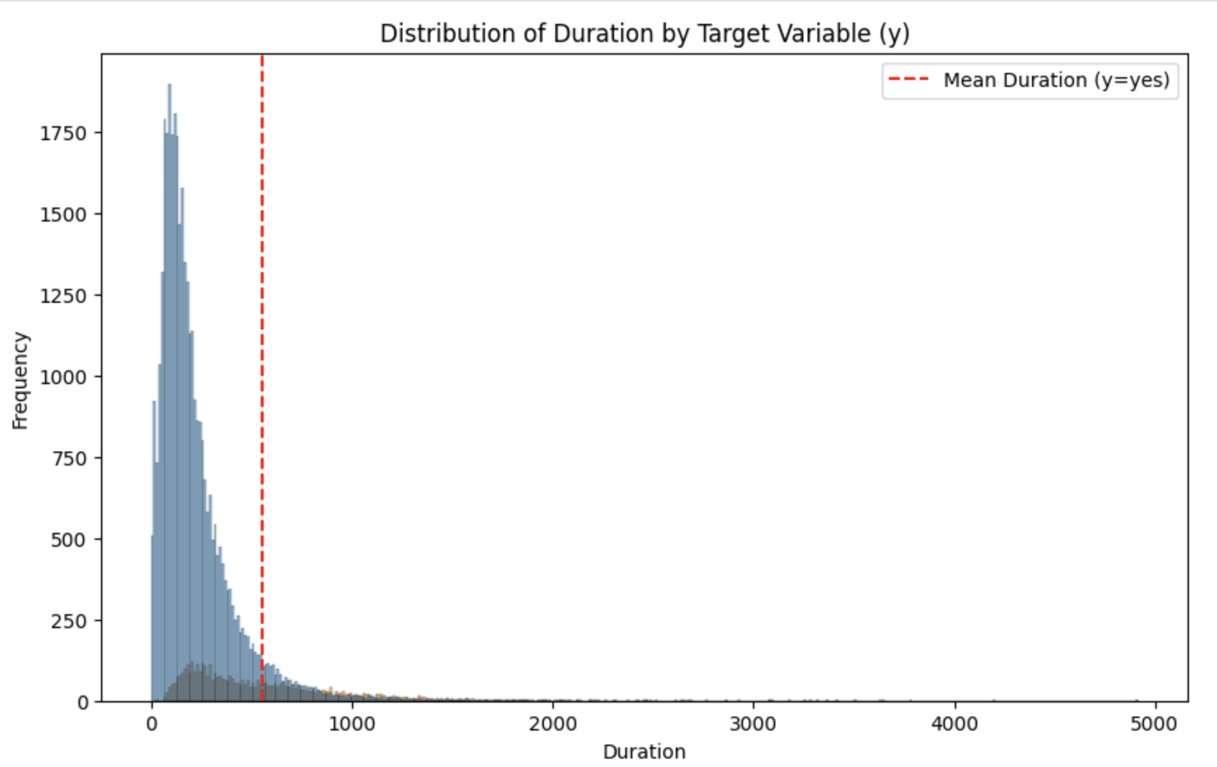
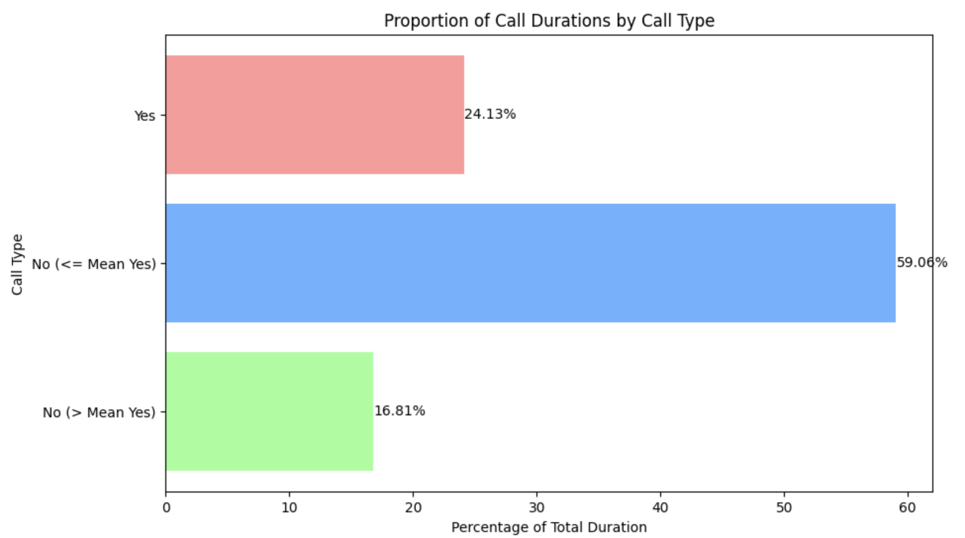
Intriguing Discovery Very long ‘no’ calls are a huge waste of time
Just 6% of 'No' calls exceed the mean duration of 'yes' calls, yet they encompass 17% of total call durations.
By mitigating prolonged 'No' calls, we can free-up a significant portion of agent time.
Implementing models to detect extended 'No' instances at an early stage could be beneficial.
Optimizing agent training to efficiently conclude sales or elicit a 'No' promptly is a strategic approach.

Slide 4
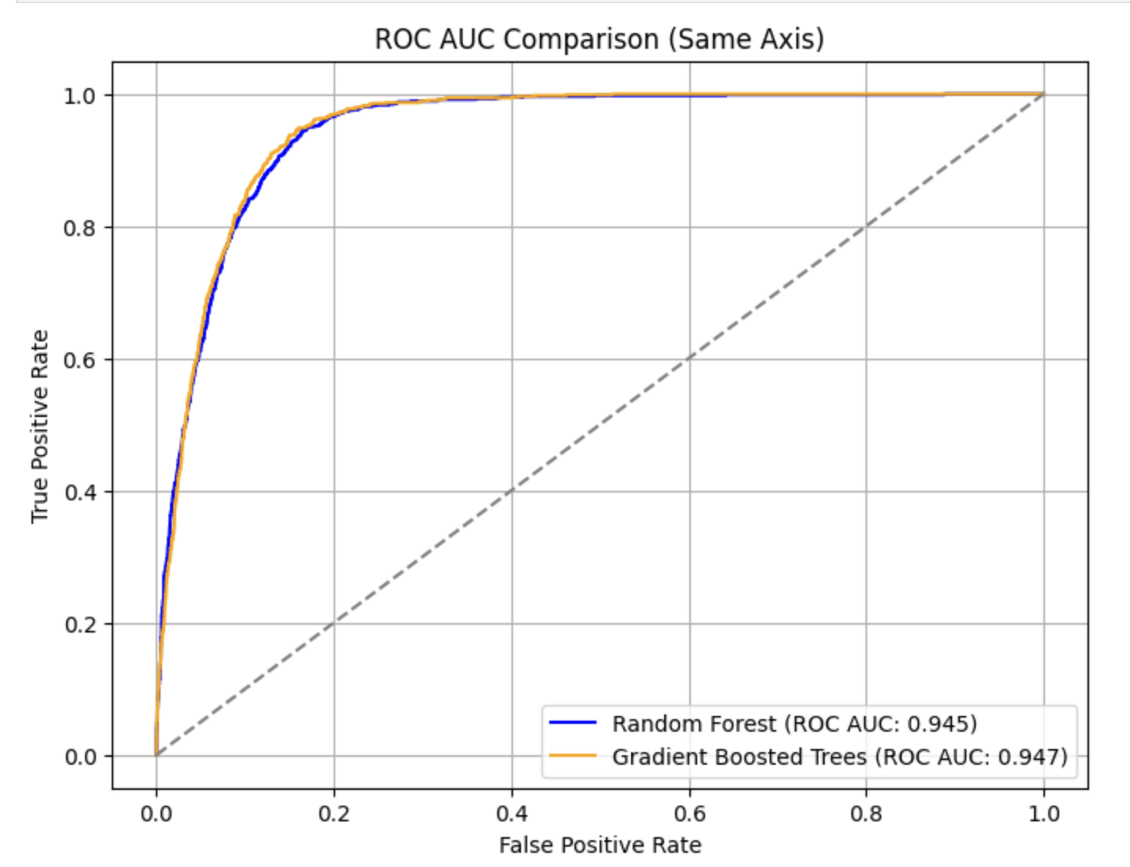
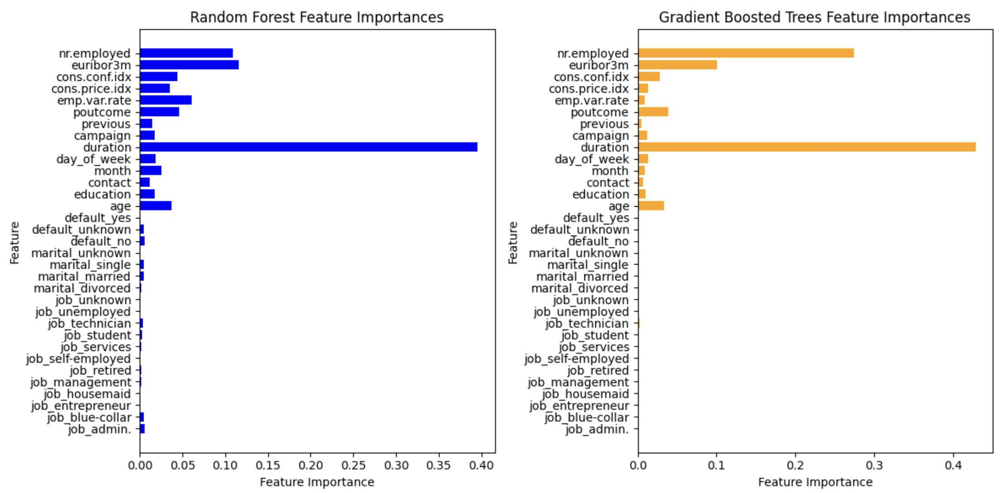
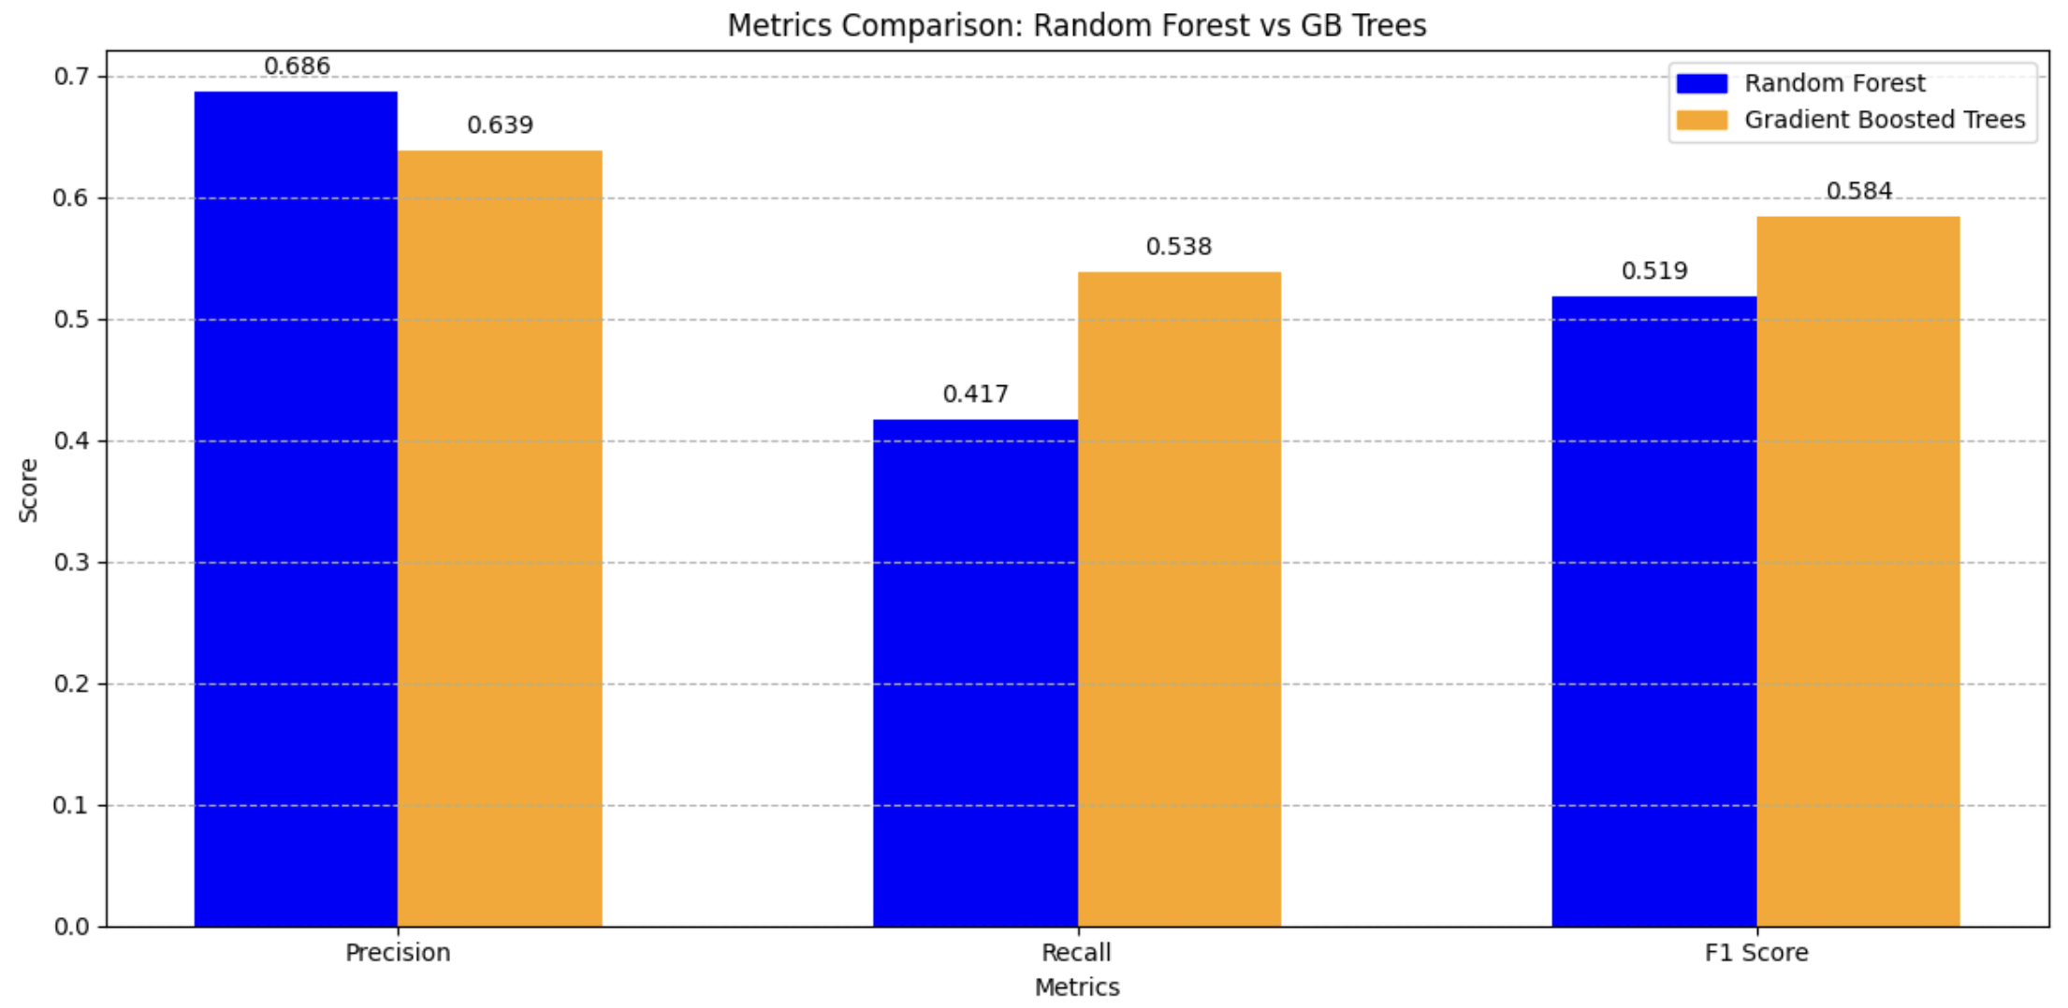
Comparative Analysis – Bagging or Boosting?
Despite the abundance of categorical features, the paper's exploration of tree-based methods seemed insufficient.
Evaluation metrics encompassed Precision, Recall, F1 Score, and AUC ROC.
Employed RandomisedCV search for hyperparameter optimization.
The GBT model demonstrated a marginal performance edge over the RF model concerning ROC AUC.
The decision between models remains ambiguous.
Is a highly precise model necessary? Potentially leading to reduced call time wastage?
Does the model with high recall hold potential for identifying more successful calls overall?
Notably, both models slightly surpassed the neural network model presented in the paper. (0.929 ROC AUC)

Slide 5
Future Explorations
Enhance data representations for improved model performance.
Consider alternative transformations, such as sine/cosine, for datetime features instead of ordinal encoding.
Utilize embeddings to capture semantic similarities within text features, rather than one-hot encoding, especially for 'jobs’.
Integrate a 'CatBoost' model, as it intelligently handles of categorical features.
Validate feature selection and outlier removal strategies through extensive model training with varied feature sets.
While our models marginally outperformed the paper's neural network, conducting a DeLong test could ascertain the statistical significance of ROC AUC improvements.
Reproduce the paper's rolling window evaluation methodology to conduct a comparative analysis.
Allocate additional time for slide creation to ensure quality and clarity. (Sorry I spent too long on the notebook!)

