Slide 1
FINAL SHAREOUT · SUMMER 2026
Instantly Shareable Playtest
Streaming pre-release builds from the cloud — in seconds, no install.
Melanie Chen — Software Engineering Intern
Xbox / Juno · Summer 2026
Notes:
Hi, I'm Melanie — a software engineering intern on the Xbox Juno team. This summer I worked on Instantly Shareable Playtest: letting a game creator share an unreleased build that a tester can stream from the cloud in seconds, with no download and no install. Here's what it is, what I built, and what shipped.

Slide 2
ABOUT ME
About me
▪ [University · Degree · Expected year]
▪ Team Juno (Xbox) — reducing friction for game creators
▪ Manager Brian Bowman · Mentor Emma Park
▪ My summer: backend across ~8 services, two orgs
▪ [One line — an interest or something fun about you]
Instantly Shareable Playtest · Melanie Chen · Xbox / Juno
2
Notes:
A quick bit about me. [Fill in your school and background.] I joined Juno, whose whole mission is to lower the barrier for game creators. My project lived almost entirely in the backend, threading a build across about eight services — which meant ramping up fast. Big thanks to my manager Brian and my mentor Emma for the support.

Slide 3
THE PROBLEM
Testing shouldn't mean shipping the whole game
xPlaytest already shares RETAIL-signed private builds — no cert, no store page.
▪ Games are hundreds of GB — every tester waits on a slow install
▪ Creators must provision many hardware profiles for compatibility
▪ Physical devices risk leaking locally-inspectable game code
Instantly Shareable Playtest · Melanie Chen · Xbox / Juno
3
Notes:
Where did this start? The xPlaytest team had already made testing easier — a creator can share a retail-signed private build without certification or a store page. But three barriers remained. Modern games are hundreds of gigabytes, so every tester sits through a huge download. Creators have to buy and set up lots of hardware to test compatibility. And physical devices are a security risk — a lost devkit means the unreleased code is right there to inspect. We wanted to remove all three.

Slide 4
THE VISION
Instantly Shareable Playtest
xPlaytest × Xbox Cloud Gaming
▪ The creator flips on “allow cloud streaming” and shares a link
▪ An invited tester streams the private RETAIL build in seconds
▪ No install. No download. No devkit.
Instantly Shareable Playtest · Melanie Chen · Xbox / Juno
4
Notes:
The idea is to combine xPlaytest with Xbox Cloud Gaming. The creator just opts in to cloud streaming and shares a link. An invited tester clicks it and — instead of downloading anything — streams the build straight from the cloud, in seconds. It's still a real retail build; it just runs in xCloud instead of on the tester's own hardware. That's the north star.

Slide 5
THE GOAL
What I was asked to build — connect two clouds
To make that link work, the backend had to…
▪ Stand up a new service-to-service link: publishing ↔ Game Streaming
▪ Create a private streaming offering per playtest
▪ Scope access to only invited testers (DNA groups)
▪ Ingest each new build and point the offering at it
▪ Return a shareable link that streams
Instantly Shareable Playtest · Melanie Chen · Xbox / Juno
5
Notes:
Under the hood, that link needs a lot to happen. My goals — the P0s from the project doc — were: create a brand-new service-to-service connection between publishing and Xbox Game Streaming Services; on publish, spin up a private streaming offering just for that playtest; make sure only invited testers can see it; ingest every new build and point the offering at it; and hand back a link that actually streams. That's the checklist I was measured against.

Slide 6
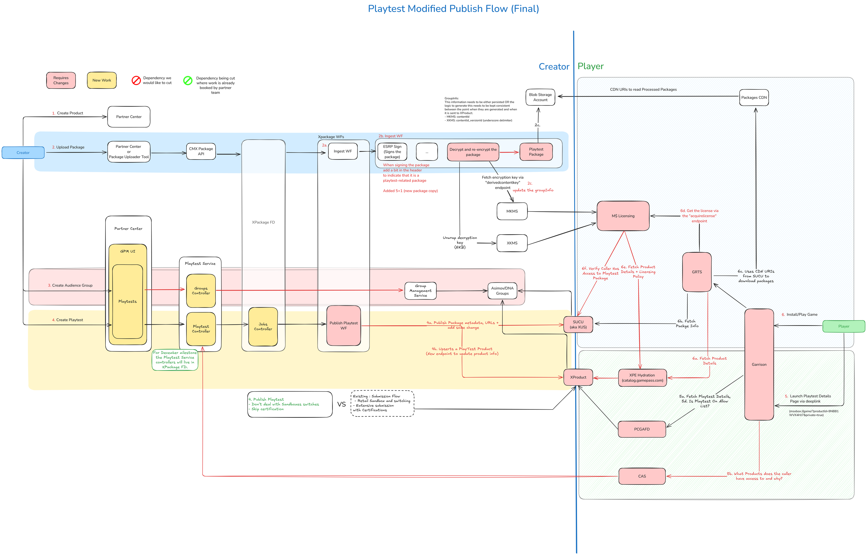
HOW IT WORKS
The backend spine
audience → offering → payload → cross-tenant send (Green→Corp) → ingest → readiness poll → share link
Instantly Shareable Playtest · Melanie Chen · Xbox / Juno
6
Notes:
Here's the whole flow on one slide. Reading left to right: we resolve who's allowed in (the audience), publish an offering, assemble a payload of everything xCloud needs, send it across an organizational boundary — from the MSFT Green cloud to Corp — through a gateway called SAGE, ingest the build while binding its title and offering together, poll until the servers are ready to stream, and then the share link works. I touched every hop; the next slides zoom into the two I'm proudest of.

Slide 7
MY CONTRIBUTION
The payload builder
PR 15834601 — assembling everything xCloud needs to stream a build
▪ Builds the payload from the publish snapshot: StoreAsset, allowed DNA groups, sandbox, bounded expiration
▪ Mints a cross-tenant token and fires the streaming ingest
▪ Opt-in (pilot seller) and non-blocking — never breaks the normal download publish
Instantly Shareable Playtest · Melanie Chen · Xbox / Juno
7
Notes:
My headline piece is the payload builder. When a creator publishes, I take a snapshot of that publish and assemble everything Game Streaming Services needs: the store asset details, the allowed audience groups, the sandbox, and a bounded expiration. Then it mints a cross-tenant token and fires the ingestion. Two design choices I care about: it's opt-in, gated to a pilot seller so we could roll it out safely; and it's non-blocking — if streaming ever fails, the normal download publish still succeeds. We never degrade the existing product to add the new one.

Slide 8
THE HARD PROBLEM
Making two clouds trust each other
The send crosses an org boundary: MSFT Green → Corp
▪ Green mints a v1.0 token whose audience is a bare app-id GUID
▪ The receiver rejected it — “audience (null) is invalid”
▪ I traced it end-to-end and made ingestion accept the bare-GUID audience — auth and authz passed
Instantly Shareable Playtest · Melanie Chen · Xbox / Juno
8
Notes:
The hardest problem was authentication across that org boundary. The caller lives in the MSFT Green tenant and the receiver lives in Corp — two separate trust domains. The Green side mints an older-style token whose audience claim is just a bare GUID, and the receiver kept rejecting it with 'audience null is invalid.' I traced the token through both services to find that mismatch, then fixed the receiver to accept the bare-GUID audience. When that clicked, the request finally authenticated and authorized end to end. It's the kind of bug that's invisible until you understand both sides.

Slide 9
IMPACT
What shipped
Against the P0 goals:
✓ Private offering created per playtest
✓ Audience scoped to invited DNA groups
✓ New build ingested into streaming on publish
✓ Seller flighting to limit blast radius
✓ Shareable-stream backend
▪ ~22 merged PRs across ~8 services, two orgs
▪ Backend spine in main and deployed to prod — a pilot-seller publish fires the full Green→SAGE→ingest call
▪ Next: the two front ends
Instantly Shareable Playtest · Melanie Chen · Xbox / Juno
9
Notes:
So what actually shipped? Going down the P0 list: private offering per playtest — done; audience scoping — done; build ingestion on publish — done; seller flighting to limit blast radius — done; and the shareable-stream backend — done. All told that's about 22 merged pull requests across roughly eight services and two organizations. The entire backend spine is merged to main and deployed to production — today a publish by our pilot seller fires the whole cross-cloud call for real. What's left is the two front ends.

Slide 10
WHAT I LEARNED
What I grew in
▪ Ramping fast with AI across many unfamiliar repos and services
▪ Microservice & systems design in .NET — resilient, non-blocking
▪ Cross-team & cross-functional collaboration (GSSV × xPlaytest × PM)
▪ Working through ambiguity — reverse-engineering an undocumented flow
▪ Detail-oriented problem solving at the trust boundary
Instantly Shareable Playtest · Melanie Chen · Xbox / Juno
10
Notes:
On the growth side — these map to the skills my project set out to build. I got much faster at ramping into unfamiliar codebases, using AI to understand many repos and services quickly. I learned real microservice and systems design in .NET, especially designing each hop to fail safely. I collaborated across the Game Streaming, xPlaytest, and PM teams to get decisions made and code reviewed. And a huge amount of the work was navigating ambiguity — reverse-engineering a flow nobody had fully documented — then handling the edge cases carefully.

Slide 11
WHAT'S NEXT
What's next
▪ Two front ends: creator toggle + share link; tester landing that logs in first & doesn't leak
▪ End-to-end validation once the front ends land
▪ Roadmap: Library integration, invite tokens, console support
Instantly Shareable Playtest · Melanie Chen · Xbox / Juno
11
Notes:
The backend is ready and waiting for two front ends. On the creator side, Partner Center needs a toggle to enable streaming and surface the share link. On the tester side, the Bayside landing page needs to log the user in before revealing anything, so a playtest never leaks to people who aren't invited. Once those land we can run the full end-to-end flow. Beyond that, the roadmap has Library integration, invite tokens, and console support. I've documented all of it for the next engineer.

Slide 12
Thank you
Mentor Emma Park · Manager Brian Bowman
Feature leads David Kushmerick & Bec Lyons
Experts Anthony Keller · Timi Bolaji · Ashton Summer · Chuy Galvan
The Juno, xPlaytest, and GSSV teams
Questions?
Instantly Shareable Playtest · Melanie Chen · Xbox / Juno
12
Notes:
Thank you — especially to my mentor Emma and my manager Brian, to David and Bec on the feature side, and to Anthony, Timi, Ashton, and Chuy, who answered endless questions about services I'd never seen before. And thanks to the whole Juno, xPlaytest, and Game Streaming teams. I'd love to take any questions.

