Slide 1
XBOX DEVELOPER DEMOS · JUL 2026
▶
Instantly Shareable Playtest
Stream a pre-release build from the cloud — in seconds. No install, no devkit.
Melanie Chen — Software Engineering Intern
Xbox / Juno
Notes:
Hi everyone — I'm Melanie, an SWE intern on Xbox Juno. In under 10 minutes I'll show Instantly Shareable Playtest: a creator can share an unreleased build that a tester streams from the cloud in seconds — no download, no install, no devkit. I'll frame the problem, walk the architecture and the two hardest pieces, then play a recorded end-to-end demo.

Slide 2
ABOUT ME
About me
▪ [University · Degree · Expected year]
▪ Team Juno (Xbox) — reducing friction for game creators
▪ Manager Brian Bowman · Mentor Emma Park
▪ My summer: backend across ~13 services, two orgs
▪ [One line — an interest or something fun about you]
Instantly Shareable Playtest · XBOX Developer Demos · Melanie Chen
2
Notes:
A quick bit about me. [Fill in your school and background.] I joined Juno, whose mission is to lower the barrier for game creators. My project lived almost entirely in the backend, threading a build across about thirteen services — which meant ramping up fast. Big thanks to my manager Brian and my mentor Emma.

Slide 3
THE PROBLEM
Testing shouldn't mean shipping the whole game
xPlaytest already shares RETAIL-signed private builds — no cert, no store page.
▪ Games are hundreds of GB — every tester waits on a slow install
▪ Creators must provision many hardware profiles for compatibility
▪ Physical devices risk leaking locally-inspectable game code
Instantly Shareable Playtest · XBOX Developer Demos · Melanie Chen
3
Notes:
Where did this start? The xPlaytest team had already made testing easier — a creator can share a retail-signed private build without certification or a store page. But three barriers remained. Modern games are hundreds of gigabytes, so every tester sits through a huge install. Creators have to buy and set up lots of hardware to test compatibility. And physical devices are a security risk — a lost devkit means the unreleased code is right there. We wanted to remove all three.

Slide 4
THE VISION
Instantly Shareable Playtest
xPlaytest × Xbox Cloud Gaming
▪ The creator flips on “allow cloud streaming” and shares a link
▪ An invited tester streams the private RETAIL build in seconds
▪ No install. No download. No devkit.
▪ Not aware of another platform that does this — beta channels download; cloud gaming streams published titles
Instantly Shareable Playtest · XBOX Developer Demos · Melanie Chen
4
Notes:
The idea is to combine xPlaytest with Xbox Cloud Gaming. The creator just opts in to cloud streaming and shares a link. An invited tester clicks it and — instead of downloading anything — streams the build straight from the cloud, in seconds. It's still a real retail build; it just runs in xCloud instead of on the tester's own hardware. That's the north star. Worth noting the differentiation: we're not aware of another platform where a tester streams a private, unreleased build with no install — the beta channels (Steam playtests, TestFlight) are download-based, and cloud gaming services stream published titles you already own. This combines the two.

Slide 5
HOW IT WORKS
The backend spine
XBET · XPLAYTEST / XPACKAGE
XCLOUD · GSSV
Audience
invited DNA groups
Build
xPackage publish
Payload
asset + audience
SAGE
Ingest
CTIN loads build
Offering
PTNR · gated + title
Readiness
poll until staged
Share link
tester streams
One publish → one cross-cloud call → a private, invite-scoped stream.
Instantly Shareable Playtest · XBOX Developer Demos · Melanie Chen
5
Notes:
One slide for the whole flow, since this is a dev crowd, grouped by the two systems it spans. On the left, Xbet — that's xPlaytest and the xPackage publish workflow, the caller: it resolves the audience (the invited DNA groups), the build publishes, and I assemble the payload of everything xCloud needs. That crosses to xCloud through SAGE, the cross-tenant gateway. On the right, xCloud — Game Streaming Services: content ingestion (CTIN) ingests the build, configures the private offering and attaches the title in Partner Registry, polls until a server has staged the exact version, and the share link streams it. I touched every hop across both systems; the next two slides zoom into the pieces I'm proudest of.

Slide 6
MY CONTRIBUTION
The payload builder
Assembling everything xCloud needs to stream a build, from the publish snapshot
▪ Builds the payload from the publish snapshot: StoreAsset, allowed DNA groups, sandbox, bounded expiration
▪ Mints a cross-tenant token and fires the streaming ingest
▪ Opt-in (pilot seller) and non-blocking — never breaks the normal download publish
Instantly Shareable Playtest · XBOX Developer Demos · Melanie Chen
6
Notes:
My headline piece is the payload builder. When a creator publishes, I take a snapshot of that publish and assemble everything Game Streaming Services needs: the store asset details, the allowed audience groups, the sandbox, and a bounded expiration. Then it mints a cross-tenant token and fires the ingestion. Two design choices I care about: it's opt-in, gated to a pilot seller so we could roll out safely; and it's non-blocking — if streaming ever fails, the normal download publish still succeeds. We never degrade the existing product to add the new one.

Slide 7
THE HARD PROBLEM
Making two clouds trust each other
The send crosses an org boundary: MSFT Green → Corp
▪ Green mints a v1.0 token whose audience is a bare app-id GUID
▪ The receiver rejected it — “audience (null) is invalid”
▪ I traced it end-to-end and made ingestion accept the bare-GUID audience — auth and authz passed
Instantly Shareable Playtest · XBOX Developer Demos · Melanie Chen
7
Notes:
The hardest problem was authentication across that org boundary. The caller lives in the MSFT Green tenant and the receiver lives in Corp — two separate trust domains. The Green side mints an older-style token whose audience claim is just a bare GUID, and the receiver kept rejecting it with 'audience null is invalid.' I traced the token through both services to find that mismatch, then fixed the receiver to accept the bare-GUID audience. When that clicked, the request finally authenticated and authorized end to end — the kind of bug that's invisible until you understand both sides.

Slide 8
DEMO
Publish → cross-cloud ingest → live offering
▶
Recorded end-to-end demo
Drop your recording in XPD-Demo\Demo\ and re-run build_deck.py to embed it.
1 opt in & publish · 2 backend threads it across two clouds (Green→Corp) · 3 a private streaming offering, live in prod — *goal: stream in seconds*
Instantly Shareable Playtest · XBOX Developer Demos · Melanie Chen
8
Notes:
You've seen the architecture and the two hard parts — now watch it work. Beat one: a creator publishes a playtest with cloud streaming on — opt-in. (The creator toggle front end isn't built yet, so I fire the exact same publish signal it will send.) Beat two: on publish, the backend assembles the payload, mints the cross-tenant token, sends Green→Corp through SAGE, ingests the build, and polls for a server. Beat three: that one publish produces a **private, invite-scoped streaming offering that's live and resolvable in prod** — here's the product page with the 'Get Ready to Stream' CTA. The **goal is the tester clicking that and streaming in seconds** — that last mile, the front ends and the prod streaming lane, is what's next. [Play recording. ~3 min.]

Slide 9
WHAT I DELIVERED
What's shipped
✓ Private streaming offering created per playtest
✓ Audience scoped to invited DNA groups
✓ New build ingested into streaming on publish
✓ Seller flighting to limit blast radius
✓ Shareable-stream backend
▪ Shipped across ~13 services in two orgs
▪ Backend spine in main and deployed to prod — a pilot-seller publish fires the full Green→SAGE→ingest call
▪ Next: the two front ends (creator toggle + tester landing)
Instantly Shareable Playtest · XBOX Developer Demos · Melanie Chen
9
Notes:
So what actually shipped? Going down the P0 list: private offering per playtest — done; audience scoping — done; build ingestion on publish — done; seller flighting to limit blast radius — done; and the shareable-stream backend — done. It spans roughly thirteen services across two orgs. The backend spine is in main and deployed to prod — today a publish by our pilot seller fires the whole cross-cloud call for real. Why it matters: it removes the two barriers testing had — there's no multi-hundred-GB install for the tester, and because the build only ever runs in the cloud, an unreleased game never leaves on someone's hardware, so there's no leaked-devkit risk. What's left is the two front ends.

Slide 10
Thanks — questions?
▶
Mentor Emma Park · Manager Brian Bowman
Feature leads David Kushmerick & Bec Lyons · the Juno, xPlaytest & GSSV teams
What's next: the two front ends — the creator's share link + the Bayside tester experience (log in first, then metadata + stream)
Then: playtester feedback to the studio · launch args, streaming region / touch controls, console support
Questions?
Instantly Shareable Playtest · XBOX Developer Demos · Melanie Chen
10
Notes:
That's the demo. Huge thanks to my mentor Emma and manager Brian, to David and Bec on the feature side, and the Juno, xPlaytest, and Game Streaming teams. On what's next — straight from the project's north star: the two front ends are the big ones, the creator's shareable link in the xPlaytest portal and the Bayside tester experience, which logs the tester in first so nothing leaks, then shows the playtest's details and art and lets them stream. After that, rounding out self-serve — deleting a playtest cleans up its offering, and funneling playtester feedback back to the studio — and the stretch goals: launch args so a nightly test can jump to a level or a dev mode, streaming region and touch controls, and console support. It's all documented in the Juno repo. Happy to take questions.

Slide 11
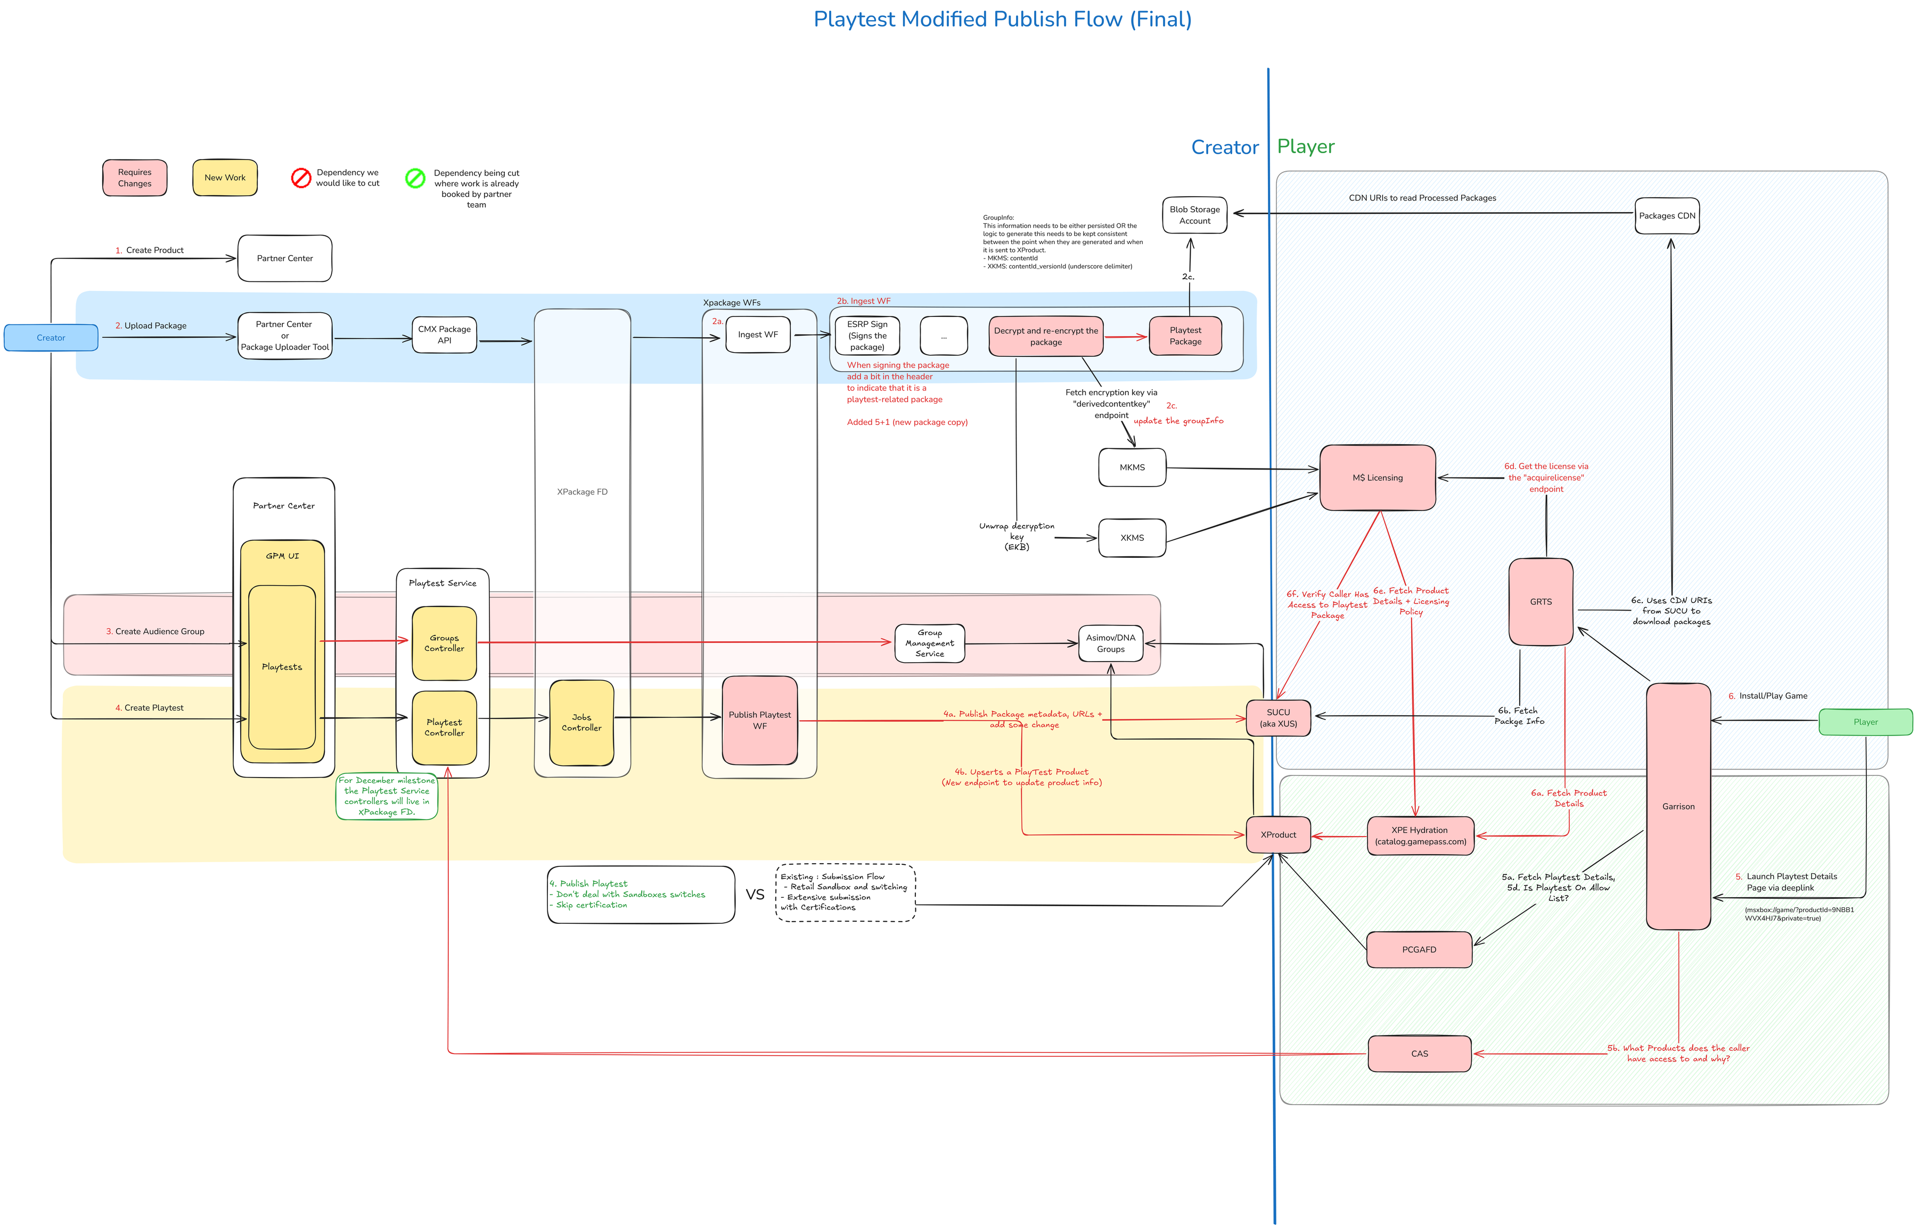
APPENDIX
Detailed architecture
Full end-to-end flow & readiness polling — deep-dive reference.
Instantly Shareable Playtest · XBOX Developer Demos · Melanie Chen
11
APPENDIX
Notes:
Backup slide for Q&A — the complete, detailed architecture diagram behind the six-step spine, including the PC install-readiness polling loop.

