Slide 1

Seasonal Agriculture Performance Analysis
Submitted by:
Neha T
Sri Venkateshwara College of Engineering, Bangalore
AICTE STU ID : STU6a6981c5278a51785299397

Slide 2

PROBLEM STATEMENT
Agricultural performance is influenced by seasonal changes in environmental conditions, farming practices, resource availability, and market conditions.
These factors can cause variations in agricultural performance across different seasons.
However, raw agricultural data does not clearly reveal these seasonal patterns, trends, and relationships.
Therefore, this project aims to analyse the agricultural dataset and identify meaningful seasonal differences, trends, relationships, and variations in agricultural performance.

Slide 3
Project Description
Analyzes agricultural performance across different seasons.
Examines farming practices, environmental conditions, resource usage, crop production, and economic performance.
Performs data cleaning and preparation for reliable analysis.
Uses statistical analysis and data visualization to identify seasonal patterns and trends.
Compares different seasons to identify variations, relationships, and significant differences.
Derives data-driven insights and recommendations for better seasonal agricultural planning.

Slide 4

WHO ARE THE END USERS?
Farmers & Agricultural Producers: Understand seasonal performance and improve farming decisions.
Agricultural Planners & Government Agencies: Support evidence-based seasonal agricultural planning.
Agricultural Organizations & Cooperatives: Compare seasonal trends and resource usage.
Agricultural Analysts & Researchers: Study patterns, relationships, and variations in agricultural data.
Agribusiness & Market Stakeholders: Understand seasonal economic and production trends.

Slide 5

Technology Used
Python: Data analysis and processing
Pandas & NumPy: Data manipulation and numerical analysis
Matplotlib & Seaborn: Data visualization
Scikit-learn: Statistical/machine learning analysis
Jupyter Notebook: Project development and documentation
CSV: Dataset format

Slide 6
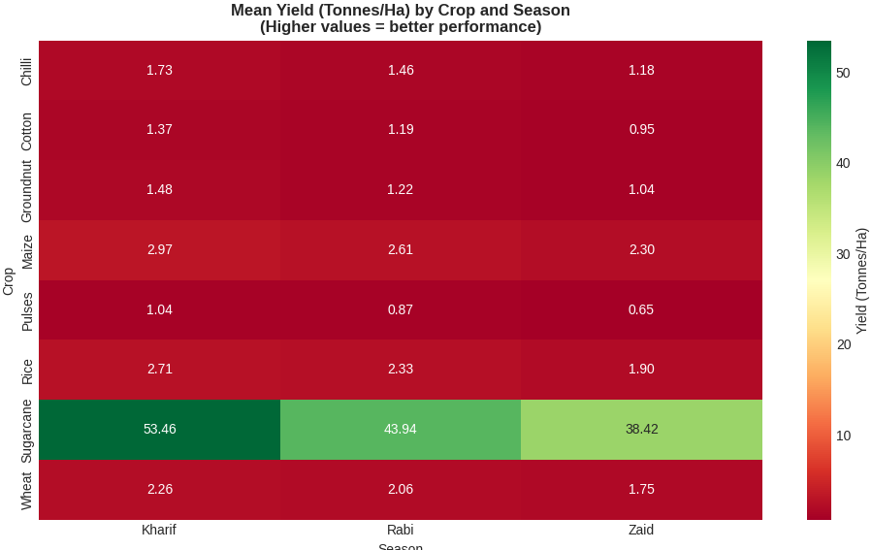
RESULTS

Slide 7
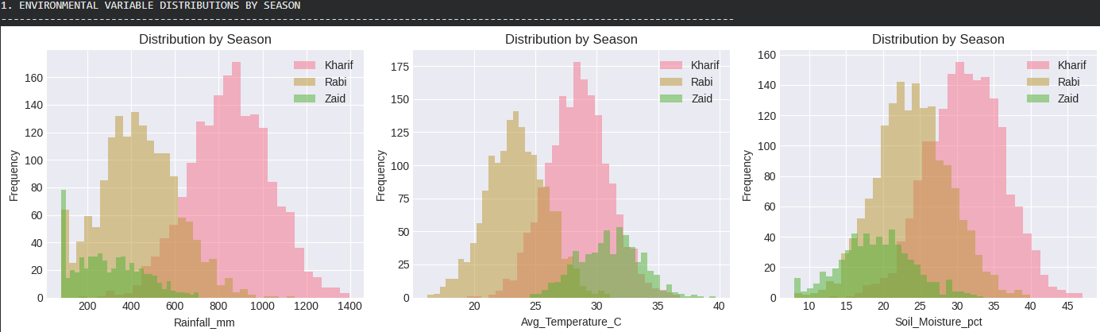
RESULTS

Slide 8
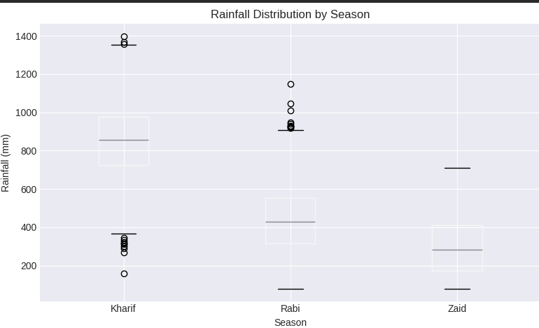
RESULTS

Slide 9
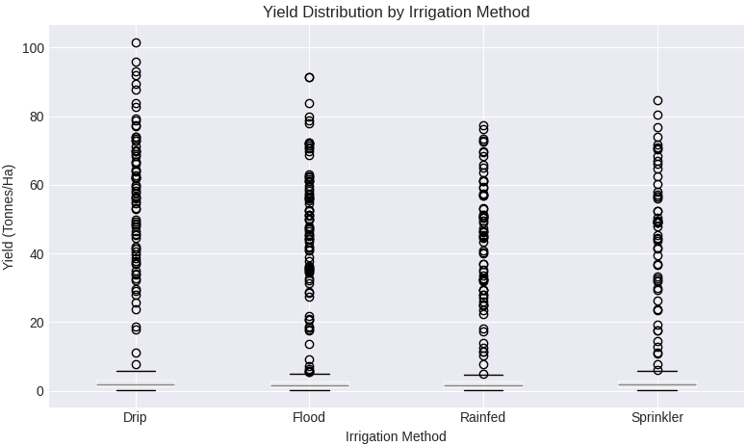
RESULTS

Slide 10
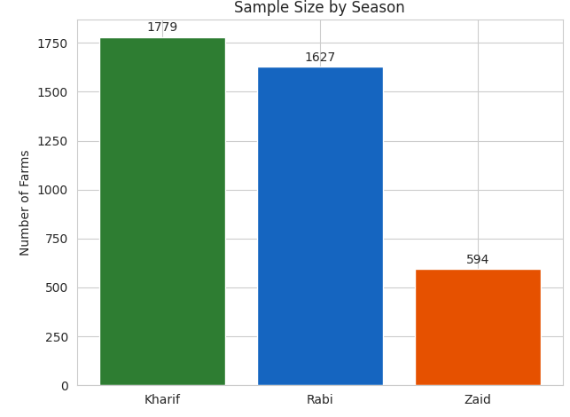
RESULTS

Slide 11
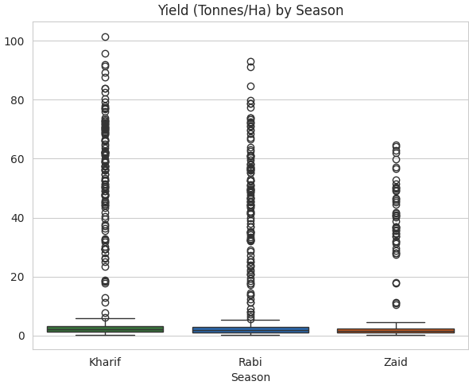
RESULTS

Slide 12
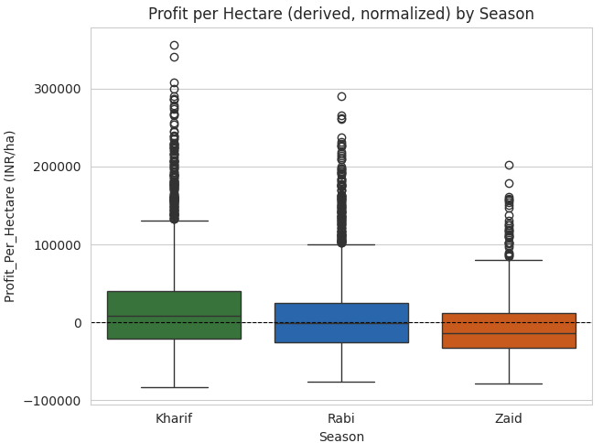
RESULTS

Slide 13
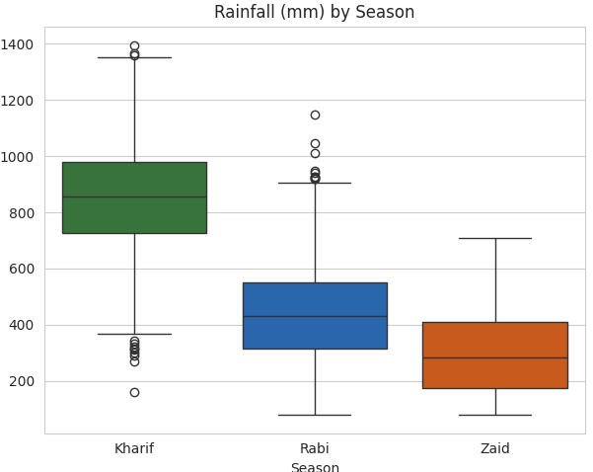
RESULTS

Slide 14
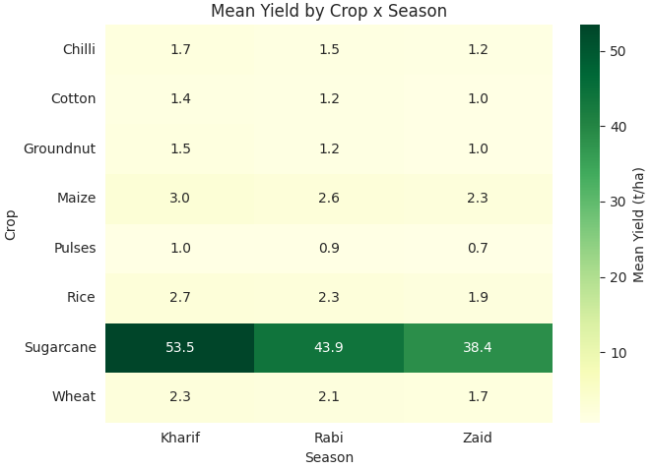
RESULTS

Slide 15
Future scope
Use machine learning to predict crop performance in future seasons.
Include weather and climate data to understand their effect on agriculture.
Expand the project to compare different regions and farming conditions.
Study how water, fertilizers, and other resources can be used more efficiently.
Build an interactive dashboard so farmers and agricultural planners can easily understand the results.
Use more data over time to improve the accuracy and usefulness of the analysis.

Slide 16
GitHub Link
https://github.com/t-neha23/Seasonal-Agriculture-Performance-Analysis-.git

Slide 17

VOIS Course completion certificate: Course name - Data Visualization

Slide 18
Thank you
.
.

