Slide 1



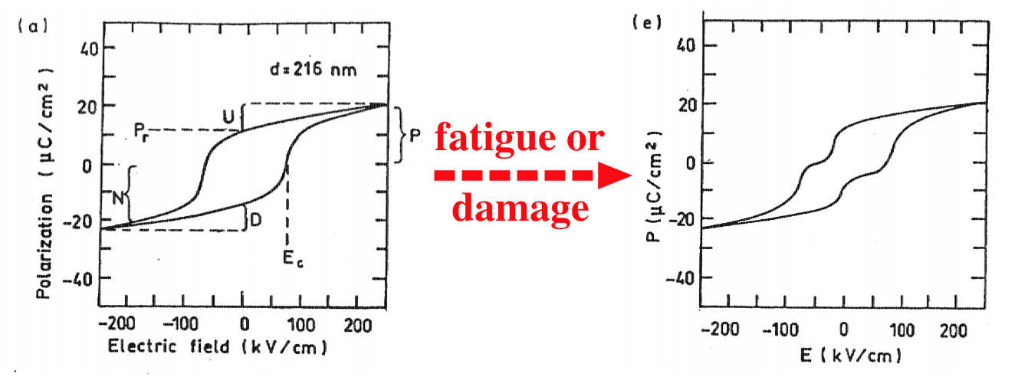
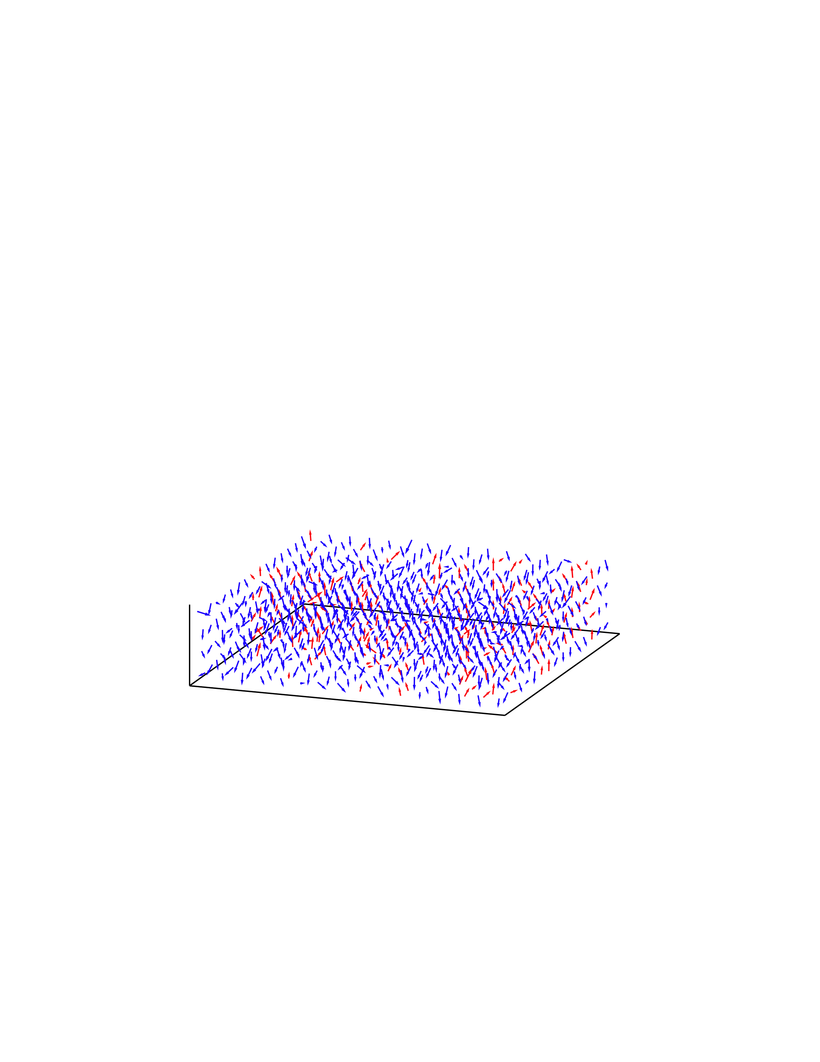
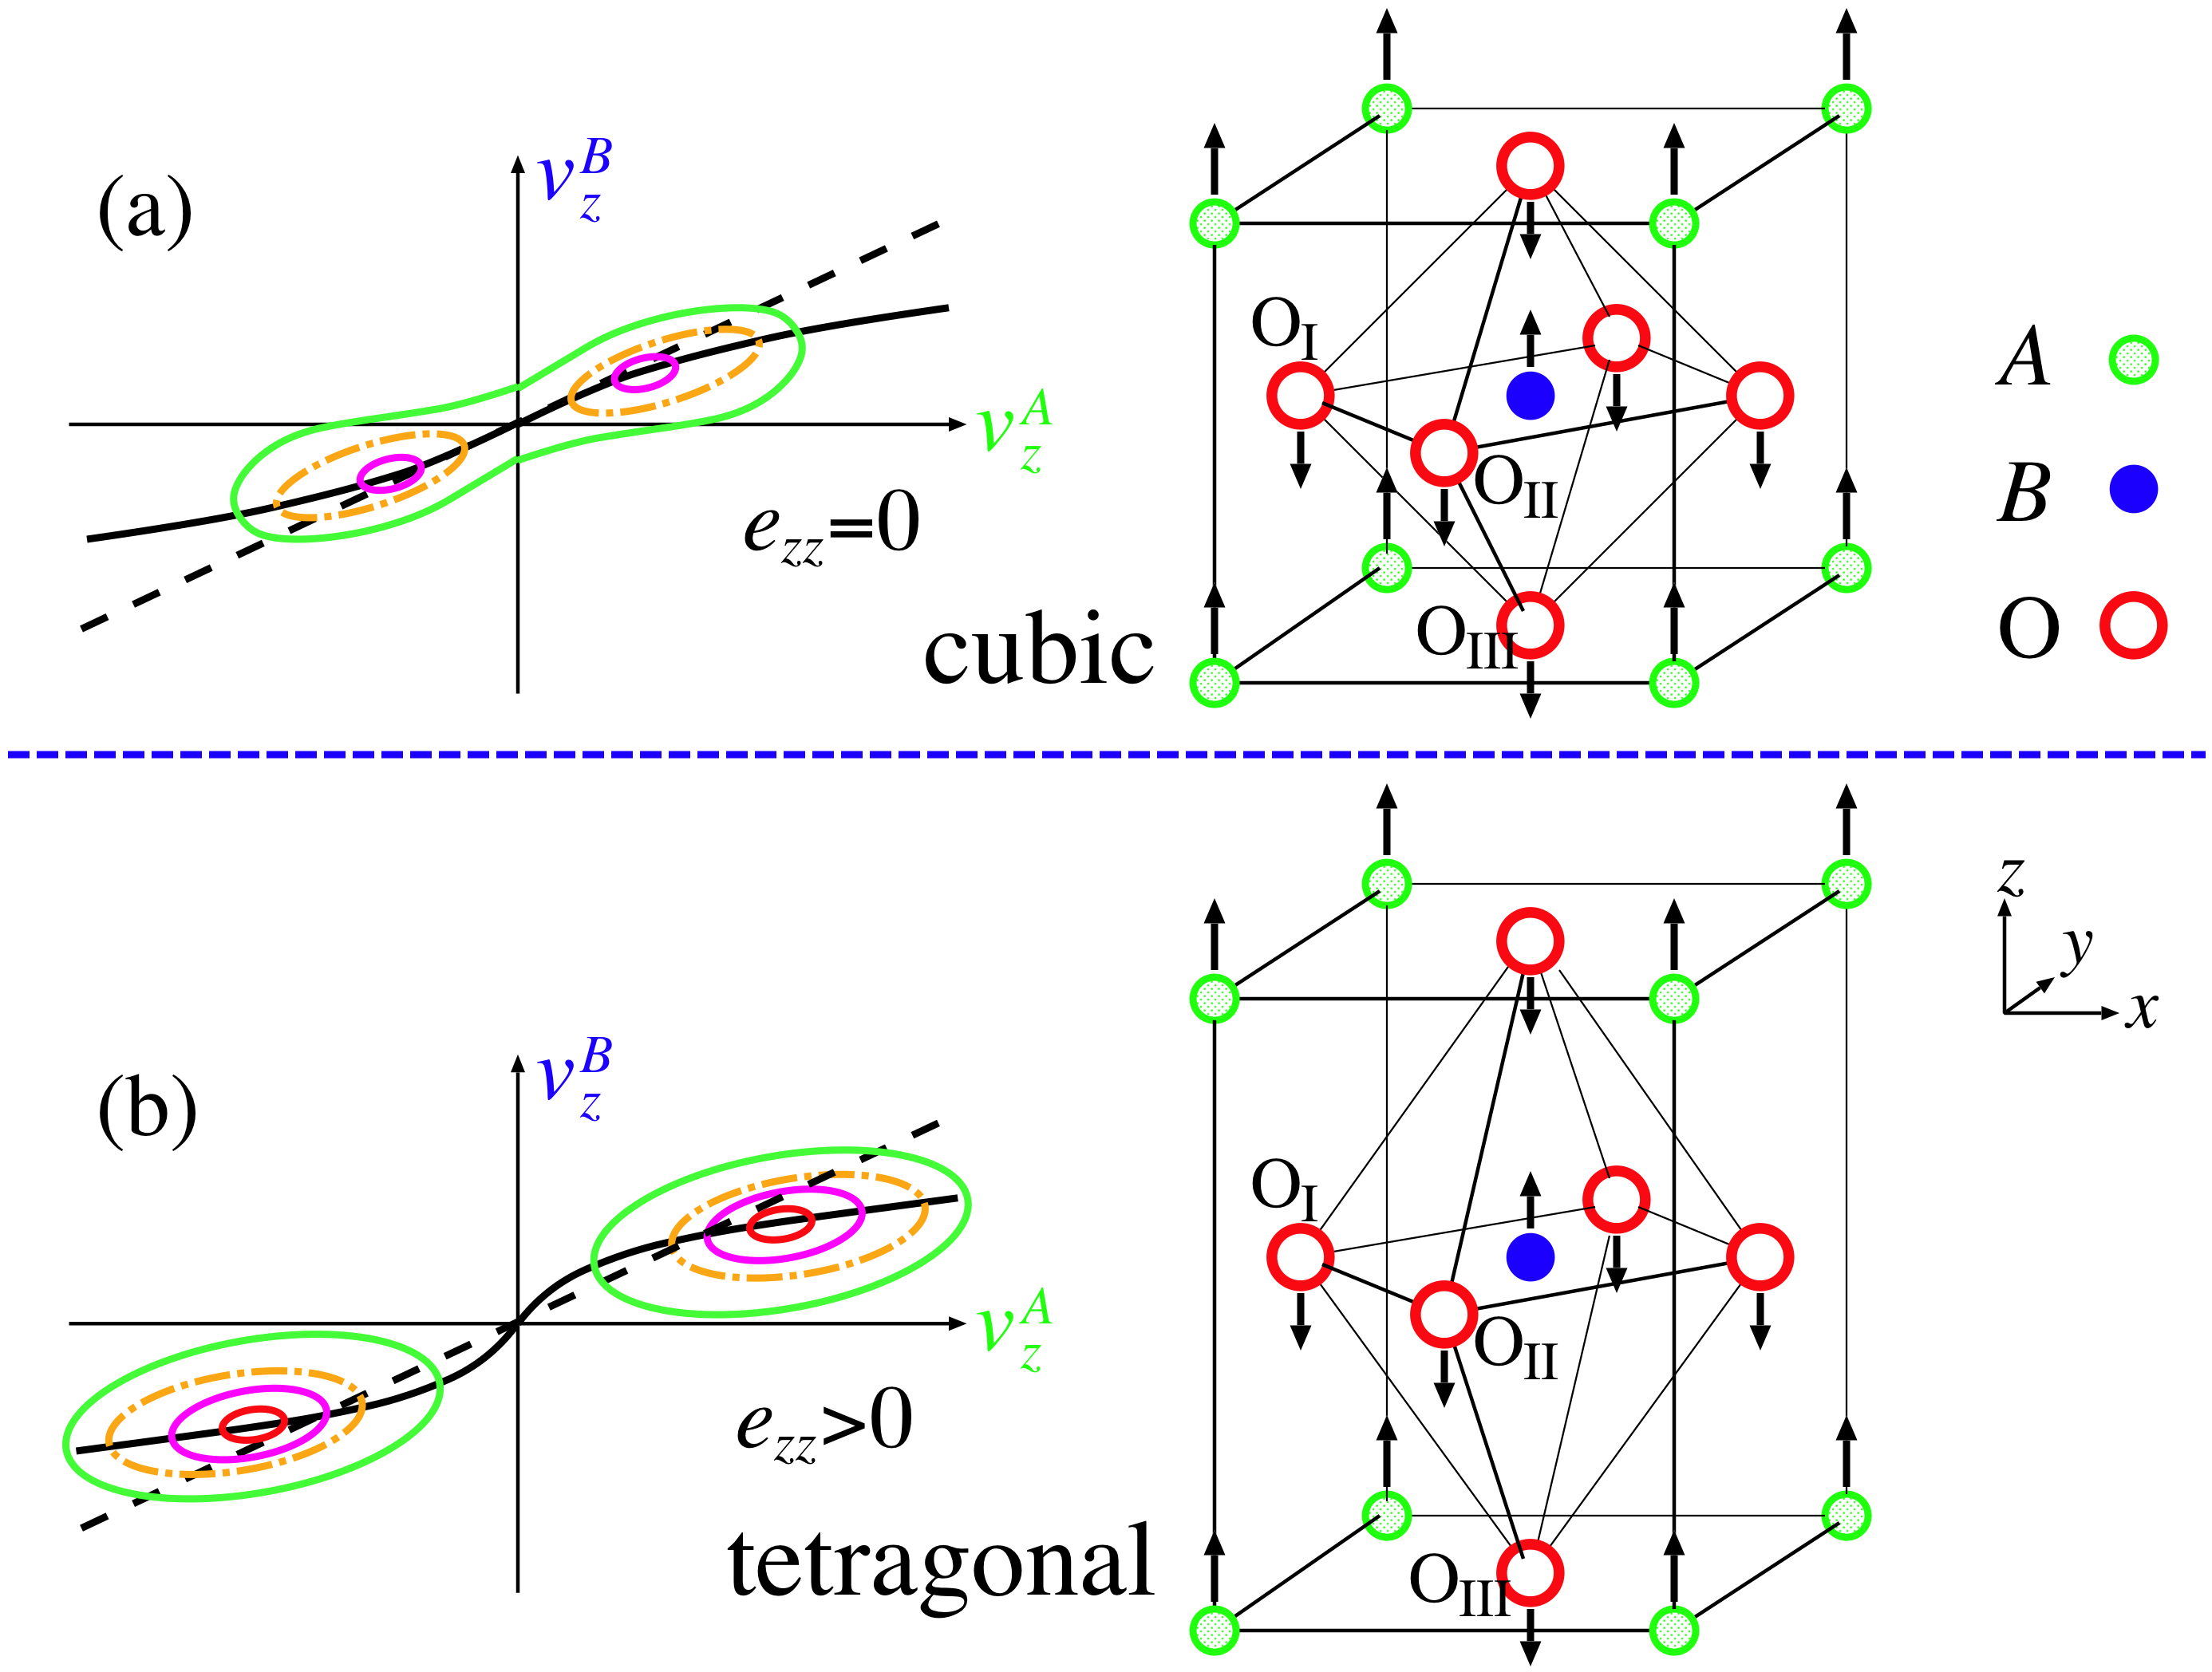
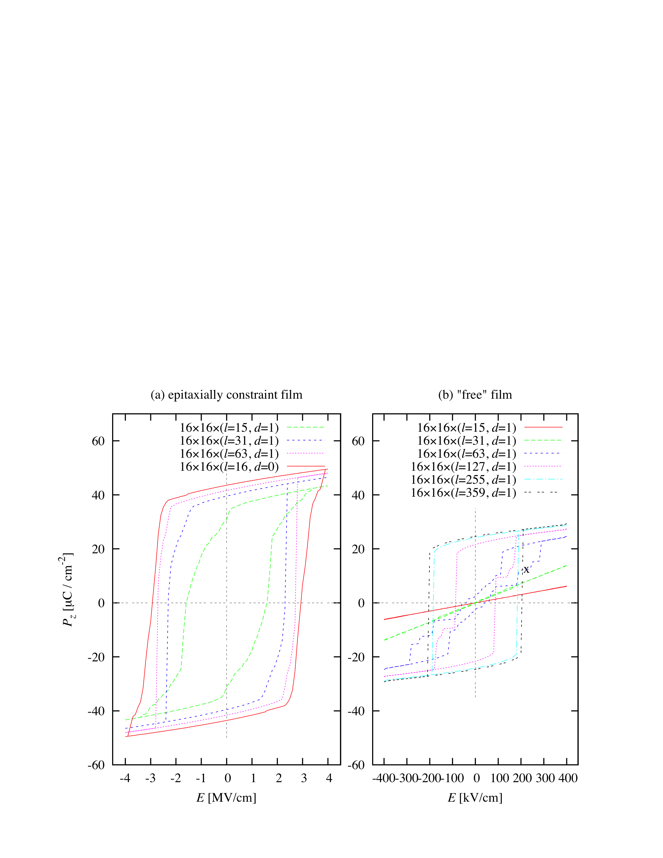
feram is a fast molecular-dynamics simulator for ferroelectrics. You can download it freely from http://loto.sourceforge.net/feram/ .
Background
Ferroelectric thin films are applied in multilayer capacitors, nano-actuators and non-volatile FeRAMs.
Downsizing is highly demanded.
Influence of dead layers between electrodes and ferroelectrics is beginning to appear.
Fatigue damages polarization properties (FIG. 1).
FIG. 1. Thinned hysteresis loop of a ferroelectric capacitor.
After [J. F. Scott: Ferroelectric Memories (Springer, 2000)] .
Features of feram
Molecular-dynamics simulation based on first-principles effective Hamiltonian for perovskite-type ferroelectrics ABO₃ such as BaTiO₃, PbTiO₃, etc (FIG. 2), using super cells (FIG. 3).
feram can simulate ferroelectric thin films sandwiched between two short-circuited electrodes as well as bulk ferroelectrics.
Temperature, film-thickness and strain dependences of dielectric constant, hysteresis loops (FIG. 4) and the other polarization properties can be simulated.
Imperfect screening caused by dead layers between electrodes and ferroelectrics can be simulated.
Fast (a realistic system size (> 100 nm) and a realistic time span (> 1 ns))
  Long-range dipole-dipole interactions are calculated in reciprocal space using FFT.
  Nosé-Poincaré thermostat
  FFTW library version 3
  Parallelized with OpenMP
Multi platform (Linux PC and supercomputers)
Object-Oriented Programming with Fortran2003
Easy to compile: ./configure && make
FIG. 2. Potential surface for atomic displacements in perovskite-type ferroelectrics ABO₃. After [T. Hashimoto, T. Nishimatsu et al.: Jpn. J. Appl. Phys. 43, 6785 (2004)].
FIG. 3. Snapshot of a simulation. Dipole moments of each site are indicated with arrows.
Future plan
Relaxors
Ferromagnetic thin films and nano-particles
FIG.4. Simulated hysteresis loops for BaTiO₃ ferroelectric thin-film capacitors. After [Takeshi Nishimatsu, Umesh V. Waghmare, Yoshiyuki Kawazoe and David Vanderbilt: Phys. Rev. B 78, 104104 (2008)].
Contact:
Takeshi Nishimatsu: Institute for Materials Research, Tohoku University, Sendai 980-8577 JAPAN
E-mail: t-nissie@imr.tohoku.ac.jp Lab. homepage: http://www.kawazoe.imr.tohoku.ac.jp/

