Slide 1
STAT 184: Introduction to R
Padma Tanikella
Dept. of Statistics, Penn State

Slide 2
Getting to know each other
Your name, the year and department you belong to.
Any prior data analysis experience using calculators, Excel sheets etc.?
Any prior programming experience?

Slide 3
Textbooks and syllabus
We have four recommended textbooks, all of which are freely available. (Check Canvas course homepage.)
Daily agenda Excel sheet and syllabus page are available on the course homepage.
The Daily agenda sheet has recommended readings associated for each day of class.

Slide 4
Regular R Activities
We will have regular R activities associated with lectures.
All activities will be posted and graded on Canvas.
Each R activity is due on the third day of classes following the time it is first released.

Slide 5
Midterm and Final Project
Midterm will be held during class timings on 19th July.
Midterm will be a closed-book pencil-code exam.
Final project will have three different parts:
Submit a topic idea (due 25 July, 11:59pm)
Submit initial exploratory data analysis (EDA) (due 31 July. 11:59pm)
Submit a final report (due 7 August, 11:59pm)
Further details about the Midterm and Final project will eventually be posted on Canvas.

Slide 6
Office hours and TA
Haochen Zhang is the course TA.
My PSU email ID is pbt5137@psu.edu and Haochen's PSU email ID is hqz5340@psu.edu
Do not use the Canvas discussion board to communicate personal information.
Information about office hours will soon be posted on the Canvas homepage.

Slide 7
Should I learn to program?
Let us look at how the nature of data has changed over time.

Slide 8
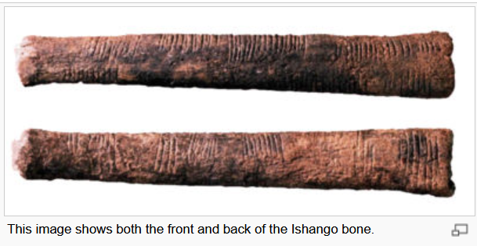
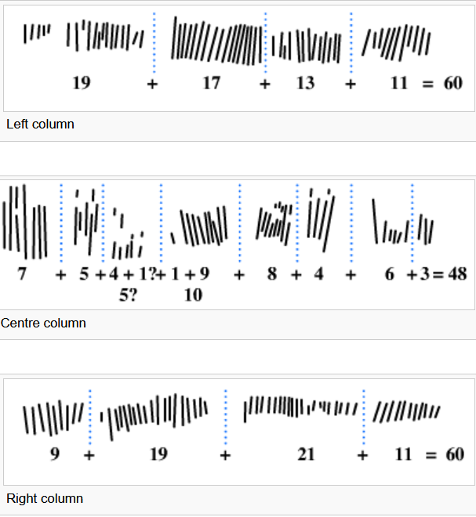
Ishango Bone (~20,000 BCE)
Reference: Ishango Bone, 2007 Schools Wikipedia Selection

Slide 9
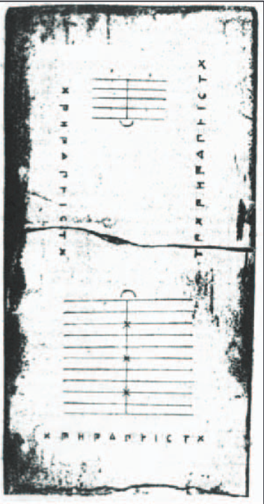
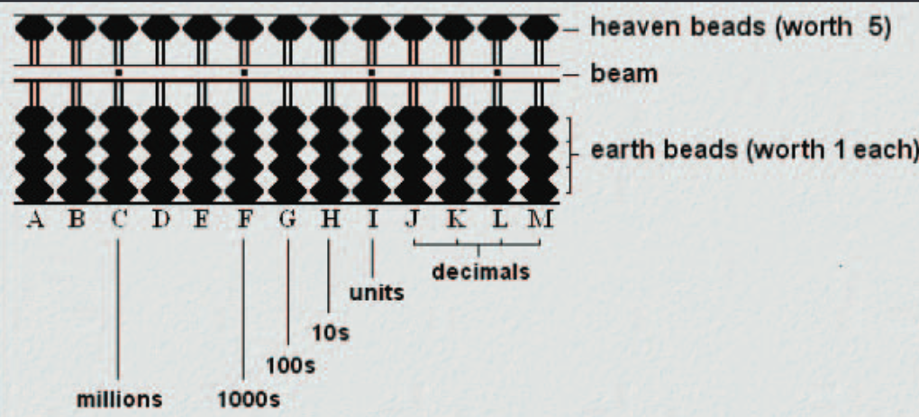
Counting tables and Abacus
Fig. 2: Soroban Abacus
Reference: The History of the Abacus, Kevin Samoly, Ohio Journal of School Mathematics, Number 65 (Spring 2012)
Fig 1: Salamis Counting board

Slide 10
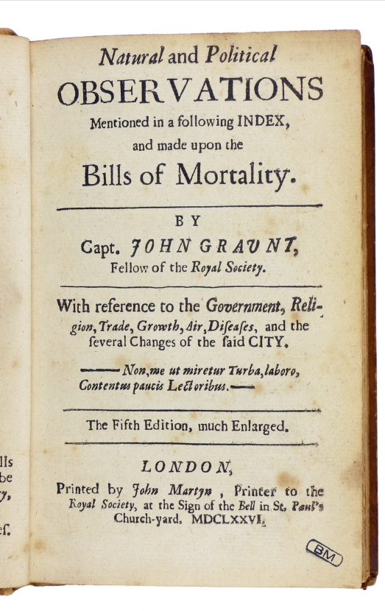
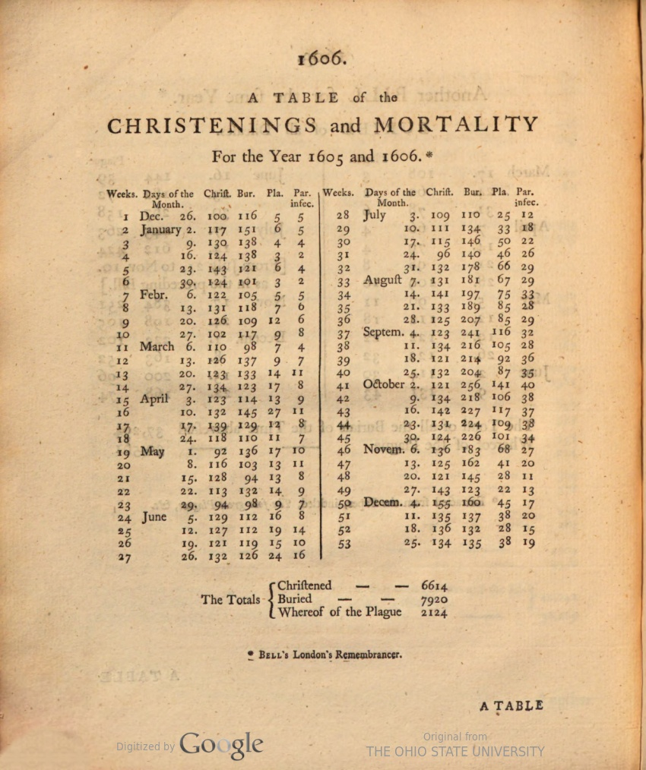
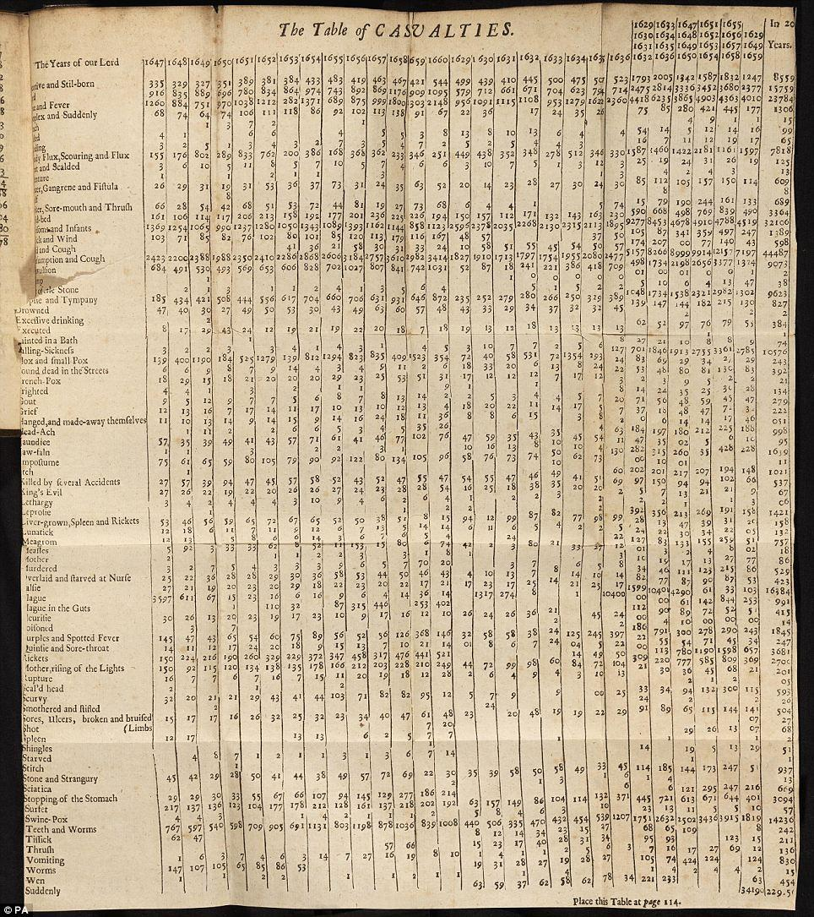
John Graunt’s work in demography (1662)
Fig 1: Bill of Mortality for the year 1605-1606
Fig 2: Title page of the 5th edition of Graunt’s book.
Fig 3: “Table of Casualties” from Graunt’s book.
Reference: Wikipedia page on John Graunt

Slide 11
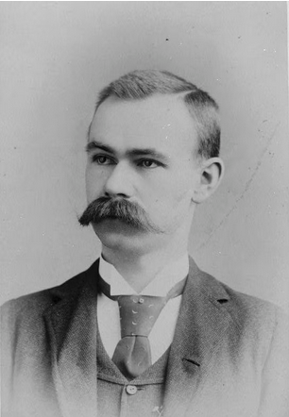
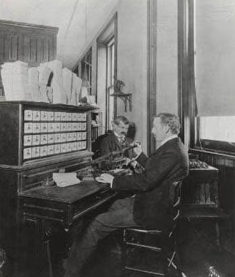
Herman Hollerith invents an electronic tabulating machine (1880)
“Three contestants accepted the Census Bureau's challenge.
The first two contestants captured the data in 144.5 hours and 100.5 hours.
The third contestant, Herman Hollerith, completed the data capture process in 72.5 hours.”
Reference: The Hollerith Machine, US Census Bureau article.
Fig 1. Herman Hollerith
Fig 2: Hollerith's electronic tabulator
(Image taken from US Census Bureau article on Herman Hollerith)

Slide 12
During the 1900s…
1965 - US Government plans the world’s first data center to store 742 million tax returns and 175 million sets of fingerprints on magnetic tape.
1989 - Possibly the first use of the term Big Data (without capitalization) in the way it is used today, by international best-selling author Erik Larson.
1991 - Computer scientist Tim Berners-Lee announced the birth of what would become the Internet as we know it today.
1997 - Google search engine debuts this year!
1999 - Possibly first use of the term “Internet of Things”, to describe the growing number of devices online and the potential for them to communicate with each other, often without a human “middle man”.
Reference: World Economic Form article “A brief history of big data everyone should read (2015) ”

Slide 13
What are the different kinds of data collected these days?

