Slide 1
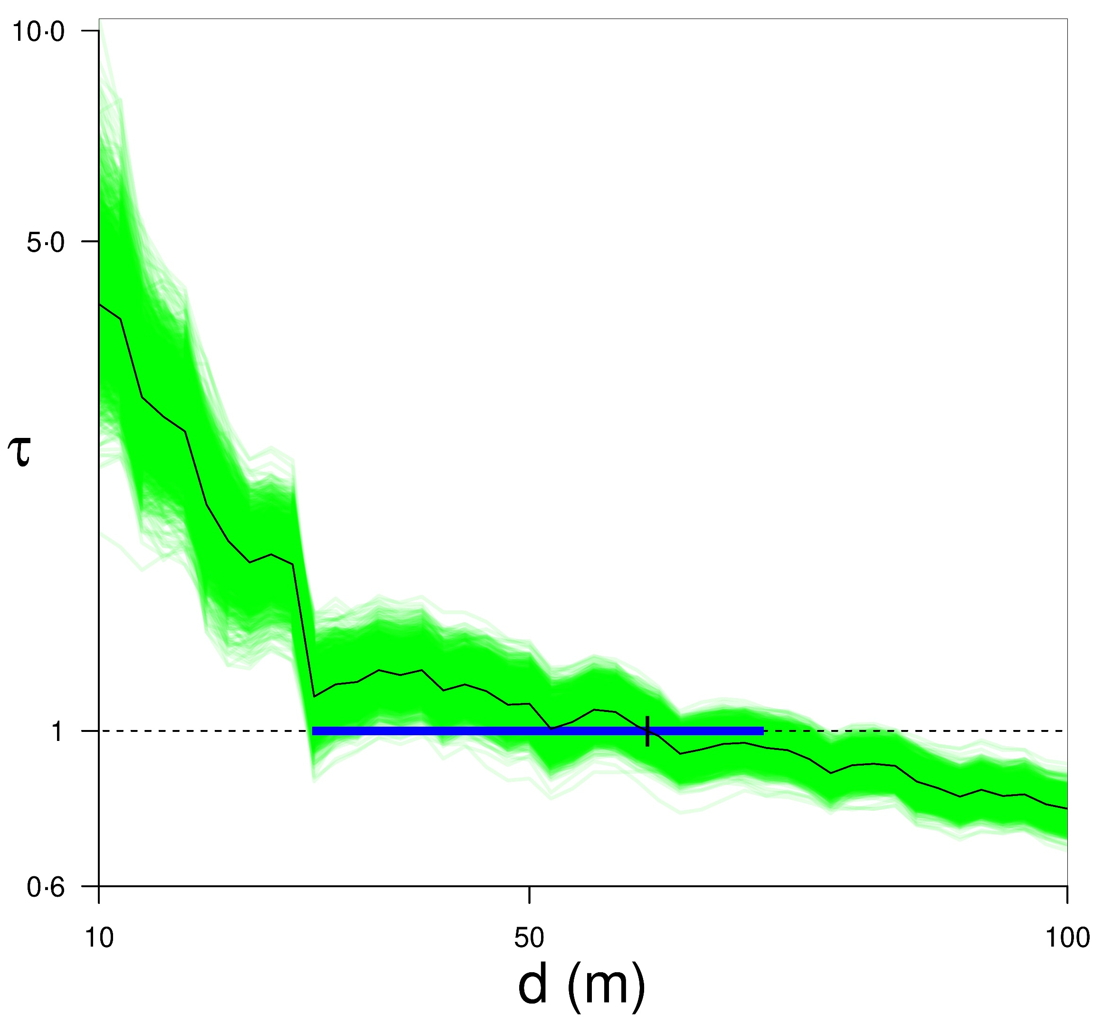
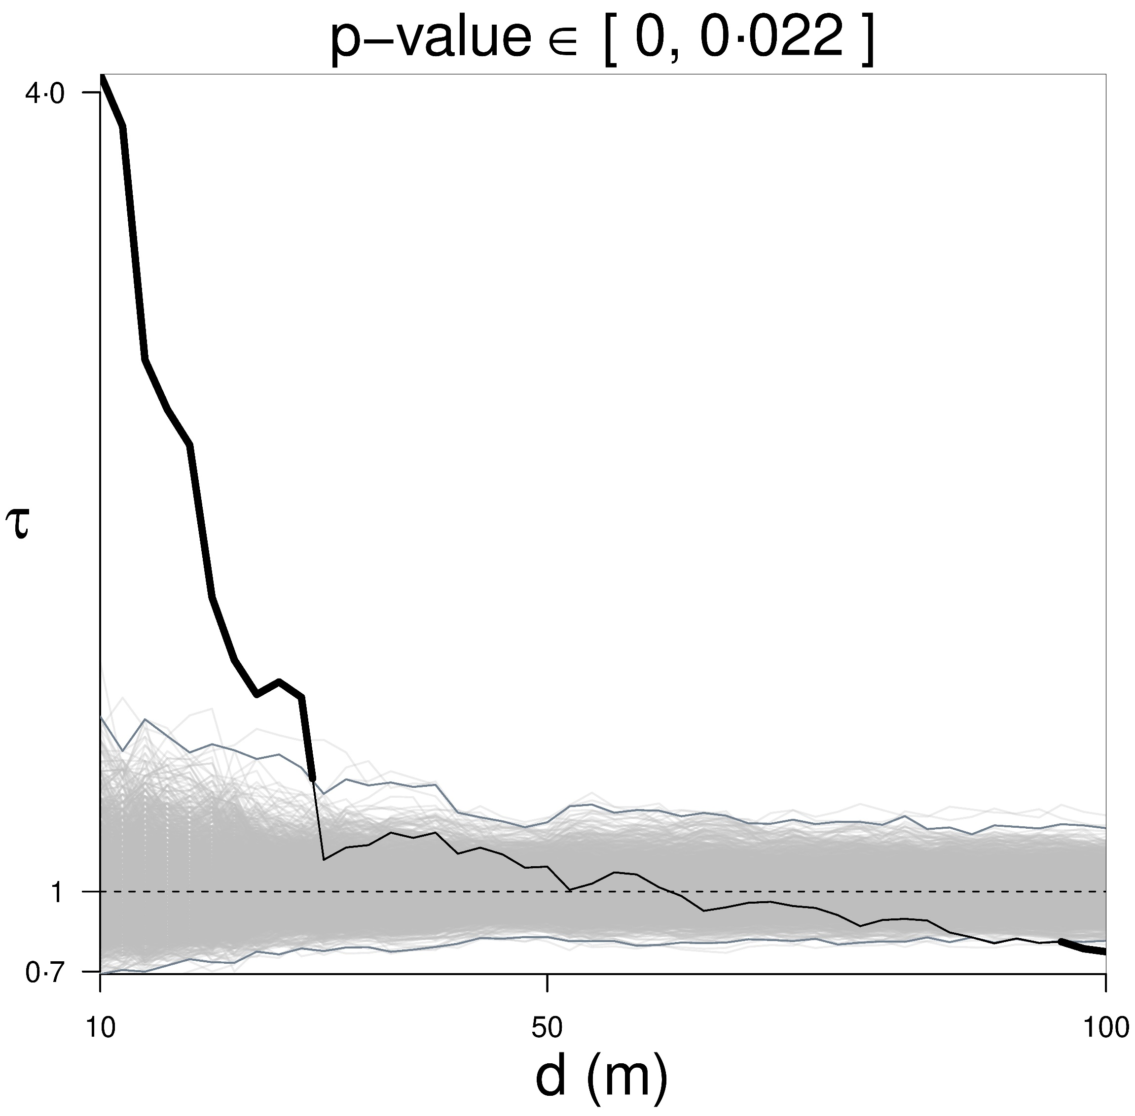
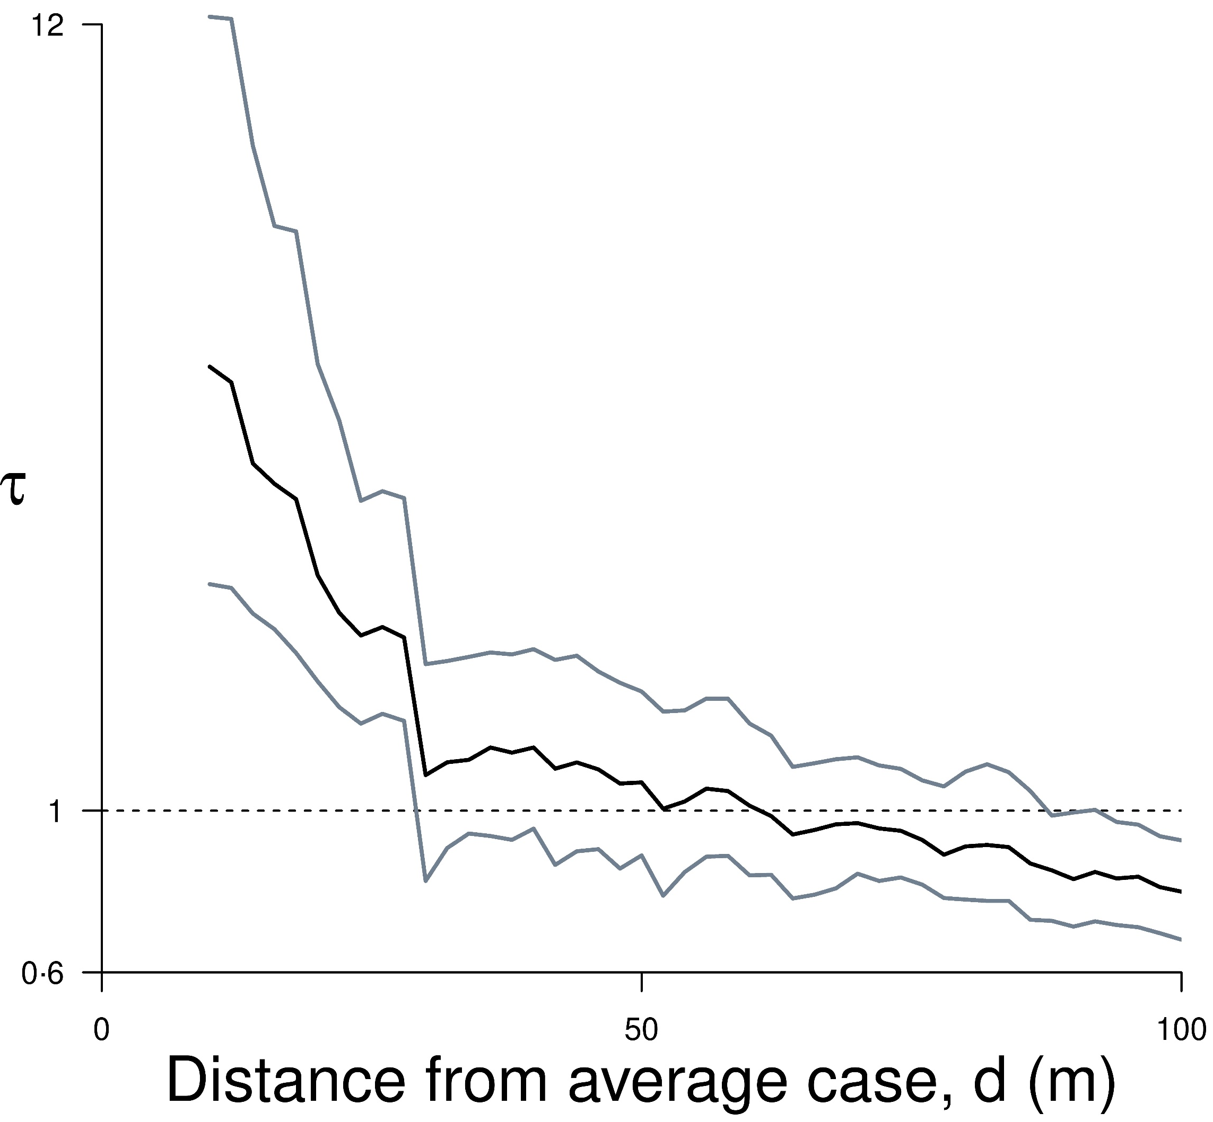
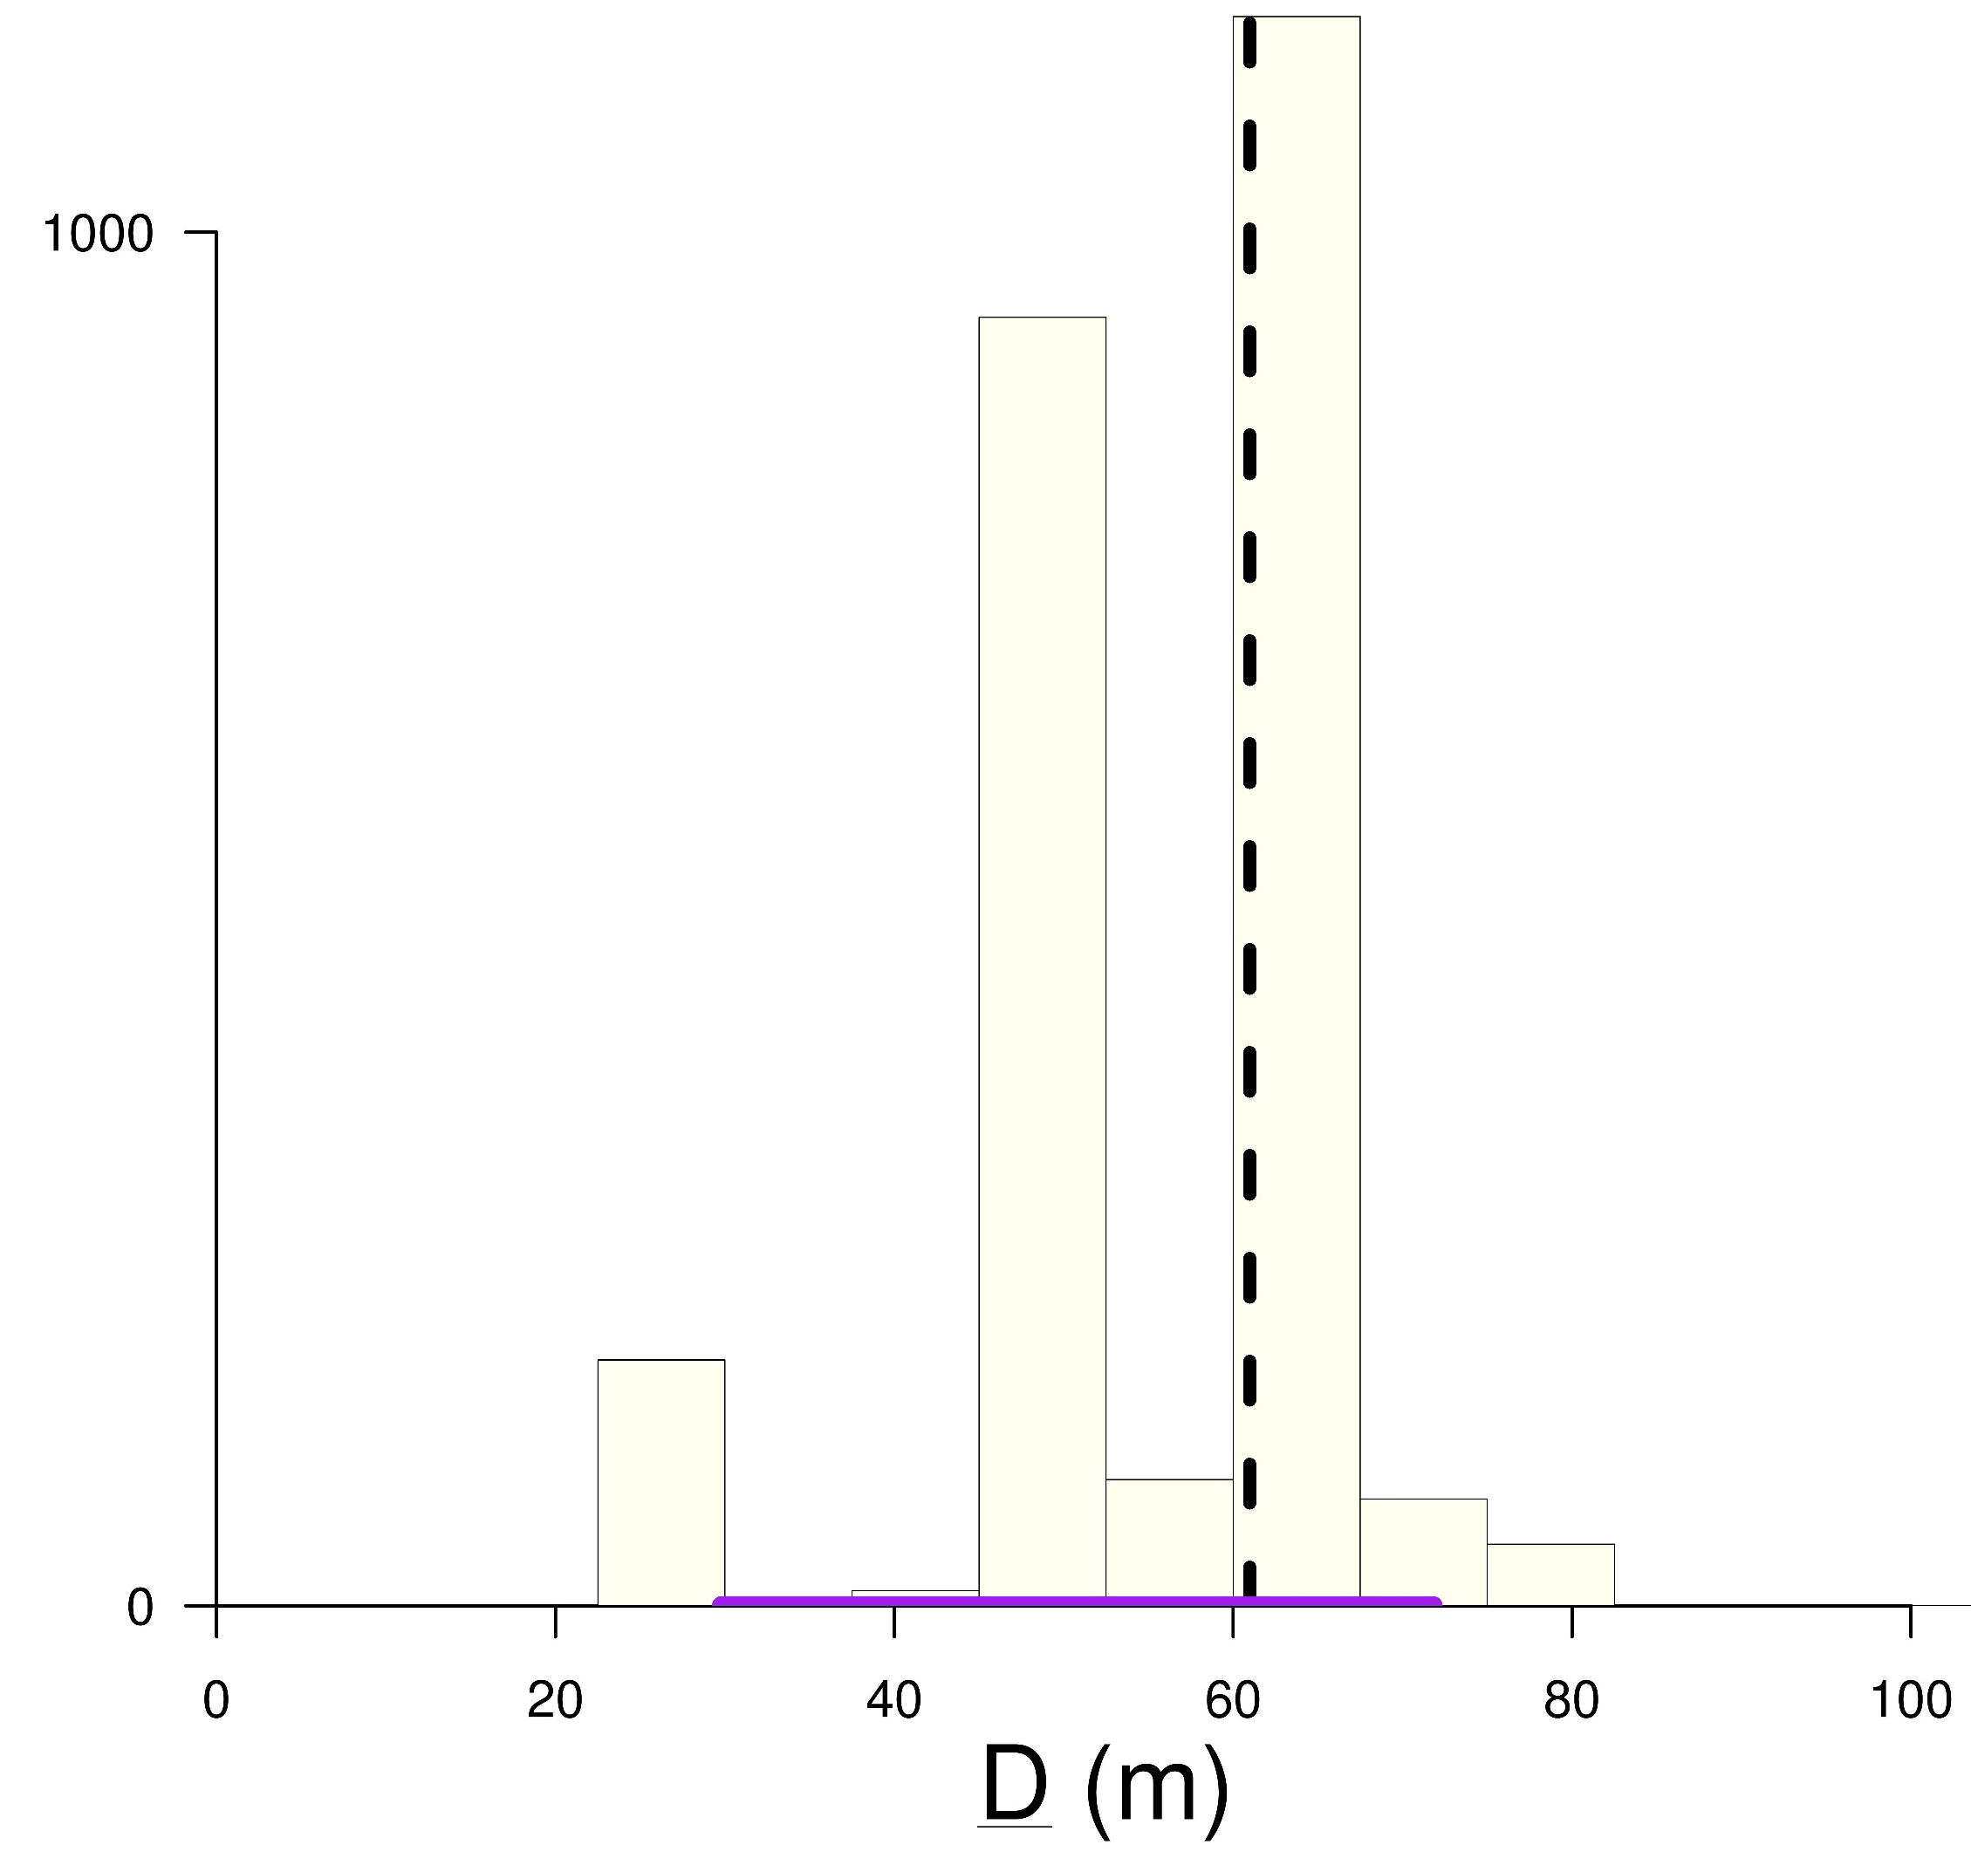
Existing and improved application of the tau statistic 𝜏 to
spatiotemporal data X (case geolocation (x,y), disease onset t)
B.2) Point estimation & CI
range of clustering D
Data (X)
y
x
B.1) Graphical hypothesis testing
if clustering visible, simulate 𝜏 using spatial bootstrap
t
assess statistical evidence
against no clustering, H₀
𝜏(X)
X=(x,y,t)
𝜏(X)
𝜏(X) &
𝜏(t-permuted X) simulations
A.) Diagnostic
D distribution: where 𝜏 simulations intercept 𝜏=1, obtain point estimate & CI
indicative use:
structure (over multiple scales)
or magnitude of clustering
𝜏(t-p X)
global envelope test: evidence vs. H₀: 𝜏=1
pointwise BCa CIs

