Slide 1
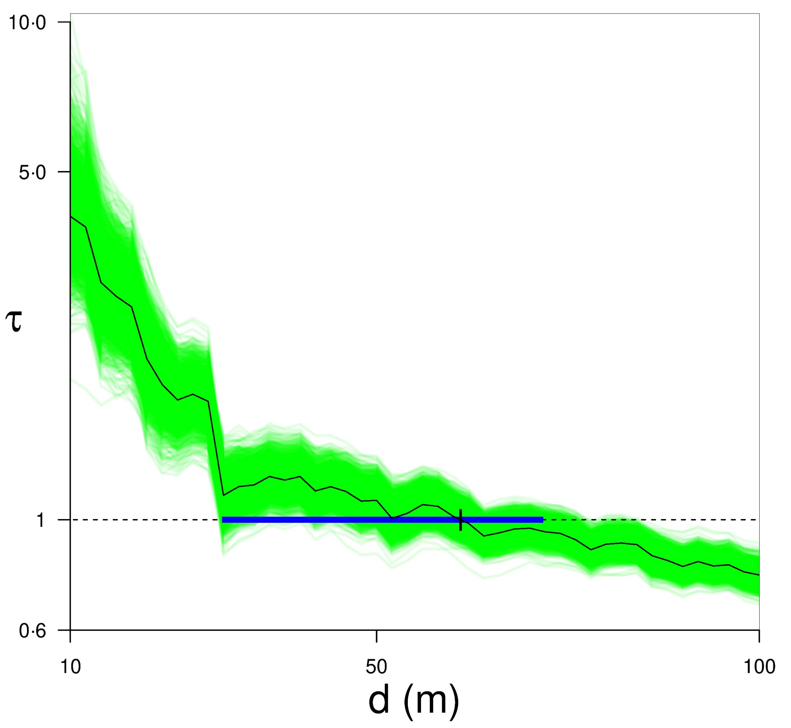
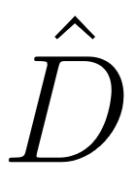
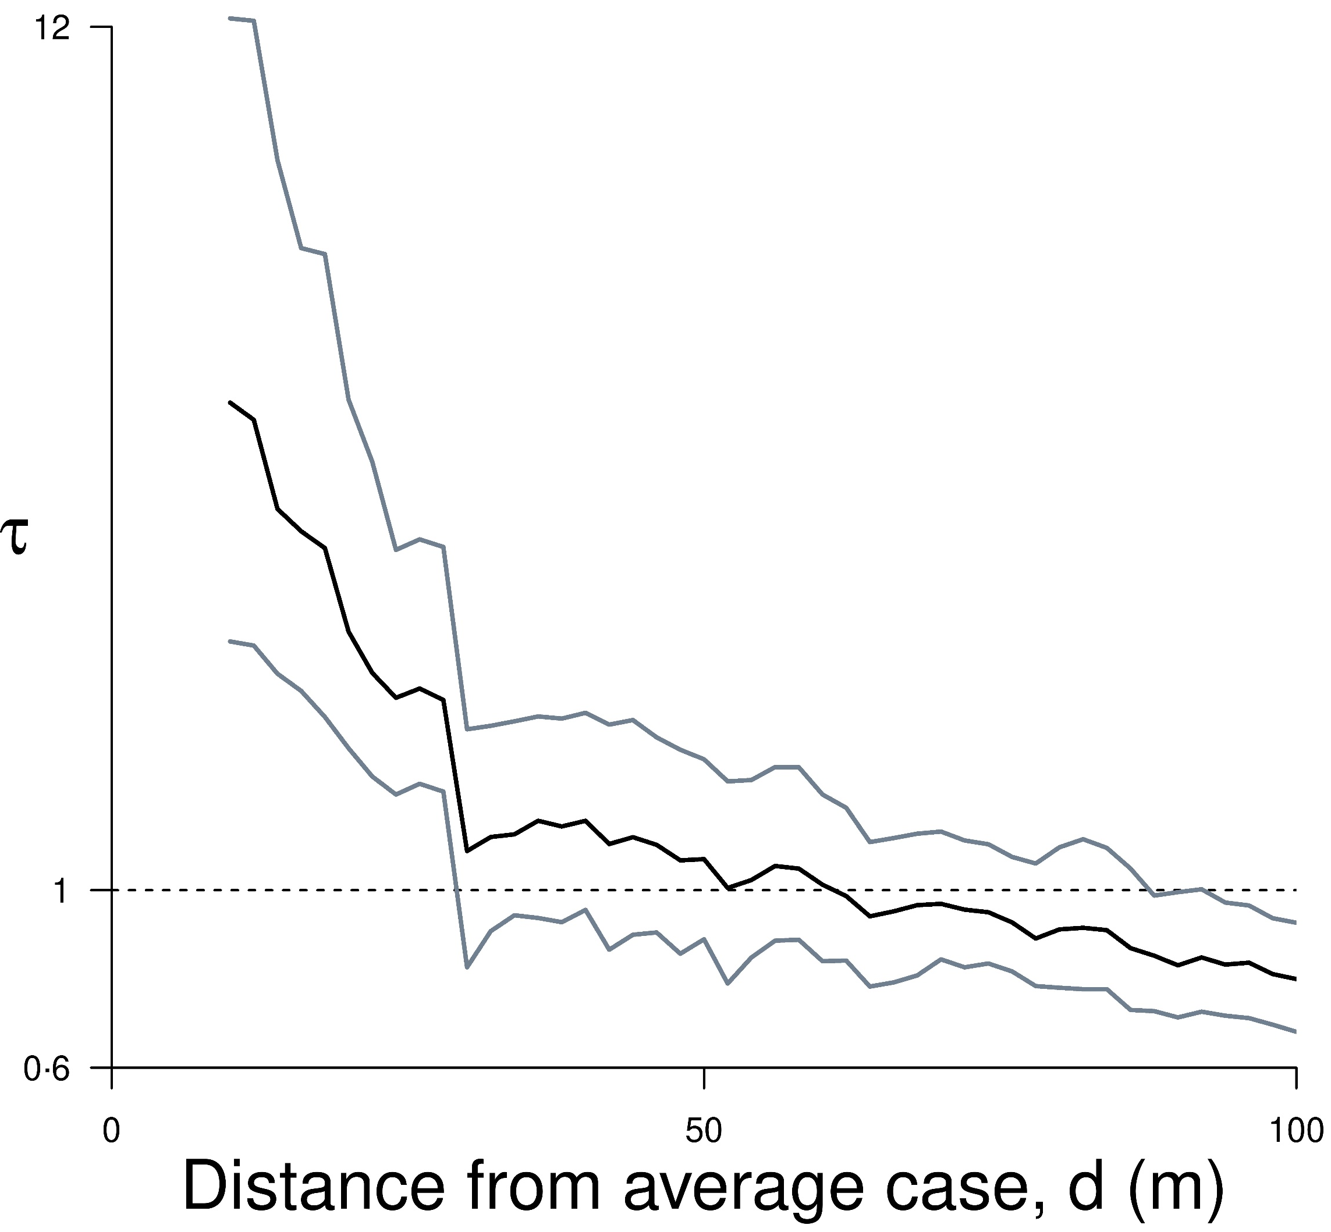
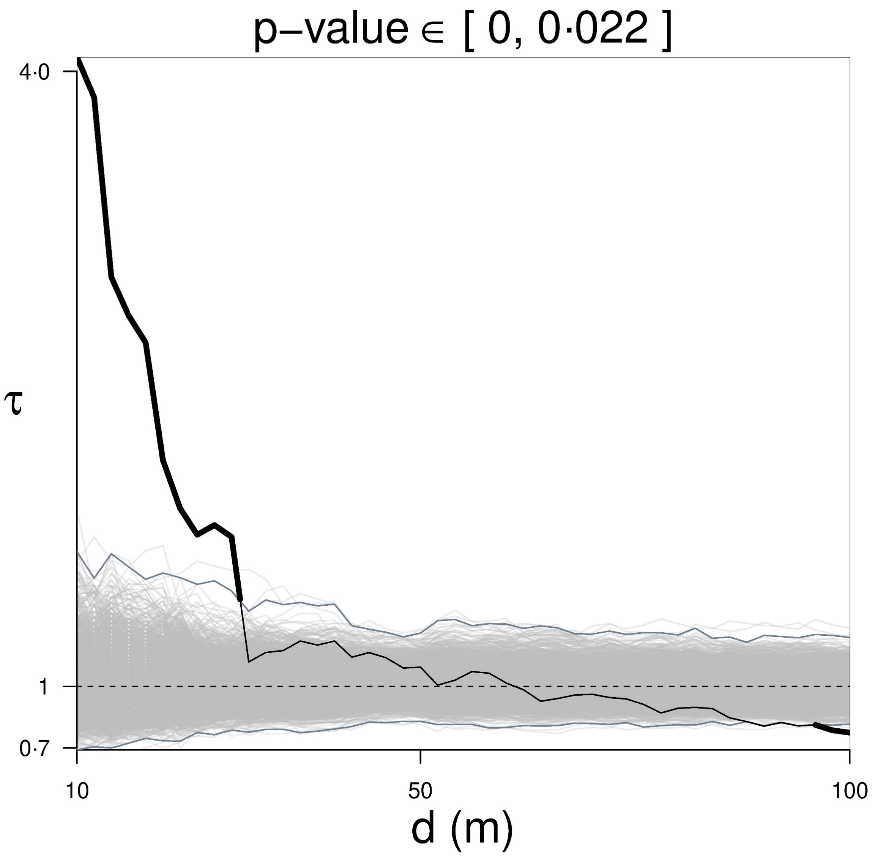
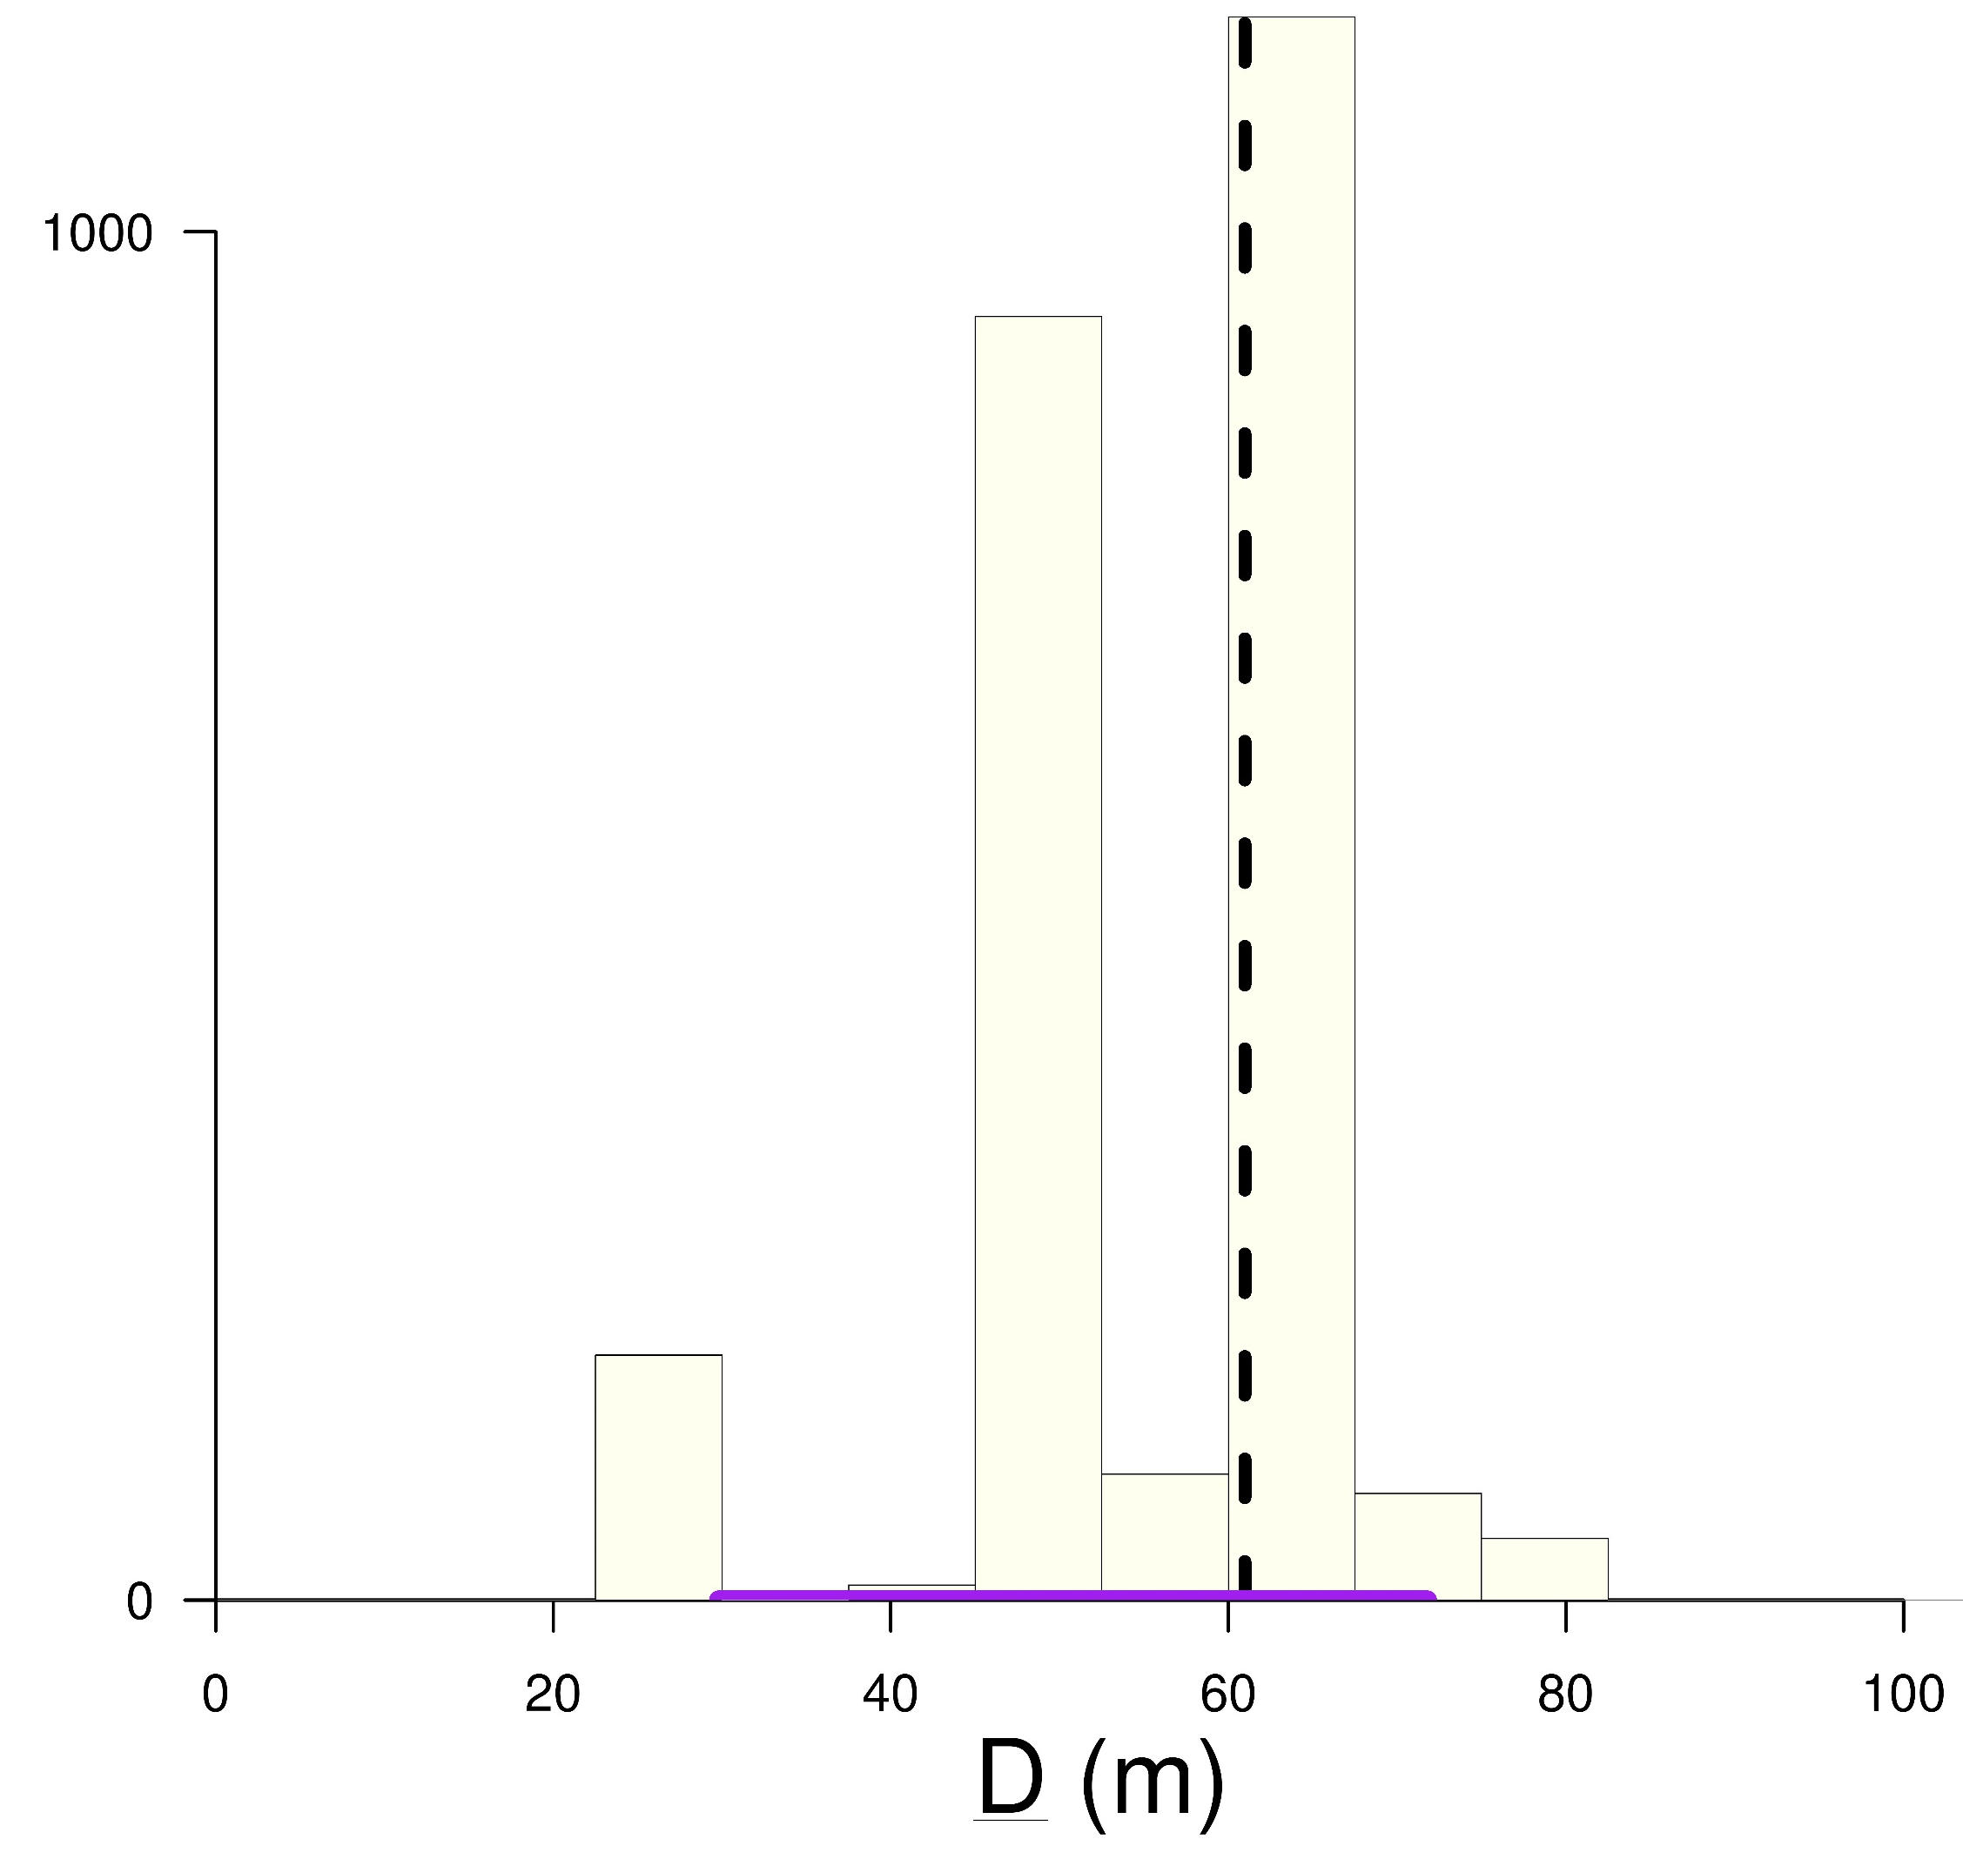
Existing and improved application of the tau statistic 𝜏 to
spatiotemporal data X (case geolocation (x,y), disease onset t)
B.2) Point estimation & CI
clustering range D
if clustering visible,
use spatial bootstrap
to simulate 𝜏
Data (X)
y
x
B.1) Graphical hypothesis testing
t
(t-permuted X)
simulations 𝜏 & 𝜏(X)
assess statistical evidence
against no clustering, H₀
X=(x,y,t)
𝜏(X)
A) Diagnostic
D distribution:
where 𝜏 simulations
intercept 𝜏=1,
obtain point estimate & CI
indicative use:
structure (over multiple scales)
or magnitude of clustering
𝜏(X)
pointwise BCa CIs
global envelope test: evidence vs. H₀: 𝜏=1
𝜏(t-p X)

