Slide 1
MedMD ;)
Tara & Salomon´s data structures adventure!

Slide 2
What we do: (overview)
The user enters symptoms
MedMD tells what percent of the symptoms associated with each condition the user entered

Slide 3
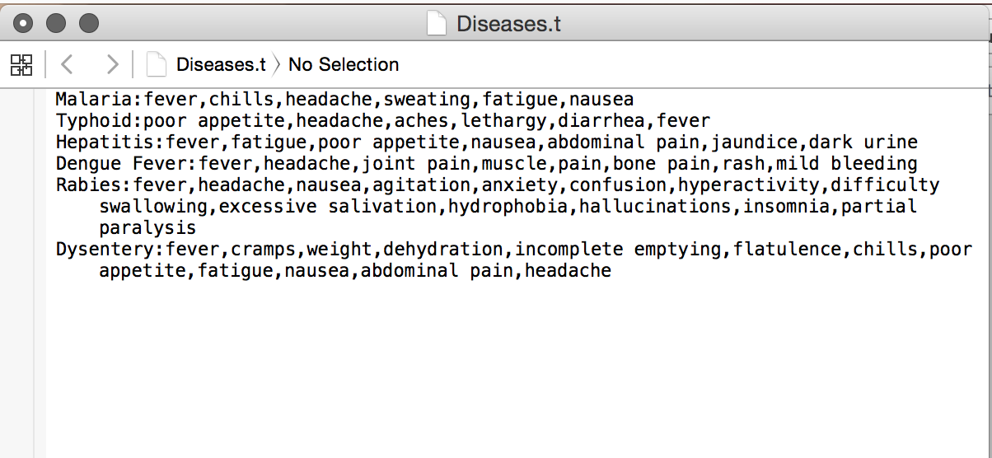
What we do:
Load a list of Diseases with their symptoms -

Slide 4
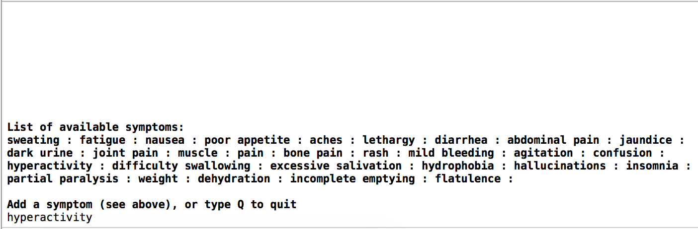
What we do:
Ask the user to provide their symptoms -

Slide 5
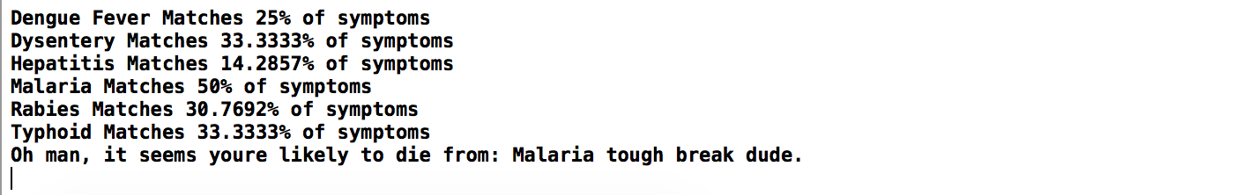
What we do:
Output their possible diseases with % of symptoms met -

Slide 6
Data structures!
Map(string,vector); - To assign symptoms to Diseases
Map(string,int); - To assign quantity of symptoms to Diseases (total and found)
Vector(string); - To quickly traverse and manipulate Disease and symptom without HDD overhead
STD::String; - To have an easy string storage
A TON of custom classes. (ok, more like 3)

Slide 7
Odd code bits:
STOI
for (auto& x: dictionary) {
CINIsBuggy

Slide 8
Its DEMO TIME
Benefits:
Quick access to hard drive storage (into vector)
Quick editing of diseases (real time demo)
Easy fool-proof UI.
Removing used symptoms.
Challenges:
CIN bug :(

Slide 9
Possible extensions
At the cost of runtime, we could make it so that the symptoms are derived from the Diseases not a separate file.
Thorough testing… no way (that we found) that the user can crash it.

Slide 10

Thanks!

