Slide 1

Dave Becker
Matt Baumann
Carter Konz
Tara Raj
Carl Reider

Slide 2
What does it do?
In households where pet care responsibilities are shared between multiple people it can be hard to keep track of your pets’ needs.
Bowlful tracks and stores information about your pets, such as when they were last fed.
No more forgetting to feed (or double feeding) your furry friends.
Provides a simple interface that lists all your pets in one place and provides at a glance information about their immediate individual needs.
Synchronizes information between multiple users and devices within a household.

Slide 3
Features
Signup & Login
Track multiple pets
Simple overview screen
Quick feed button
Detailed information about individual pets
Such as time last fed, time last walked, important medications
Customizable actions with timetables
Walking
Meds
Vet appointments

Slide 4
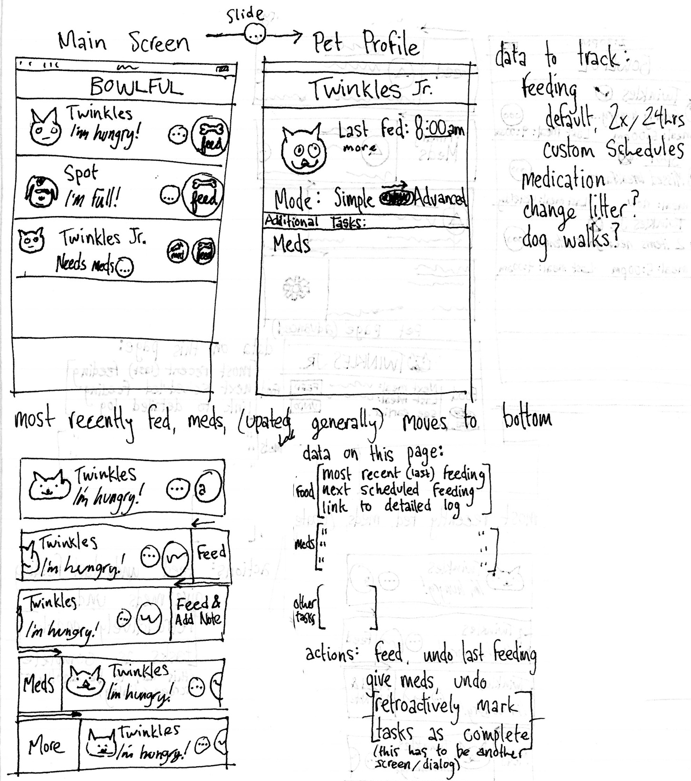
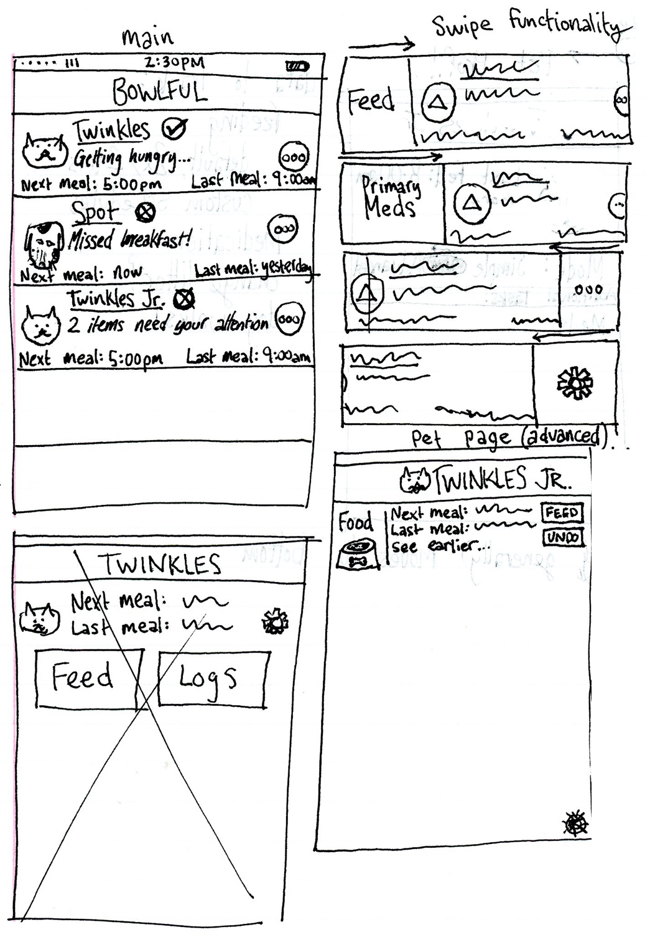
First Mockup
Notes:
Explain our thought process here and then we will go through the evolution of it…

Slide 5
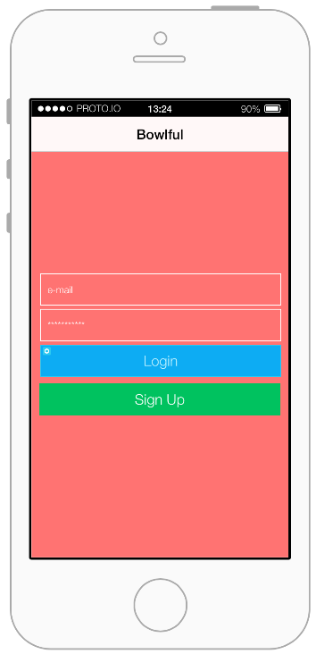
Second Mockup Proto.io

Slide 6
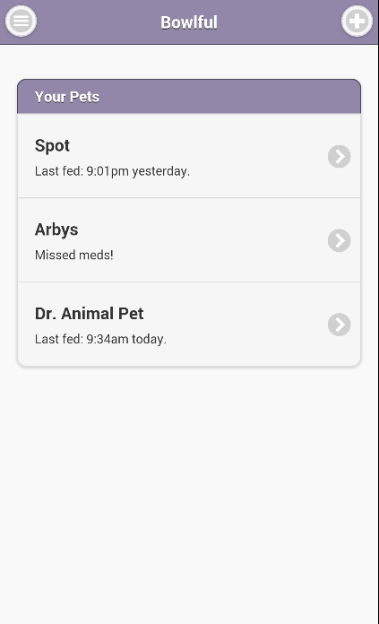
Current Prototype

Slide 7
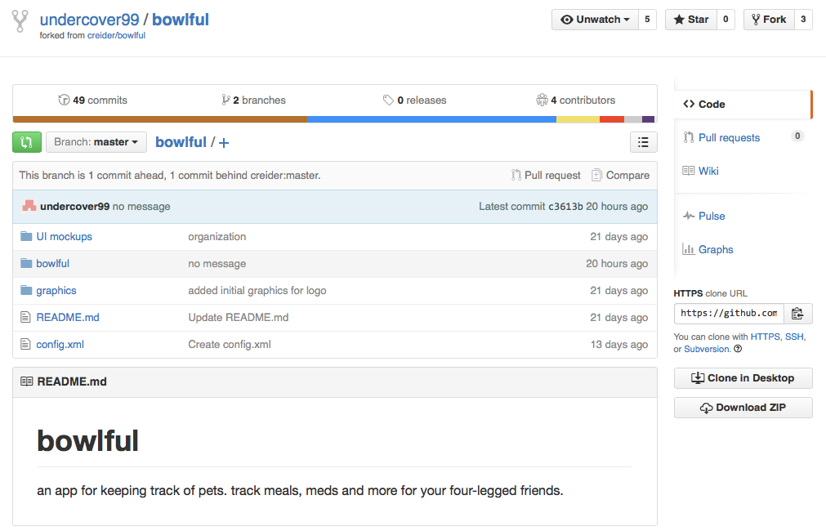
Code Walkthrough

Slide 8
Pages
Login Screen
Sign up with a new account or log in with an existing one.
Home Screen
List of all pets with names and at-a-glance status
Quick feed button
Tapping a pet’s list element will take you to their “profile” where users are able to log additional actions for that pet
Pet Profile
Detailed information about each pet and their associated actions
Settings button
Pet Settings
Create and edit custom actions

Slide 9
Goals
Gain more familiarity with JavaScript and jQueryMobile
Primary setback
Dynamic Page Generation
Local Data Storage
Cloud Synchronization
Further GUI customization
Secure User Authentication Database

